Slide 1

Backstory
Flamingo
Podium
Gem
Squats
Unearth

Slide 2
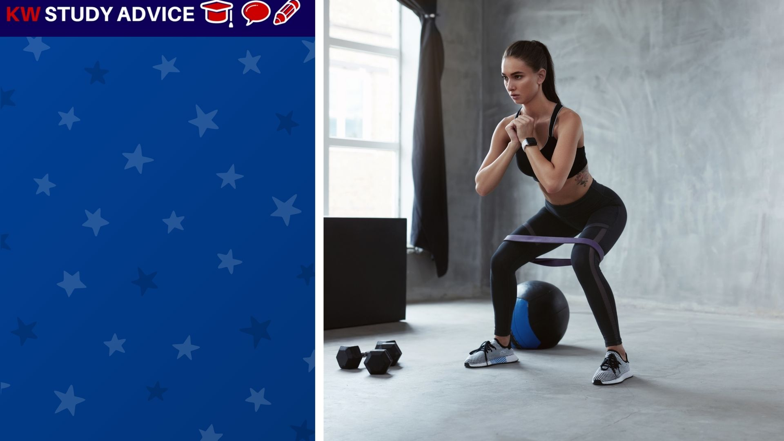
Squats
An exercise which incudes the action of bending down and standing up again. This is done many times in a row until finished.
The girl decided to start doing squats every evening to help he become more healthy. She loved the feeling after doing her squats.

Slide 3
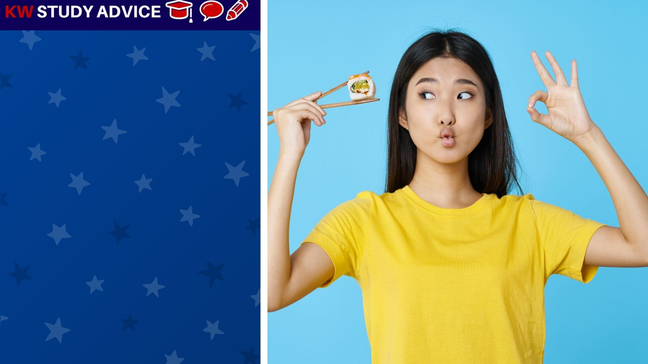
Unearth
Another, and more formal word, to say that we have found something new. It usually means to find something nice.
The girl was delighted to unearth a new Japanese restaurant in the city. Before she found it she did not know any other.

Slide 4
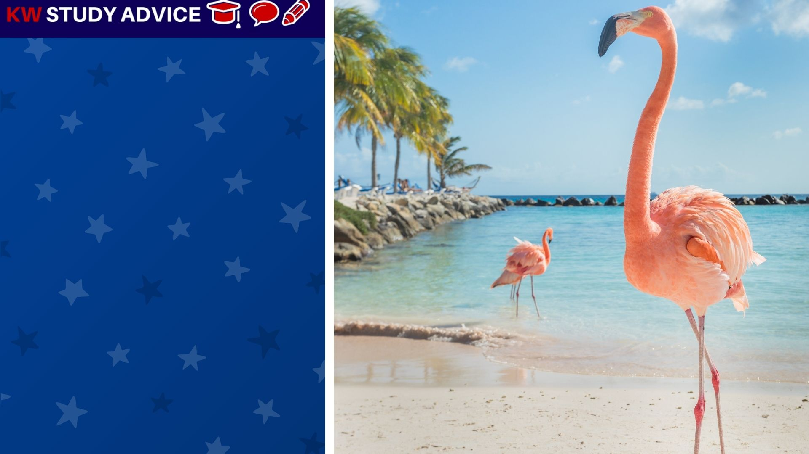
Flamingo
This is a pink bird with long legs which likes to walk in water. These are often found in warm countries and in Zoos in cooler ones.
The flamingos were walking through the water at the beach. They were looking for small fish in the shallow waters.

Slide 5
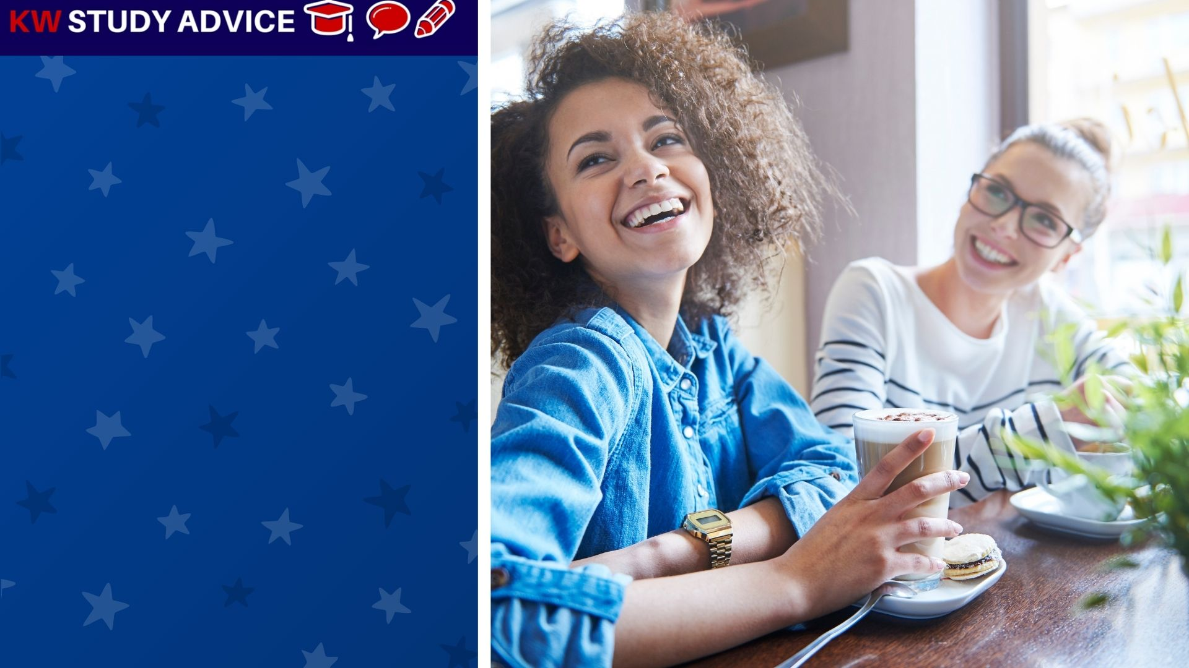
Gem
This is an informal word meaning someone, an object or place which is really great and enjoyable.
The girls often went to their favourite café for drinks and snacks. They loved it so much that they believed it was a gem of a café.

Slide 6

Backstory
This is the history or background of characters in a fictional tv show or movie. Their past is often written by writers.
The fans loved their drama so much that they wanted to learn more about the characters’ backstories in more detail.

Slide 7
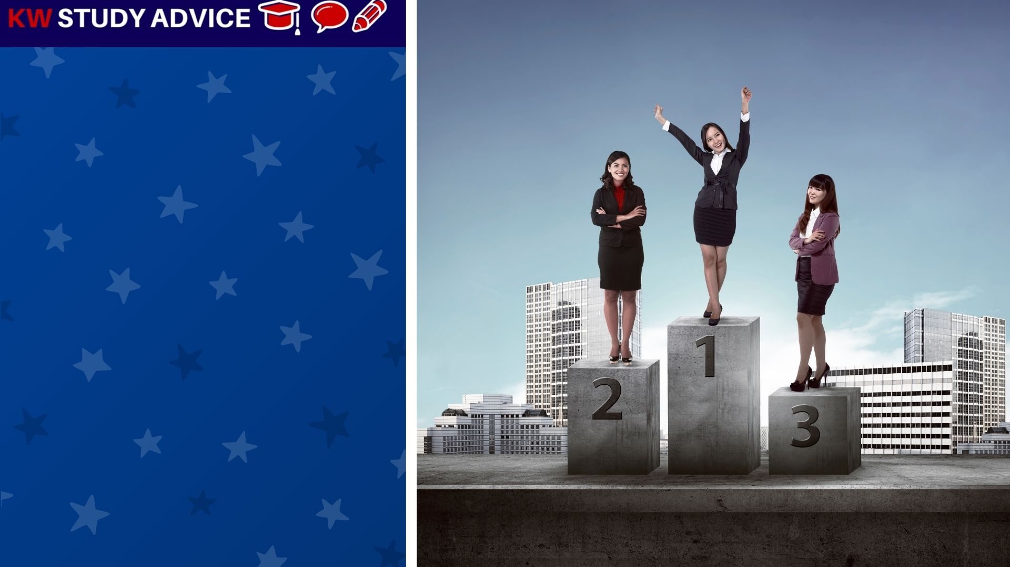
Podium
The stand where the first, second and third placed teams or individuals stand to collect their awards. First place is always highest.
The workers were awarded prizes for excellent work throughout the month. The winner stood at the top of the podium.

Slide 8


