Slide 1

Capacity
We have just calculated a volume.
Volume is how much space is inside a 3D shape.
Capacity is how much we can fit inside the space.

Slide 2
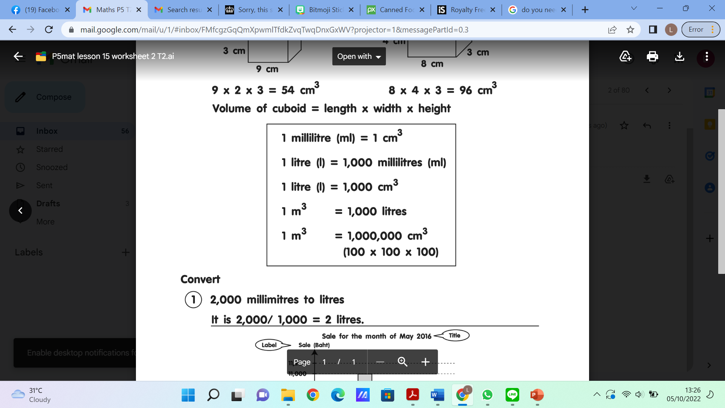
We can convert measurements of capacity and measurements of volume using this table:

Slide 3
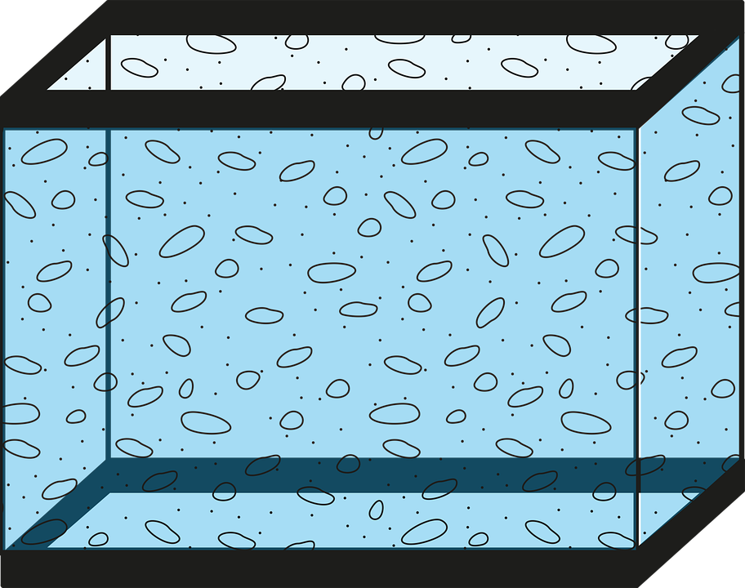
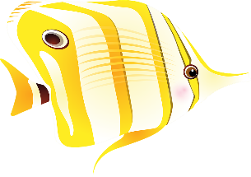

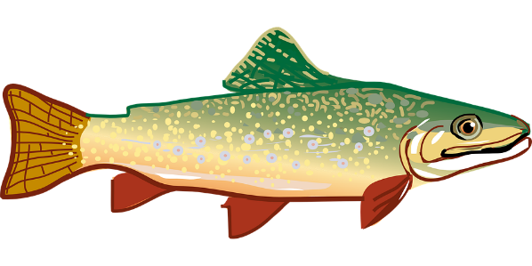
2m
Here is a fish tank at an aquarium.
How many litres are needed to fill it completely with water?
3m
3m

Slide 4
2m
First we need to find the volume.
3m x 3m x 2m = 18m³
3m
1m

Slide 5
2m
We now know the volume is 18m³.
Now we need to multiply the volume by 1,000 litres.
3m
1m

Slide 6
2m
18 x 1,000 = 18,000
So a full tank can hold eighteen thousand (18,000) litres.
3m
1m

