Slide 1




Causation and Remoteness in Tort Law
Tutor: Okwudili O. ONWURAH, LL.B. (Nigeria); BL (Abuja, Nigeria); LLM (Exeter, UK); LLM (Qingdao, PRC); LLM (Shanghai, PRC)
PhD in Law (Hong Kong)
Dr Okwudili O. Onwurah
1

Slide 2

The purpose of the online lesson is to encourage you to participate actively in achieving your needs and simplifying your legal education. I want you to be the best!
Minor House Keeping
Will make the learning process more interactive discussions and feel free to ask any question or you can speak.
You have the right to choose whether to turn on your video or not.
Participation prepares you for your exam and learning needs with ease.
2

Slide 3
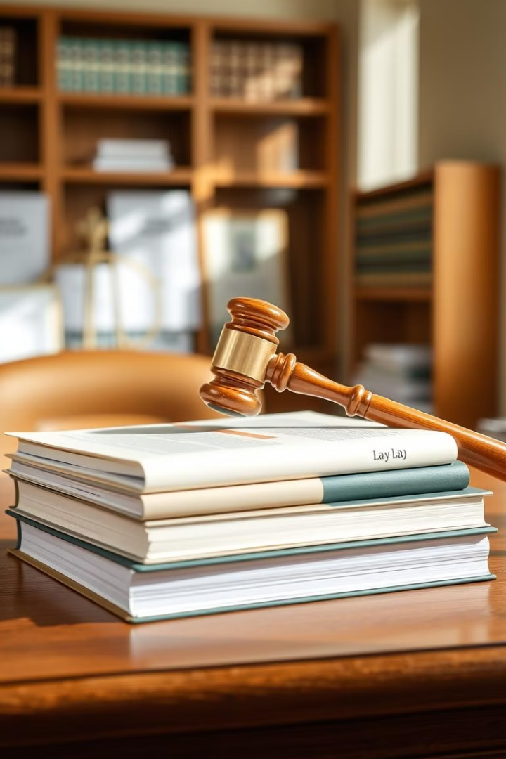

Introduction
Welcome to this comprehensive exploration of causation and remoteness in tort law. These fundamental concepts play a crucial role in determining liability and damages in legal cases. Throughout this presentation, we will delve into the intricacies of causation in fact and law, examine the 'but for' test, analyse multiple and consecutive causes, and explore the doctrine of novus actus interveniens. We will also investigate the concept of remoteness of damage, including the Wagon Mound test and the foreseeability of damage. By studying relevant English and Hong Kong case law, we will gain a deeper understanding of these principles and their practical applications in modern legal practice.

Slide 4
Concept of Causation
Causation is a fundamental principle in tort law that establishes the link between a defendant's wrongful conduct and the claimant's loss or injury. It is essential for determining liability and plays a crucial role in various areas of law, including negligence, nuisance, and breach of statutory duty. Causation is typically divided into two distinct elements: causation in fact and causation in law.
Causation in fact, also known as 'factual causation', is the first hurdle that must be overcome. It seeks to establish whether the defendant's actions were a necessary condition for the harm suffered by the claimant. This is often determined using the 'but for' test, which we will explore in more detail later. Causation in law, on the other hand, addresses whether the defendant should be held legally responsible for the harm, considering policy and common-sense factors.
1
Causation in Fact
Establishes the factual link between the defendant's actions and the claimant's harm using the 'but for' test.
2
Causation in Law
Determines whether it is fair, just, and reasonable to hold the defendant legally responsible for the harm.
3
Remoteness
Considers whether the type of damage was foreseeable and not too remote from the defendant's actions.

Slide 5
Causation in Fact: The 'But For' Test
The 'but for' test is the primary method used to establish causation in fact. This test asks: "But for the defendant's actions, would the claimant have suffered the harm?" If the answer is no, then the defendant's conduct is considered a cause of the harm. This test was famously articulated in Cork v Kirby MacLean Ltd [1952] 2 All ER 402, where Lord Denning stated: "If the damage would not have happened but for a particular fault, then that fault is the cause of the damage; if it would have happened just the same, fault or no fault, the fault is not the cause of the damage."
While the 'but for' test is generally straightforward, it can become complex in cases involving multiple causes or where the chain of causation is not clear. In such instances, the courts may need to apply additional tests or principles to determine causation. It's important to note that passing the 'but for' test is a necessary but not always sufficient condition for establishing legal liability.
Step 1: Identify the harm
Step 2: Hypothetical scenario
Clearly define the injury or loss suffered by the claimant.
Imagine a scenario where the defendant's wrongful act did not occur.
Step 3: Compare outcomes
Step 4: Draw conclusion
Determine if the harm would have occurred in the hypothetical scenario.
If the harm would not have occurred, causation is established.

Slide 6
Case Study: Barnett v Chelsea & Kensington Hospital
The case of Barnett v Chelsea & Kensington Hospital Management Committee [1969] 1 QB 428 is a landmark decision that illustrates the application of the 'but for' test in medical negligence cases. In this case, three-night watchmen arrived at the hospital's emergency department complaining of vomiting after drinking tea. The nurse on duty telephoned the doctor, who, without examining the patients, advised them to go home and see their own doctors if symptoms persisted. One of the men, Barnett, died several hours later from arsenic poisoning.
Although the hospital was found negligent in failing to examine Barnett, the court held that this negligence did not cause his death. Expert evidence showed that even if Barnett had been examined and diagnosed immediately, the poisoning was so severe that he would have died anyway. Thus, the 'but for' test was not satisfied, as the harm (death) would have occurred even without the defendant's negligence. This case demonstrates the importance of establishing a clear causal link between the defendant's actions and the claimant's harm, even in situations where negligence is evident.
Facts of the Case
Legal Issue
Court's Decision
Three-night watchmen arrived at hospital with symptoms of vomiting. They were not examined and sent home. Barnett died from arsenic poisoning hours later.
Did the hospital's negligence in failing to examine Barnett cause his death?
The hospital's negligence did not cause Barnett's death, as he would have died even if examined immediately due to severe poisoning.

Slide 7



Multiple Causes and Consecutive Causes
In some cases, harm may result from multiple causes or a series of consecutive events, making it challenging to apply the simple 'but for' test. For multiple causes, the courts have developed alternative approaches. One such approach is the 'material contribution' test, established in Bonnington Castings Ltd v Wardlaw [1956] AC 613. In this case, the House of Lords held that it was sufficient for the claimant to show that the defendant's breach of duty materially contributed to the harm, even if it was not the sole cause.
Consecutive causes involve a chain of events leading to the harm. The court must determine whether the chain of causation has been broken by an intervening act (novus actus interveniens) or whether the original wrongdoer should still be held liable. In Baker v Willoughby [1970] AC 467, the House of Lords dealt with consecutive causes where the claimant suffered an injury in a car accident and later lost his leg in an unrelated incident. The court held that the original tortfeasor remained liable for the continuing injury, despite the intervening event.
Initial Event
Intervening Factors
Final Harm
The defendant's negligent act or omission occurs, setting the chain of events in motion.
Additional events or circumstances may contribute to or alter the outcome.
The ultimate injury or loss suffered by the claimant, which may result from multiple or consecutive causes.

Slide 8



Novus Actus Interveniens and Causation in Law
Novus actus interveniens, Latin for "new intervening act", is a principle in tort law that can break the chain of causation between the defendant's wrongful act and the claimant's harm. This doctrine is crucial in determining whether a defendant should be held legally responsible for damages that may seem remote or unforeseeable. For an intervening act to qualify as a novus actus, it must be so powerful that it obliterates the wrongdoing of the original tortfeasor.
Causation in law, also known as legal causation, goes beyond mere factual causation. It involves policy considerations and asks whether it is fair, just, and reasonable to hold the defendant liable for the harm caused. The case of Lamb v Camden LBC [1981] QB 625 illustrates this concept. Here, the court held that although the defendant's negligence allowed squatters to occupy a house, causing damage, this damage was too remote, and the chain of causation had been broken by the deliberate acts of the squatters.
Policy Considerations
Chain of Causation
Judicial Discretion
Courts weigh fairness and public policy in determining legal causation.
Assessing whether intervening acts break the causal link.
Judges apply common sense and legal principles to establish causation in law.

Slide 9
Remoteness of Damage and The Wagon Mound Test
Remoteness of damage is a key principle in tort law that limits the extent of a defendant's liability. It addresses the question of whether the type of damage suffered by the claimant was reasonably foreseeable. The landmark case that established the modern approach to remoteness is Overseas Tankship (UK) Ltd v Morts Dock & Engineering Co Ltd [1961] AC 388, commonly known as The Wagon Mound (No. 1).
In this case, the Privy Council rejected the previous 'direct consequence' test from Re Polemis [1921] 3 KB 560 and established the 'reasonable foreseeability' test. Lord Simonds stated that "the essential factor in determining liability is whether the damage is of such a kind as the reasonable man should have foreseen." This test requires that the type of damage, not its extent or precise manner of occurrence, be foreseeable. The Wagon Mound test has since been applied and refined in numerous cases, including Hughes v Lord Advocate [1963] AC 837, which demonstrated that the precise details of the accident need not be foreseeable, only the type of harm.
Case
Key Principle
Impact on Remoteness
Re Polemis (1921)
Direct consequence test
Defendant liable for all direct consequences, even if unforeseeable
The Wagon Mound (1961)
Reasonable foreseeability test
Defendant liable only for reasonably foreseeable type of harm
Hughes v Lord Advocate (1963)
Type of harm, not exact manner
Foreseeability of general type of harm sufficient

Slide 10
The Thin Skull Rule and Smith v Leech Brain & Co.
The thin skull rule, also known as the eggshell skull rule, is a principle in tort law that states that a tortfeasor must take their victim as they find them. This means that if a claimant has a pre-existing condition that makes them more susceptible to injury, the defendant cannot use this as a defence to reduce their liability. The rule was famously applied in the case of Smith v Leech Brain & Co [1962] 2 QB 405.
In Smith v Leech Brain & Co, the claimant was splashed with molten metal due to his employer's negligence. The burn caused a pre-existing cancerous condition to become malignant, leading to the claimant's death. The court held that the defendant was liable for the full extent of the harm, including the fatal consequences, even though they could not have foreseen the specific vulnerability of the claimant. This case illustrates that while the type of harm must be foreseeable under the Wagon Mound test, the extent of the harm or the claimant's particular susceptibility need not be. The thin skull rule ensures that vulnerable individuals are not disadvantaged in seeking compensation for their injuries.
1
Take Your Victim As You Find Them
2
Type vs Extent of Harm
Defendants are liable for the full extent of harm, even if the claimant has unusual susceptibilities.
While the type of harm must be foreseeable, the extent or specific manifestation need not be.
3
No Reduction in Damages
4
Protection for Vulnerable Claimants
The thin skull rule prevents defendants from arguing for reduced damages based on the claimant's pre-existing conditions.
The rule ensures that individuals with pre-existing conditions are not disadvantaged in tort claims.

Slide 11
Recent Developments and Criticisms
Recent developments in causation and remoteness have seen courts grappling with complex scenarios, particularly in medical negligence cases. The case of Chester v Afshar [2004] UKHL 41 introduced a modified approach to causation in informed consent cases. Here, the House of Lords held that the doctor's failure to warn of a small risk associated with surgery could be considered causative of the patient's injury, even though the patient might have consented to the surgery at a later date. This decision has been criticised for stretching traditional causation principles to achieve a just result.
In Hong Kong, the Court of Final Appeal has addressed causation issues in cases such as Yeung Mei Hoi v Tam Cheuk Shing [2015] HKCFA 42, which dealt with the 'loss of chance' doctrine in medical negligence. The court emphasised the need for a robust and pragmatic approach to causation, considering the realities of medical practice. Critics argue that these developments, while well-intentioned, may lead to uncertainty and potentially expand liability in ways that could have unintended consequences for healthcare providers and other professionals.
Informed Consent
Loss of Chance
Criticisms
Chester v Afshar modified causation principles in cases involving failure to warn of medical risks.
Yeung Mei Hoi v Tam Cheuk Shing addressed the complex issue of lost opportunities in medical contexts.
Concerns about legal uncertainty and potential expansion of liability in professional negligence cases.

Slide 12




Conclusion and Future Perspectives
As we conclude our exploration of causation and remoteness in tort law, it is clear that these principles continue to evolve in response to complex legal challenges. The courts have shown a willingness to adapt traditional tests to achieve just outcomes, particularly in cases involving medical negligence and informed consent. However, this flexibility must be balanced against the need for legal certainty and predictability.
Looking to the future, it is likely that causation and remoteness will face new challenges in areas such as artificial intelligence, autonomous vehicles, and environmental torts. Legal scholars and practitioners must continue to refine these concepts to ensure they remain fit for purpose in an increasingly complex world. As Lord Nicholls stated in Kuwait Airways Corp v Iraqi Airways Co [2002] UKHL 19, "Causation is to be understood as the man in the street, and not as either the scientist or the metaphysician, would understand it." This pragmatic approach, combined with a willingness to adapt to new scenarios, will be crucial in shaping the future of tort law.
Legal Certainty
Emerging Technologies
Global Perspective
Ongoing Research
Balancing flexibility with predictability in applying causation principles.
Considering international approaches to causation and remoteness in tort law.
Continual refinement of legal principles through academic study and case law analysis.
Adapting causation concepts to challenges posed by AI and autonomous systems.

