Slide 1
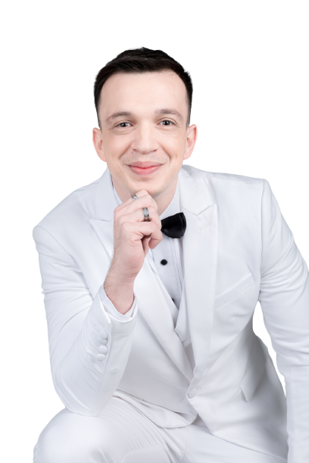
Talking about your Job

Slide 2
1. Introducing Your Job
I’m a ________ I’m a writer.
I work in ________ I work in online education.
I work for _________I work for a publishing company.

Slide 3
I work in is used with a field, meaning a type of work, with a place or a department of a company.
I work in finance.
I work in digital marketing.
I work in the HR department of a financial firm.
I work in a school, teaching modern languages.
If you use an article a or the after work in, it means you’re talking about the place or department where you work.

Slide 4
I work for… is used with a company.
I’m a salesman.
I work for a mobile phone company.
I work for a law firm based in Frankfurt.
I run my own business, so I work for myself.

Slide 5
2. Describing Your Company
I work for a _________ company which __________
We need one adjective, and the end of the sentence after which.
Think about these ideas: is your company big or small? Local or multinational?
For the part after which, ask yourself: what does your company do? Does it make things, sell things, organize things? Does it provide products, services, or both?

Slide 6
Example.
I work for an international electronics company which makes tablet computers.
I work for a German company which does market research for other companies.
I work for Unilever. It’s a multinational company which has brands and offices all around the world.

Slide 7
What if you don’t work for a company?
I’m a freelancer. –> I work independently, for different people and companies.
I’m self-employed. –> I work for myself, either freelance or I have my own business.
I’m a business owner.

Slide 8
If you don’t work, and people ask you what you do, what can you say?
I’m between jobs at the moment.
I’m taking some time out to travel/spend time with my kids/write a book/recover from an illness/etc.
I’m retired.
I’m between jobs means that I’ve left one job, and haven’t found another yet. This sounds nicer than saying, “I’m unemployed.”
I’m taking some time out means I’m not working at the moment because I want to focus on something else.

Slide 9
3. How to Describe Your Job in More Detail
I have to _________
I’m responsible for _________
Most of my time is spent _________

Slide 10
Ex.1
I’m a nurse. I have to look after patients, give them medicine and make sure they’re comfortable. I’m responsible for about 20-30 patients. Most of my time is spent talking to patients and checking that everything is okay.

Slide 11
Ex.2
I have to design websites to the client’s specifications. I’m responsible for the whole design process, so I have to take the client’s ideas and turn them into a finished product. Most of my time is spent experimenting with different designs and ideas and seeing what looks good, because attention to detail is important in this kind of work.

Slide 12
4. Saying How You Feel about Your Job | Adjectives
+ | I like my Job.
Stimulating –> Something which is stimulating is exciting and gives you energy.
Satisfying –> Means that your job gives you a sense of achievement.
Creative –> You can use your imagination when you work.
Rewarding –> This means your job gives you very positive feelings. It’s often used to talk about jobs in which you help other people. For example, teachers or nurses might describe their jobs as rewarding.
Challenging –> Challenging can be positive or negative, but if you use it to talk about your job, it would have a positive meaning. It means that your job is difficult, but in an interesting way which makes you think and learn.

Slide 13
- | I don’t like my Job.
Exhausting –> Describes work which makes you feel very tired, either physically or mentally.
Thankless –> If your work is thankless, no one notices or appreciates what you do.
Mind-numbing –> Extremely boring.
Dead-end –> Describes a job which has no prospects for the future. If you have a dead-end job, you will never get promoted and the job will always be the same.
Soul-destroying –> Describes a job which is extremely unpleasant and boring, and which you really, really hate.

Slide 14
Ex.1.
I’m a pharmacist. I started my own small pharmacy, so I’m also a business owner. I have to work as a pharmacist, of course, giving advice to patients and making sure they have the right medicine. However, I’m also responsible for the pharmacy, so I have to manage my staff, do the accounts, and so on. It’s stimulating work because I have to do many different things every day, so I never get bored.

Slide 15
Ex.2.
I’m a writer. I work in online education. I work for a big publishing company, which produces different educational materials that are used all around the world. I have to write lesson plans and materials for teachers to use in the classroom. I spend most of my time thinking about how I can make different things fit together into a lesson. It’s very challenging work and it can be exhausting, but it’s also very creative and satisfying, because I know people all around the world are using lessons which I wrote.

