Slide 1
Fundamental of Accounting
Materials referenced include CFA, CFI, MSc (Nanyang Business School)
Update: 2025

Slide 2
Content: Introduction to Accounting
Short vs Long term
1
IFRS vs US GAAP
1
Fixed vs Variable Cost
2
Depreciation policy
2
3 Accrual vs Cash Accounting
3
Ratio Analysis
Bad Debt Policy
4
Redflags in Accounting
4
Inventory valuation
5
Book keeping (GL)
5
Quality of Earnings
6
Budgeting h Forecasting
6
Free Cashflow to Firm
7
Big 3 Financial Statements
7

Slide 3




The 3 sets of “Accounting Books”
Tax Accounts
Comply with local tax laws and regulations
Who are they for?
03
1.
Internal management
2.
External stakeholders
01
02
3.
Tax Authorities
Management Accounts
Internal ﬁnancial reports
customized for leadership and
Statutory Accounts
operational teams to support
An oﬃcial and audited
business decision-making,
record of a company’s
budgeting, and performance
ﬁnancial position and
monitoring
performance

Slide 4
The main purpose of accounting is to:
  Address tax concerns
  Track and report financial information
  Assess valuation of company
  Avoid paying taxes
Who uses accounting information?
  Business owners
  Government
  Both internal & external users
  Investors

Slide 5
Which of the following is the correct sequence of bookkeeping steps?
  Prepare Trial Balance, Record Transactions, Post to Ledger
  Record Transactions, Post to Ledger, Prepare Trial Balance, Adjust Entries, Create Financial Statements
  Create Financial Statements, Adjust Entries, Post to Ledger

Slide 6

Key Accounting Principles
Matching Principle
01
Conservatism
02
-Expenses to be recorded in the same accounting period as revenue
- Provision for potential loss
03
Materiality
04 Accrual
-Revenues and expenses are recorded when they are earned or incurred
-Omission or misstatement could influence the decisions of users

Slide 7
Alice borrows $10,000 to buy a car. Which is correct?
  Assets $10,000; Liabilities $10,000
  Assets $10,000; Equity $10,000
  Liabilities $10,000; Equity $0
  Assets $0; Equity $10,000
Alice invests $10,000 in her café. Which is correct?
  Assets $10,000; Liabilities $10,000
  Assets $10,000; Equity $10,000
  Liabilities $10,000; Equity $0
  Assets $0; Equity $10,000

Slide 8

Overview of Financial statements - Income Statement
Income Statement
Revenue
Expenses
Core Revenue
Other Income
Operating Exp.
Non- Operating Exp.
Fixed Cost
Variable Cost
Interest expense
Write-offs (Bad debt, Inventory) Legal cost
FX loss
Loss on Disposal
By Product By BU
By Location
FX Gain
Gain on Disposal
Office rent Insurance premiums Depreciation
Utilities Salary cost Direct cost
Revaluation Interest Income

Slide 9

Overview of Financial statements - Balance Sheet
Balance Sheet
Asset
Liability
Equity
Current Asset
Non- Current Asset
Current Liability
Non- Current Liability
LT loan
Lease obligation Deferred tax
Retained Earning Common share cap Preferred share cap
A/P
Accrued Exp. Salary payable
Cash A/R
Inventory
Land PPE
liability
ST Loan
Deferred Tax A RoU Asset
sset

Slide 10
Rent cost belongs to:
  Asset
  Liability
  Equity
  Expense
Accounts payable is classified as:
  Asset
  Liability
  Revenue
  Expense

Slide 11
Cash vs Accrual Accounting
Example 1: Deferred Revenue
Example 2: Accrued Revenue
01 2024
12 2024
12 2024
01 2025
Dr Cash
Dr Def Rev.
Dr Accrued Rev.
Dr Cash
Cr Def. Rev
Customer pays upfront for full year subscription
Cr Revenue
Revenue is recognized when earned in following months
Cr Revenue
Ensure revenue recognized in correct period
Cr Accrued Rev
Cash received in Jan next year, no extra revenue recognized.
Even though cash not in

Slide 12
Match the following!
Accrued Expense
Deferred/ Prepaid Revenue
Accrued Revenue
Deferred/ Prepaid Expense
Receives full year subscription in Q1
Customer pays after work completed next year Employee Bonus to be paid after Financial Year

Slide 13
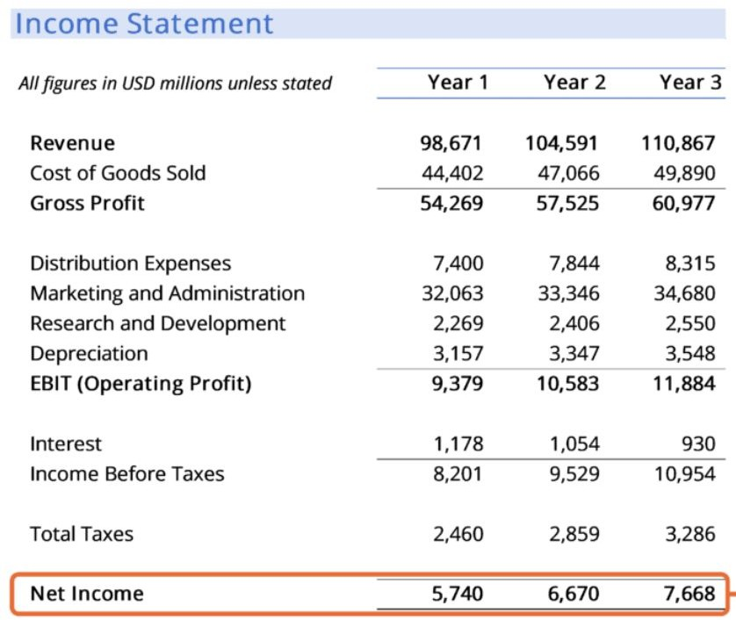

Big 3 Financial Statements - Income Statement
How profitable company has been during the time interval (eg.
Quarterly / Semi - annual / Annual)
Amount that was earned (Accrual Accounting)
G.P / Rev. = Margin %
OPEX ( - ) EBITDA

Slide 14

Income Statement - Red Flags
RED FLAG #1
RED FLAG #2
RED FLAG #3
RED FLAG #4
Over / understated Revenue
Inventory management
Debt Collectability
Depreciation
Use Cash Accounting (Recognize early or omit revenue stream)
Change in Inventory valuation method (FIFO vs LIFO)
resulting in higher profit (Lower COGS)
Depreciation methods (Straight-line vs Accelerated)
and the estimation of useful lives can significantly impact profitability
If receivables are increasing as a percentage of total revenue.
Related Party Transaction
Indicate channel-stuffing or fictitious sales or collectibility issue (eg. aggressive bad debt policy)
Fictitious Sales (E-fishery, Luckin Coffee)

Slide 15
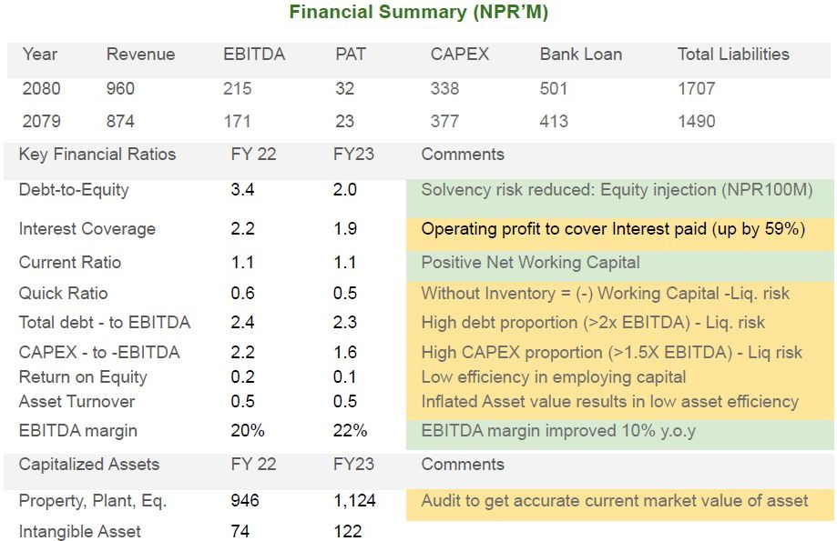
Example - Ratio Analysis

Slide 16

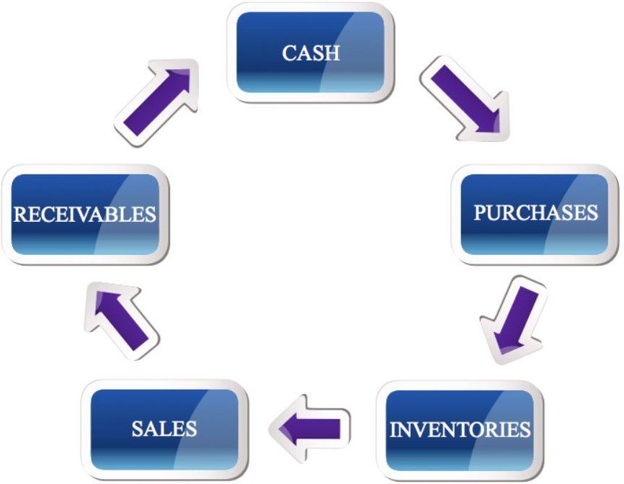
Balance Sheet - Red Flags
RED FLAG #1
RED FLAG #2
RED FLAG #3
RED FLAG #4
Increasing Solvency ratios
Increasing Cash C. Cycle
Negative Net Working Cap
Off-balance sheet liability
Debt-to-Equity ratio surpassing sector avg
Current Asset < Current Liability
Are all contingent liabilities accounted in B.S?
(Eg. Legal case, contingent tax liability)
High leverage leading to unsustainable interest repayment
Insufficient Liquid asset to pay
short-term obligation
Lease liability
Going-concern in question

Slide 17
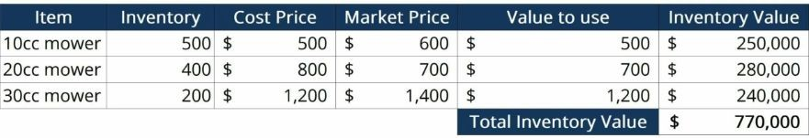
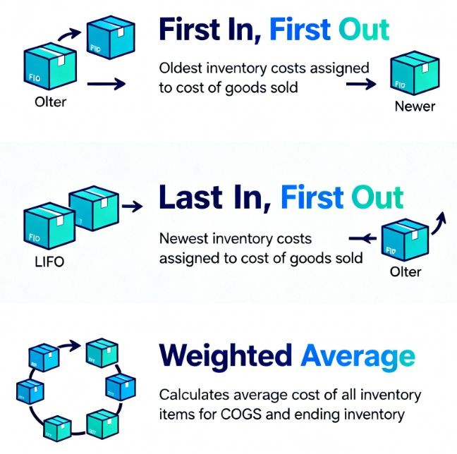
Inventory Valuation
IFRS not allowed

Slide 18
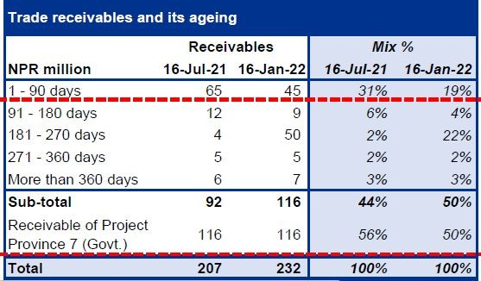

Bad Debt Policy
Example of Bad debt policy
90 days → 20% doubtful debt allowance
180 days → 50%
>360 days → 100%

Slide 19
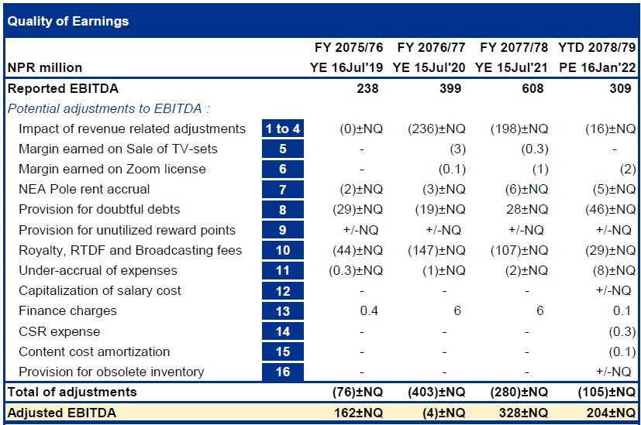

Quality of Earnings
Non-operating Revenue
Understated expenses

Slide 20

Cashflow Statement - Red Flags
RED FLAG #4
Volatile Net Cashflow
RED FLAG #1
RED FLAG #2
RED FLAG #3
(+)Net profit but (-) Cashflow
Aggressive rev e recognition
Large Debt Borrowing
Capital Exp.
EBITDA
enu
Gap in Operating Cashflow is plugged by borrowing or issuance of new shares
Maintenance / replacement CAPEX makes up huge % of Revenue
Presence of one-off revenue or expenses
Rising receivables or inventory buildup
Large dividend payment despite weak cashflow
High capital outlay erodes overall profit margin
Profit may not be real or sustainable
Mismatch between Income and Cash conversion

