Slide 1






TRIGONOMETRIC RATIOS
Finding missing sides of a triangle
SIN
TAN
COS
H
O
θ
A

Slide 2
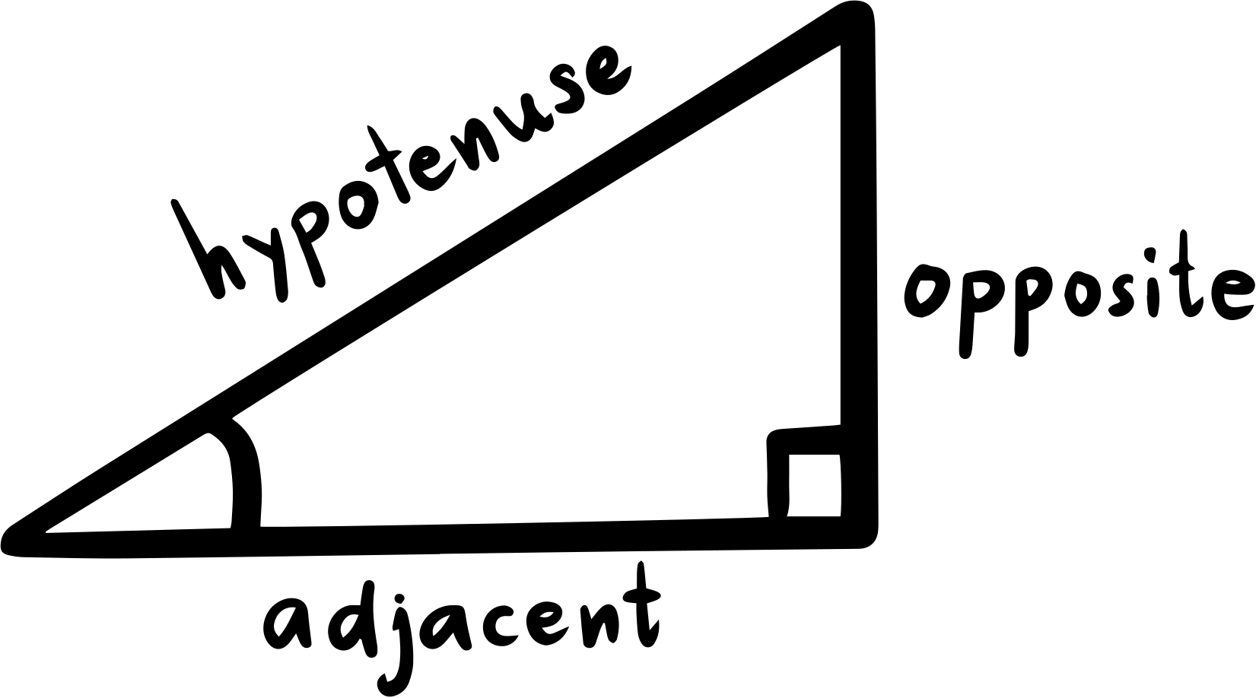

TANGENT
A right-angled triangle has an angle of 90°. In this triangle, the longest side which is opposite the right angle is known as the hypotenuse.

Slide 3
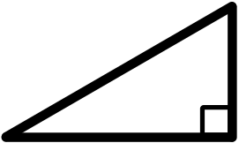
EXAMPLE 1
The diagram shows a right-angled triangle ABC. Name:
a) Hypotenuse b) The adjacent side - opposite side (in respect to angle A)
C
A
B

Slide 4
CONCEPT OF TANGENT
The tangent of an angle in a right-angled triangle is the ratio of the lenght of the opposite side to the lenght of the adjacent side. Tangent of is usually written as tan
Opposite side
Tan =
Adjacent side

Slide 5
TANGENT
The tangent of an angle is constant when the size of the triangle changes proportionally. For example:
F
D
B
6cm
4cm
2cm
A
3cm
C
3cm
E
3cm
G

Slide 6
TANGENT
Find the value of tan in triangle ABC
A
10cm
C
B
6cm

Slide 7
TRIGONOMETRIC
RATIOS
Label the Triangle Sides
opposite side
BC
C
sin =
=
Hypotenuse
AC
Hypotenuse
Opposite
adjacent side
AB
cos =
=
Hypotenuse
AC
A
B
Adjacent
opposite side
BC
tan =
=
adjacent side
AB

Slide 8


Slide 9
TANGENT
Finding the lengths of sides from the tangent of an angle
The tangent of x of the right-angled triangle is 1.5. Find the length of AB.
B
9cm
x
A
C

Slide 10
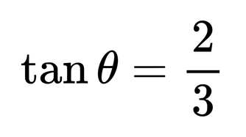
EXERCISES PAGE 87
Find the value of x in each of the following triangles with the given value of tan
3m
x m

Slide 11
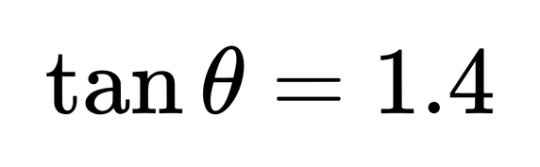
EXERCISES PAGE 87
Find the value of x in each of the following triangles with the given value of tan
x mm
10mm

Slide 12
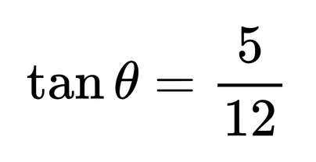
EXERCISES PAGE 87
Find the value of x in each of the following triangles with the given value of tan
45 mm
x mm

Slide 13
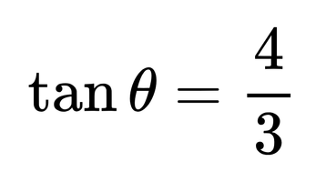
EXERCISES PAGE 87
Find the value of x in each of the following triangles with the given value of tan
3 m
x m

Slide 14
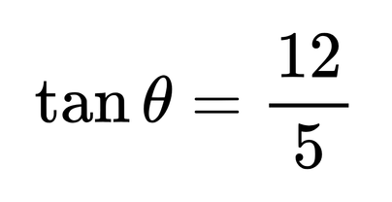
EXERCISES PAGE 87
Find the value of x in each of the following triangles with the given value of tan
24 cm
x cm

Slide 15

FINDING VALUES
30° 45° 60°
2
Choose your Ratio
1
Label the Triangle Sides
Use SOH CAH TOA to help you decide which ratio to
use (sin, cos, tan).
Identify the opposite, adjacent and hypotenuse of the right angled triangle.
Applying the formula
Calculate your answer
3
4
Substitute the side lengths into the correct formula triangle.
Complete the calculation to find your answer. Round to the required accuracy.

Slide 16
EXERCISES
In the diagram below, ABC is a straight line. It is given than tan y = 1. Find the values of cos (x).
D
y
6 cm
x
A
C
B
14 cm

Slide 17
EXERCISE PAGE 93 WB
The diagram shows two right-angled triangles. PQR is a straight line. It it given than tan x = 0.5 and the lengths of ST and QT are the same. Find the:
S
i) value of tan y
ii) length of PS
4 cm
y
T
x
P
R
Q
14 cm

Slide 18






FINDING VALUES
30° 45° 60°
Table of values for angles 30° 45° 60°
 | 30° | 45° | 60°
sin
cos
tan

Slide 19
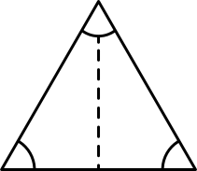






FINDING VALUES
30° 45° 60°
Table of values for angles 30° 45° 60°
 | 30° | 45° | 60°
sin
cos
tan

Slide 20
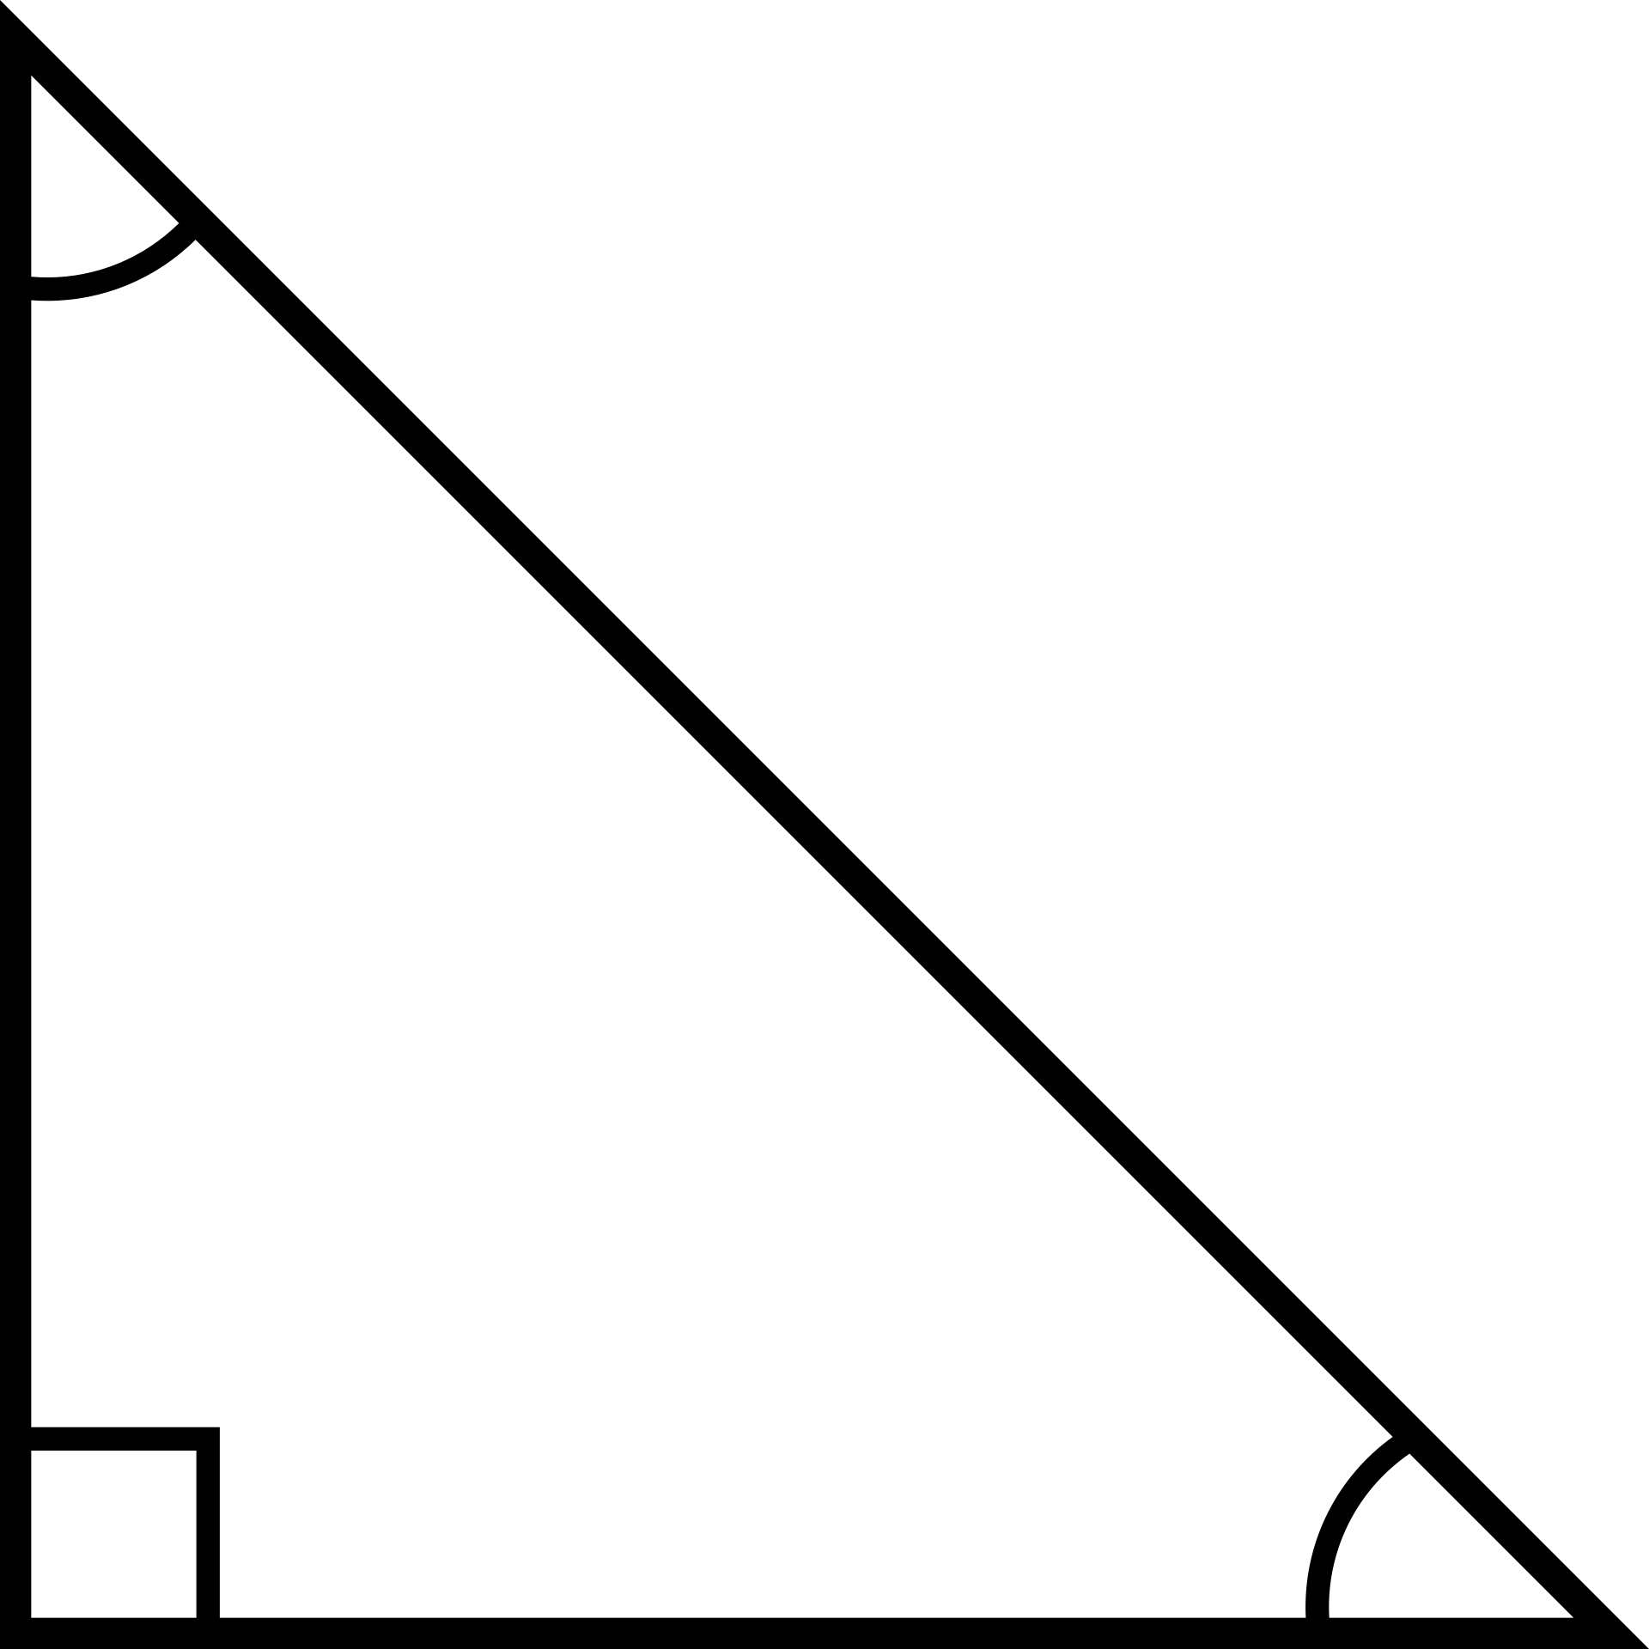
FINDING VALUES
30° 45° 60°
Table of values for angles 30° 45° 60°
 | 30° | 45° | 60°
sin
cos
tan

