Slide 1
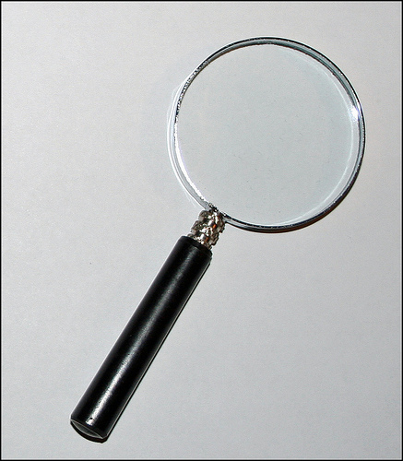
Finding information in a text
Question 1
Paper 1 & 2
Lesson 2

Slide 2
Overview
In both Paper 1 and Paper 2 of the AQA English Language exam Question 1 requires you to find information in the text.
This is a straightforward task aimed at calming you down, helping you to focus and get in the swing of the exam.
The question is worth 4 marks, which doesn’t seem a lot, but they are 4 marks you can count on if you use your skimming and scanning skills and check your answers are correct!
In Paper 1 you must write the four answers, but in Paper 2 you must choose from the statements which four are correct.

Slide 3
Fact or fiction?
Remember that for Paper 1 the answers are all based on an extract (which means just a part of) a fictional text – such as a book, or a short story.
While in Paper 2 the answers are all based on two extracts from non-fictional texts – such as a newspaper or a magazine.
Also in Paper 2 – one of the texts will be modern (like the language we use nowadays), but the other will be from quite a long time ago. This means that sometimes they will use words we don’t use anymore and write in an old fashioned way.

Slide 4
Let’s Practice!
Read the extract from a university newsletter on the following slide, then together we will use our skimming and scanning skills to find the answers to the questions on slide 6.

Slide 5
Northtown University Volunteers needed! Can you help?
In July, Northtown University will be holding three open days for future students, and we need more of you to help on these days. There will be hundreds of visitors – mainly teenagers in their last year of school, who are interested in studying at our university next year, but also some parents and teachers.
The open days take place on Thursday 6, Friday 7 and Wednesday 12 July. Approximately 45 student volunteers are needed on each date, although we now have sufficient numbers for the first and last of these.
In previous years, each student volunteer wore a purple sweatshirt with Northtown printed on it. From feedback, we have learned that these can be too hot, so we have ordered a red T-shirt for each volunteer instead. We will, of course, give everyone a folder containing all the necessary information as well.
Visitors will have received details about their open day in advance. They should enter the university by the South Gate, then report to the welcome desk in order to sign in. There, they will meet a student volunteer, and they will each be provided with a name badge, a map of the site and a bag which has the university logo on it. This will contain an information pack and a university key ring.
After signing in, visitors will go to the Great Hall where there will be two short talks: Professor Jameson’s opening speech, ‘Why choose Northtown?’, followed by ‘Student life’, a talk by third year students.

Slide 6
Questions
1. On which date in July are student volunteers still needed?
2. What will the student volunteers wear?
3. What will all visitors receive inside their bag? Give two details.
4. What is the title of the first talk on each open day?

Slide 7
Northtown University Volunteers needed! Can you help?
In July, Northtown University will be holding three open days for future students, and we need more of you to help on these days. There will be hundreds of visitors – mainly teenagers in their last year of school, who are interested in studying at our university next year, but also some parents and teachers.
The open days take place on Thursday 6, Friday 7 and Wednesday 12 July. Approximately 45 student volunteers are needed on each date, although we now have sufficient numbers for the first and last of these.
In previous years, each student volunteer wore a purple sweatshirt with Northtown printed on it. From feedback, we have learned that these can be too hot, so we have ordered a red T-shirt for each volunteer instead. We will, of course, give everyone a folder containing all the necessary information as well.
Visitors will have received details about their open day in advance. They should enter the university by the South Gate, then report to the welcome desk in order to sign in. There, they will meet a student volunteer, and they will each be provided with a name badge, a map of the site and a bag which has the university logo on it. This will contain an information pack and a university key ring.
After signing in, visitors will go to the Great Hall where there will be two short talks: Professor Jameson’s opening speech, ‘Why choose Northtown?’, followed by ‘Student life’, a talk by third year students.

Slide 8
answers
1. On which date in July are student volunteers still needed?
A: Friday 7
2. What will the student volunteers wear?
A: Red T shirt
3. What will all visitors receive inside their bag? Give two details.
A: An information pack and a university key ring.
4. What is the title of the first talk on each open day?
A: ‘Why choose Northtown?’

Slide 9
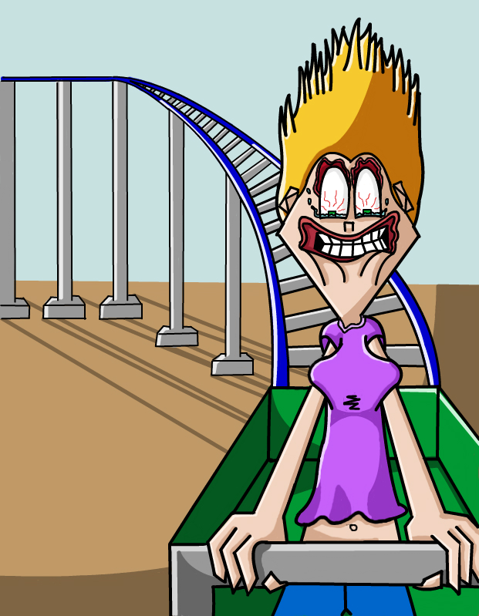
Let’s try another!
We’re going to look at an extract from a different kind of information text, a personal recount (retelling a true story) in an article about rollercoaster rides. Read the text and see how quickly we can answer the questions that follow!
This Photo by Unknown Author is licensed under CC BY-SA-NC

Slide 10
My first ever rollercoaster ride
I have come to a theme park to meet rollercoaster enthusiast Jay Murray, to find out what makes these rides so popular. Jay estimates he has been on 700 rides in the past 10 years, and is surprised that I have never been on one. He says that one of the attractions of these rides is that you feel out of control, but safe. Jay really wanted to emphasise the importance of safety. “All rides are tested for 1,000 hours before they open to the public,” he said. “They also do a test run on every ride each morning, and there’s a thorough annual inspection too.”
Rollercoasters first appeared in 17th-century Russia. These were sloping structures up to 15 metres high, built of wood, with a layer of ice on the surface which people would slide down. Rollercoasters with wheeled sledges were developed soon afterwards. Later, in Pennsylvania, in the USA, a train that had been used to deliver coal was converted to carry passengers on day trips. This gave a man called LaMarcus Thompson the idea to open a park with pleasure rides at Coney Island, New York. A school teacher by profession, he had the eye of a designer, and the mind of a businessman. In just three weeks, he raised enough money from the rides to pay for the cost of building the park.

Slide 11
questions
How do theme parks make sure each ride is safe every day?
What were the earliest rollercoasters covered in?
What did the railway in Pennsylvania originally transport?
What was the occupation of the man who first designed the rides at Coney Island?

Slide 12
My first ever rollercoaster ride
I have come to a theme park to meet rollercoaster enthusiast Jay Murray, to find out what makes these rides so popular. Jay estimates he has been on 700 rides in the past 10 years, and is surprised that I have never been on one. He says that one of the attractions of these rides is that you feel out of control, but safe. Jay really wanted to emphasise the importance of safety. “All rides are tested for 1,000 hours before they open to the public,” he said. “They also do a test run on every ride each morning, and there’s a thorough annual inspection too.”
Rollercoasters first appeared in 17th-century Russia. These were sloping structures up to 15 metres high, built of wood, with a layer of ice on the surface which people would slide down. Rollercoasters with wheeled sledges were developed soon afterwards. Later, in Pennsylvania, in the USA, a train that had been used to deliver coal was converted to carry passengers on day trips. This gave a man called LaMarcus Thompson the idea to open a park with pleasure rides at Coney Island, New York. A school teacher by profession, he had the eye of a designer, and the mind of a businessman. In just three weeks, he raised enough money from the rides to pay for the cost of building the park.

Slide 13
answers
1. How do theme parks make sure each ride is safe every day?
A: They do a test run on every ride each morning
2. What were the earliest rollercoasters covered in?
A: A layer of ice
3: What did the railway in Pennsylvania originally transport?
A: Coal
4: What was the occupation of the man who first designed the rides at Coney Island?
A: A teacher

Slide 14
Now that we’ve warmed up, let’s try in AQA exam format!
Let’s look again at the first text, the university newsletter (this is on slide 16) – this time the questions are in the same format as in Paper 1.

Slide 15
First look at the Question
From paragraphs 4 & 5 (the last two) give four details about what visitors should do on the open day.

Slide 16
Northtown University Volunteers needed! Can you help?
In July, Northtown University will be holding three open days for future students, and we need more of you to help on these days. There will be hundreds of visitors – mainly teenagers in their last year of school, who are interested in studying at our university next year, but also some parents and teachers.
The open days take place on Thursday 6, Friday 7 and Wednesday 12 July. Approximately 45 student volunteers are needed on each date, although we now have sufficient numbers for the first and last of these.
In previous years, each student volunteer wore a purple sweatshirt with Northtown printed on it. From feedback, we have learned that these can be too hot, so we have ordered a red T-shirt for each volunteer instead. We will, of course, give everyone a folder containing all the necessary information as well.
Visitors will have received details about their open day in advance. They should enter the university by the South Gate, then report to the welcome desk in order to sign in. There, they will meet a student volunteer, and they will each be provided with a name badge, a map of the site and a bag which has the university logo on it. This will contain an information pack and a university key ring.
After signing in, visitors will go to the Great Hall where there will be two short talks: Professor Jameson’s opening speech, ‘Why choose Northtown?’, followed by ‘Student life’, a talk by third year students.

Slide 17
Answers
In July, Northtown University will be holding three open days for future students, and we need more of you to help on these days. There will be hundreds of visitors – mainly teenagers in their last year of school, who are interested in studying at our university next year, but also some parents and teachers.
The open days take place on Thursday 6, Friday 7 and Wednesday 12 July. Approximately 45 student volunteers are needed on each date, although we now have sufficient numbers for the first and last of these.
In previous years, each student volunteer wore a purple sweatshirt with Northtown printed on it. From feedback, we have learned that these can be too hot, so we have ordered a red T-shirt for each volunteer instead. We will, of course, give everyone a folder containing all the necessary information as well.
Visitors will have received details about their open day in advance. They should enter the university by the South Gate, then report to the welcome desk in order to sign in. There, they will meet a student volunteer, and they will each be provided with a name badge, a map of the site and a bag which has the university logo on it. This will contain an information pack and a university key ring.
After signing in, visitors will go to the Great Hall where there will be two short talks: Professor Jameson’s opening speech, ‘Why choose Northtown?’, followed by ‘Student life’, a talk by third year students.

Slide 18
Now let’s try with the second text in the answer format for paper 2 (text is on slide 19)
Choose four statements which are true:
The writer’s name is Jay Murray.
Jay Murray has been on about 700 rides.
All rides are tested for 1,000 hours each morning.
The first rollercoasters were in Russia.
Rollercoasters were first built of wood.
LaMarcus Thompson was a designer.
It took three weeks to pay for the cost of the park.

Slide 19
My first ever rollercoaster ride
I have come to a theme park to meet rollercoaster enthusiast Jay Murray, to find out what makes these rides so popular. Jay estimates he has been on 700 rides in the past 10 years, and is surprised that I have never been on one. He says that one of the attractions of these rides is that you feel out of control, but safe. Jay really wanted to emphasise the importance of safety. “All rides are tested for 1,000 hours before they open to the public,” he said. “They also do a test run on every ride each morning, and there’s a thorough annual inspection too.”
Rollercoasters first appeared in 17th-century Russia. These were sloping structures up to 15 metres high, built of wood, with a layer of ice on the surface which people would slide down. Rollercoasters with wheeled sledges were developed soon afterwards. Later, in Pennsylvania, in the USA, a train that had been used to deliver coal was converted to carry passengers on day trips. This gave a man called LaMarcus Thompson the idea to open a park with pleasure rides at Coney Island, New York. A school teacher by profession, he had the eye of a designer, and the mind of a businessman. In just three weeks, he raised enough money from the rides to pay for the cost of building the park.

Slide 20
answers
Choose four statements which are true:
The writer’s name is Jay Murray.
Jay Murray has been on about 700 rides.
All rides are tested for 1,000 hours each morning.
The first rollercoasters were in Russia.
Rollercoasters were first built of wood.
LaMarcus Thompson was a designer.
It took three weeks to pay for the cost of the park.

Slide 21

As you practice, so you will become faster and more accurate.
Read carefully, sometimes the question can be a little tricky!
Make sure you double check your answer.
In the exam this question is worth 4 marks, therefore it should not take you any longer than five minutes!
When you complete the coursework for this unit you will have plenty more practice, so that when you tackle some past paper questions in your tutorial you should be an expert!

