Slide 1

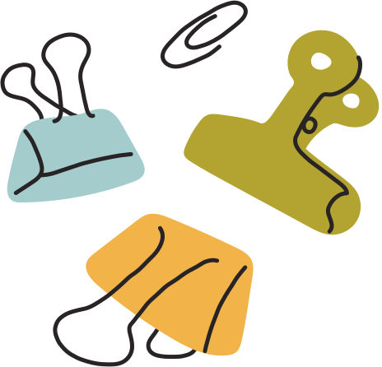




BOUNDS & ERRORS
IB Math AI SL
Topic 1: Number and Algebra
by @TUTORIO.MATH

Slide 2
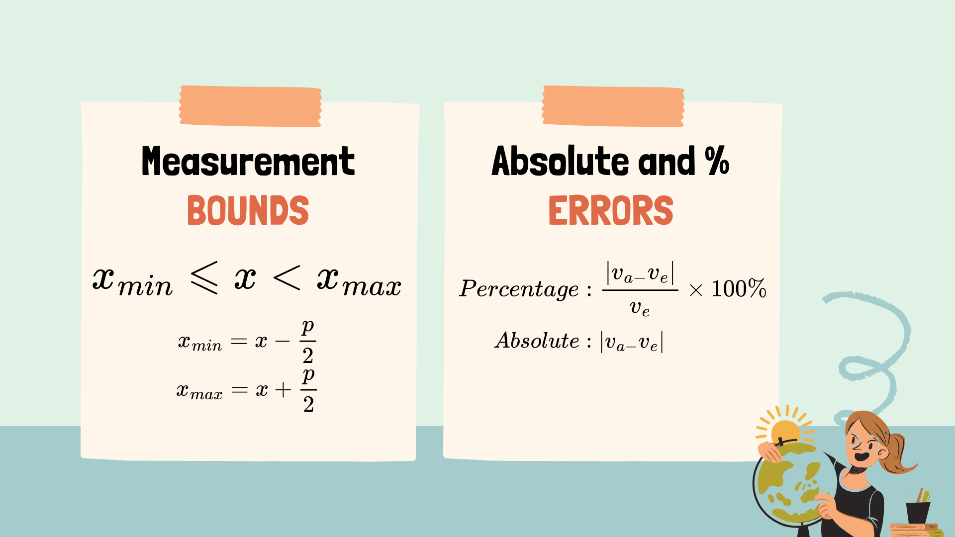

Slide 3



Practice 1
Ben measures a box as 15 cm x 12 cm x 8 cm, rounded to the nearest centimetre.
a. Use Ben’s measurements to estimate the box volume
The actual dimensions of the box are 15.2 cm x 11.9 cm x 8.2 cm
b. Find the actual volume of the box
c. Find the absolute and percentage error in Terry’s estimate

Slide 4
Practice 2
The radius of a circle is measured as 7 cm, rounded to the nearest centimetre.
a. Use this measurement to estimate the area of the circle
b. Find the boundary values for the area of the circle
c.Find the maximum percentage error in the estimate

