Slide 1
General Aptitude
Work & Time
By Priyanka Gurbani

Slide 2
Work & Time
Work from Days :
If A can do a piece of work in n days ,
then A's 1 day work = 1/n
Days from Work :
If A's 1 day work = 1/n,
then A can finish the total work in n days
Ratio:
If A is twice as good a workman as B, then:
Ratio of work done by A and B = 2 : 1
Ratio of times taken by A and B to finish a work = 1 : 2

Slide 3
Example 1
A can do a work in 6 days, B can do the same work in 3 days. How many days will they take to do the same work together?
Solution:
= A*B/ A+B
= 6*3/ 6+3
= 18/9 = 2 days

Slide 4
Example 2
Abhinav can do a work in 9 days, Abhinav and Banshi together can do the same work in 3 days. How many days will Banshi take to do the same work alone?
Solution:
Abhinav (A)= 9
Banshi (B) = ?
A*B/ A+B = 3
9* B/ 9+B = 3
9B = 27 + 3B
6B = 27
B = 4.5 days
Banshi will take 4.5 days to do the same work alone.

Slide 5
Example 3
3 men and 4 women can do a work in 19 days. How many days will 5 men and 6 women take to finish the same work?
Solution:
5 men and 6 women will take to finish the same work
= no of days/ [(5/3) + (6/4)]
= 19/ [(20+18)/12]
= 19/ [(38/12)]
= 6 days

Slide 6
Practice Question 1
A is twice as good as workman as B and therefore is able to finish a job in 30 days less than B. Working together, they can do it in how many days?
t(A) : t(B) = 1x : 2x.
time difference = (2 - 1) = 1x days
t(B) = 2 days and t(A) = 1 day.
For x work, B takes 2 days
30x, B takes (2/1 * 30) days = 60 days
A takes 60 – 30 = 30 days
A’s 1 day work = 1/30
B’s 1 day work = 1/60

Slide 7
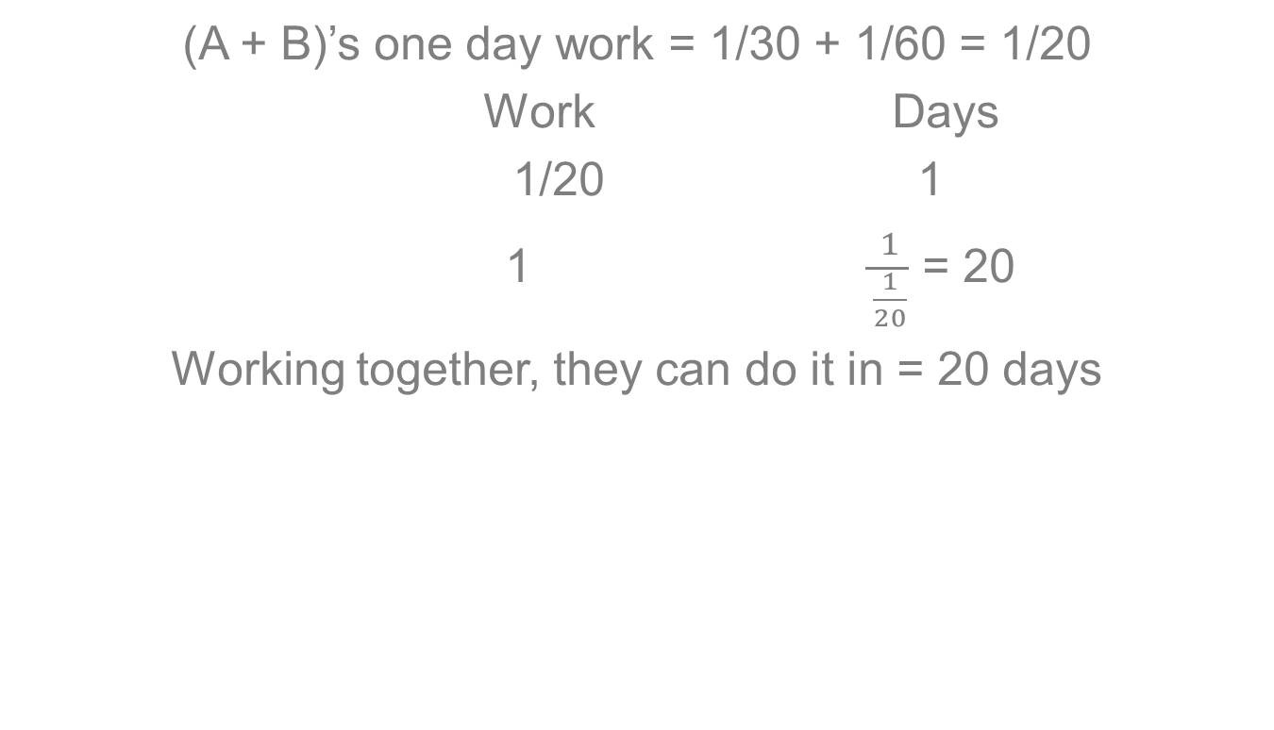
(A + B)’s one day work = 1/30 + 1/60 = 1/20
Work Days
1/20 1
1 $\frac{1}{\frac{1}{20}}$ = 20
Working together, they can do it in = 20 days

Slide 8
Practice Question 2
A can do a piece of work in 24 days and B can do the same job in 20 days. With help of C, they did the job in 8 days only. C alone can do the work in how many days?
(A+B+C)’s one day work = 1/8
A’s one day work = 1/24
B’s one day work = 1/20
C’s one day work = (A+B+C)’s work – (A + B)’s work
= 1/8 - (1/24 + 1/20)
= 1/8 – 11/120
C’s one day work = 4/120 = 1/30
C alone can do the work in 30 days.

Slide 9
Multiple Choice question 1
In the beginning, Ajay works at a rate such that he can finish a piece of work in 20 hrs, but he only works at this rate for 15 hrs. After that, he works at a rate such that he can do the whole work in 16 hrs. If Ajay is to finish this work during one period, how many hours will he take to finish this work?
(a) 16 hrs (b) 17 hrs (c) 18 hrs (d) 19 hrs
Solution:
Ajay’s 15 hr work = 15/20 = 3/4. Remaining work = 1 – 3/4 = 1/4.
Using work and time formula: Required Time = work to be done * Rate. This will be completed in 1/4 × 16 i.e. 4 hrs.
So, total time taken to complete work = 15 + 4= 19 hrs.

Slide 10
Multiple Choice question 2
A can do a piece of work in 10 days. B can do this work in 15 days. A started the work alone. After how many days should B join him, so that the work is finished in 8 days?
2 days (b) 3 days (c) 4 days (d) 6 days
Solution:
A's work in 8 days = 8/10 = 4/5.
Remaining work = 1- 4/5 = 1/5.
This work was done by B in 1/5 × 15 = 3 days.
B would have joined A after 8 – 3 = 5 days.

Slide 11
Multiple Choice question 3
A and B can do a piece of work in 30 days, B and C can do it in 45 days. If B alone can do it in 90 days, in how many days will A and C do it together?
30 days (b) 50 days (c) 45 days (d) 15 days
Solution:
A + B take 30 days. B alone takes 90 days.
∴ A will take 1/30 - 1/90 = 2/90 ⇒ 90/2 days = 45 days.
B + C take 45 days ∴ C alone will take 1/45 – 1/90 = 1/90
i.e. 90 days. ∴ A & C together will take 1/45 + 1/90
= 3/90 ⇒ 90/3 = 30 days to complete the work.

Slide 12
Multiple Choice question 4
A and B undertake to do a piece of work for $480. A alone can do it in 75 days and B alone can do it in 50 days. With the help of C, they finish it in 25 days. How much should C get for his contribution?
(a) $60 (b) $80 (c) $120 (d) $150 days
Solution: A & B would have done 25/75 & 25/50 of the work respectively in 25 days.
Together they have done 25/75 + 25/50 = 5/6th of the work. This implies that C has done 1 – 5/6 = 1/6thrr of the work. Thus, C should be paid 1/6th of the amount i.e. 480 × 1/6 = $80.

Slide 13
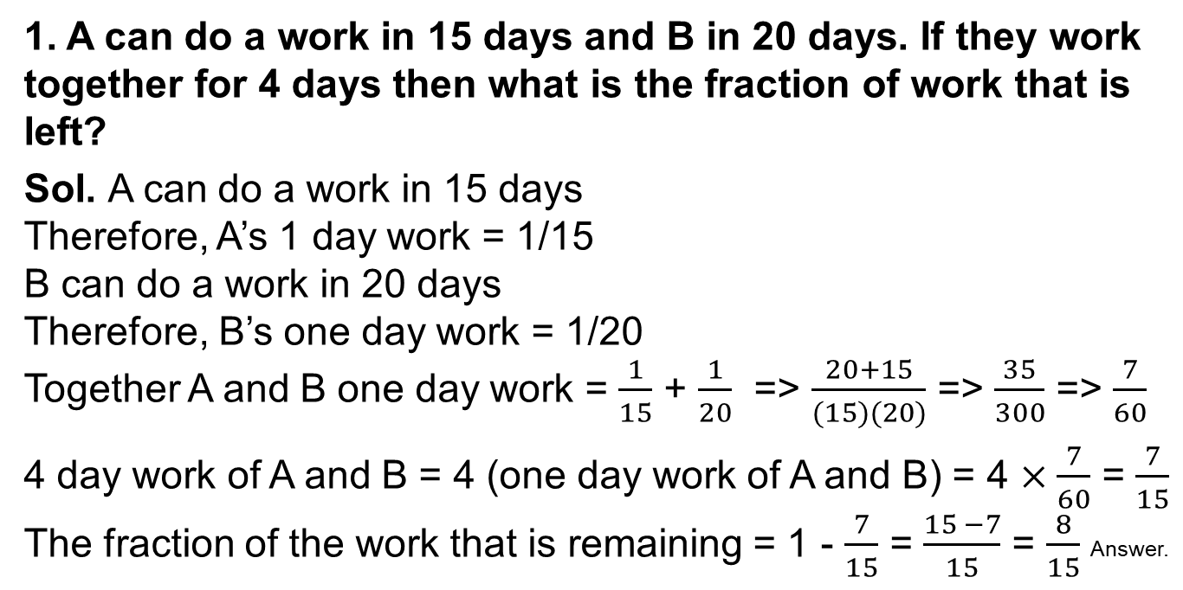
Question
1. A can do a work in 15 days and B in 20 days. If they work together for 4 days then what is the fraction of work that is left?
Sol. A can do a work in 15 days
Therefore, A’s 1 day work = 1/15
B can do a work in 20 days
Therefore, B’s one day work = 1/20
Together A and B one day work = $\frac{1}{15}$ + $\frac{1}{20}$ => $\frac{20+15}{(15)(20)}$ => $\frac{35}{300}$ => $\frac{7}{60}$
4 day work of A and B = 4 (one day work of A and B) = 4 $×\frac{7}{60}$ = $\frac{7}{15}$
The fraction of the work that is remaining = 1 - $\frac{7}{15}$ = $\frac{15 −7}{15}$ = $\frac{8}{15}$ Answer.

