Slide 1

Chapter 5
Lecture 9
Presented by:
Dr: Ibrahim Htita
Reference:- Fundamentals of Electric Circuits, Ch. 13
Charles K. Alexander | Matthew n. o. Sadiku

Slide 2

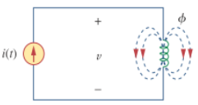

The voltage is induced in a circuit whenever the flux linking (i.e., passing through) the circuit is changing.
According to Faraday’s law, the voltage induced in the coil is proportional to the number of turns and time rate of change of the flux linkages

Slide 3
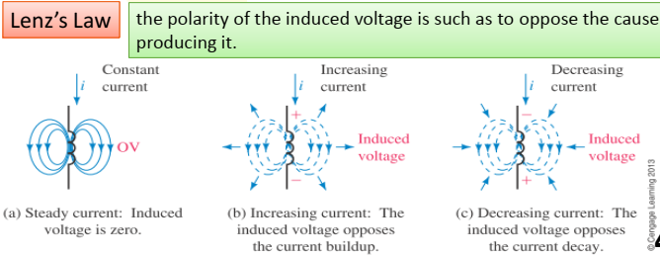

Slide 4



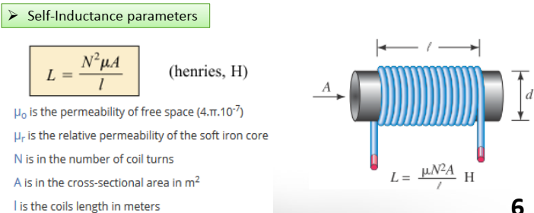

L is the self inductance of the inductor which carry current i

Slide 5
Introduction To Mutual Inductance :-
When two loops with or without contacts between them affect each other through the magnetic field generated by one of them, they are said to be magnetically coupled.
The transformer is an electrical device designed on the basis of the concept of magnetic coupling. It uses magnetically coupled coils to transfer energy from one circuit to another.
Transformers are used in power systems for stepping up or stepping down AC voltages or currents.

Slide 6
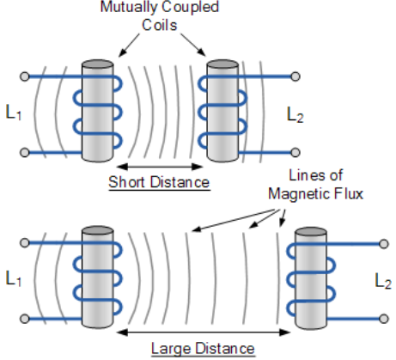
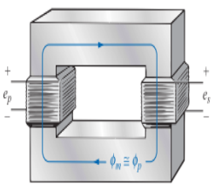
These devices use magnetically coupled coils to transfer energy from one circuit to another.

Slide 7
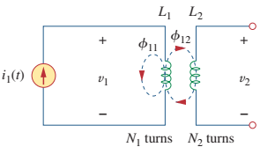
Mutual Inductance
When two inductors (or coils) are in a close proximity to each other, the magnetic flux caused by current in one coil links with the other coil, thereby inducing voltage in the other coil.
This phenomenon is known as mutual inductance.
Assume that the second inductor carries no current.
The magnetic flux emanating
from coil 1 has two components: One component links only coil 1, and another component links both coils. Hence

Slide 8







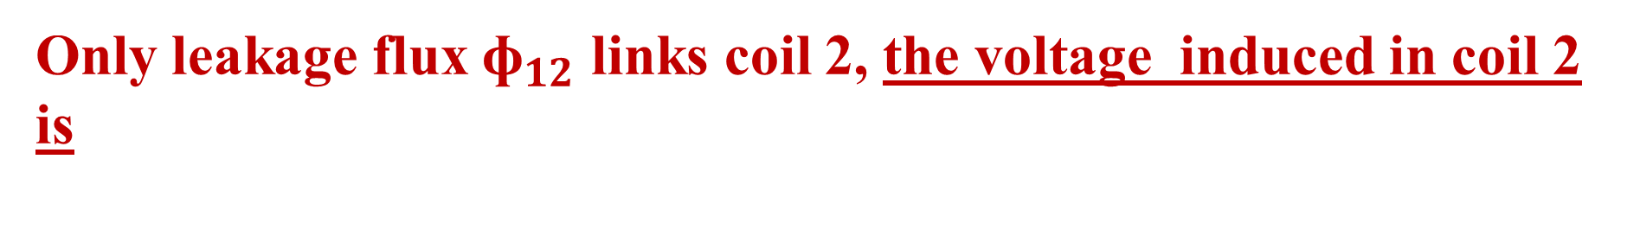
Linkage Flux + Leakage Flux
Since the entire flux links coil ${\text{ɸ}}_{11}$, the voltage induced in coil 1 is
induced voltage in coil 1 can written be
Where,
Only leakage flux ${\text{ɸ}}_{12}$ links coil 2, the voltage induced in coil 2 is
induced voltage in coil2 can written be

Slide 9

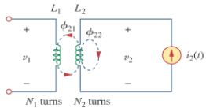
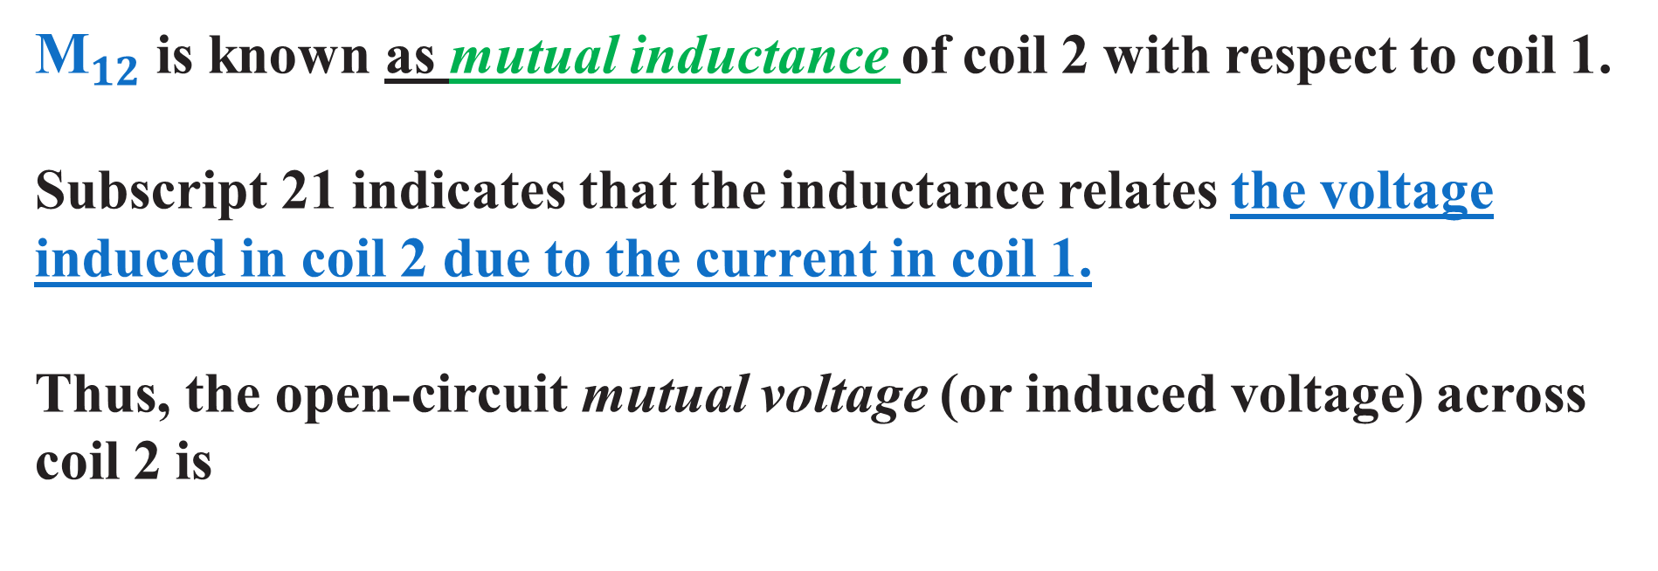
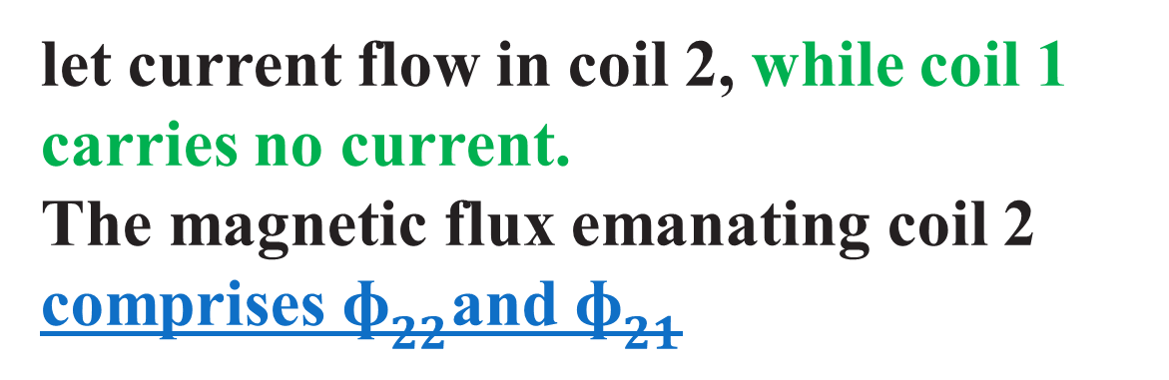
${\text{M}}_{12}$is known as mutual inductance of coil 2 with respect to coil 1.
Subscript 21 indicates that the inductance relates the voltage
induced in coil 2 due to the current in coil 1.
Thus, the open-circuit mutual voltage (or induced voltage) across coil 2 is
Similarly
let current flow in coil 2, while coil 1 carries no current.
The magnetic flux emanating coil 2 comprises ${\text{ɸ}}_{22}$and ${\text{ɸ}}_{21}$

Slide 10




The voltage induced in coil 1 due to the current in coil 2
Note:-
Mutual inductance is the ability of one inductor to induce a voltage across a neighboring inductor, measured in henrys (H)

Slide 11
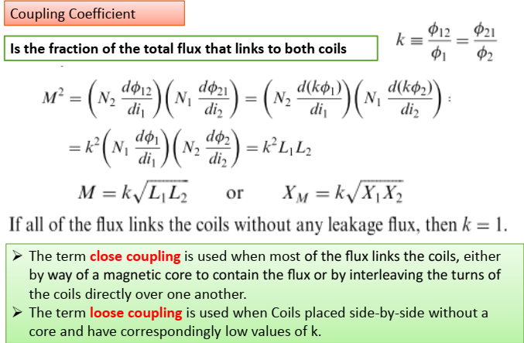

Slide 12
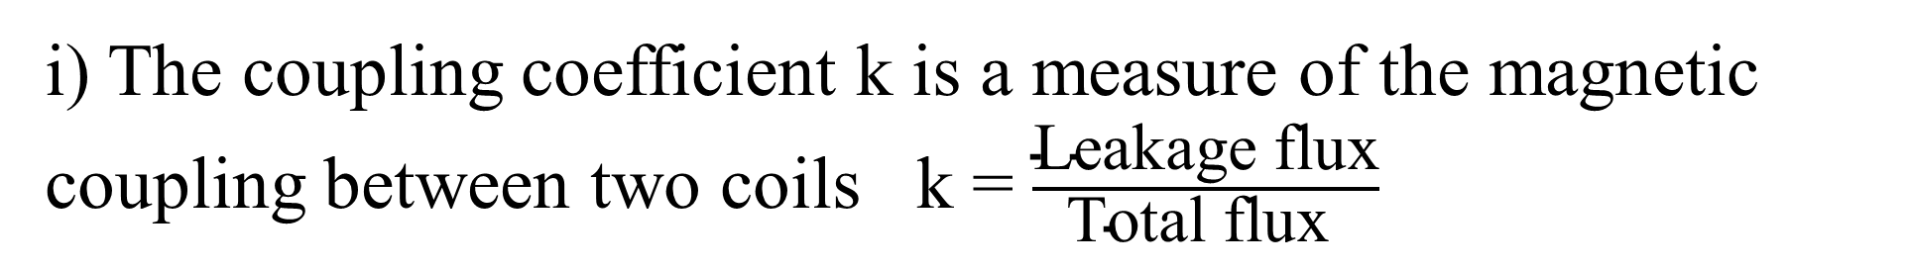
Coefficient of coupling
i) The coupling coefficient k is a measure of the magnetic coupling between two coils k = $\frac{\text{Leakage} \text{flux}}{\text{Total} \text{flux} }$
ii) For ideal circuits K = 1 (Maximum Coupling)
iii) For isolated circuit K = 0
iv) For practical circuit it is always lower than 1
k < 0.5 loosely coupled;
k > 0.5 tightly coupled.

Slide 13
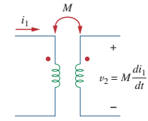
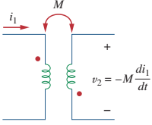
The dot convention roles
If a current enters the dotted terminal of one coil, the reference polarity of the mutual voltage in the second coil is positive at the dotted terminal of the second coil.

Slide 14
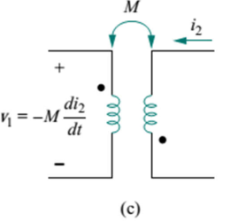
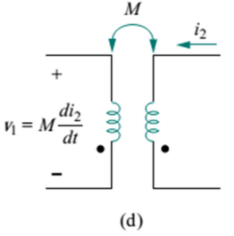
Alternatively,
If a current leaves the dotted terminal of one coil, the reference polarity of the mutual voltage in the second coil is negative at the dotted terminal of the second coil

Slide 15
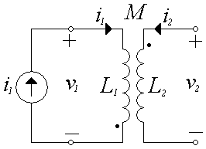
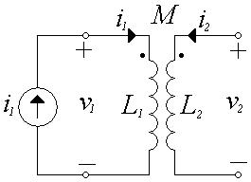
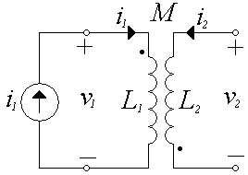
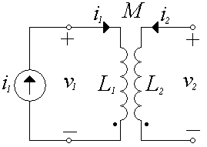
Positive at the dotted terminal
Negative at the dotted
terminal

Slide 16
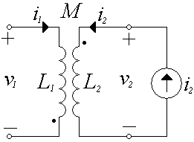
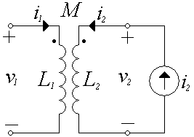
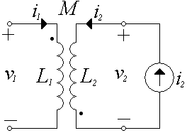
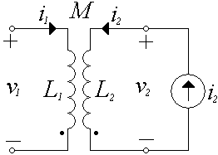
Positive at the dotted terminal

Slide 17
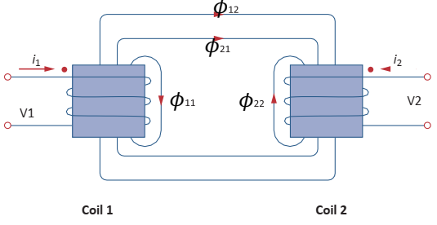
Operation with both currents flow in coil 1, and coil 2,
Note:- both currents
are enter the dot.
We use superposition

Slide 18
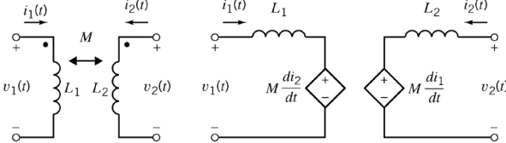
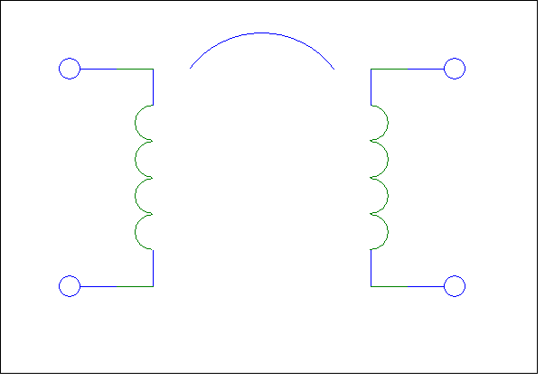
Dot convention and equivalent circuit

Slide 19
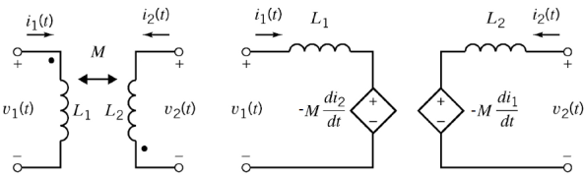
Next consider the two inductors are opposing each other, the equivalent circuit is the same however this time dependent sources are with a negative sign:

Slide 20
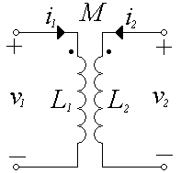
Mutual Inductance (Equivalent Circuits)
الأشارة الموجبة تعني الجهد المتبادل يعاكس التيار
الأشارة سالبة تعني الجهد المتبادل يساعد التيار

Slide 21
Dot convention
الأشارة سالبة تعني الجهد المتبادل يساعد التيار

Slide 22
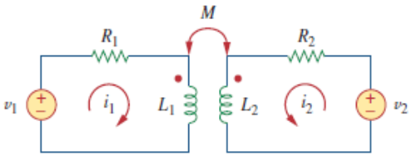



Analyze Circuits Involving Mutual Inductance
For the frequency domain circuit shown.
Applying KVL to coil 1 gives
Applying KVL to coil 1 gives
The above two equations can be written in the frequency domain as:

Slide 23
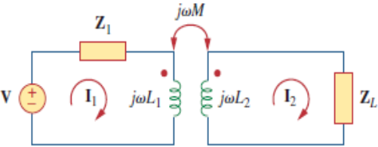


Also applying KVL to coil 1 gives in figure below:-
applying KVL to coil 2 gives:-

Slide 24
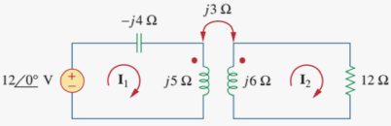
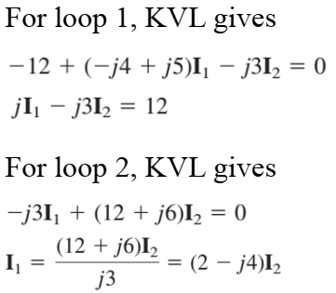
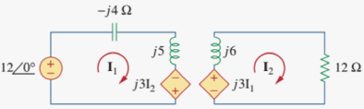
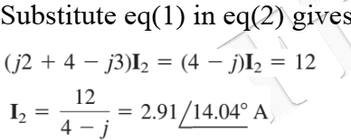
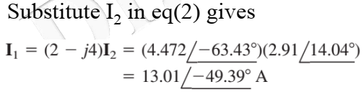

Example 1:- Calculate the phasor currents $I_{1}$ and $I_{2}$ in the circuit
Answer

Slide 25
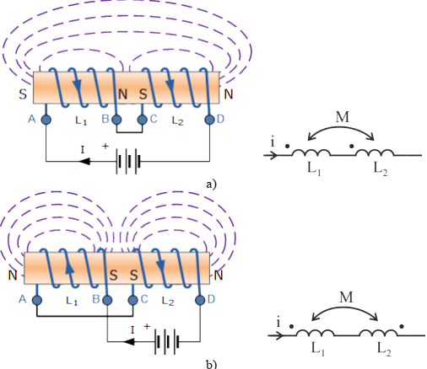
Series Connection of Coils
Series-aiding connection
Series-opposing connection
Mutually coupled inductors and dot convention: a) series aiding inductors; b) series
opposing inductors.

Slide 26
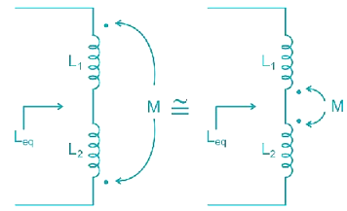
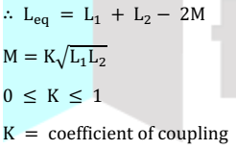
Series Connection of Coils
1
2
1
2
M
M
(a)mutually coupled coils in series-aiding connection
(b)mutually coupled coils in series–opposing connection
Total inductance
L_{T}=L₁+L₂-2M
L_{T}=L₁+L₂+2M

Slide 27
Parallel Connection of Coils
+
I
M
+
I
M
V
L₁
L₂
V
L₁
L₂
(a)mutually coupled coils in parallel-aiding connection
(b)mutually coupled coils in parallel–opposing connection
Equivalent inductance
At M =0

Slide 28
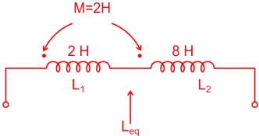
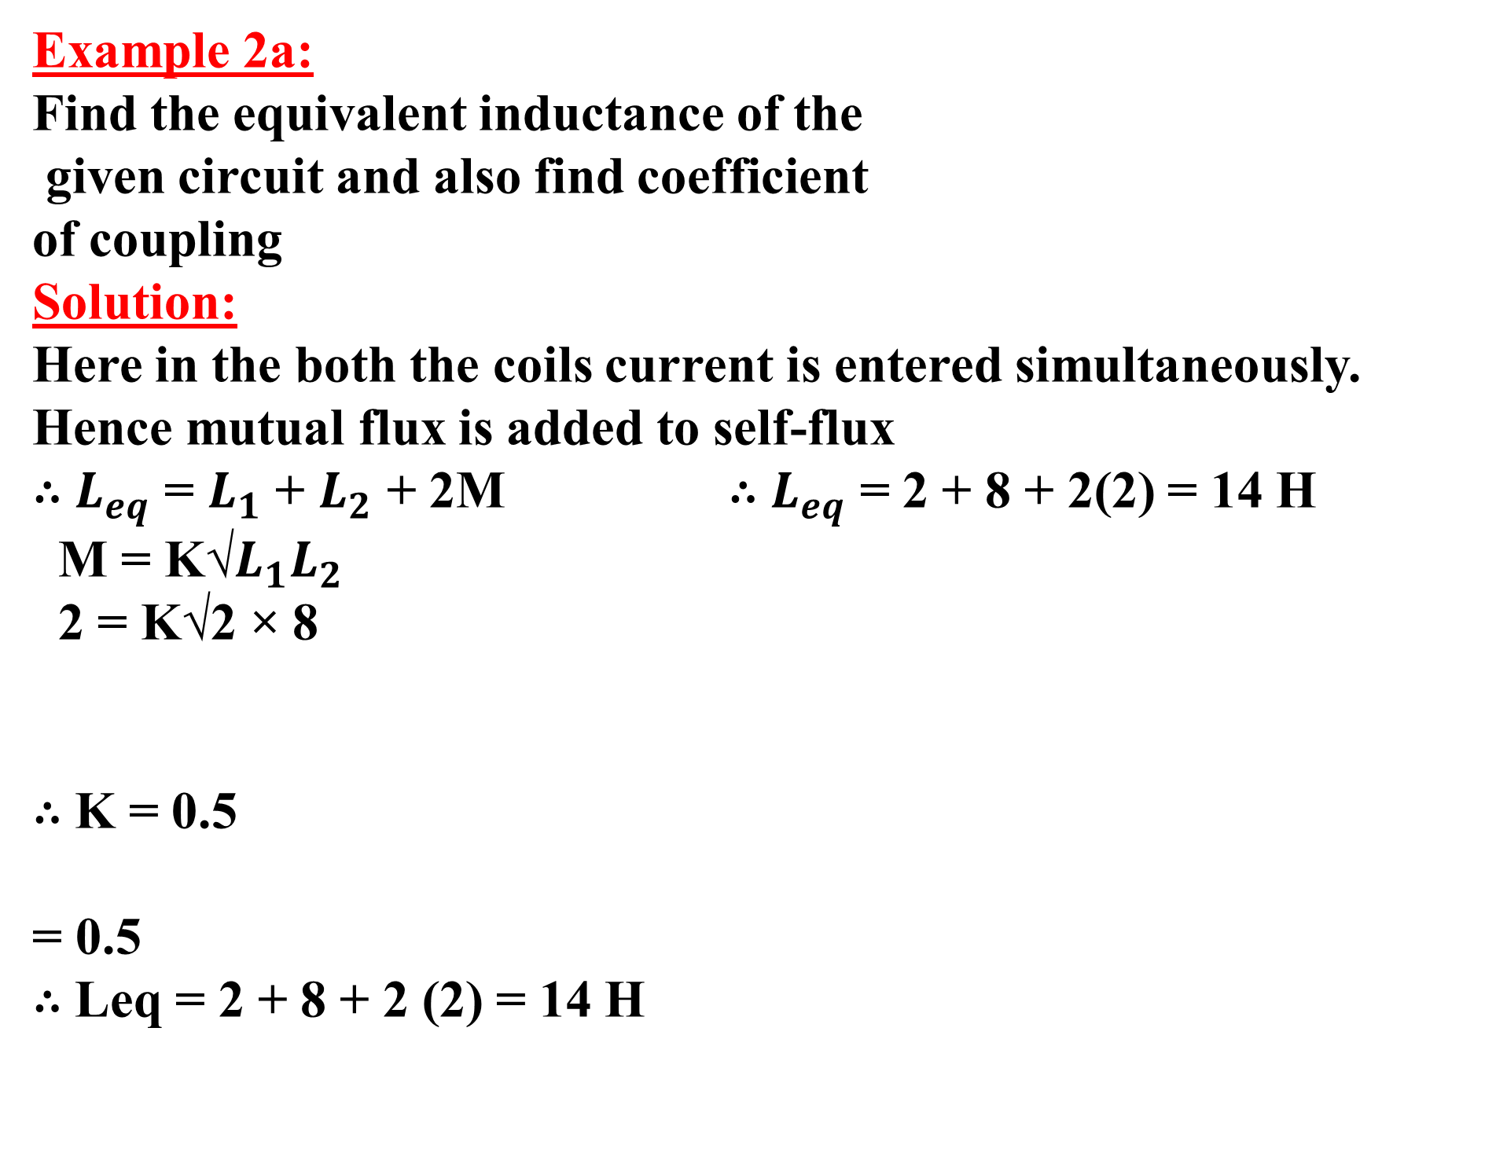
Example 2a:
Find the equivalent inductance of the
given circuit and also find coefficient
of coupling
Solution:
Here in the both the coils current is entered simultaneously. Hence mutual flux is added to self-flux
∴ $L_{eq}$ = $L_{1}$ + $L_{2}$ + 2M ∴ $L_{eq}$ = 2 + 8 + 2(2) = 14 H
M = K√$L_{1}L_{2}$
2 = K√2 × 8
∴ K = 0.5
= 0.5
∴ Leq = 2 + 8 + 2 (2) = 14 H

Slide 29
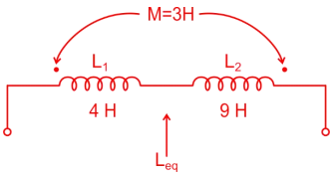
Example 2b:
Find the equivalent inductance of the
given circuit. Also find coefficient of
coupling and leakage factor.
Solution:
Here in the first coil current is entering and in the second coil current is leaving. So here mutual flux is opposing the self-flux.
∴ L_{eq}=L₁+L₂-2M = 4 + 9 – 2(3) = 13 – 6 = 7H
M = K√L₁L₂
3 = K√4 × 9 = 6K ∴ K = 0.5

Slide 30
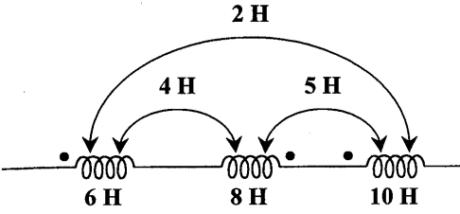
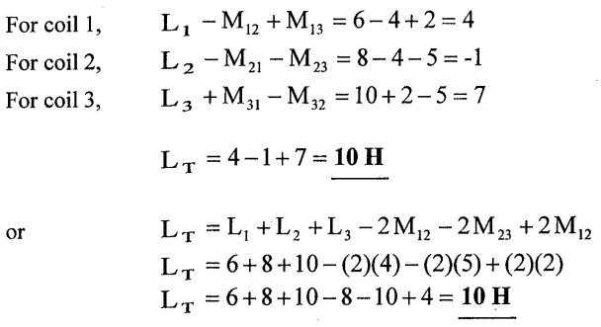
Example 3:- For the three coupled coils, calculate the total inductance
Solution:
13

