Slide 1

Functions and Their Properties
This presentation explores the fundamental concepts of functions, from their basic definition and notation to their diverse properties and applications. We'll delve into key characteristics like domain, range, and transformations, and explore families of functions, focusing specifically on linear and quadratic functions.
OI
by ONYEDIKA IK

Slide 2
Introduction to Functions
Definition
Examples
A function is a relationship between two sets of values, called the input (domain) and output (range). Each input value is associated with exactly one output value.
Think of a vending machine. Input is your money, output is the snack you get. Each button has a unique product. This demonstrates the "one-to-one" rule of functions.

Slide 3
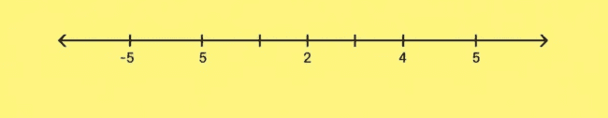
Domain and Range
Domain
Range
Example
The set of all possible input values of a function. It's what you can put into the function.
The set of all possible output values of a function. It's what the function can produce.
If a function takes a person's age as input and outputs their height, the domain is ages, the range is heights.

Slide 4
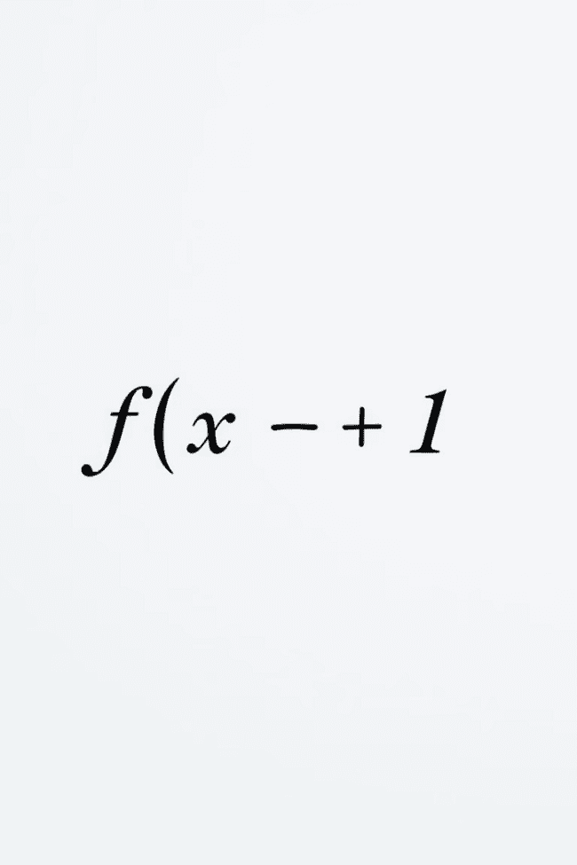



Function Notation
f(x)
The notation 'f(x)' represents a function named 'f' that takes an input value 'x'. This is read as "f of x".
x
'x' is the input variable. It can represent any value within the function's domain.
f(x) = ...
The expression after the equals sign defines the rule or calculation that transforms the input 'x' into the output 'f(x)'.

Slide 5
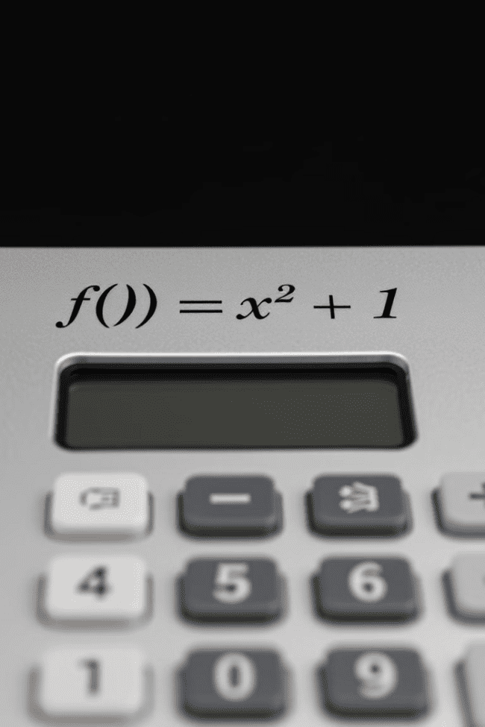
Evaluating Functions
1
Substitute
Replace the input variable 'x' in the function's formula with the given value.
2
Simplify
Perform the operations indicated by the formula to calculate the output value.
3
Example
For f(x) = x^2 + 1, to find f(2), substitute 'x' with '2', so it becomes 2^2 + 1 = 5. Thus, f(2) = 5.

Slide 6



Graphs of Functions
Visual Representation
1
A function's graph shows the relationship between its input and output values. Each point on the graph corresponds to an input-output pair.
Horizontal Axis
2
Represents the input values (domain).
Vertical Axis
3
Represents the output values (range).

Slide 7
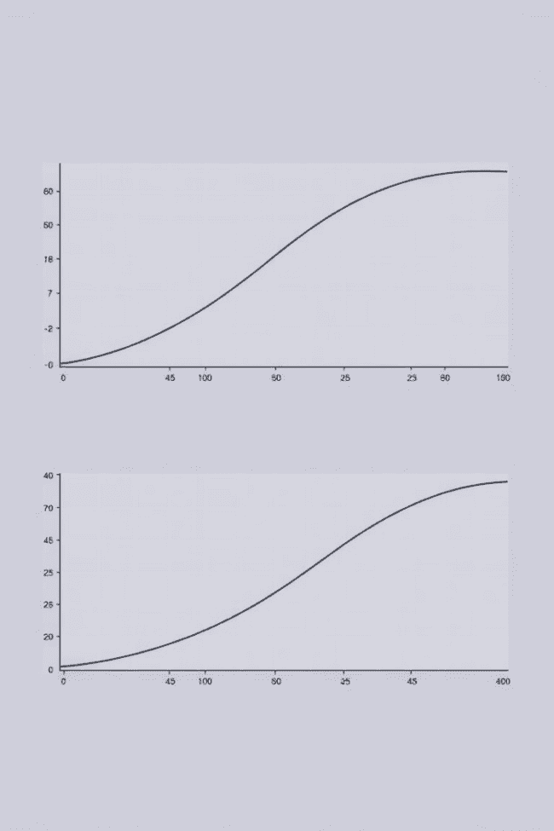



Transformations of Functions
Shifting
Moving the graph up or down, left or right. Adding or subtracting constants from the input or output value.
Stretching
Changing the steepness of the graph by multiplying the input or output value by a constant.
Reflecting
Flipping the graph across an axis. Multiplying the input or output value by -1.

Slide 8
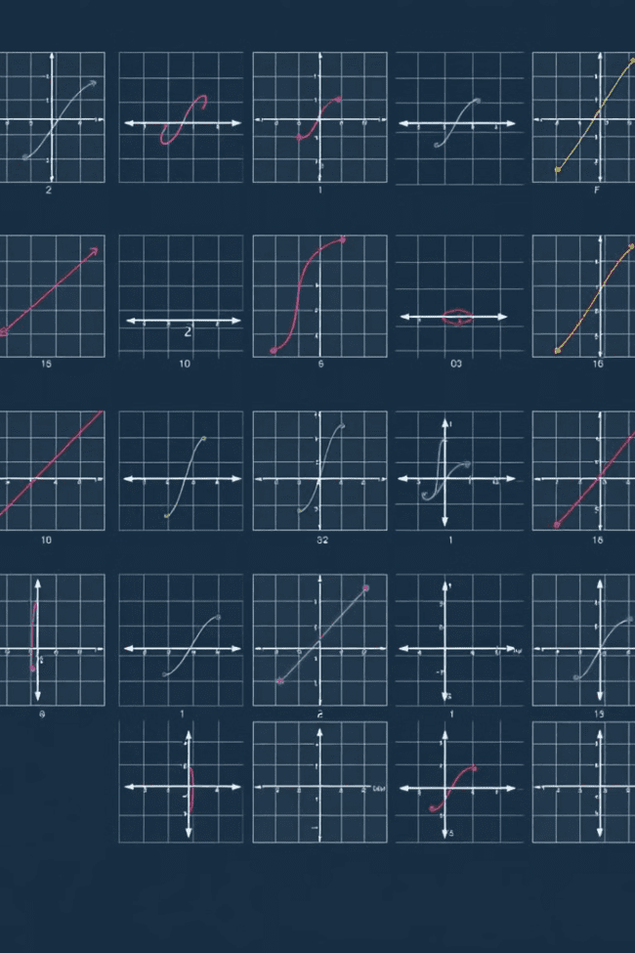
Families of Functions
1
Linear
Straight lines, represented by equations like y = mx + b.
2
Quadratic
Parabolas, represented by equations like y = ax^2 + bx + c.
3
Exponential
Curved graphs with a constant growth factor, represented by equations like y = ab^x.

Slide 9
Linear Functions and Their Properties
Constant Rate of Change
1
The slope of a linear function represents the constant rate at which the output changes with respect to the input.
Y-Intercept
2
The point where the line crosses the y-axis. It represents the output value when the input is zero.
Applications
3
Linear functions are used to model relationships with a constant rate of change, like speed, distance, or cost.

Slide 10




Quadratic Functions and Their Properties

