Slide 1
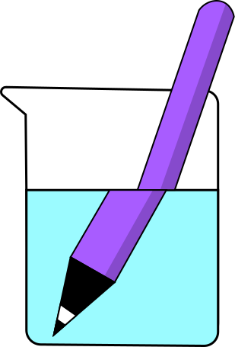
REFRACTION
Why do things look bent in water?

Slide 2
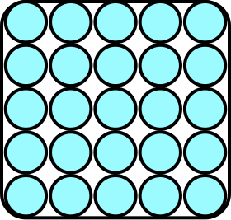
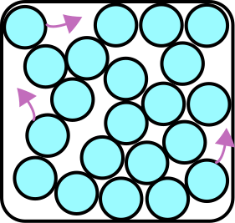
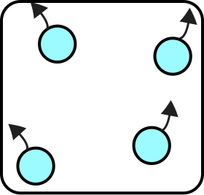
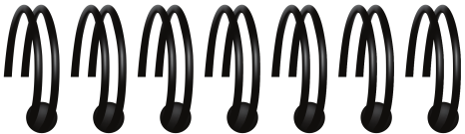
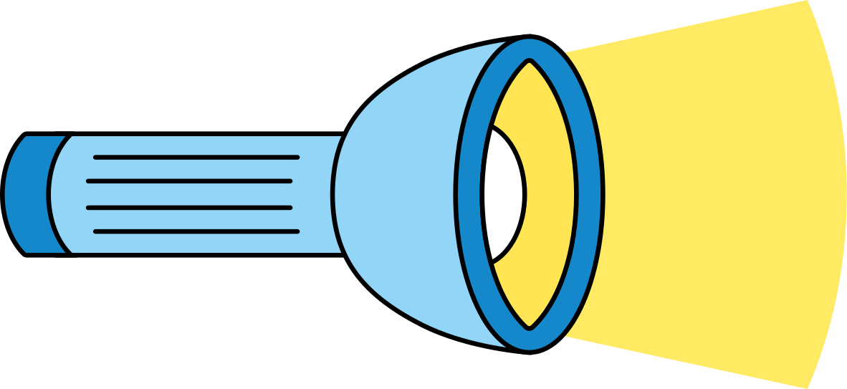
Checking understanding
What do you know about bending of light?
  Label the particles in a solid, liquid and gas.
  Explain how easily light can travel through each type of medium.
Activity
gas
solid
liquid
Investigation

Slide 3
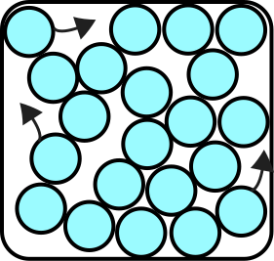
Checking understanding
What do you know about bending of light?
solid
liquid
gas
Activity
Gas - particles are spread out, allowing light to move quickly
Liquid - Particles are closer together, so light slows down a bit.
Solid: - Tightly packed particles so light slows down significantly.
Investigation

Slide 4
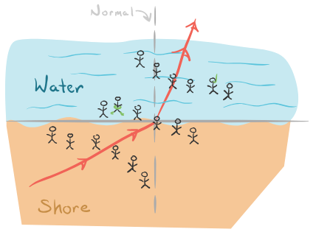

WHAT IS REFRACTION?
Refraction is when light changes direction because its speed changes
Think of a car moving from a smooth road to mud—it slows and changes direction!

Slide 5
EXPERIMENT: THE BENT PENCIL
Activity: Put a pencil in a clear glass of water and look from the side. What do you see?

Slide 6
EXPERIMENT: THE BENT PENCIL
Activity: Put a pencil in a clear glass of water and look from the side. What do you see?
Explanation: "The pencil looks bent because light bends when moving from air to water."

Slide 7
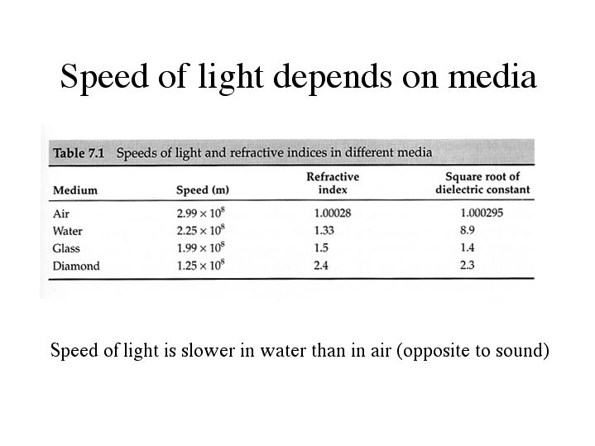
WHY DOES LIGHT BEND?
Light moves at different speeds in different materials.
It slows down in water.
solid
liquid
gas
Gas - particles are spread out, allowing light to move quickly
Liquid - Particles are closer together, so light slows down a bit.
Solid: - Tightly packed particles so light slows down a lot.

Slide 8

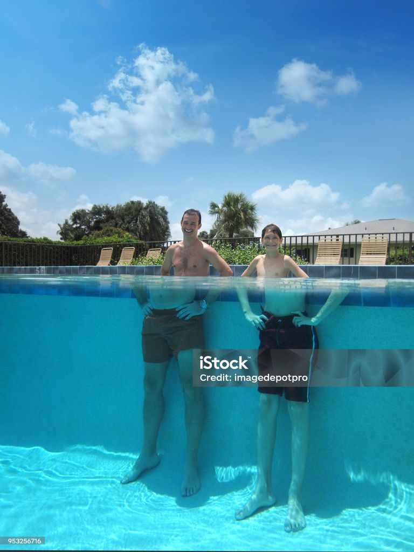

REAL-LIFE EXAMPLE: SWIMMING POOL
Ever noticed how people’s legs look weird underwater? That’s refraction!

Slide 9

ANOTHER EXPERIMENT: THE ARROW TRICK
Draw two arrows on paper
in same direction,
place a glass of water in front, and look through it.
What happens?

Slide 10
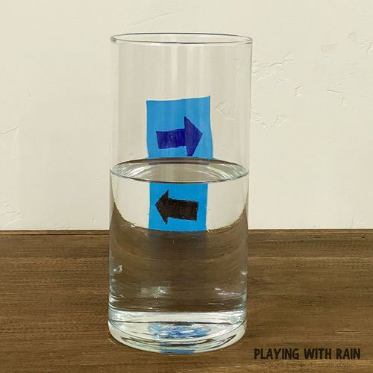
ANOTHER EXPERIMENT: THE ARROW TRICK
Draw two arrows on paper
in same direction,
place a glass of water in front, and look through it.
What happens?
The arrow appears reversed because light bends in water.

Slide 11

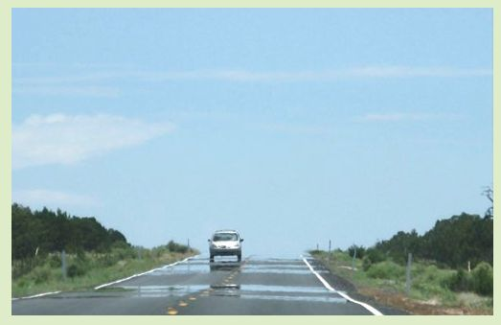

MIRAGES AND REFRACTION
Have you seen water on a hot road that disappears when you get closer? That’s a mirage!
Mirages happen because light bends when it moves through layers of hot and cool air. This makes it look like water is on the road, but it’s just light bending!

Slide 12
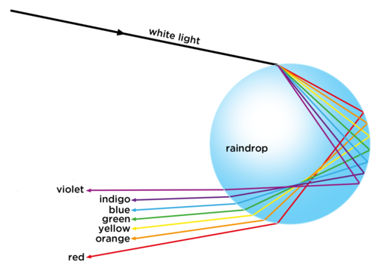
REFRACTION IN NATURE
Rainbows form because light refracts inside raindrops.

Slide 13

Refraction happens when light changes speed.
It makes objects look bent or distorted.
Refraction creates rainbows and mirages.

Slide 14
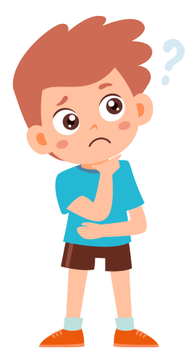
FUN QUESTION!
  "Why does a spoon in water look bent?"
  "Can you think of other examples of refraction?"

