Slide 1
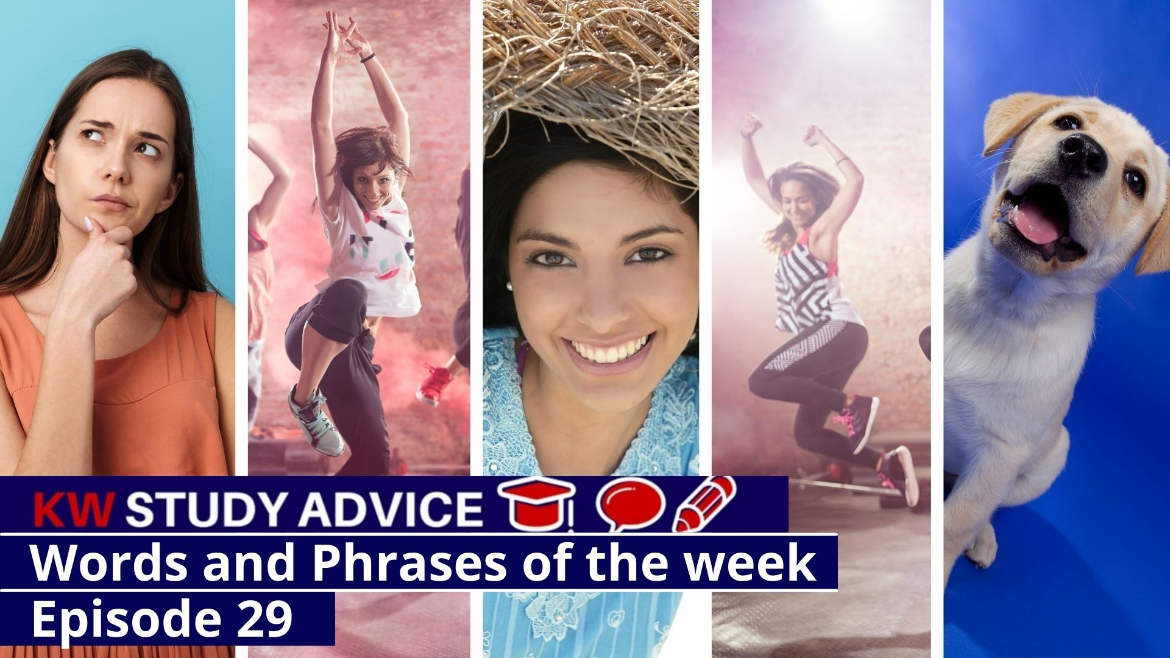
Ponder
Cheeseboard
Putting the World to Rights
Zumba
Radiant
Giddy

Slide 2
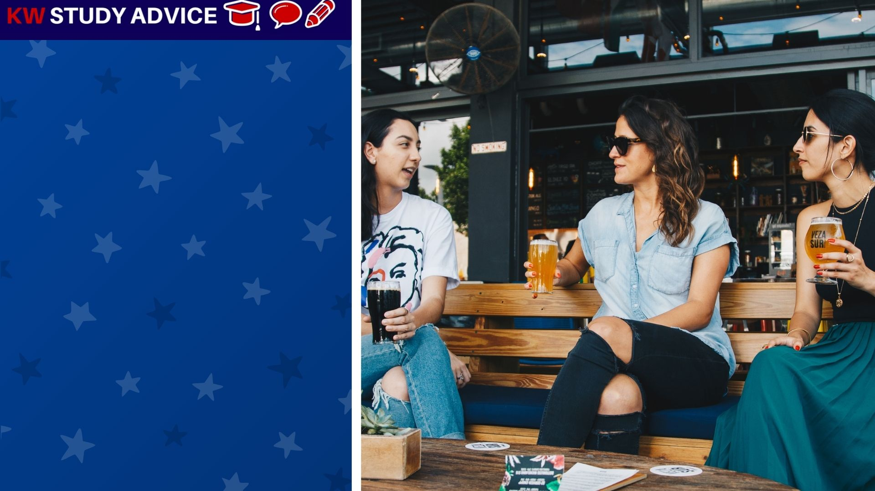
Putting the World to Rights
This is when people chat and discuss how they would solve all of the world’s issues. They use their views to make suggestions.
The girls met in the café for a chat and began to put the world to rights. They felt that poor people should be supported

Slide 3
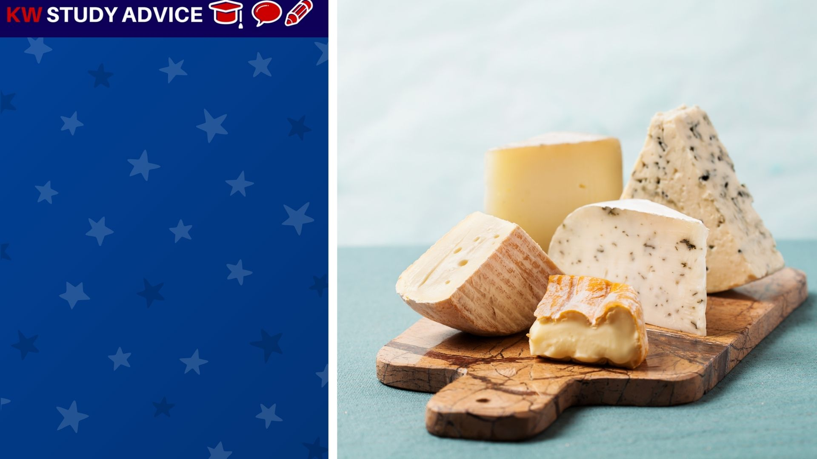
Cheeseboard
A group of cheeses served on a board as part of a main meal. This may be before or after the main course of the meal.
The family bought a selection of different cheeses from the supermarket. They cut them all up and served on a board.

Slide 4
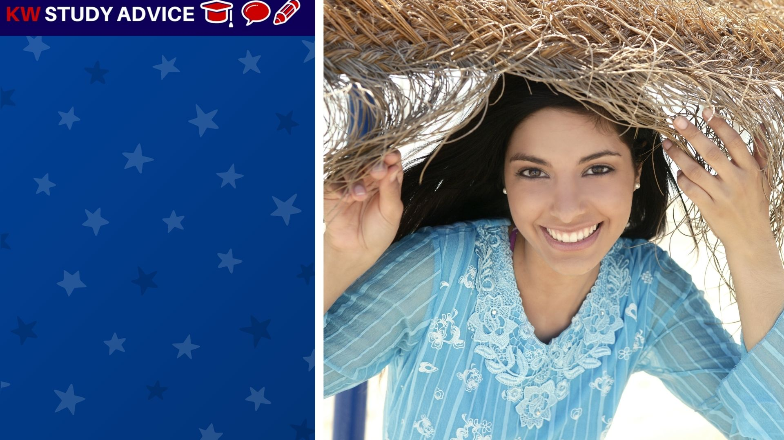
Radiant
This is when someone shows an expression displaying happiness and good health. This is most often used to describe women.
The woman displayed a beautiful radiant smile on the beach. She was so happy to be enjoying her summer holiday on the beach.

Slide 5
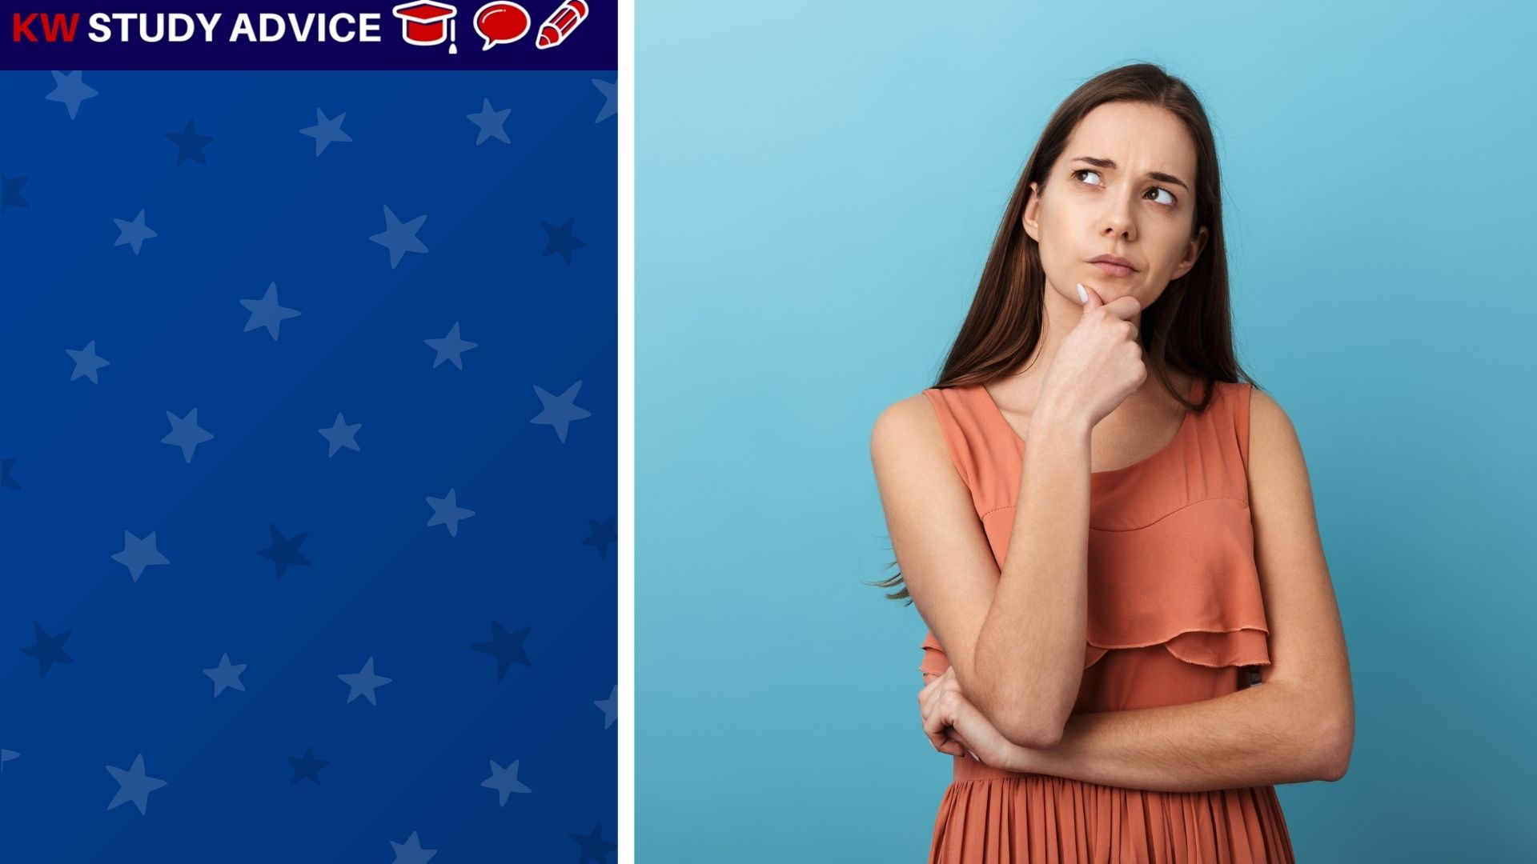
Ponder
To think about a decision in great depth before coming to a final decision. These a are often important decisions to make.
The woman had an important decision to ponder. She had been offered two different jobs. She had to choose only one job.

Slide 6
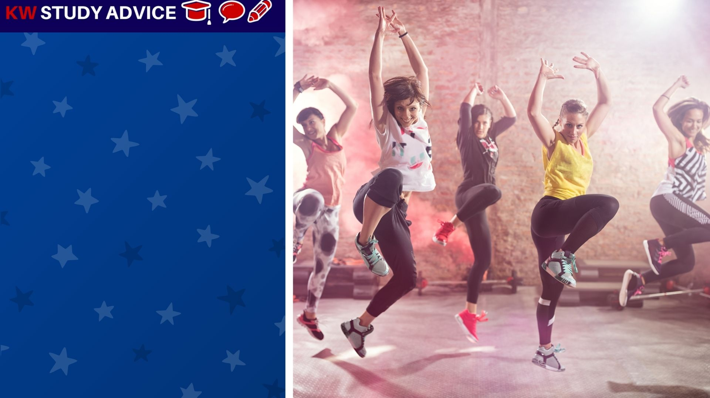
Zumba
A dance exercise where people do Latin American dancing to music. It is a fast dance style, great for improving fitness
The group did weekly Zumba dance sessions to improve their sessions. After 6 months they became great dancers and super fit.

Slide 7
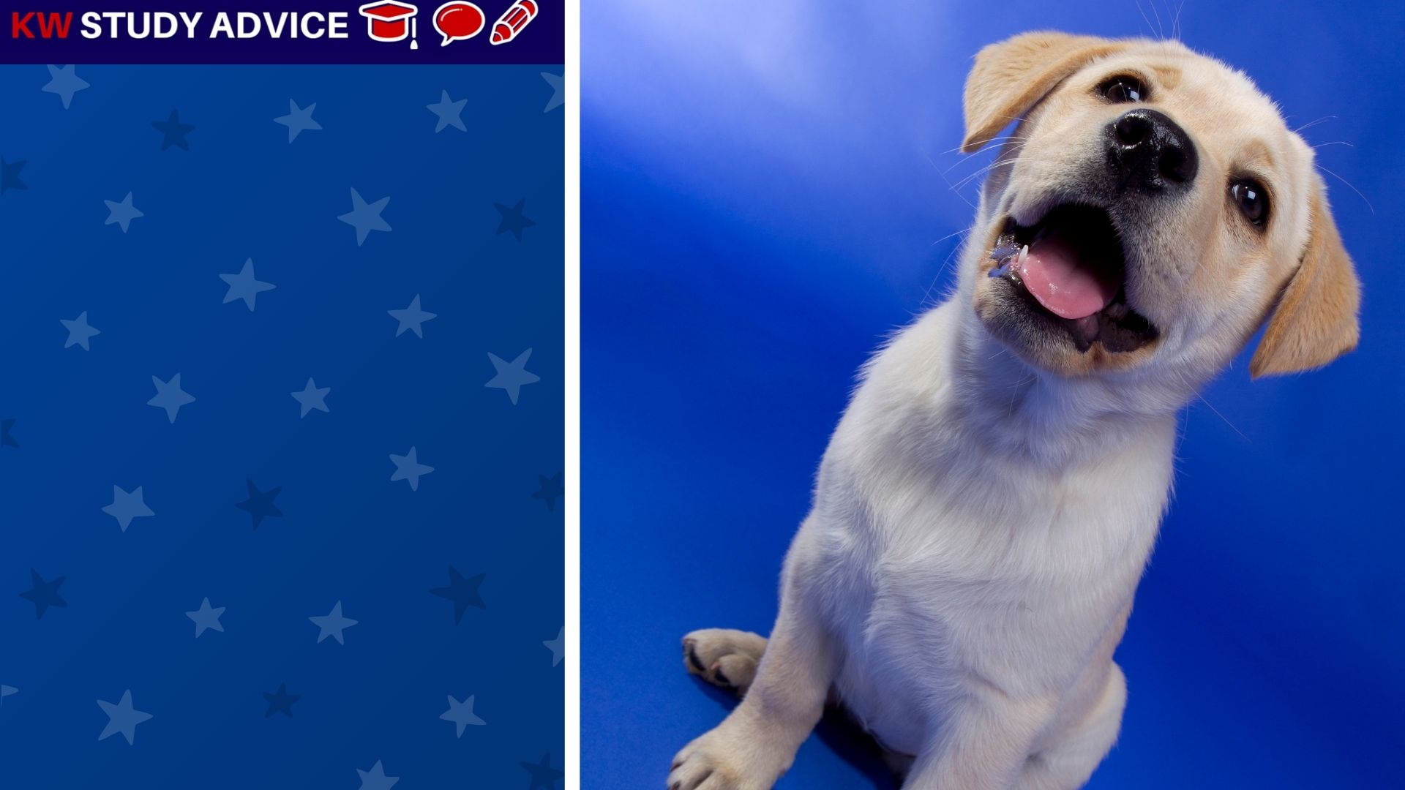
Giddy
When something or someone becomes very excited, so much so that they lose control of themselves. They show great happiness.
The little puppy became giddy when he saw his owners come back home. He ran to them, wagged his tail and rolled around.

Slide 8
