Slide 1
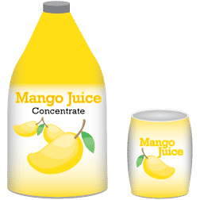
What is the difference between the two juices?

Slide 2
Solubility
A solvent can only dissolve a certain amount of solute. Solubility gives us a measure of how much a solute can dissolve in a solvent.
Solubility is the maximum amount of solute in grams that will dissolve in 100 g of solvent at a given temperature and pressure.

Slide 3
Insoluble – substances which do not dissolve in water like sand are called insoluble materials (other example are oil, glass, ethanol)
Soluble – materials like salt and sugar are called soluble as they dissolve completely in water

Slide 4
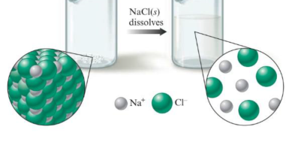
For example, the solubility of a sodium chloride in water at a temperature of 20℃ is 38 g per 100 g of water. This means that a maximum of 38 g of sodium chloride can dissolve in 100 g of water at 20℃. The solution produced is a saturated solution.

Slide 5
The solubility of a solute depends on the
Nature of solvent
Nature of solute
Temperature
Pressure

Slide 6
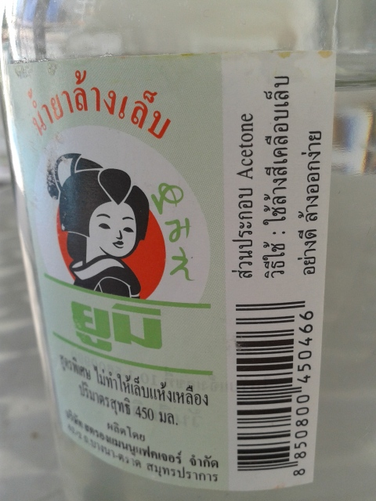
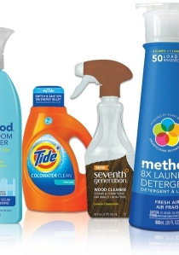
Nature of Solvent
a. Other than water, there are many more solvents such as alcohol, ether and acetone.

Slide 7
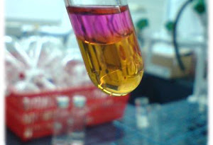
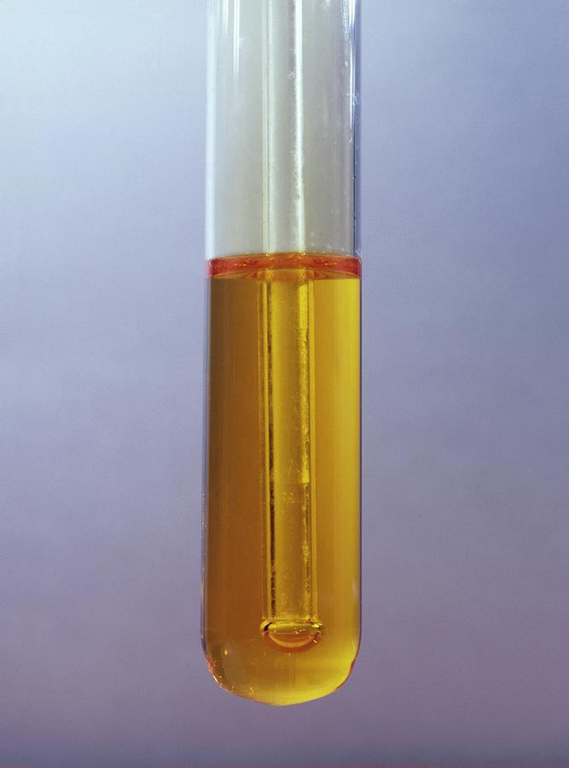
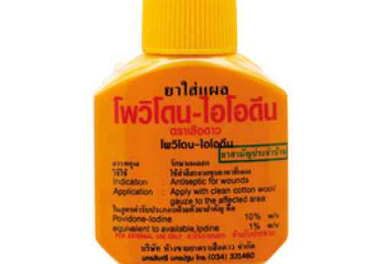
b. The solubility of a solute varies in different solvents. A solute may be soluble in a particular solvent but insoluble in another solvent. For example,
(i) salt dissolves readily in water but not in solvents like alcohol or ether.
(ii) iodine is almost insoluble in water but dissolves very well in alcohol

Slide 8
Nature of Solute
Different solutes have different solubilities in a given solvent. The table below shows the solubility of a few solutes in water at 20℃.
Solubility of some solutes in water
Based on the above table, at 20℃, potassium nitrate is more soluble in water than copper (II) sulfate. Among the three solutes, sodium chloride is most soluble in water.
Solute | Solubility (grams per 100 g of water) at 20℃
Copper (II) Sulfate | 20
Potassium Nitrate | 30
Sodium Chloride | 38

Slide 9
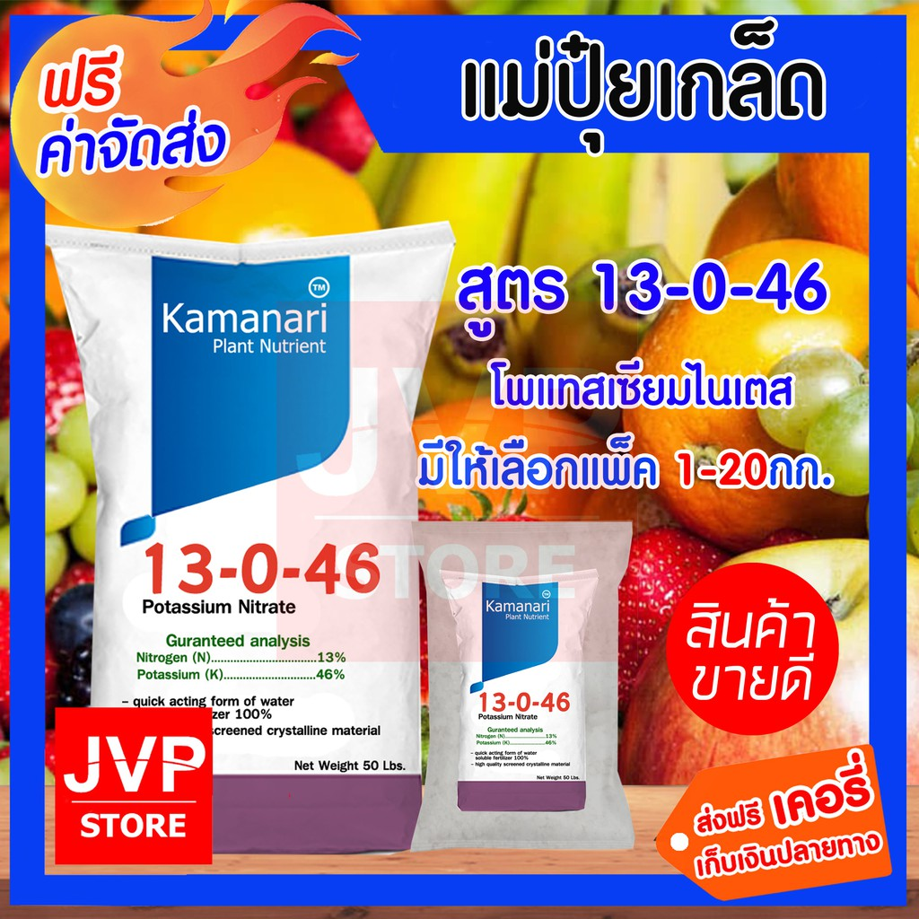
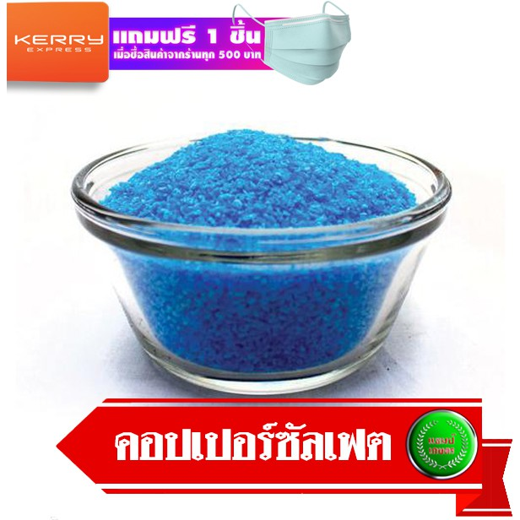

Slide 10
Temperature of the solution or solvent
Generally, the solubility of solids in liquid solvent increases with temperature but the solubility of gases in liquid solvents decreases with temperature. For example, twice as much sugar dissolves in hot water than in a room temperature.

Slide 11
Pressure
For solid and liquid solutes, changes in pressure have no effect on the solubility. For gaseous solutes, an increase in pressure increases the solubility and a decrease in pressure decreases the solubility. Carbonated drinks are formed when carbon dioxide is pressurized above the drinks in can. When the pressure is released, the gas quickly comes out of the drink.

Slide 12
For the following solutions, which chemical is the solvent?
2 ounces of oil and 2 gallons of gasoline
Carbon dioxide and water (in carbonated water)
70 ml of isopropyl alcohol and 30 ml of water (in rubbing alcohol)
25% Ni and 75% Cu (in coinage nickel)
(a) Gasoline is the solvent; there is more of it present in the solution
(b) Water is the solvent; it is present in the greater amount and its physical state is retained.
(c) Isopropyl alcohol is the solvent; it is present in the greater amount.
(d) Copper is the solvent in coinage nickel, which is 75% Cu

Slide 13
Science Terms to Remember!
Two liquids that dissolve in each other are said to be miscible. Example is water and ethanol.
If they do not dissolve in each other when mixed, they are immiscible. Example is oil and water.
When a substance does not appear to dissolve in a solvent, it is said to be insoluble. Put an iron nail in a beaker of water. There is no apparent change. We say that the iron nail is insoluble in water.

Slide 14
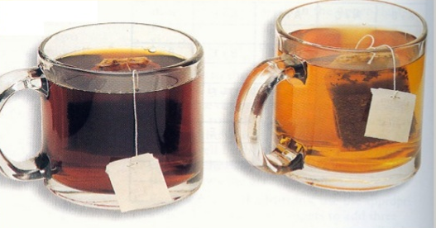
How would you describe this picture?
Concentration - a ratio comparing the amount of solute to the amount of solution
Concentrated
Dilute
Concentrated solutions contain large amount of solute while dilute has small amount of solute.

Slide 15



Concentration of solutions – there are three types of percentage concentrations used.
Mass/mass percentage (m/m%)
The mass/mass percentage is calculated as the percentage of the mass of the solute related to the total mass of the solution.
Mass/mass percentage =
This type of concentration is commonly used in solutions with solid solutes.

Slide 16









Example:
What is the mass/mass percentage of glucose in a solution made by dissolving 3.6 g of glucose in 140.2 g of water?
Solution:
Mass of glucose = 3.6 g
Total mass of solution = 3.6 g + 140.2 g = 148.8 g
Mass/mass percentage =

Slide 17
Another example:
Find the percent by mass in which 41.0 g of NaCl is
dissolved in 331 grams of water.
41 g x 100 = 11.0%
372 g

Slide 18


b. Volume/volume percentage (v/v%) – the volume/volume percentage is calculated as the percentage of the volume of the solute related to the total volume of the solution.
Volume/volume percentage =
This type of concentration is commonly used in solutions with liquid solutes especially wines.

Slide 19






Example: How would you prepare 400 ml of a 50% (v/v) of rubbing ethanol?
Solution:
Total volume of solution = 400 ml
Volume of rubbing ethanol = Volume/volume percentage
Dissolve 200 ml of rubbing ethanol in enough water to make a total of 400 ml of solution.

Slide 20
Let’s look another example:
What is the percent by volume concentration of a
solution in which 75.0 ml of ethanol is diluted to a
volume of 250.0 ml?
Let’s practice more:
What volume of acetic acid is present in a bottle containing 350.0 ml of a solution which measures 5.00% concentration?
x = 0.05
350.0 ml
x = 17.5 ml
75.0 ml x 100 = 30.0%
250.0 ml

Slide 21



c. Mass/volume percentage (m/v%) – the mass/volume percentage is calculated as the percentage of the mass of the solute related to the total volume of the solution.
Mass/volume percentage =
This type of concentration is commonly used with solid solutes.

Slide 22


Example: 20 ml of a solution of sucrose contains 850 mg of sucrose. What is the weight/volume percentage concentration of this solution in g/ml%?
Solution:
Mass of sucrose = 850 g
= 0.85 g
Total volume of solution = 20 ml
Mass/volume percentage =

Slide 23

Exercises:
Mass/mass percentage
A saline solution with a mass of 355 g has 36.5 g of NaCl dissolved in it. What is the mass/mass percent of concentration of the solution?
A dextrose solution with a mass of 2.00 X 10 g has 15.8 g of dextrose dissolved in it. What is the mass/mass percentage concentration of the solution?

Slide 24
Volume/volume percentage
What is the % v/v of a solution that has 5.0 ml of hydrochloric acid (HCl) diluted to 100 ml with deionized water?
Determine the %v/v of a solution made by combining 25 ml of ethanol with enough water to produce 200 ml of the solution.

Slide 25
Mass/volume percentage
What is the concentration in percent mass/volume of 150 ml of solution containing 30 g of solute?
What amount of solute is dissolved to make 0.5 L of a 20% m/v solution

Slide 26
Answer the following sample problems through documented problem solutions activity:
Glucose is a sugar that is found abundantly in nature. What is the percent by mass of a solution made by dissolving 163 g of glucose in 755 g of water?
What is the mass percent sucrose in a solution obtained by mixing 225 g of an aqueous solution that is 6.25% sucrose by mass with 135 g of an aqueous solution that is 8.20% sucrose by mass?
Determine the volume percent of toluene in a solution made by mixing 40.0 mL toluene with 75.0 mL of benzene.
What is the mass percent of solute when 4.12 g is dissolved in 100.0 g of water?
What amount of solute is dissolved to make 0.5 L of a 20 % m/v solution?

