Slide 1

Nuisance in the Digital Age:
Noise, Light, and Electronic Interference
Tutor: Okwudili O. ONWURAH, LL.B. (Nigeria); BL (Abuja, Nigeria); LLM (Exeter, UK); LLM (Qingdao, PRC); LLM (Shanghai, PRC)
PhD in Law (Hong Kong)
Dr Okwudili O. Onwurah

Slide 2
Minor House Keeping
The purpose of the online lesson is to encourage you to participate actively in achieving your needs and simplifying your legal education. I want you to be the best!
Will make the learning process more interactive discussions and feel free to ask any question or you can speak.
You have the right to choose whether to turn on your video or not.
Participation prepares you for your exam and learning needs with ease.

Slide 3
Introduction
The digital revolution has brought unprecedented convenience and connectivity. However, it has also introduced new forms of nuisance. This presentation explores how noise, light, and electronic interference impact our lives and legal landscape.

Slide 4
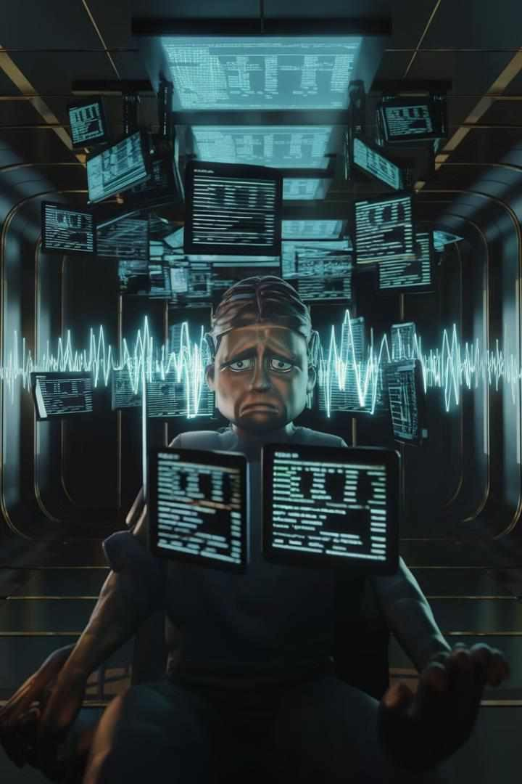
Introduction to Digital Age Nuisance
Definition
Digital age nuisance refers to disturbances caused by modern technology that interfere with an individual's right to enjoy their property.
Types
Common forms include excessive noise from electronic devices, light pollution from LED displays, and electronic interference with wireless communications.
Legal Implications
These nuisances challenge traditional legal frameworks, requiring courts to adapt existing laws to new technological realities.

Slide 5

Historical Background
1
19th Century
Traditional nuisance cases primarily dealt with industrial pollution, noise from factories, and foul odors.
2
20th Century
Nuisance law expanded to include issues like aircraft noise and environmental pollution.
3
21st Century
Digital age introduces new forms of nuisance, challenging courts to apply old principles to new technologies.

Slide 6
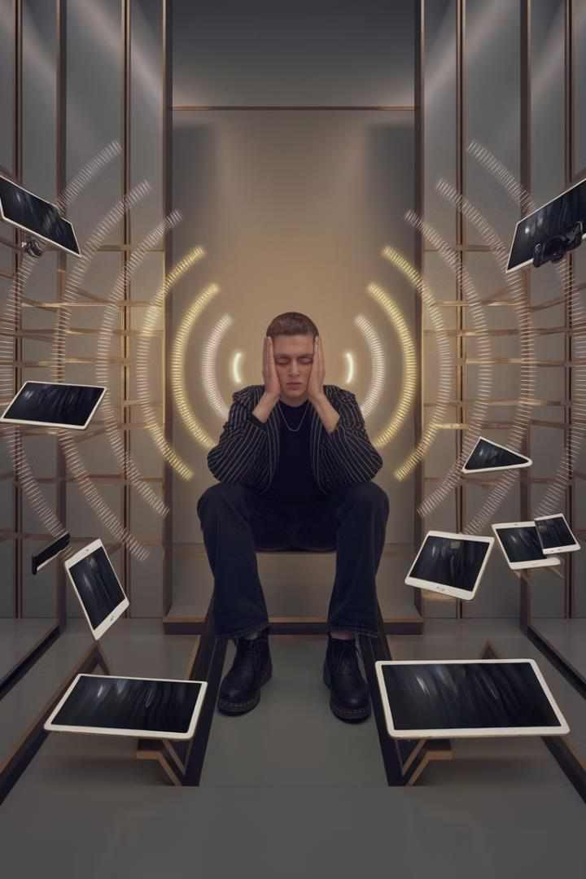
Noise Pollution in the Digital Age
1
Sources
Constant notifications from smartphones, loud music from portable speakers, and drone noise contribute to modern acoustic pollution.
2
Legal Standards
Courts apply decibel limits and "reasonable person" standards to assess noise nuisance claims.
3
Case Example
In Godfrey v Conwy County Borough Council [2001], the court ruled persistent noise from neighbors' amplified music constituted statutory nuisance.

Slide 7
Light Pollution: The Bright Side of Nuisance
Sources
LED billboards, digital signage, and excessively bright security lights contribute to light pollution.
Legal Standards
Courts consider factors like intensity, duration, and purpose when evaluating light nuisance claims.
Case Study
In Salamone v Noosa Shire Council [1988], the court recognized artificial lighting as a potential nuisance.

Slide 8
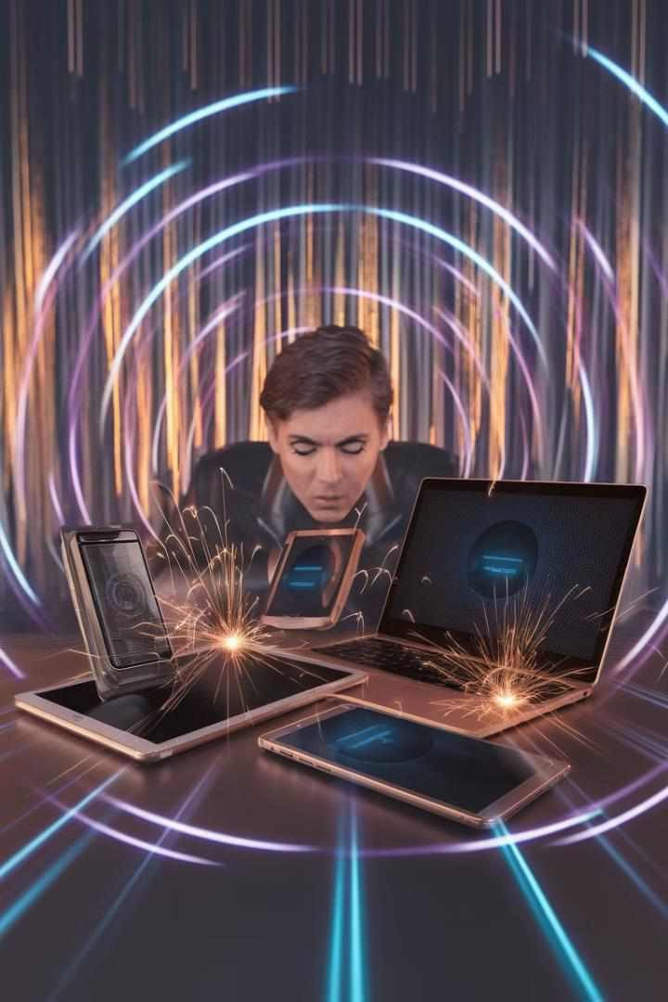



Electronic Interference: The Invisible Nuisance
Wi-Fi Interference
Overlapping Wi-Fi networks can cause signal degradation and connectivity issues.
Cellular Signals
Cell tower proximity can interfere with home electronics and medical devices.
Satellite Communications
Satellite signals can be disrupted by nearby electronic equipment or structures.

Slide 9
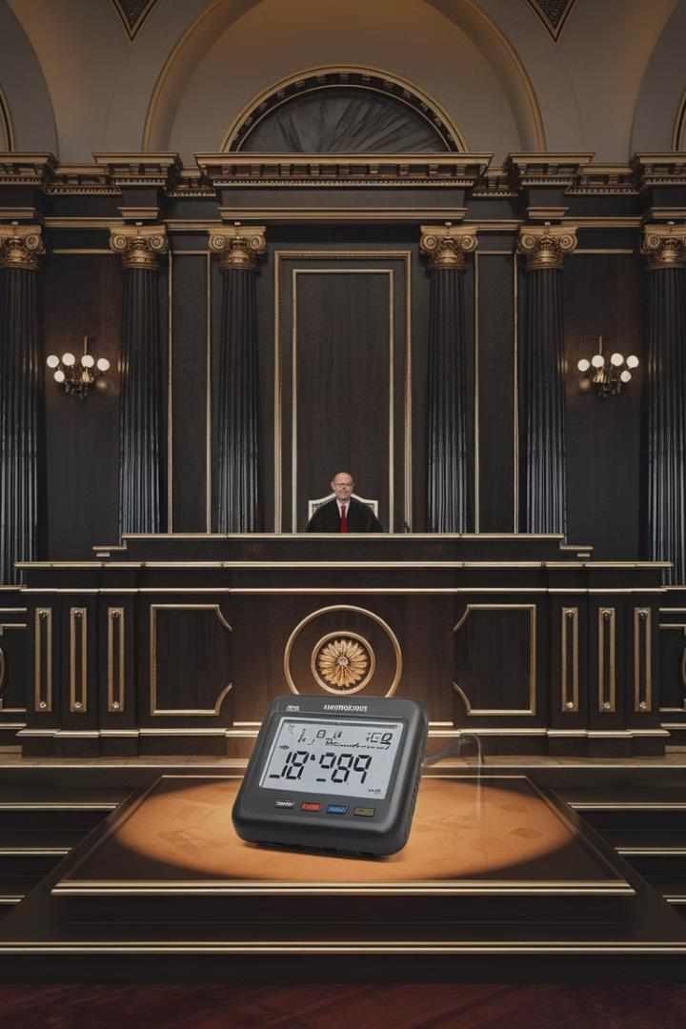
Case Study: Noise Pollution
1
Case: Barr v Biffa Waste Services Ltd [2012] EWCA Civ 312
Residents complained about noise and odor from a waste management facility.
2
Court's Decision
The Court of Appeal held that compliance with regulations doesn't automatically preclude nuisance liability.
3
Impact
This case reinforced the importance of considering actual
impact on residents in nuisance claims.

Slide 10
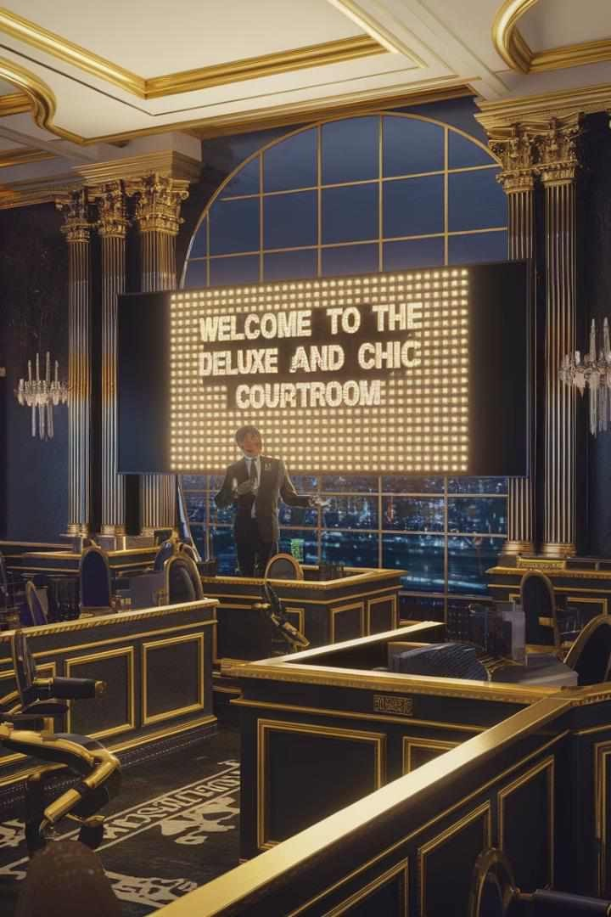
Case Study: Light Pollution
Case: Stone v Bolton [2005] EWCA Civ 29
Homeowners complained about light from a neighboring school's floodlit sports pitch.
Court's Ruling
The court found the light constituted a nuisance, emphasizing the importance of balancing interests.
Legal Principle
The case established that even lawful activities can become a nuisance if unreasonably conducted.

Slide 11
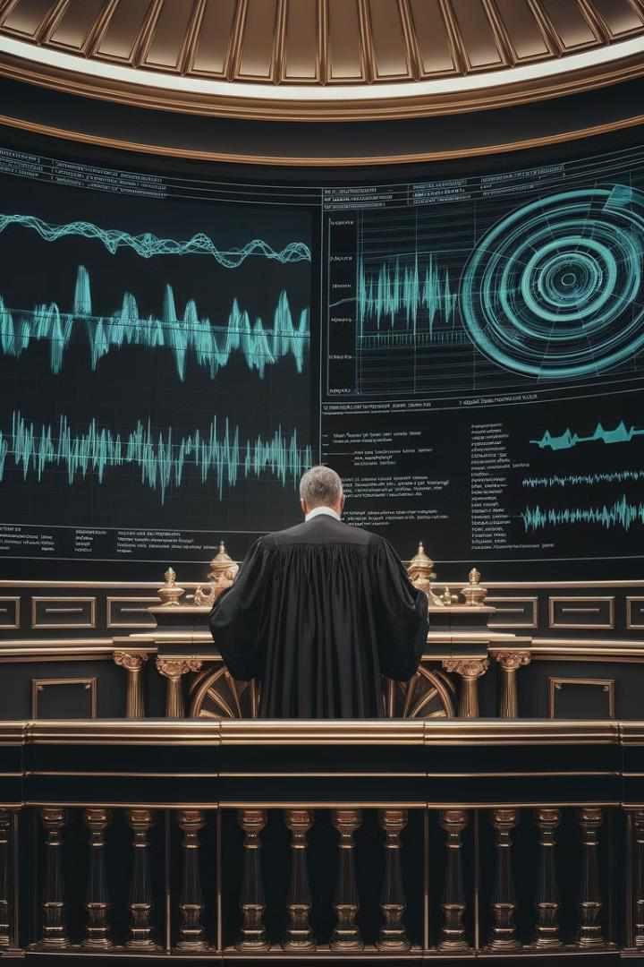

Case Study: Electronic Interference
Case: Dawlat v Hustan [2015] HKCFI 1339
Plaintiff claimed defendant's Wi-Fi router interfered with his home network and devices.
Court's Analysis
The court considered expert testimony on electromagnetic
interference and its effects on neighboring properties.
Ruling
The court recognized electronic interference as a potential nuisance but found insufficient evidence in this case.

Slide 12

Legal Challenges in the Digital Age
Challenge | Example | Legal Adaptation
Proving Causation | EMF Sensitivity Claims | Requiring Expert Testimony
Quantifying Harm | Data Privacy Breaches | Developing New Damage Models
Jurisdictional Issues | Cross-border Online Nuisance | Applying Conflict of Laws Principles

Slide 13
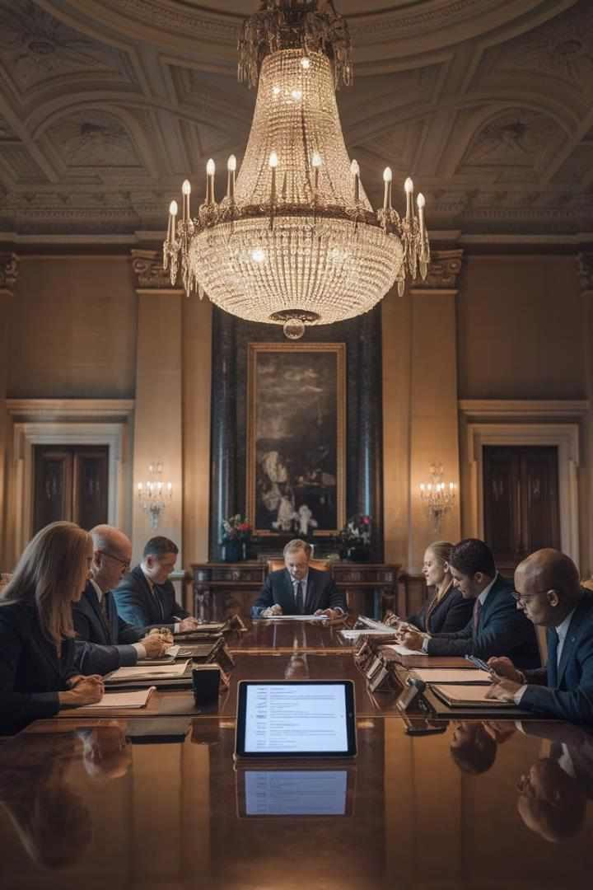
Role of Local Authorities
1
Policy Development
Local authorities create zoning laws and noise ordinances to address digital age nuisances.
2
Enforcement
Environmental health officers investigate complaints and issue abatement notices for violations.
3
Case Example
In R v Falmouth and Truro Port Health Authority, ex parte Southwest Water [2000], the court upheld local authority's power to serve abatement notice.

Slide 14
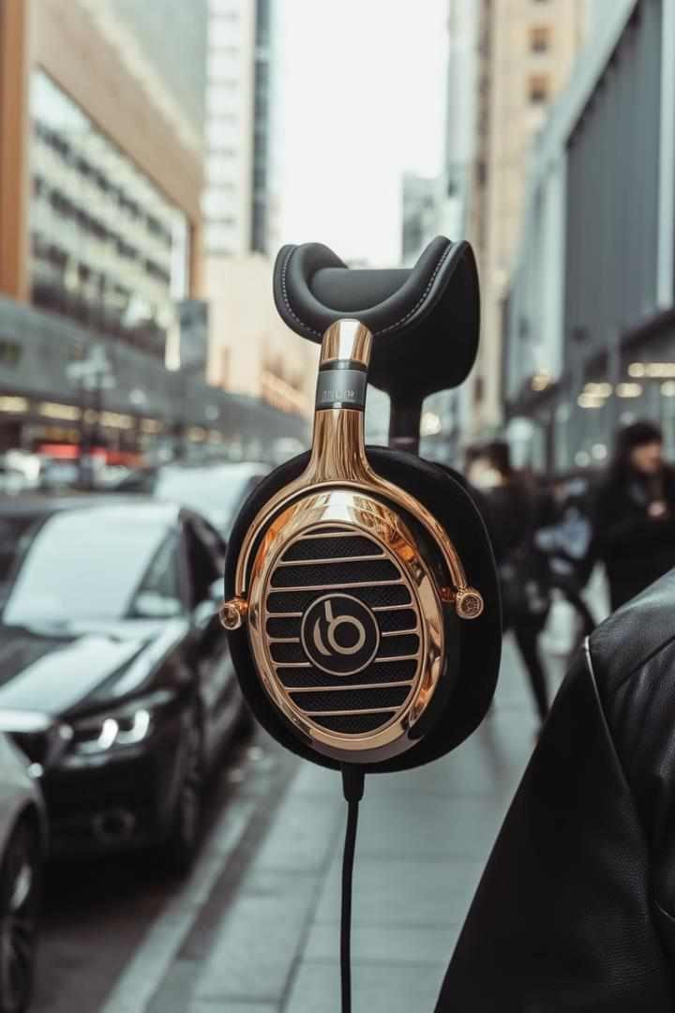



Technological Solutions
Noise Reduction
Advanced soundproofing materials and active noise cancellation technologies mitigate urban noise pollution.
Smart Lighting
Adaptive LED systems with sensors reduce light pollution while maintaining necessary illumination.
EMI Shielding
Electromagnetic interference (EMI) shielding materials protect sensitive equipment from electronic nuisances.

Slide 15
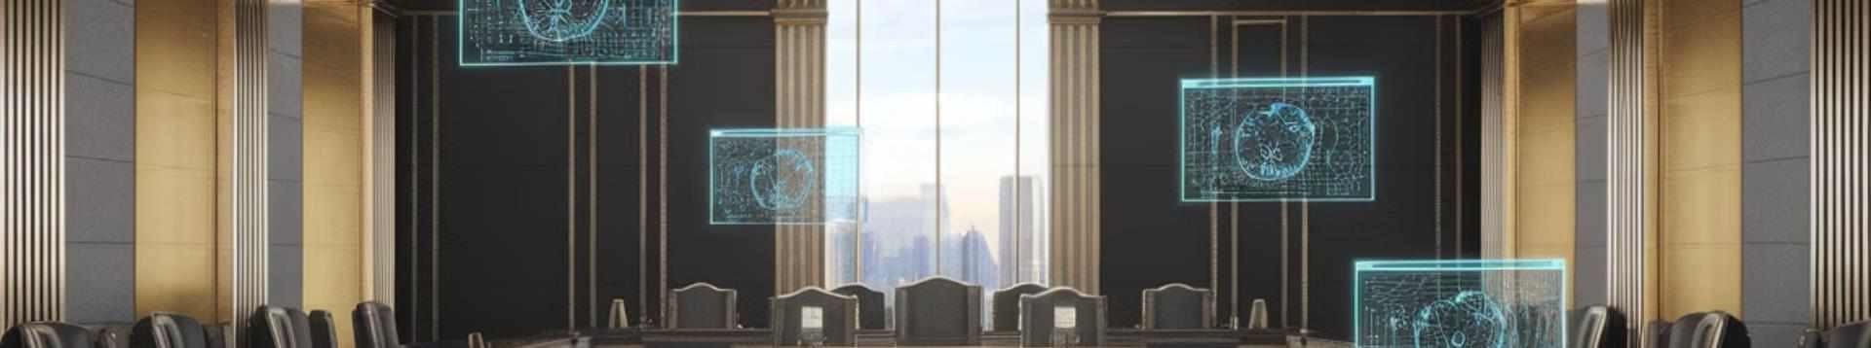
Future Trends in Digital Age Nuisance Law
AI-Powered Nuisance
Detection
Machine learning algorithms will help identify and quantify digital nuisances more accurately.
Virtual Reality Disputes
Courts may face new challenges in addressing nuisances occurring in virtual and augmented reality spaces.
IoT Regulation
As Internet of Things (IoT) devices proliferate, new laws will emerge to manage their potential nuisance impacts.

Slide 16
Practical Tips for Compliance
For Businesses
Conduct regular environmental impact assessments
Invest in noise and light reduction technologies
Develop clear policies for managing digital emissions
For Individuals
Use noise-cancelling devices and light-blocking curtains
Be mindful of your own digital footprint
Engage in community discussions about local nuisance issues

Slide 17
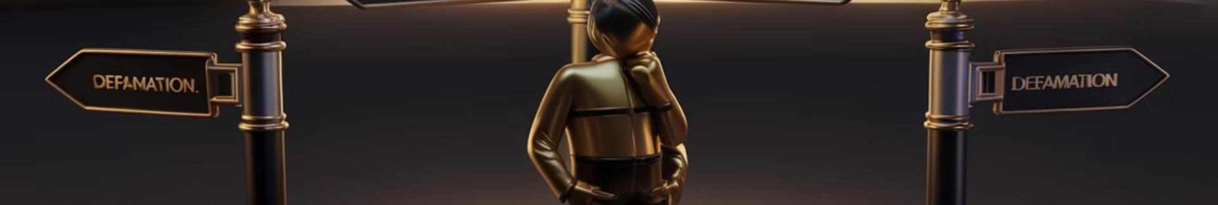
Conclusion: Navigating the Digital Nuisance Landscape
Evolving Legal Framework
Courts and legislators must continue adapting nuisance law to
address emerging digital age challenges.
Balancing Act
Finding equilibrium between technological progress and individual
rights remains a key challenge.
Collaborative Approach
Addressing digital age nuisances requires cooperation between lawmakers, technologists, and community members.
Future Outlook
As technology evolves, so too must our legal and social approaches to managing digital nuisances.

