Slide 1










UTALK ENGLISH
LESSON 1 APARTMENT FOR RENT

Slide 2


Slide 3
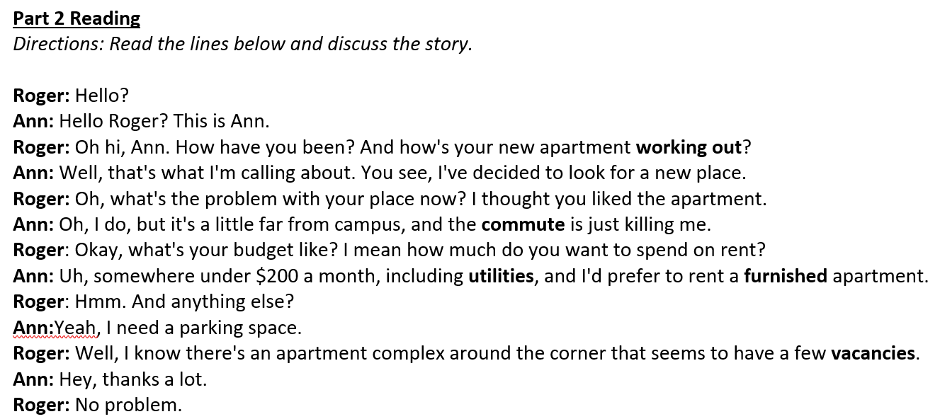

Slide 4
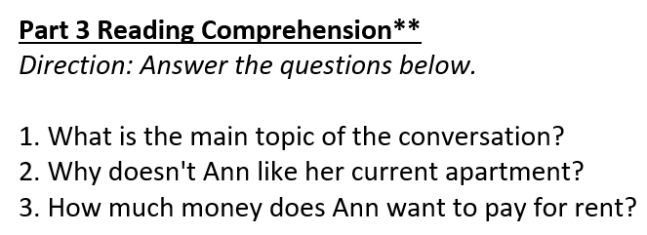

Slide 5
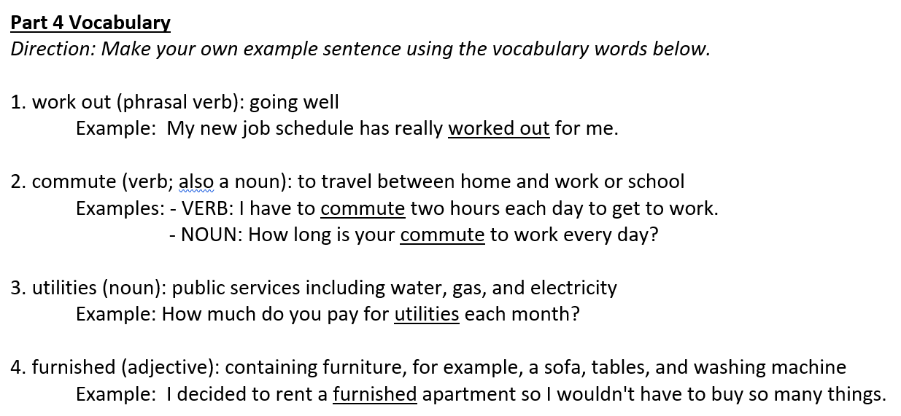

Slide 6
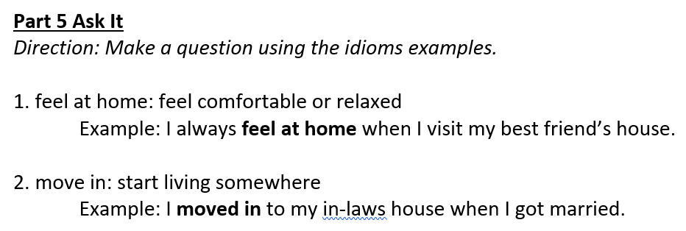

Slide 7


Slide 8
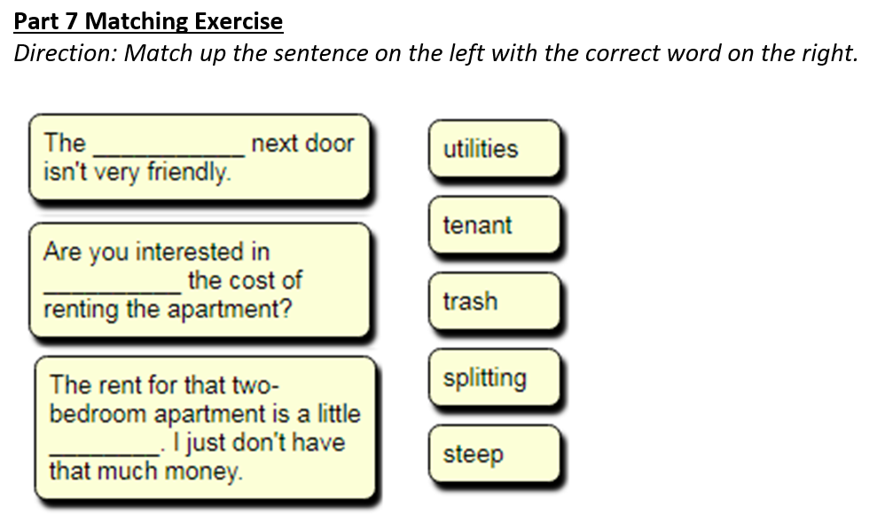

Slide 9


