Slide 1
IELTS Writing Task 1 knowledge
Sayar Saw

Slide 2
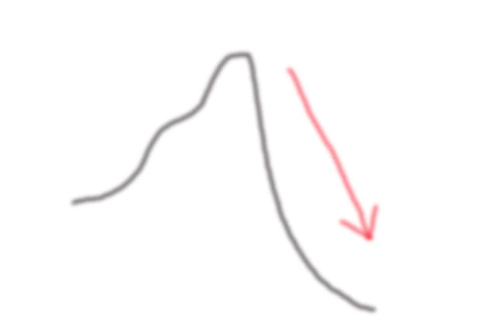
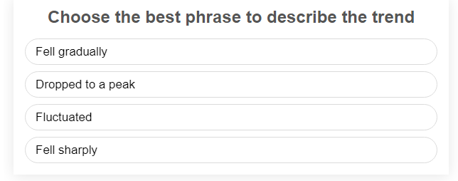
The number of CD sales FELL SHARPLY from 800 per month to 100 per month.

Slide 3
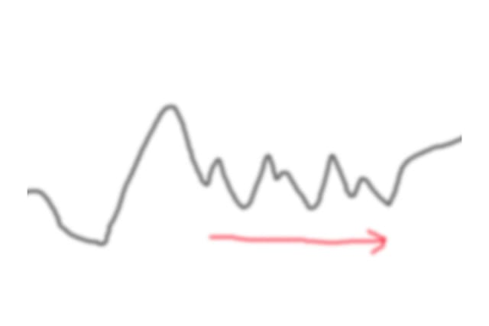
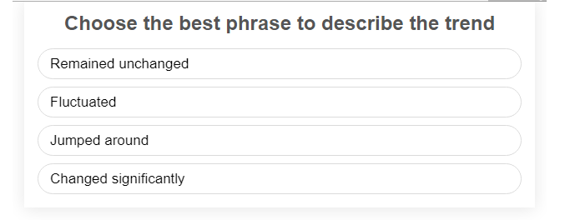

CD sales FLUCTUATED from May to September.

Slide 4
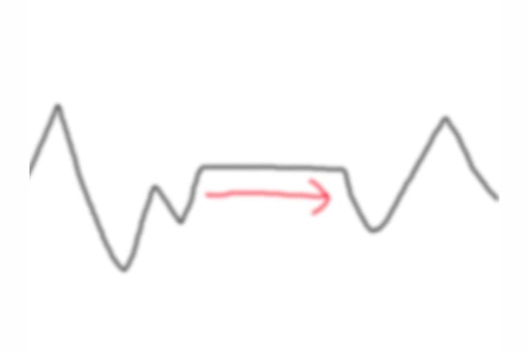
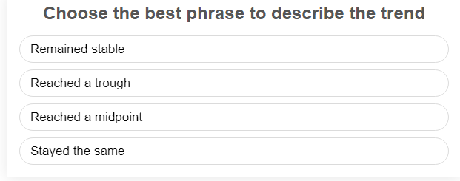
CD sales REMAINED STABLE throughout the month of October.

Slide 5
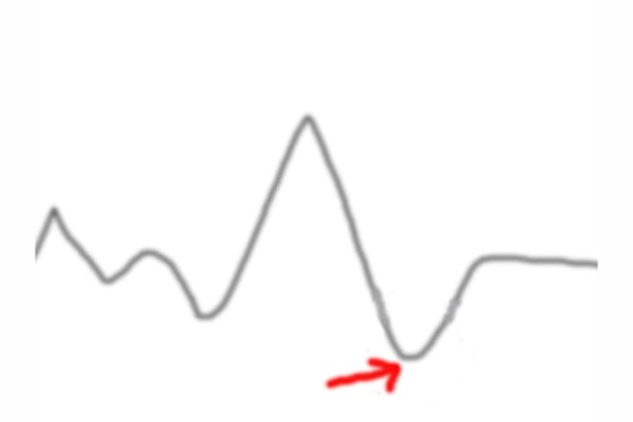
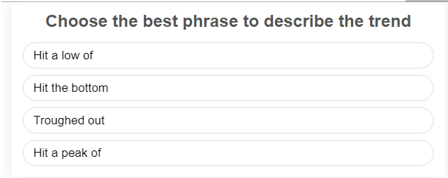
CD sales HIT A LOW of 50 in February.

Slide 6

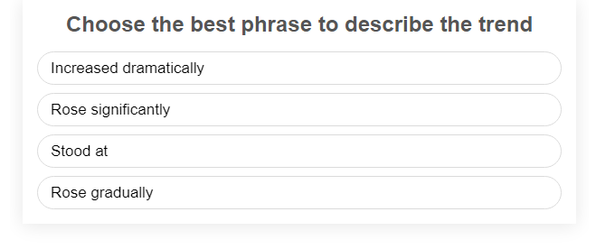
From February to March, the number of CDs purchased ROSE GRADUALLY.

Slide 7
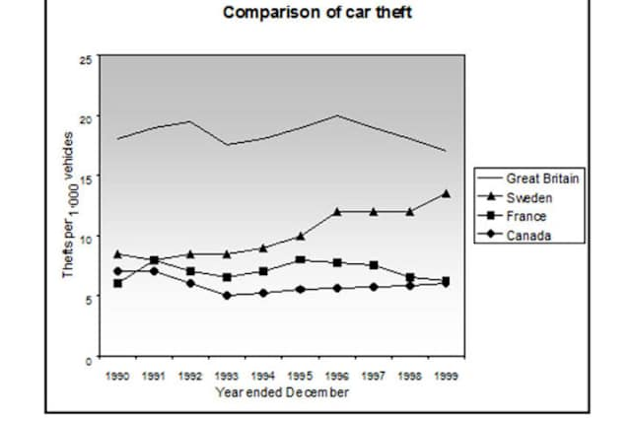
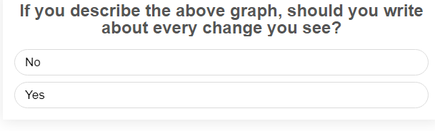
You may end up writing too much. Also you need to show you can select broader trends and describe key features. Just describing every single change may make your answer look too mechanical.

Slide 8
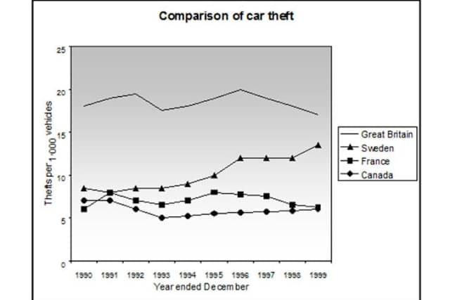
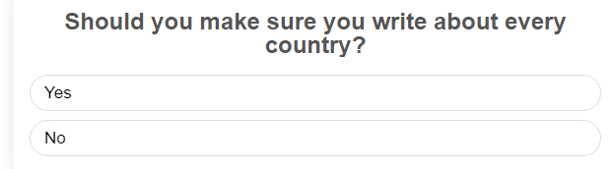
Definitely! If you don't you will be missing key features of the graph and your TR (Task Response) could get limited to a band 4.

Slide 9
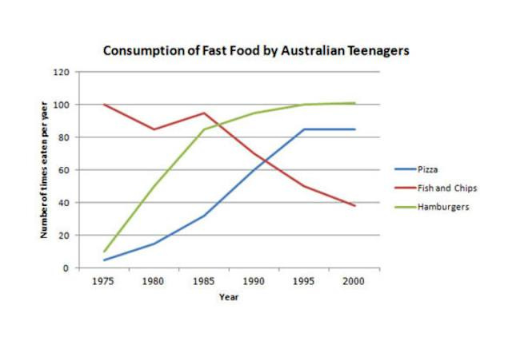
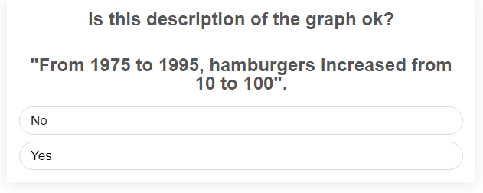
'Hamburgers' can't increase, only percentages, numbers, figures etc can. e.g. '...the consumption of hamburgers increased...' is ok.

Slide 10
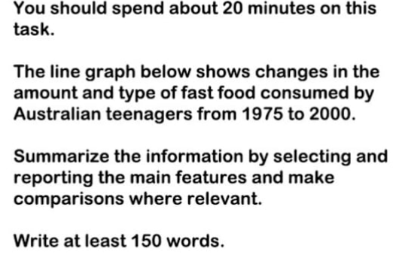
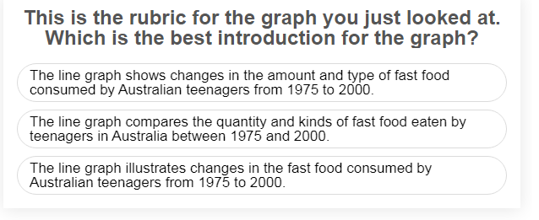
You should paraphrase the rubric. The first one simply copies it word for word. The third one is also nearly identical with just a few words missed out.

Slide 11
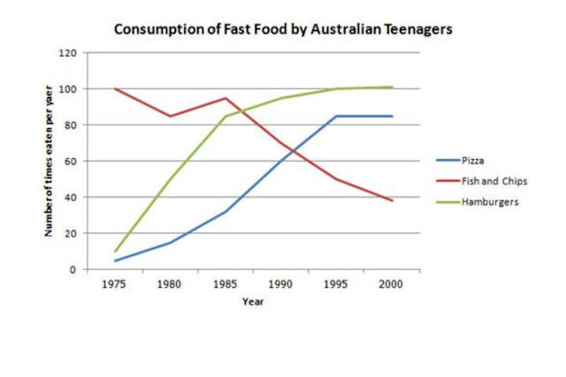
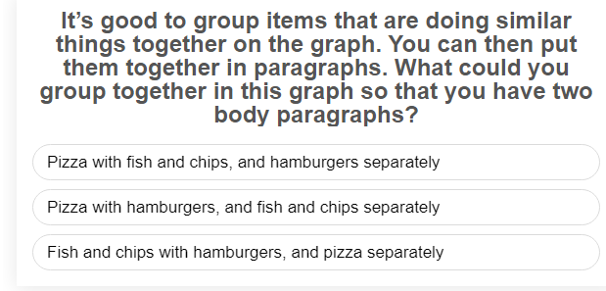
Grouping pizza and hamburgers together makes sense as they show a similar trend (increasing) while fish and chips consumption is the opposite (a downward trend).

Slide 12
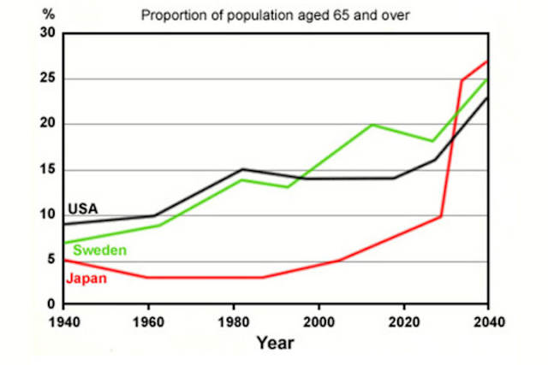
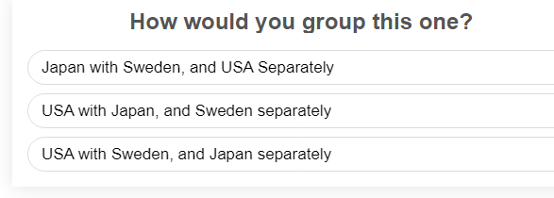
If you choose to group them, describing USA and Sweden together makes the most sense as they show a fairly similar trend.

Slide 13

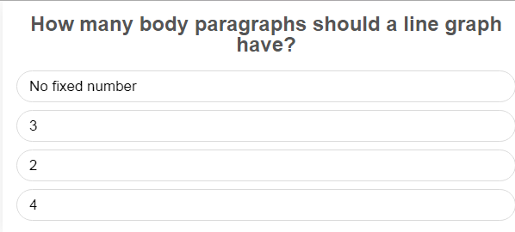
There's no fixed number but you should use paragraphing so it's easier to read. Link paragraphing to the separate trends or patterns you are writing about.

Slide 14
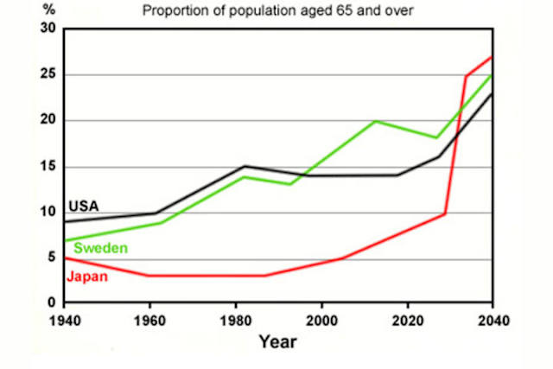
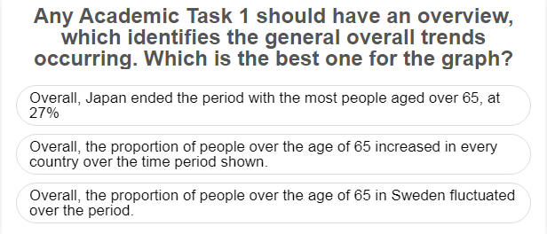
The second is the best one as it describes the general trends of the whole graph. The others pick specific details out so they would probably not be seen as 'overviews'.

Slide 15
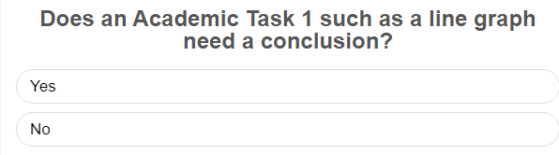
Conclusions are for essays, not graphs. It's not wrong though to place your 'overview' (identification of the main trends) at the end.

