Slide 1

English

Slide 2


Slide 3
Listen as I read each sentence.
1. Mang Brando is a driver.
2. Father Teddy is a kind priest.
3. Manny Pacquiao is a good boxer.
4. Miss Cruz is our teacher.
5. Cris is my classmate.

Slide 4
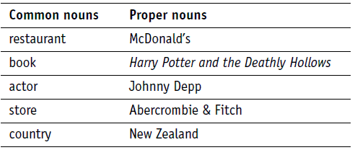

Slide 5
