Slide 1
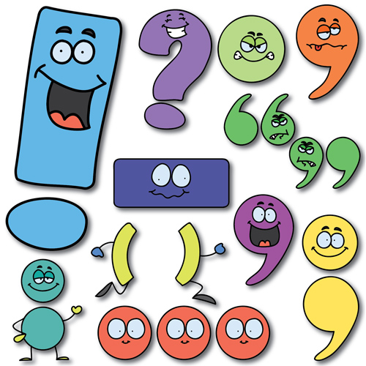
Tools of the Trade: Punctuation
“Language, never forget, is more fashion than science, and matters of usage, spelling, and pronunciation tend to wander around like hemlines.” – Bill Bryson
Dost thou doubt this? Nay, it is a verity, say I.

Slide 2
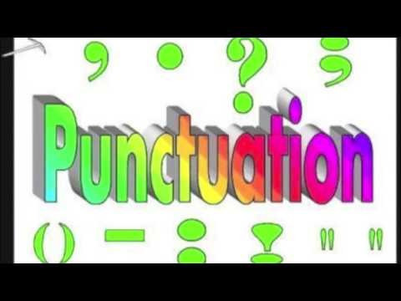
Punctuation Song

Slide 3
Tools of the trade: periods and commas
Period: “a full pause, as is made at the end of a complete sentence; full stop.” – Dictionary.com
Comma: “the sign (,), a mark of punctuation used for indicating a division in a sentence, as in setting off a word, phrase, or clause, especially when such a division is accompanied by a slight pause or is to be noted in order to give order to the sequential elements of the sentence. It is also used to separate items in a list, to mark off thousands in numerals, to separate types or levels of information in bibliographic and other data” – Dictionary.com
Normally a thick forest as this one had been for as long as anyone could remember would be the perfect place to hide notwithstanding the fine tracking skills Xavier possessed and my skills too to a lesser degree but even the forest had not fully escaped the two locust plagues of 1874 and 75 that had begun on its fringes and fanned out eastward like biblical pestilences devouring nearly all plant life in their paths the voracious insects had spared the conifers but cottonwoods aspens and even scrub oaks had been denuded of all leaves and even many limbs leaves and grass were just beginning to re-emerge

Slide 4
With punctuation
Normally, a thick forest, as this one had been for as long as anyone could remember, would be the perfect place to hide, notwithstanding the fine tracking skills Xavier possessed, and my skills, too, to a lesser degree. But even the forest had not fully escaped the two locust plagues of 1874 and ‘75 that had begun on its fringes and fanned out eastward like biblical pestilences, devouring nearly all plant life in their paths. The voracious insects had spared the conifers, but cottonwoods, aspens, and even scrub oaks had been denuded of all leaves and even many limbs. Leaves and grass were just beginning to re-emerge.

Slide 5
Tools of the trade: colons and semicolons
Colon: “the sign (:) used to mark a major division in a sentence, to indicate that what follows is an elaboration, summation, implication, etc., of what precedes; or to separate groups of numbers referring to different things, as hours from minutes in 5:30; or the members of a ratio or proportion, as in 1 : 2 = 3 : 6.” – Dictionary.com
Semicolon: “the punctuation mark (;) used to indicate a major division in a sentence where a more distinct separation is felt between clauses or items on a list than is indicated by a comma, as between the two clauses of a compound sentence.” – Dictionary.com
Two years of dodging bullets and dread diseases while enduring great privations and watching young men all around him fall like hay before a reaper’s scythe had given Timothy a melancholy demeanor and more than enough adventure he was happy to settle down to assisting Father in the hard but methodical life of operating a Kansas farm I on the other hand detested the drudgery of farm life routine was a balm to Timothy’s war-weary soul but to me it was as close to hell on earth as I could imagine so in 1871 after enduring nine years of hell in Kansas I saw an opportunity for adventure and I sought it for all I was worth

Slide 6
With punctuation
Two years of dodging bullets and dread diseases while enduring great privations and watching young men all around him fall like hay before a reaper’s scythe had given Timothy a melancholy demeanor and more than enough adventure; he was happy to settle down to assisting Father in the hard but methodical life of operating a Kansas farm. I, on the other hand, detested the drudgery of farm life. Routine was a balm to Timothy’s war-weary soul, but to me it was as close to hell on earth as I could imagine. So in 1871, after enduring nine years of hell in Kansas, I saw an opportunity for adventure, and I sought it for all I was worth.

Slide 7
Tools of the trade: hyphens and dashes
Hyphen: “a short line (-) used to connect the parts of a compound word or the parts of a word divided for any purpose.” – Dictionary.com
En-dash: “a dash one en long.” – Dictionary.com
The en-dash is used to connect: We won, 21-14.
Em-dash: “a dash one em long.” – Dictionary.com
The em-dash is used to separate: We won—but we easily could have lost. ***
“Routine was a balm to Timothy’s war weary soul, but to me it was as close to hell on earth as I could imagine. So, in 1871, after enduring nine years of hell in Kansas, I saw an opportunity for adventure, and I sought it for all I was worth.”
Fortunately for us, Zane’s confidence and his hunger got the better of him. We came upon him in the late afternoon, sitting alongside a creek, with a crackling fire he’d made, apparently to roast some fish he’d caught. Unfortunately, he caught sight of us at the very moment we spotted him. Forsaking his meal, in a few quick steps and a leap, he was astride the palomino, and the aforementioned chase was on.

Slide 8
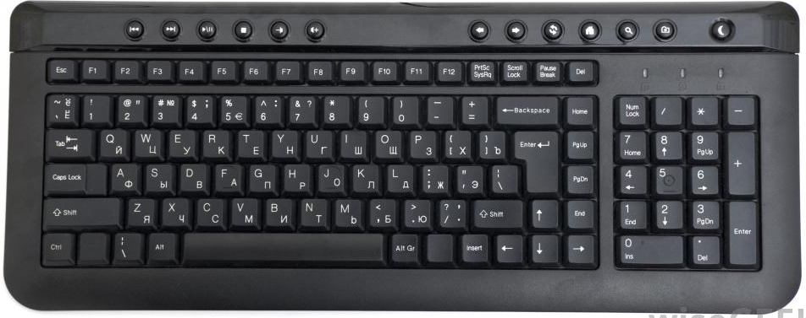
How to make en and em dashes

Slide 9
Tools of the trade: parentheses and ellipses
Parenthesis: “either or both of a pair of signs () used in writing to mark off an interjected explanatory or qualifying remark, to indicate separate groupings of symbols in mathematics and symbolic logic, etc.” - Dictionary.com
When we tied the horses to the hitching post in front of the Crabtrees’ house the sheriff had informed us of the couple’s name all appeared as it had been when we left there the previous afternoon.
Ellipsis: “the omission from a sentence or other construction of one or more words that would complete or clarify the construction, as the omission of who are, while I am, or while we are from I like to interview people sitting down.” – Dictionary.com
"After school I went to her house, which was a few blocks away, and then came home."
"After school I went to her house … and then came home."

Slide 10
Tools of the trade: quotation marks
one of the marks used to indicate the beginning and end of a quotation, in English usually shown as “at the beginning and” at the end, or, for a quotation within a quotation, of single marks of this kind, as “He said, ‘I will go.’”
Note: Proper American punctuation is much like American measurement systems. We are independent; we go our own way. In most other countries, all punctuation goes outside quotation marks, but in the United States we (if we want to be correct) place periods and commas inside quotation marks. Colons and semicolons go outside quotation marks. Question marks can go inside or outside, depending on whether the quoted portion is the question.
“How are we going to pay for more supplies?” I asked.
But I also thought, then, about why I do many of the things I do. Do I do them because “… it’s what people do”?

Slide 11
Tools of the trade: apostrophes
“the sign ('), as used: to indicate the omission of one or more letters in a word, whether unpronounced, as in o'er for over, or pronounced, as in gov't for government; to indicate the possessive case, as in man's; or to indicate plurals of abbreviations and symbols, as in several M.D.'s, 3's.” – Dictionary.com
Remember this: Basically, apostrophes are used for contractions, such as aren’t, can’t, won’t, or to show possession: That is Bob’s bike. We walked to Clyde’s house.
Where do we need apostrophes?
I gave Zane another boot to his backside before placing my hand on Xaviers shoulder and insisting we talk the matter out. “Look, amigo,” I said, “were not in some backward Zuni village. This is modern America; we dont believe in monsters. The only monsters are bad people, like this scalawag,” I said as I again let Zanes backside feel the point of my boot.

Slide 12
Misplaced modifiers
“Modifiers are words, phrases, or clauses that add description to sentences. Typically, you will find a modifier snuggled right next to—either in front of or behind—the word it logically describes.” – Grammar Bytes
“Sometimes a writer places the modifier too far away from the word it should describe.”
Churning in the Atlantic Ocean, we anxiously watched the weather report for information about the hurricane.
Churning in the Atlantic Ocean is a participle phrase. In the current sentence, it is describing the pronoun we. How illogical! We cannot churn in an ocean!
“This is a story you will only see here on KRDO” … KKTV … KOAA
“This is a story you will see only here on KRDO” … KKTV … KOAA

Slide 13
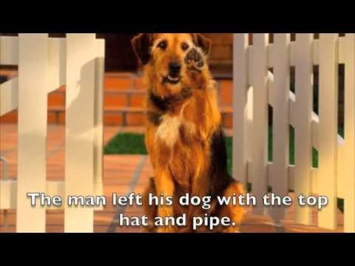
Misplaced Modifiers: A Doggone Easy Fix

Slide 14

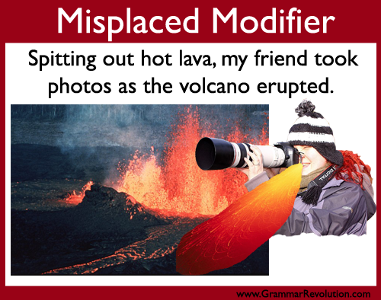
Assignment: Write an imaginary letter or news story using (correctly) as many of the punctuation elements as possible—and no misplaced modifiers.

