Slide 1





Intro
Algebra and Equations
by Mario Willyam
For;
IGCSE/'O' Level
IB MYP

Slide 2
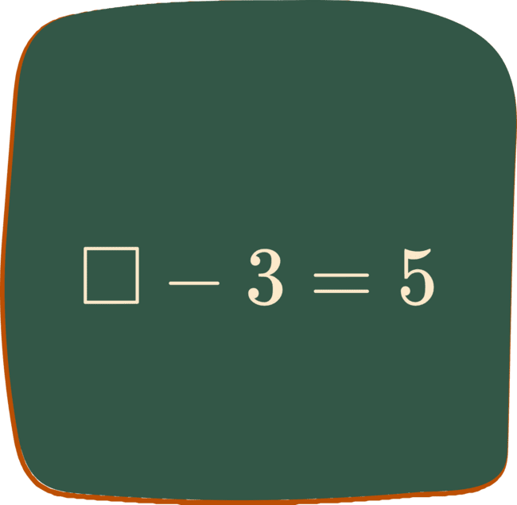
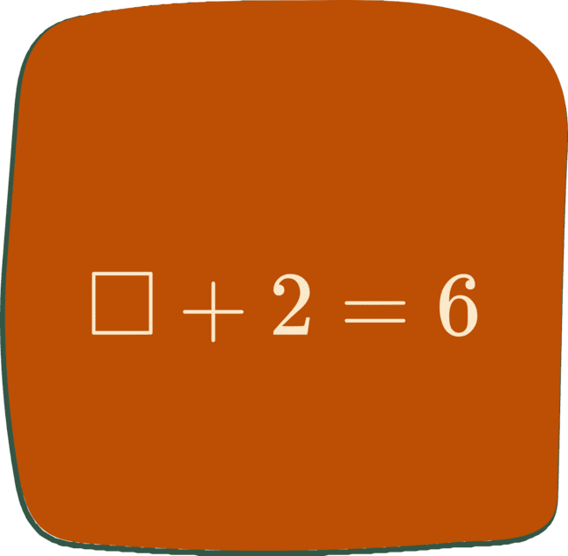
Missing Number (+ and -)
What is the missing number?
What is the missing number?

Slide 3
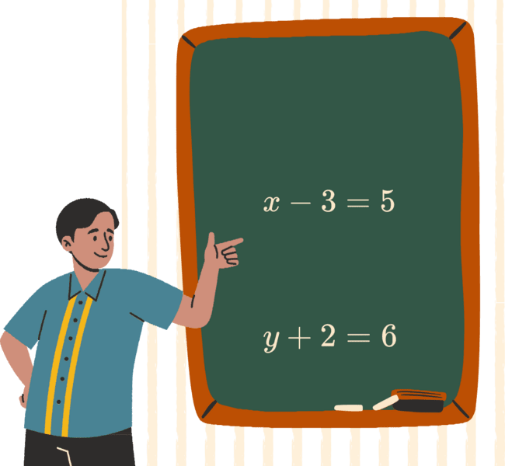
Unknown variable
From prev.
Part 1
1
Drawing ‘empty boxes’ are quite tedious
2
Mentioning “the empty box” is also tiresome!
Let’s use a LETTER!
3
Part 2

Slide 4

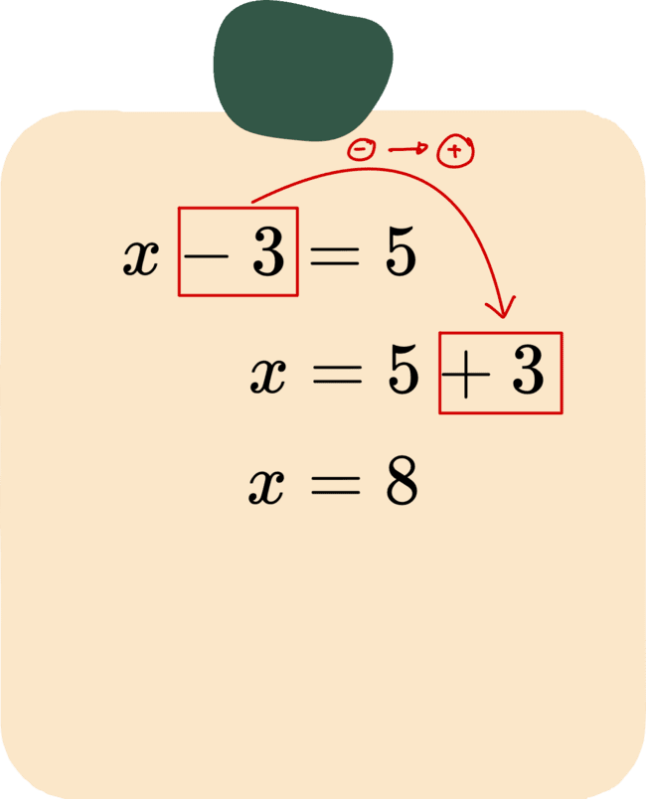
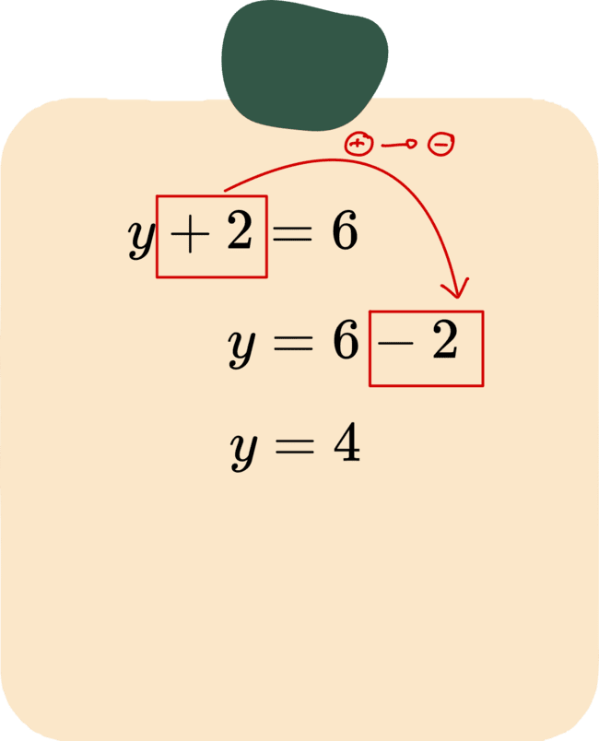
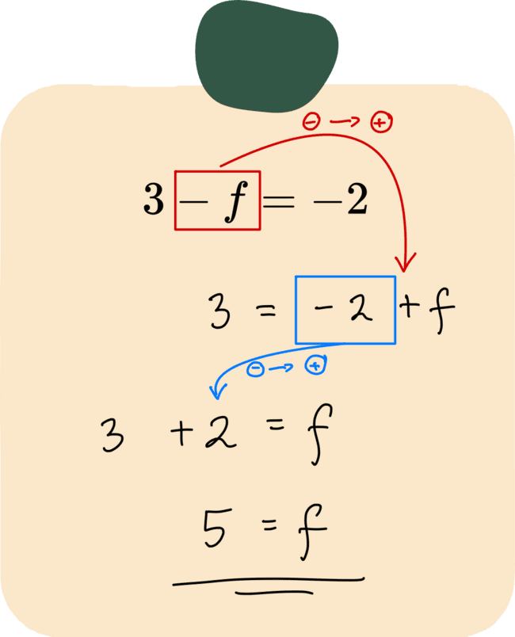
You did that 'subconsciously'!
Inversing!
Q1.
Q2.
Q3.

Slide 5
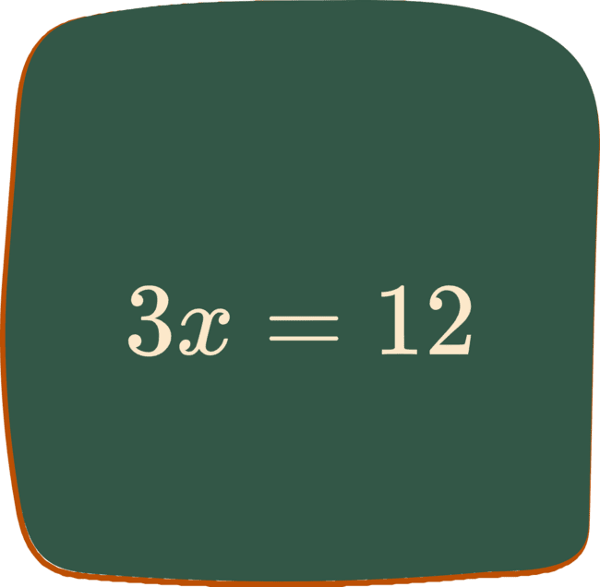
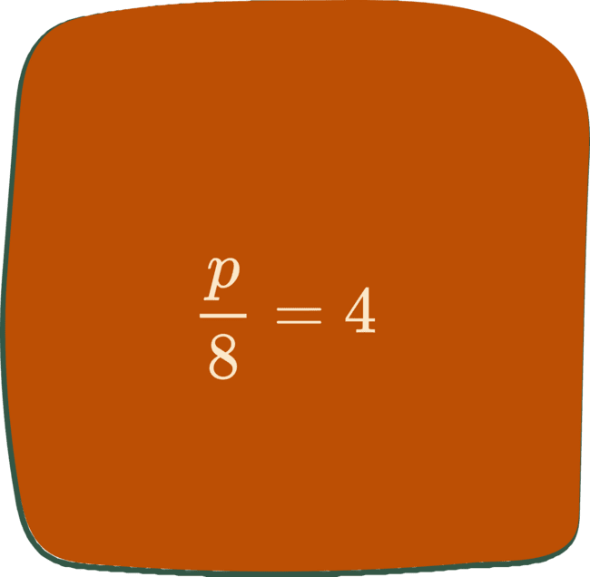
Missing Number (x and :)
What is the missing number?
What is the missing number?

Slide 6

Unknown variable
From prev.
Part 1
1
Drawing ‘empty boxes’ are quite tedious
2
Mentioning “the empty box” is also tiresome!
Let’s use a LETTER!
3
Part 2

Slide 7

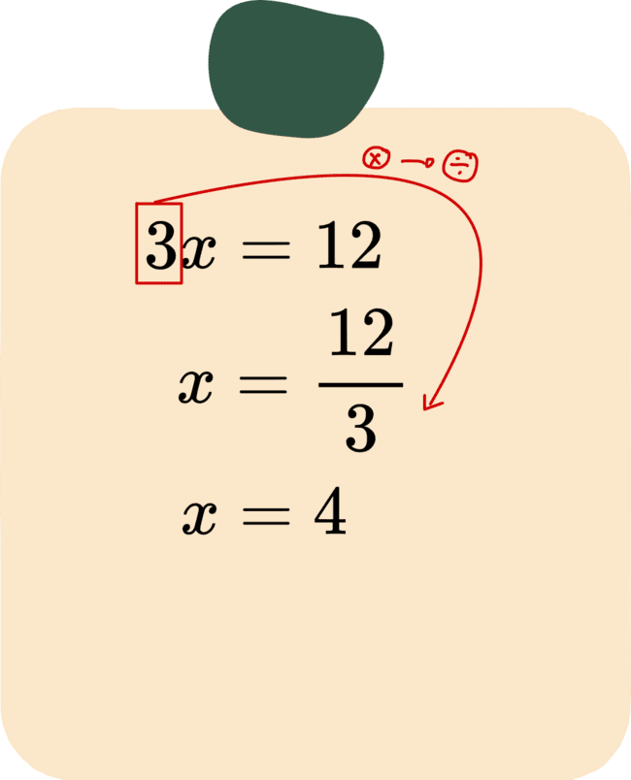
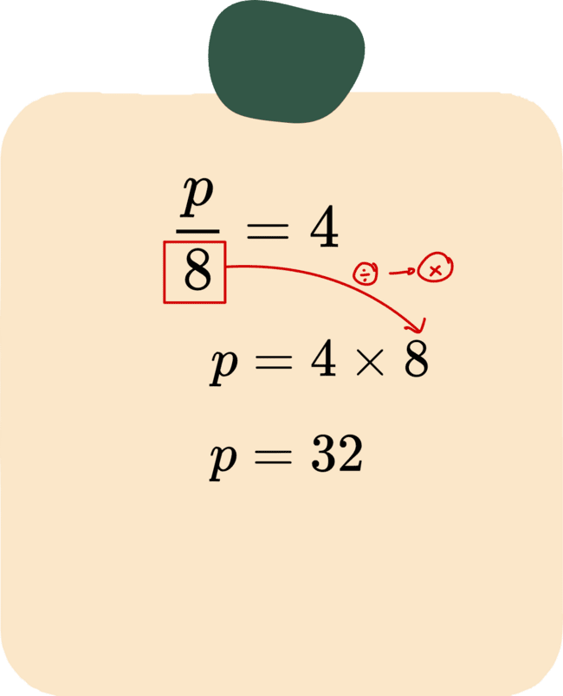
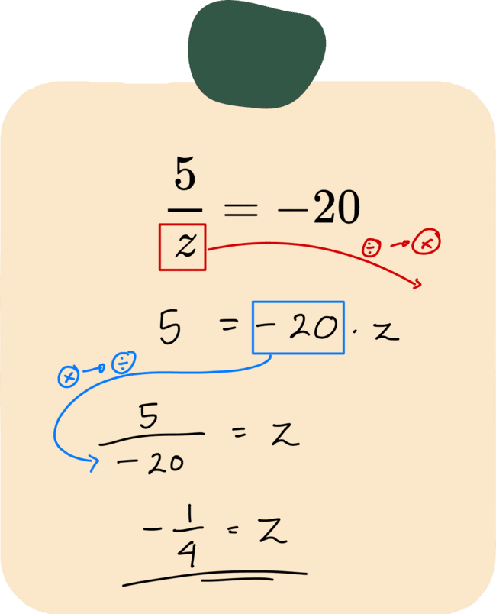
You did that 'subconsciously'!
Inversing!
Q1.
Q2.
Q3.

Slide 8
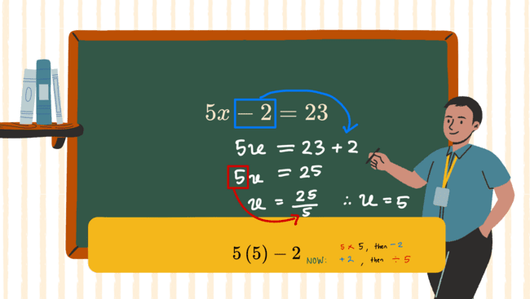
"Undo" equation / reverse BEDMAS
Hint: How do you calculate

Slide 9








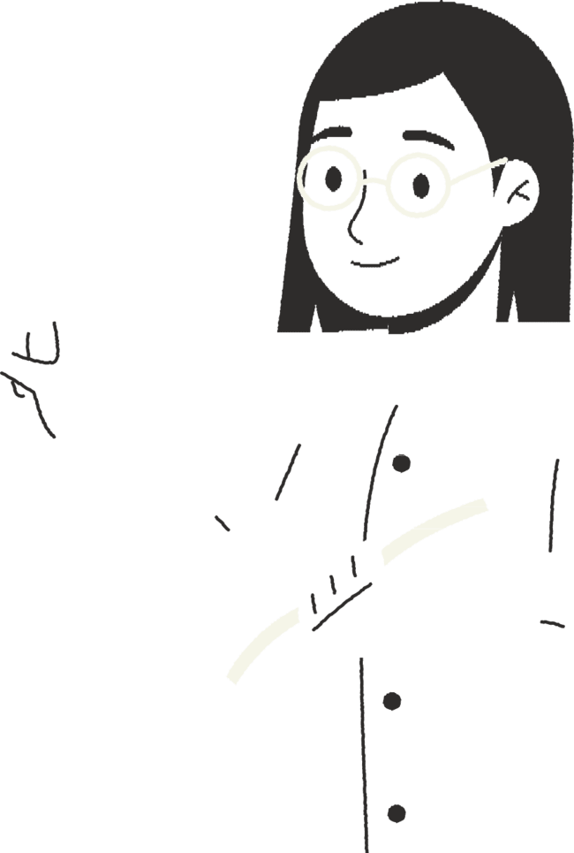





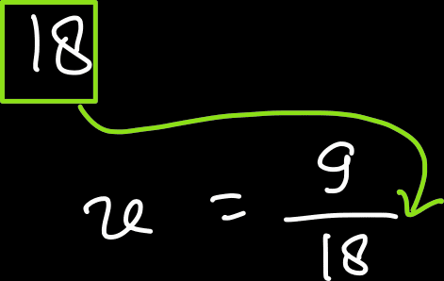





More "Undo"

Slide 10
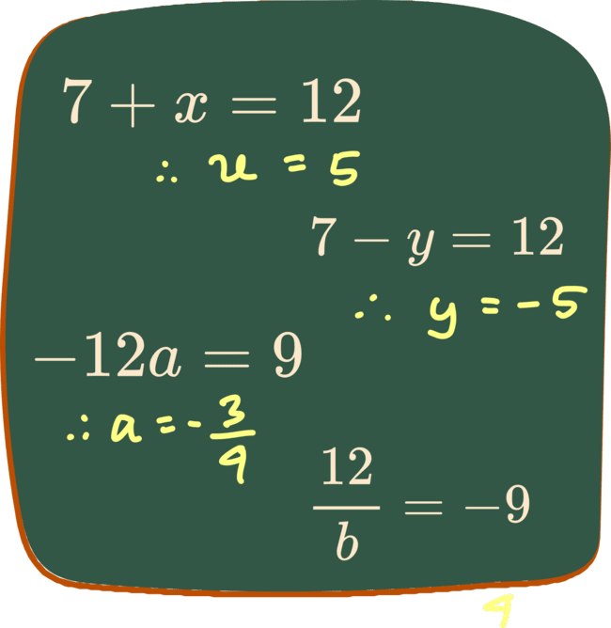
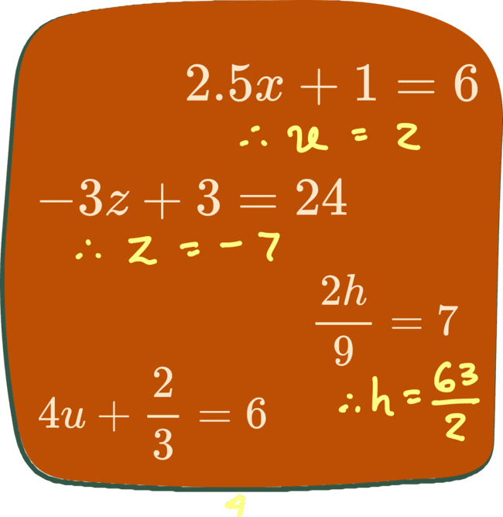
PRACTICE

Slide 11


Summary
And that's a wrap!
Contact me for tutoring consultation and services!
Inversing
“Flip” the signs!
Undo
Reverse the steps!

