Slide 1
The numbers
one
two
three
four
five

Slide 2
six
seven
eight
nine
ten

Slide 3
twelve
thirteen
eleven
fourteen
fifteen

Slide 4
sixteen
eighteen
seventeen
nineteen
twenty

Slide 5
What number is it?
I think it’s …
11
12
13
14
15
16
17
18
19
20
eleven
twelve
thirteen
fourteen
fifteen
sixteen
seventeen
eighteen
nineteen
twenty

Slide 6
17
21
17
23
31
19
31
16
24
29
20
22

Slide 7
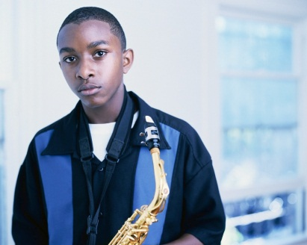
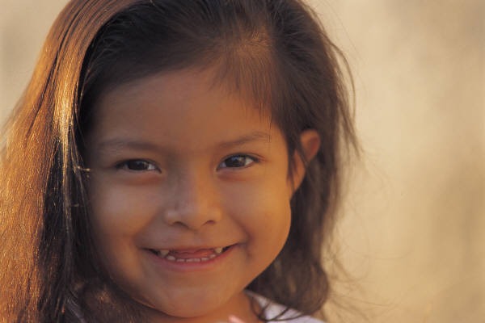
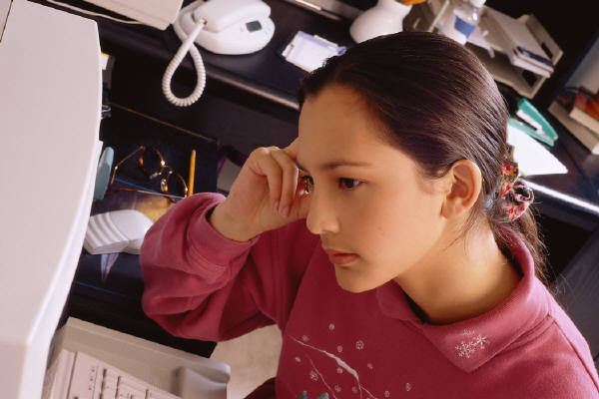
How old are you?
I am … years old.

Slide 8
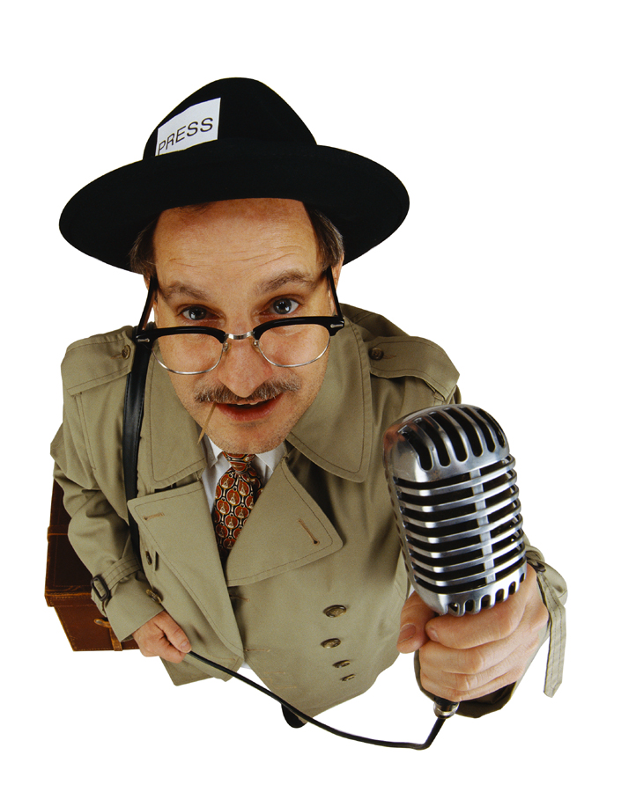
How old are you?
I am … years old.

Slide 9
How old are you?
I am 4 years old.

Slide 10
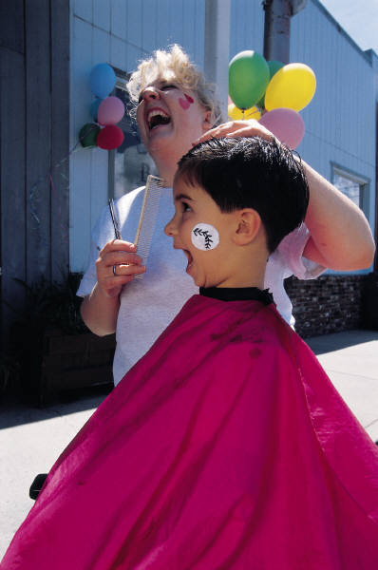
How old are you?
I am 8 years old.

Slide 11
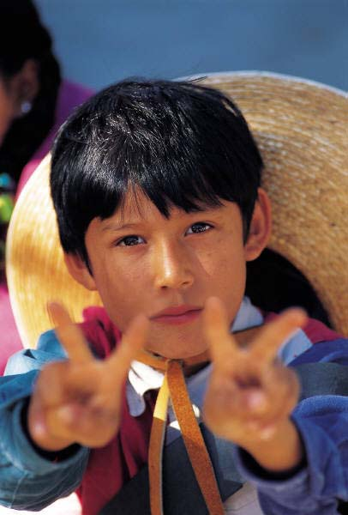
How old are you?
I am 11 years old.

Slide 12
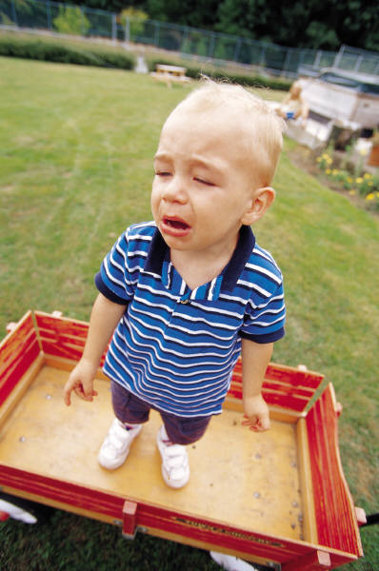
How old are you?
I am 2 years old.

Slide 13
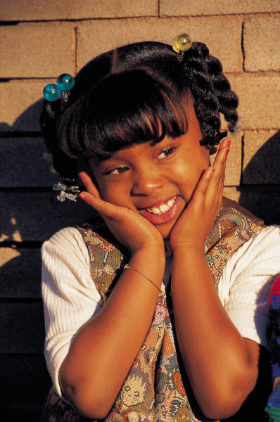
How old are you?
I am 7 years old.

Slide 14
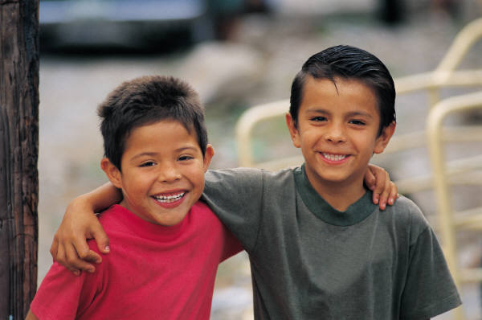
How old are you?
I am 6 years old.
I am 5 years old.

Slide 15
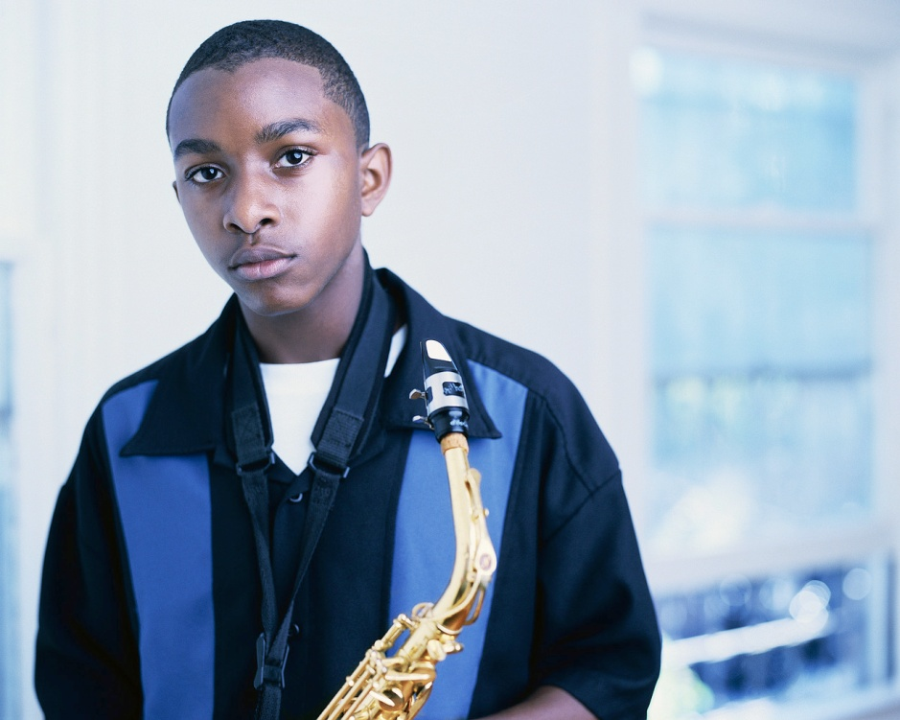
How old are you?
I am 14 years old.

Slide 16
How old are you?
I am 13 years old.

Slide 17
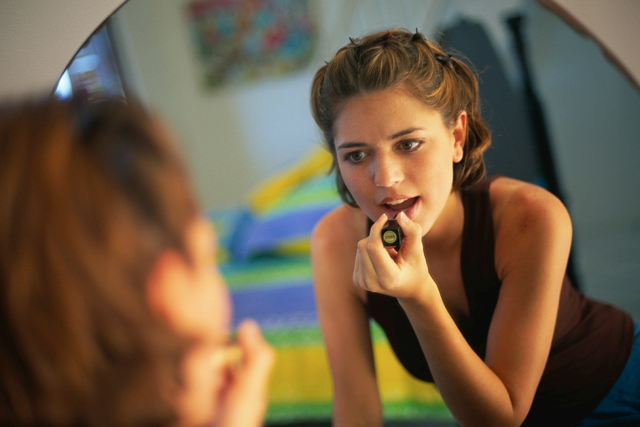
How old are you?
I am 15 years old.

Slide 18
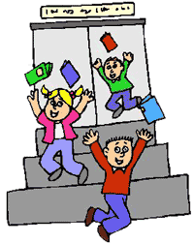

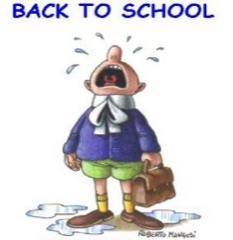
Which month is it?
I think it is …
January
February
March
April
May
June
July
August
September
October
November
December

Slide 19
Which month is it?
I think it is …

Slide 20
When is your birthday?
My birthday’s on the…
10 September
My birthday’s on the…
+ number
+ month

Slide 21
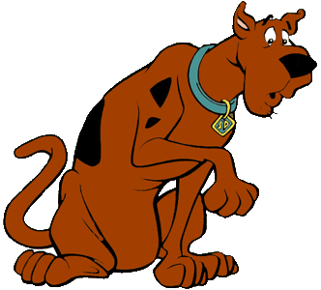
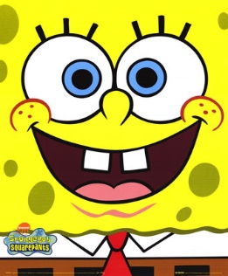
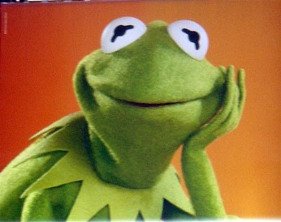
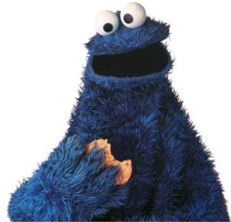
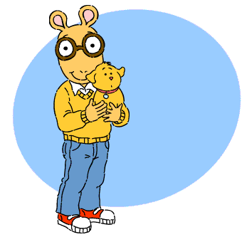
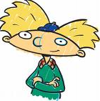
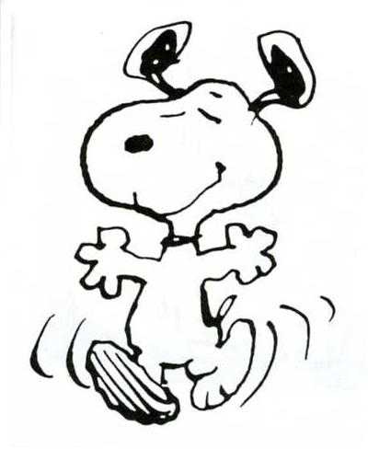
When is your birthday?
11/06
10/01
25/04
30/10
15/12
18/07
2/03

