Slide 1
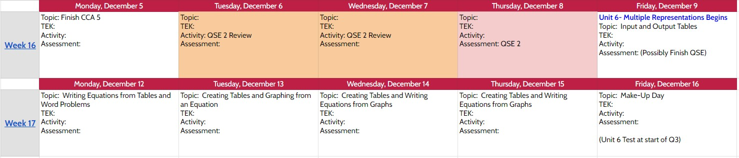
Unit 6– Multiple Representations
Nafte: ________________________ Per __________
Teacher: _______________ Due Date: _____________
Hoftework Packet
During this unit: Students will apply their knowledge of graphing to linear relationships. Students will learn to recognize the characteristics of the additive (y=x+b) or multiplicative (y=kx) relationship from a table, graph, or equation. Students will recognize independent and dependent quantities from tables and graphs. They will also make comparisons between the two relationships and explain their reasoning.

Slide 2
HW #1 Input and Output Tables
Complete each table.
1.
Input (x) | x + 6 | Output (y)
0
3
7
2.
Input (x) | x – 1 | Output (y)
1
4
8
3.
Input (x) | 3(x) | Output (y)
0
2
4
4.
Input (x) | x ÷ 2 | Output (y)
4
8
10
5. | Input (x) | 2x + 3 | Output | 6. | Input (x) | 2x − 5 | Output
 | 1 |  |  |  | 12
 | 3 |  |  |  | 16
 | 4 |  |  |  | 24
7. | Input (x) | x + 5 | Output | 8. | Input (x) | 3x − 4 | Output
 |  |  | 7 |  |  |  | 20
 |  |  | 12 |  |  |  | 26
 |  |  | 17 |  |  |  | 32
9. The Friendly Critters Pet Store keeps 3 rabbits in each cage. The rule 3(x) represents the number of rabbits that x cages can hold. Make a table of values to show how many cages it takes to hold 9, 15, and 18 rabbits.
10. A bead shop sells glass beads for $7 each minus a $2 discount. The rule 7(x) - 2, where x is the number of glass beads, can be used to find the total cost of x beads. Make a table of values to show how much it costs to buy 5, 6, and 9 glass beads
Input(x)
Output (y)
Input(x)
Output (y)
Course 1 • Chapter 6 Multiple Representations

Slide 3
HW #2 Writing Equations from Tables and Word Problems
Write an equation for each table. The first one is done for you.
1. | Input, x | 0 | 1 | 2 | 3 | 4
 | Output, y | 0 | 9 | 18 | 27 | 36
3. | Input, x | 1 | 2 | 3 | 4 | 5
 | Output, y | 7 | 14 | 21 | 28 | 35
y = 9x
2. | Input, x | 1 | 2 | 3 | 4 | 5
 | Output, y | 2 | 4 | 6 | 8 | 10
4. | Input, x | 0 | 1 | 2 | 3 | 4
 | Output, y | 0 | 4 | 8 | 12 | 16
5.
x | −2 | 0 | 2 | 4
y | 6 | 2 | −2 | −6
6.
x | −1 | 0 | 1 | 2
y | −16 | −11 | −6 | −1
For questions 7-8, use words and symbols to describe the value of each term in relation to its position. Then determine the value of the sixteenth term in the sequence.
7.
Position | 2 | 3 | 4 | 5 | n | 16
Value of Term | 8 | 12 | 16 | 20
8.
Position | 21 | 22 | 23 | 24 | n | 16
Value of Term | 12 | 13 | 14 | 15
The average person uses about 12 gallons of water each day for showering.
  Complete the table to show the relationship between the number of gallons g a person uses for showering in days d.
Days, d | 1 | 2 | 3 | 4 | d
Number of Gallons, g
Write an equation to find g, the number of gallons of water a person uses for showering in d days.
How many gallons of water does a person use for showering each week?
10. There are 52 weeks in 1 year. In the space at the right, make a table and write a rule relating the number of weeks to the number of years for 1, 2, 3, and n years. Then find Hana’s age in weeks if she is 11 years old.

Slide 4
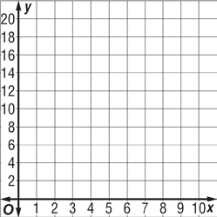
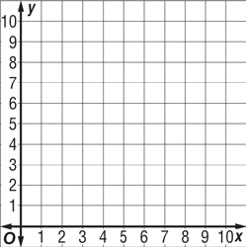
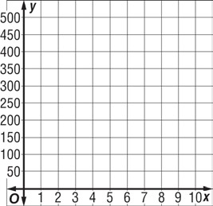
HW #3 Creating Tables and Graphing from an Equation.
Represent each relationship with a table and graph.
1. y = 5(x) 2. y = x + 2 3. y = 3x
x | y
x | y
x | y
4. y = 4x
5. y = x – 5
6. y = 3x – 2
x | y
x | y
x | y
7. A manatee eats an average of 70 pounds of
wet vegetation each day. The equation y = 70(x) describes the amount y that a manatee eats in x days. Graph the relationship.
x | y
Course 1 • Chapter 6 Multiple Representations

Slide 5
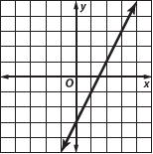
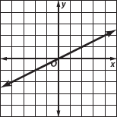
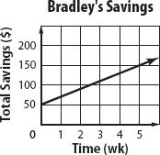
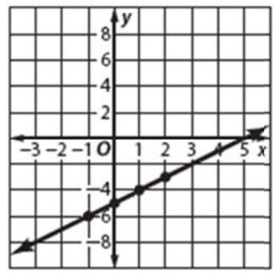
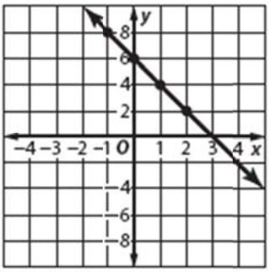
HW #4 Creating Tables and Writing Equations from Graphs
Create a table for each Graph. Then, write an Equation to represent the data.
1.
2.
Bradley has already saved $50. He continues to save more money each week at a rate of $20 per week. Create a table for the table, then answer the questions below.
  Write an equation to represent the total savings y for x weeks.
b. If Bradley saves for 4 weeks, what is the total amount of money he will have saved?
Write an equation for each line.
4.
5.
6.
7.

Slide 6
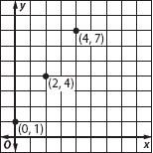
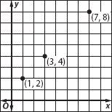
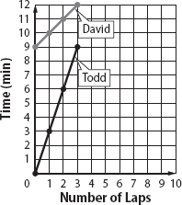
HW #5 Multiple Representations, Additive and Multiplicative
Additive Relationships: y = x + a & Multiplicative Relationships: y = ax
Determine if each relationship is an additive or multiplicative relationship. Then, write an equation for each table or graph or word problem.
1. 2.
Input (x) | 4 | 5 | 6
Output (y) | 7 | 8 | 9
Input (x) | 0 | 2 | 4
Output (y) | 0 | 8 | 16
3.
4.
Input (x) | 0 | 3 | 5
Output (y) | 0 | 27 | 45
Input (x) | 2 | 3 | 4
Output (y) | 9 | 10 | 11
5.
6.
7. A pizza place sells pizzas for $7 each plus a $4 delivery charge per order. If Pat orders 3 pizzas to be delivered, what will be his total cost?
A store sells used DVDs for $8 each and used videotapes for $6 each. The rule 8(d) + 6(v) can be used to represent the total selling price of DVDs d and videotapes v. Then use the rule to determine the price of 5 DVDs and 3 videotapes.
The graph shows the relationship between the number of laps Todd and David each run and the length of time it takes each to run those laps.
Write an equation for each relationship.

