Slide 1
Dulce et Decorum Est
Wilfred Owen

Slide 2
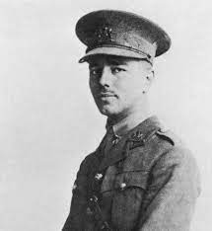
Wilfred Owen
When we study poetry, it is sometimes helpful to know about the poet.
If you were writing a poem, you wouldn’t write about something you didn’t know!
It’s the same in poetry - learning about the poet tells us about their feelings and ideas.
Look at the picture on the right - what can you guess about Wilfred Owen?

Slide 3
Wilfred Owen
Wilfred Owen was one of the most famous war poets in English literature. He was born on March 18, 1893, in Oswestry along the Welsh border.
In 1913, he had traveled to France as a part-time teacher in the Berlitz School of Languages to sustain a living.
In 1915, he returned home after the outbreak of war and became a member of the Artist’s Rifle.
Before the year ended, he went to France for the front line battle. Letters to his mother kept him alive as he described each phase of being a military man.
On May 2, 1917, he returned home after a shell-shock incident which made him unfit to lead the troops.
He met Siegfried Sassoon, the poet who influenced him to utilize his tragic experiences and nightmares of the war. Together with Sassoon, Robert Graves expanded his literary world.
In 1918, he returned to the front line in France. He also began writing and rewriting poems. He was awarded with the Military Cross for his bravery and leadership during the battle in Joncourt.Wilfred was preparing to publish his first collection when he died on November 4, 1918, as a result of a head shot while crossing the Sambre-Oise canal at Ors. Seven days later, his family received a telegram about his death.

Slide 4
Owen went to France to take part in the war. He wrote his mother letters whilst he was there
Owen returned home and joined the Army
Owen met Siegfried Sassoon who told him to use his experience to write poetry
Owen went to France to become a part time teacher
The war began
Owen returned home after being shell shocked
Owen was born
He went back to the war and unfortunately died by being shot in the head

Slide 5
So! What do we know?
Wilfred Owen went to war himself, so his poems are of his own experiences - what he saw, heard and felt during his time as a soldier.
Owen was encouraged to write about his experiences by his friend, Sassoon.
He spent a lot of time in and out of the army - Owen is known for writing about how bad it was for soldiers. He tried to tell his readers how awful it really was to be in the war.

Slide 6
Dulce Et Decorum Est
This is one of Owen’s most famous poems - does it look like English to you?
If not, can you guess which language it is in?

Slide 7
Latin
Dulce Et Decorum Est is Latin - it means It is sweet and fitting…
It comes from a saying, “Dulce Et Decorum Est, pro patria mori” which means
It is sweet and fitting to die for one’s country.
Do you think Wilfred Owen thought it was sweet and fitting (positive) to die for his country?

Slide 8

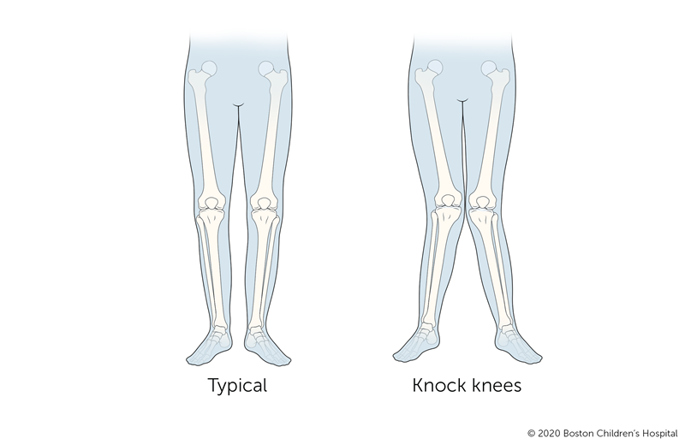

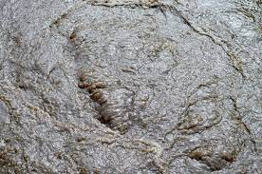
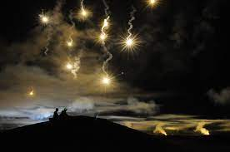
First stanza
Bent double, like old beggars under sacks,
Knock-kneed, coughing like hags, we cursed through sludge,
Till on the haunting flares we turned our backs,
And towards our distant rest began to trudge.
Men marched asleep. Many had lost their boots,
But limped on, blood-shod. All went lame; all blind;
Drunk with fatigue; deaf even to the hoots
Of gas-shells dropping softly behind.

Slide 9

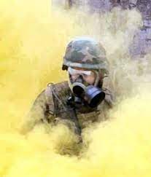
Stanza 2
Gas! GAS! Quick, boys!—An ecstasy of fumbling
Fitting the clumsy helmets just in time,
But someone still was yelling out and stumbling
And flound’ring like a man in fire or lime.—
Dim through the misty panes and thick green light,
As under a green sea, I saw him drowning.
In all my dreams before my helpless sight,
He plunges at me, guttering, choking, drowning.

Slide 10
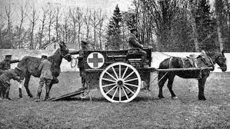
Last stanza
If in some smothering dreams, you too could pace
Behind the wagon that we flung him in,
And watch the white eyes writhing in his face,
His hanging face, like a devil’s sick of sin;
If you could hear, at every jolt, the blood
Come gargling from the froth-corrupted lungs,
Obscene as cancer, bitter as the cud
Of vile, incurable sores on innocent tongues,—
My friend, you would not tell with such high zest
To children ardent for some desperate glory,
The old Lie: Dulce et decorum est
Pro patria mori.
enthusiastic

