Slide 2
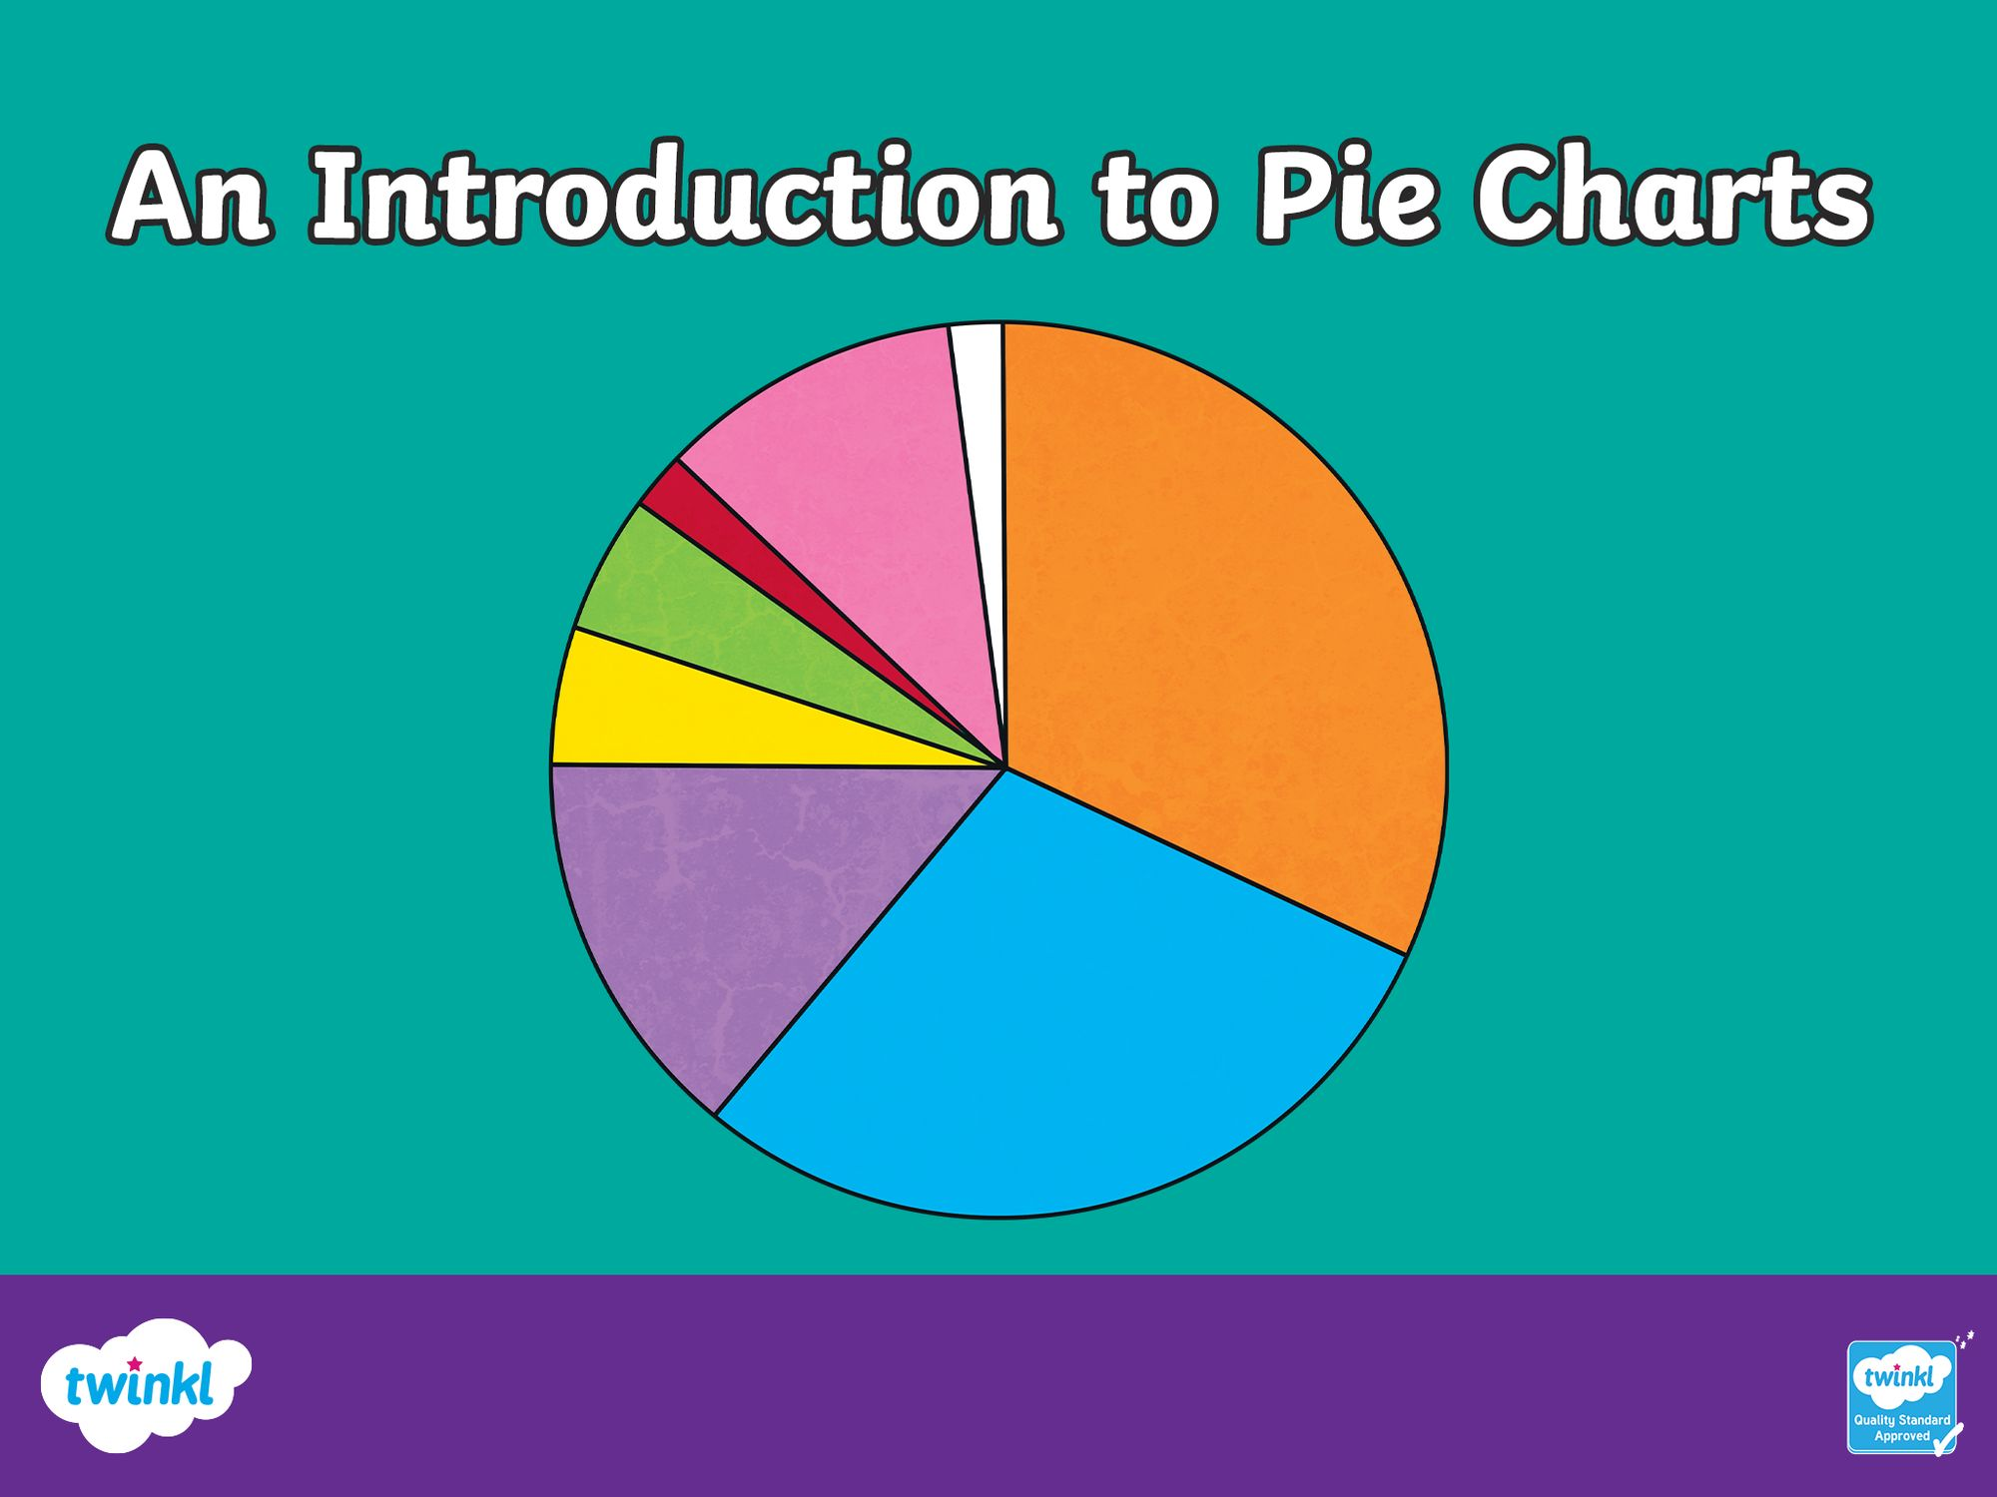

Slide 3

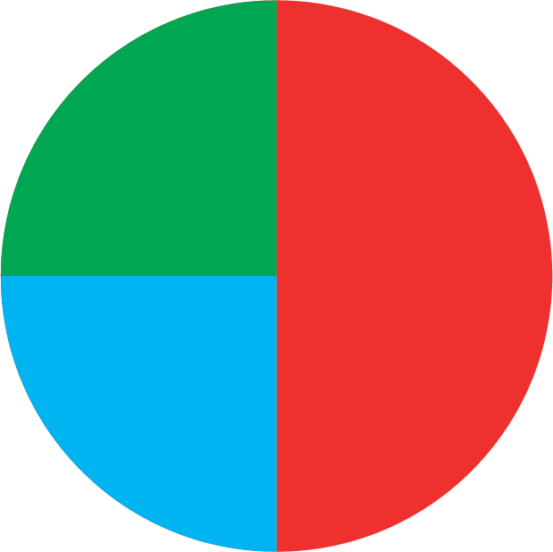
An Introduction to Pie Charts
Pie charts are a way of displaying information or data.
Each slice or sector of the chart or pie represents a different category.
Pie charts do not show actual amounts - they show proportions that represent the actual amount.
Favourite Colours
Green
25%
Red
50%
Blue
25%

Slide 4
An Introduction to Pie Charts
This pie chart shows the favourite colours of a group of 160 people surveyed.
What information does this pie chart give us?
In the group surveyed, half of the people liked red = 80 people.
In the group surveyed a quarter of the people liked green = 40 people.
A quarter of the people also liked blue = 40 people.
Favourite Colours
Green
Red
Blue

Slide 5
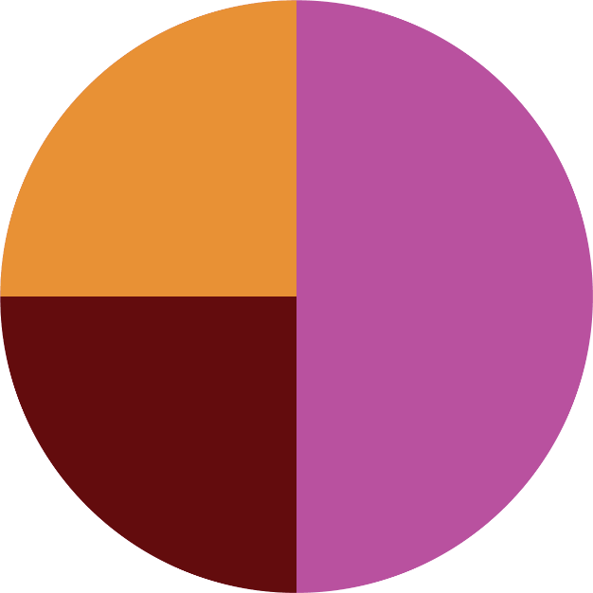
This pie chart tells us about the ice cream toppings a group of 20 people preferred.
What other information does it give us?
Half of the group surveyed preferred sprinkles on their ice cream.
Ice CreamToppings
One quarter of the group preferred hot fudge sauce on their ice cream.
One quarter of the group preferred chocolate flakes.
Hot fudge sauce
How many people preferred each topping?
Sprinkles = half of 20 = 10 people
Sprinkles
Chocolate
Flake
Hot fudge sauce = one quarter of 20 = 5 people
Chocolate flakes = one quarter of 20 = 5 people

Slide 6
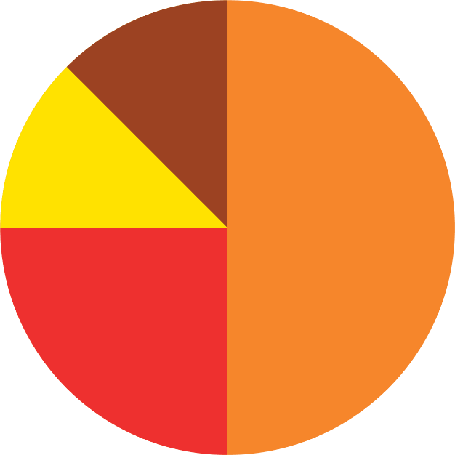
This pie chart shows the favourite choices of 48 children at a breakfast club.
How many children chose toast and butter?
Half of 48 = 24
How many children chose toast and jam?
One quarter of 48 = 12
How many children chose fruit and yogurt?
Breakfast Choices
One eighth of 48 = 6
How many children chose cereal?
Cereal
One eighth of 48 = 6
Fruit and
Yoghurt
Toast and
Butter
Toast and
Jam

Slide 7
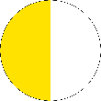


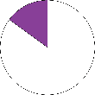
The following facts are important to help us read, understand and create pie charts:
A pie chart is a circle.
A circle is a full turn of 360°.
A pie chart represents a whole set of data or 100%. The sectors in a pie chart fit together to make 100%.
Pie charts show fractions and percentages of a whole set of data.
We can use data to find the angles and create the sectors of a pie chart.
Percentage | Fraction | Angle
100% | one whole or 1 | 360°
50% | one half or ½ | 180°
75% | three quarters or ¾ | 270°
25% | one quarter or ¼ | 90°
10% | one tenth or ⅒ | 36°

Slide 8
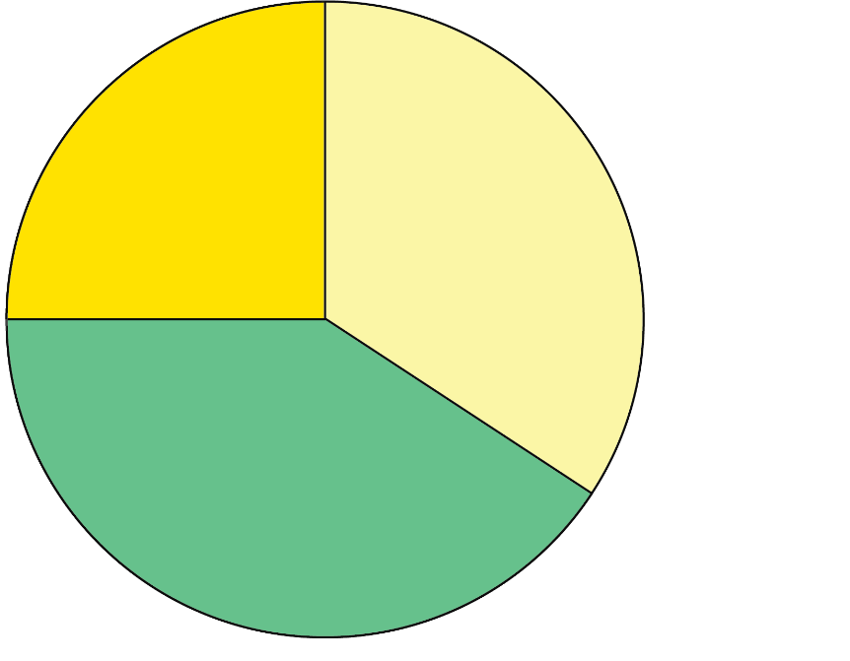
Creating a Pie Chart
36 pupils were asked about their favourite pizza topping.
There are 36 pupils in the whole set of data, so 36 pupils equals 360° on the pie chart.
360 ÷ 36 = 10 so one pupil is represented on the pie chart by 10°.
Favourite Pizza Toppings
Favourite Pizza Toppings
Ham - 12 pupils so 12 × 10 = 120°
Pepper - 15 pupils so 15 × 10 = 150°
Cheese - 9 pupils so 9 × 10 = 90°
Here is a pie chart displaying all the data.
Cheese
Ham
Pepper

Slide 9
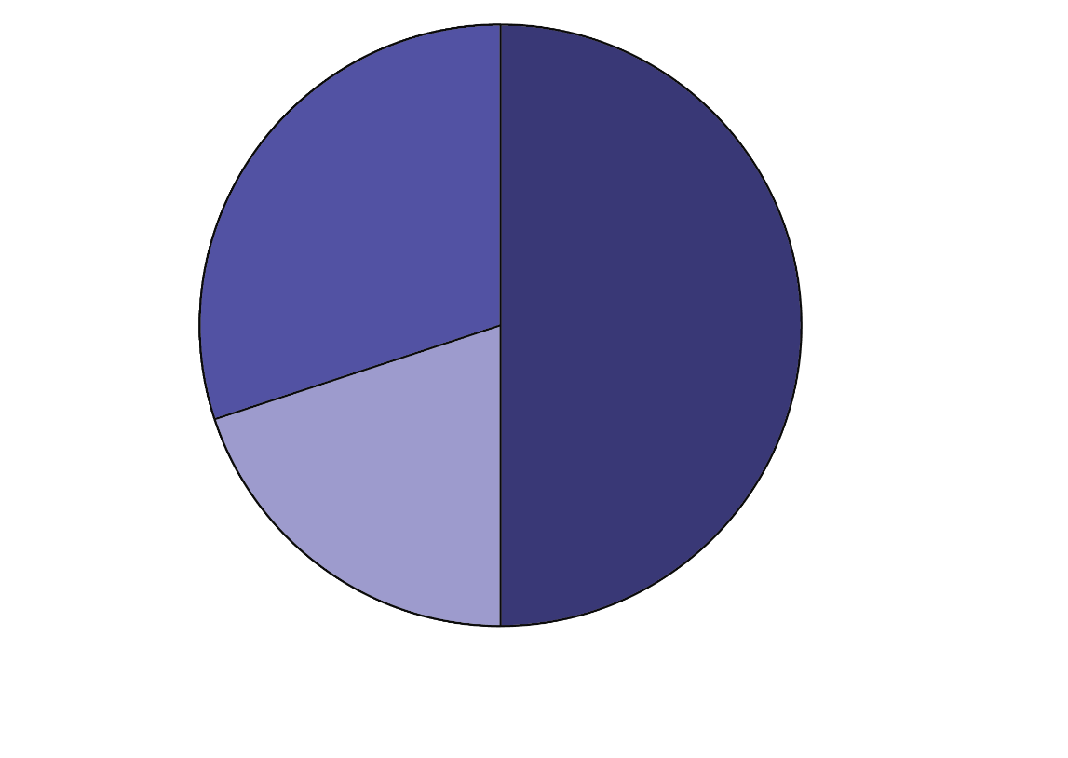
Creating a Pie Chart
36 people were asked what their favourite flower was.
There are 36 people in the whole set of data, so 36 people equal 360° on the pie chart.
360 ÷ 36 = 10 so one person is represented on the pie chart by 10°.
What angle should each sector be?
Favourite Flowers
Favourite Flowers
Daffodil = 18 people so 18 × 10 = 180°
Sunflower = 11 people so 11 × 10 = 110°
Rose = 7 people so 7 × 10 = 70°
Sunflower
Daffodil
Here is a pie chart displaying all the data.
Rose

Slide 10
Creating a Pie Chart
A pie chart represents a whole set of data or a whole population. 100% is represented by 360°.
1800 people were asked their favourite holiday destination.
Favourite Holiday Destination | Number of people
Scotland | 580
Spain | 465
Italy | 148
France | 343
Canada | 264
Total | 1800
To calculate the angle for Scotland 580 × 360° = 116°
1800
To calculate the angle for Scotland 580 × 100 = 32% to
the nearest whole percentage.
1800
Can you calculate the angle and percentage for the other holiday destinations?

Slide 11
Favourite Holiday Destination | Number of people | Number of degrees | Percentage of the total
Scotland | 580 | 116° | 32% (to the nearest whole %)
Spain | 465 | 93° | 26% (to the nearest whole %)
Italy | 149 | 30° (to the nearest whole °) | 8% (to the nearest whole %)
France | 341 | 68° (to the nearest whole °) | 19% (to the nearest whole %)
Canada | 265 | 53° | 15% (to the nearest whole %)
Total | 1800 | 360° | 100%
Can you draw the pie chart for this data? Label the sectors and include their percentage.
Write two statements about the data you have displayed.

Slide 12
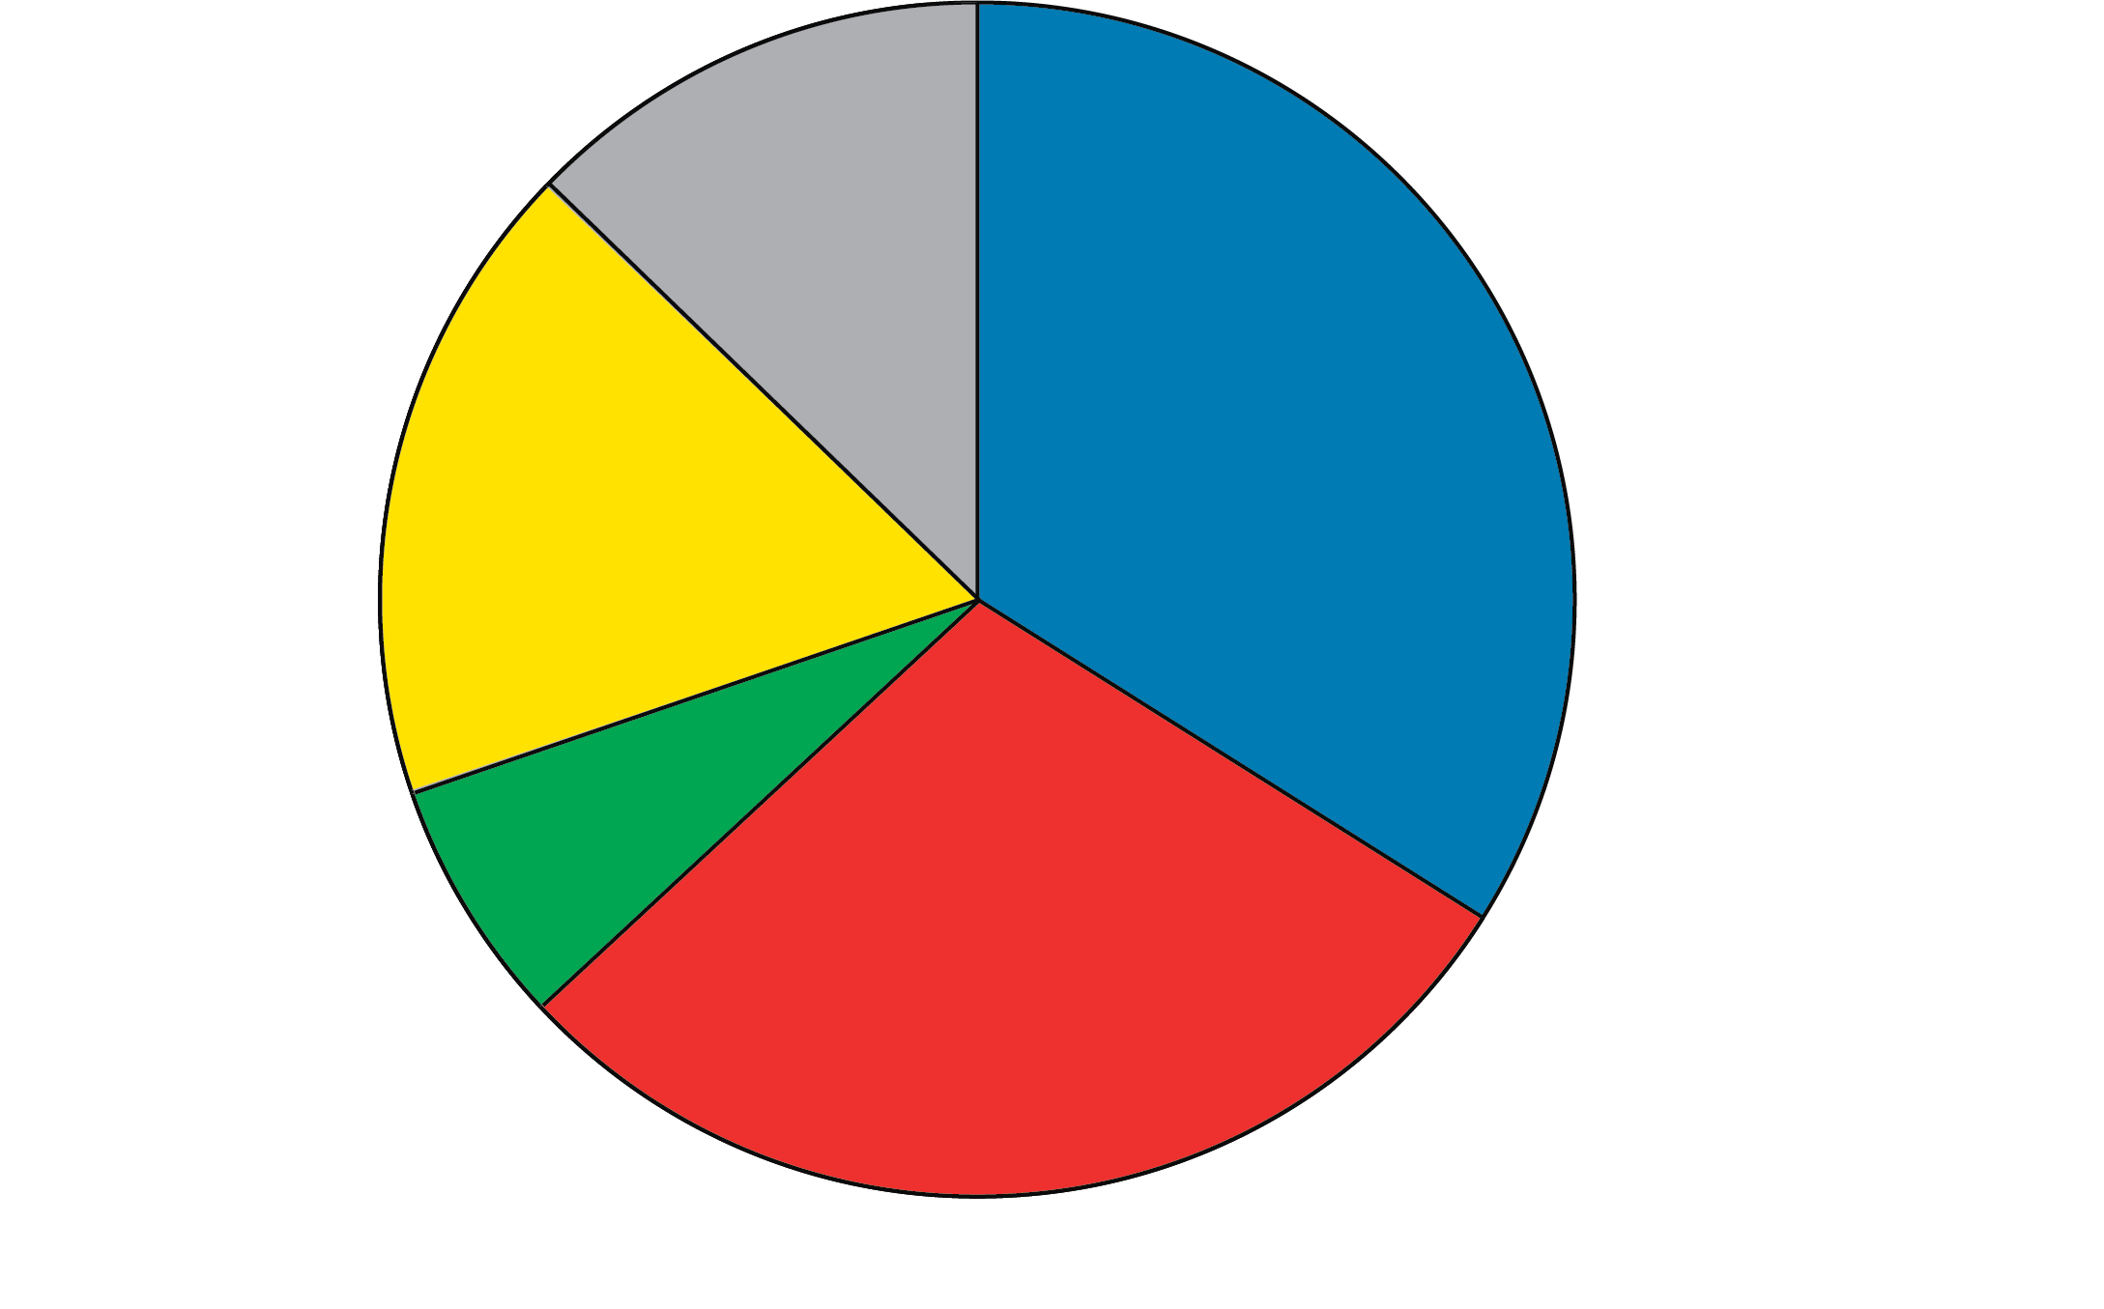
Favorite Holiday Destinations
Canada
14.7%
France
18.9%
Scotland
32.2%
Italy
8.3%
Spain
25.8%

Slide 13
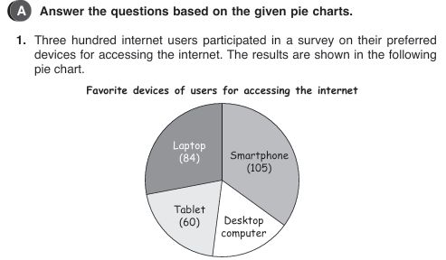

Slide 14
