Slide 1

Factoring Polynomials: A Comprehensive Guide
Welcome to this presentation exploring the world of factoring polynomials. Whether you're a student learning algebra or a math enthusiast, this guide will provide a clear and comprehensive understanding of the various methods and applications of factoring.
RO
by Rejoice Onwurah

Slide 2
Introduction to Polynomials
What is a Polynomial?
Examples:
A polynomial is a mathematical expression consisting of variables and coefficients, combined using addition, subtraction, and multiplication. They are generally written in descending order of their exponents, from highest to lowest. The degree of the polynomial is the highest power of the variable.
A simple polynomial is x^2 + 2x - 3. This is a quadratic polynomial because the highest power of the variable x is 2. Other examples include 3x^3 - 5x (cubic) and 7x^5 + 2x^2 - 1 (quintic).

Slide 3
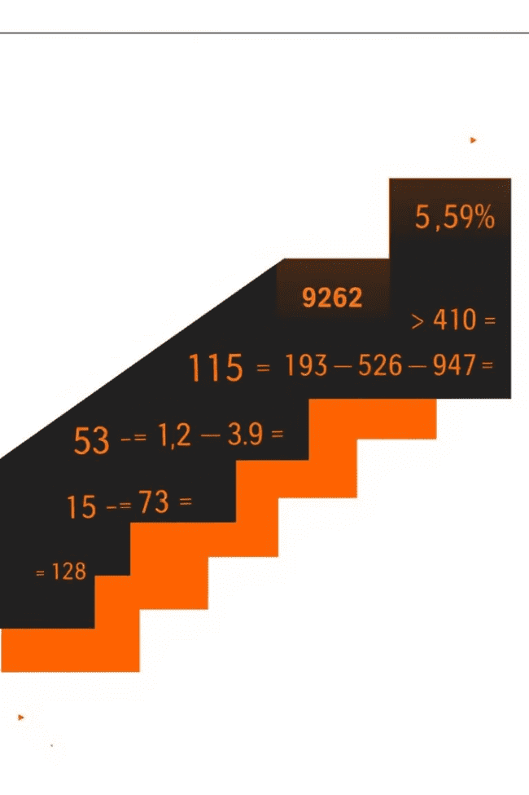
Greatest Common Factor (GCF)
1
1. Find the GCF of the terms
2
2. Factor out the GCF
Divide each term in the polynomial by the GCF and write the result in parentheses. The GCF is written outside the parentheses.
Identify the greatest common factor (GCF) of all the terms in the polynomial. The GCF is the largest factor that divides all the terms.
3
3. Simplify
Simplify the expression if possible. The factored polynomial is the product of the GCF and the expression in parentheses.

Slide 4
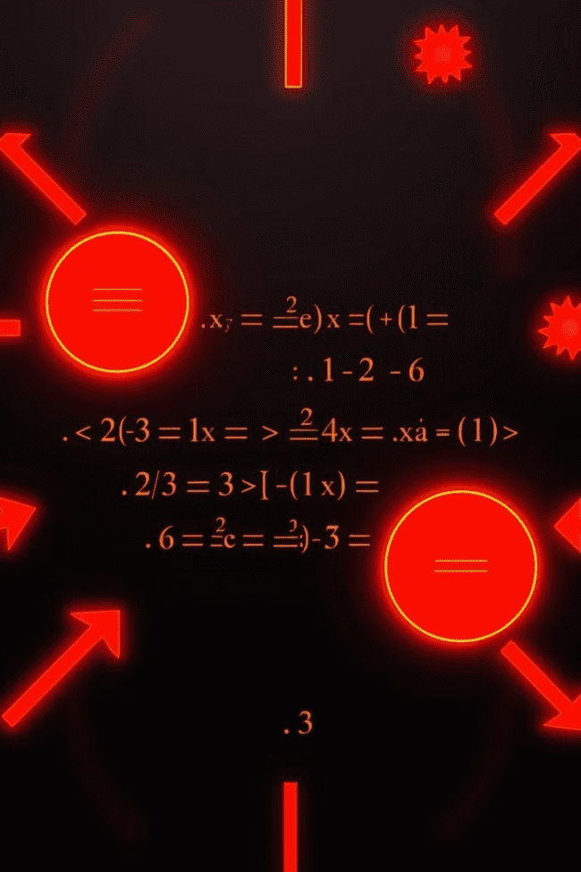
Factoring by Grouping
Step 1: Group terms
Step 2: Factor out the GCF
Group terms of the polynomial in pairs, considering common factors within each group.
Factor out the greatest common factor from each group. This should lead to a common binomial factor in both groups.
Step 3: Factor out the common binomial
Factor out the common binomial from the two terms, leaving a product of the GCFs and the common binomial factor.

Slide 5
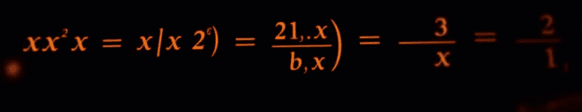


Factoring Trinomials of the Form x^2 + bx + c
Find two numbers that add up to b and multiply to c
Write the trinomial as a product of two binomials
Identify two numbers that add up to the coefficient of the middle term (b) and multiply to the constant term (c).
Express the trinomial as a product of two binomials, using the two numbers found in the previous step. The signs of the binomials depend on the signs of b and c.

Slide 6
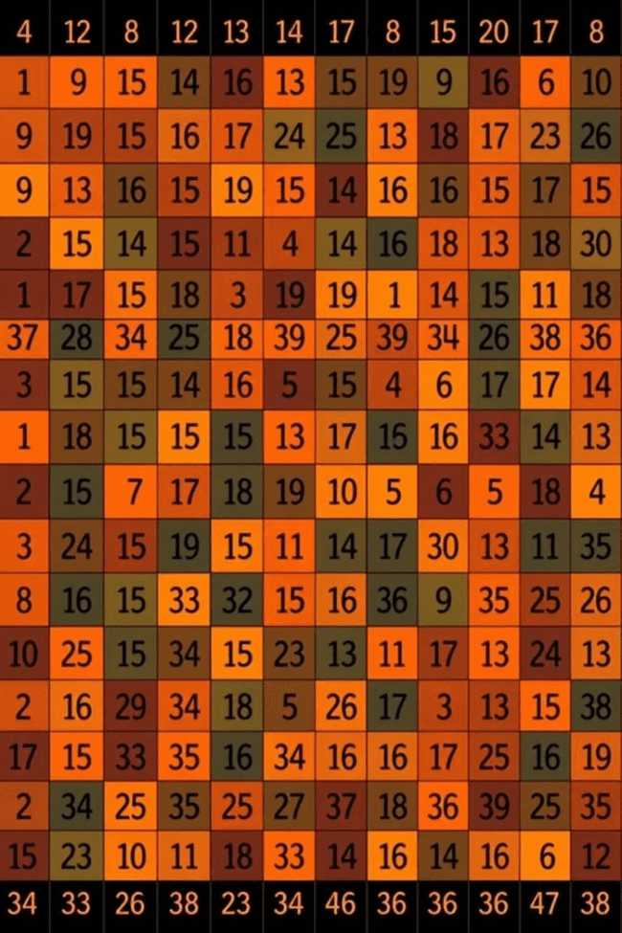
Factoring Trinomials of the Form ax^2 + bx + c
1
1. Multiply a and c
Multiply the coefficient of the leading term (a) by the constant term (c).
2
2. Find two numbers that add up to b and multiply to ac
Find two numbers that add up to the coefficient of the middle term (b) and multiply to the product ac.
3
3. Rewrite the middle term
Rewrite the middle term (bx) as the sum of two terms using the two numbers found in step 2.
4
4. Factor by grouping
Factor the polynomial by grouping, using the steps outlined in the previous section.

Slide 7
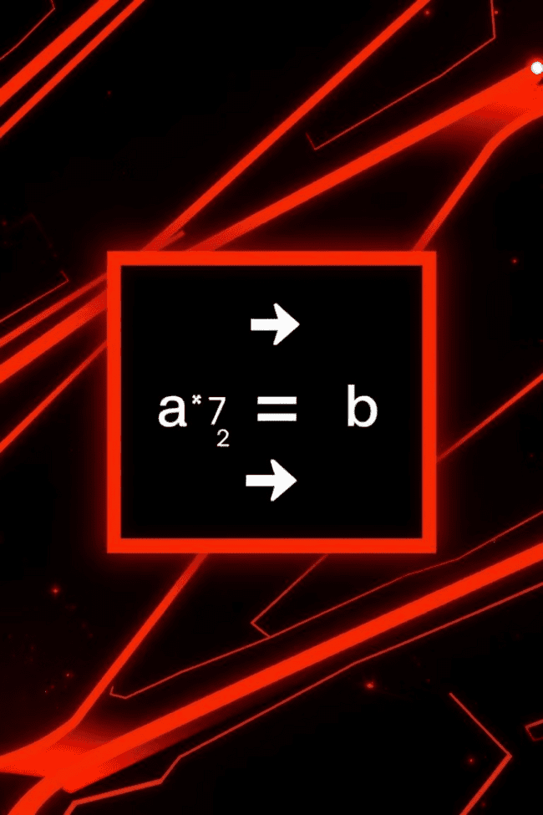


Factoring Difference of Squares
Recognize the pattern
The difference of squares pattern occurs when a polynomial is written as the square of one term minus the square of another term.
Apply the formula
The difference of squares can be factored using the formula: a^2 - b^2 = (a + b)(a - b). The result is the product of two binomials, one with a sum and the other with a difference.

Slide 8


Factoring Sum and Difference of Cubes
Recognize the pattern
1
The sum and difference of cubes are specific patterns that allow for quick factoring.
Apply the formulas
2
The sum of cubes is factored as a^3 + b^3 = (a + b)(a^2 - ab + b^2). The difference of cubes is factored as a^3 - b^3 = (a - b)(a^2 + ab + b^2).

Slide 9
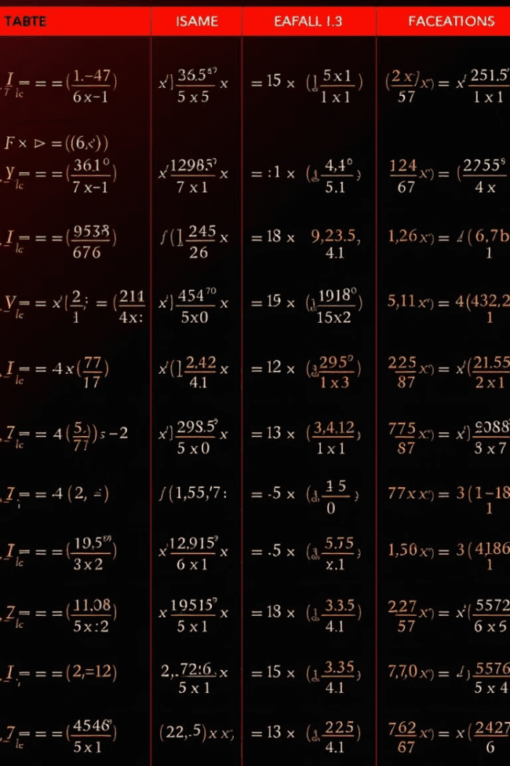
Applications of Factoring Polynomials
1
Solving Equations
Factoring allows us to solve polynomial equations by setting the factored expression equal to zero and finding the roots (solutions).
2
Simplifying Expressions
Factoring can help simplify complex expressions by reducing them to a product of simpler terms.
3
Solving Real-World Problems
Factoring can be applied in various fields like physics, engineering, and economics to model and solve real-world problems involving polynomials.

Slide 10

Conclusion and Key Takeaways
Understanding factoring polynomials is crucial for success in algebra and beyond. From solving equations to simplifying expressions, factoring provides essential tools for various mathematical tasks. By mastering these techniques, you'll be well-equipped to tackle a wide range of problems involving polynomials.

