Slide 1
How to plot the graph of the reciprocal of a function?
Given the function y = F(x), the question is how to define and plot the graph of G(x) = 1/ F(x).
Four simple rules are given below about how the graph main characteristics of F(x) (extrema, asymptotes, X-intercept points) are transformed in the graph of 1/F(x).
In addition, the following applies:
Point-by-point correspondence: if (x,y) is a point of F(x), then (x, 1/y) is the corresponding point of G(x),
If F(x) is increasing in a given interval of x, then G(x) = 1/F(x) is decreasing in the same interval,
Vice-versa: if F(x) is decreasing in a given interval of x, then G(x) = 1/F(x) is increasing in the same interval.
Rule 1: Transformation of extrema
If (a,b) is a maximum of F(x) , then (a,1/b) is a minimum of G(x),
If (a,b) is a minimum of F(x) , then (a,1/b) is a maximum of G(x).
Rule 2: Horizontal asymptotes
A horizontal asymptote of F(x) e.g. y = b becomes a horizontal asymptote y = 1/b of G(x).
In other words:
If Limit of F(x) when x goes to -∞ is b, then: Limit of G(x) when x goes to -∞ is 1/b,
If Limit of F(x) when x goes to +∞ is b, then: Limit of G(x) when x goes to +∞ is 1/b .
Arnaud Nougues
Math Tutoring

Slide 2
How to plot the graph of the reciprocal of a function? (continued)
Rule 3: Vertical asymptotes
A vertical asymptote x = a of F(x) becomes a x-intersect point (a, 0) of G(x).
In other words: If Limit of F(x) when x goes to a is +∞ or -∞, then: G(a) = 0 .
Rule 4: X-intersect points - this is the reciprocal of rule 3 -
A x-intersect point of F(x) for instance a such that F(a) = 0 becomes a vertical asymptote x = a of G(x).
In other words:
If F(a) = 0 and F is increasing at point a, then:
  Limit of G(x) when x goes to a⁻ is -∞
  Limit of G(x) when x goes to a⁺ is +∞
If F(a) = 0 and F is decreasing at point a, then:
  Limit of G(x) when x goes to a⁻ is +∞
  Limit of G(x) when x goes to a⁺ is -∞

Slide 3
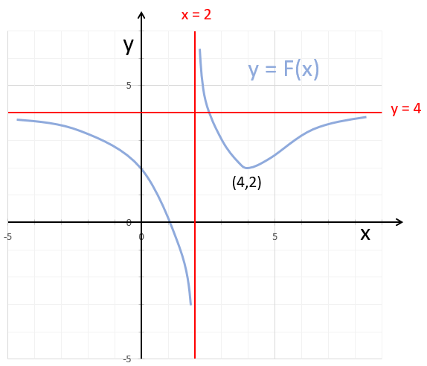
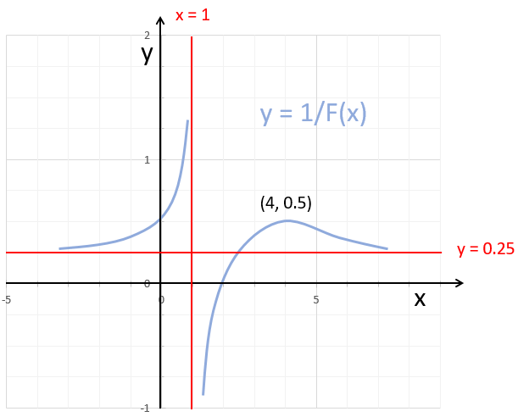
Example:
F(x) and 1/F(x) graphs characteristics:
Transformation of extrema: (4,2) minimum of F
→ (4, 0.5) maximum of 1/F
2. Horizontal asymptote: Horizontal asymptote of F: y = 4
→ Horizontal asymptote of 1/F: y = 0.25
3. Vertical asymptote: Vertical asymptote of F: x = 2
→ x-intersect point of 1/F: (2. 0)
4. X-intersect point: X-intersect point of F (1, 0)
→ vertical asymptote of 1/F: x = 1

