Slide 1

Unraveling the Secrets of Mathematical Induction: A Journey from Basics to Brilliance

Slide 2






Introduction to Induction
Welcome to the fascinating world of
! This presentation will guide you through the and
of this powerful proof technique. Prepare to embark on a journey that transforms your understanding of mathematics into a
realm of and .

Slide 3
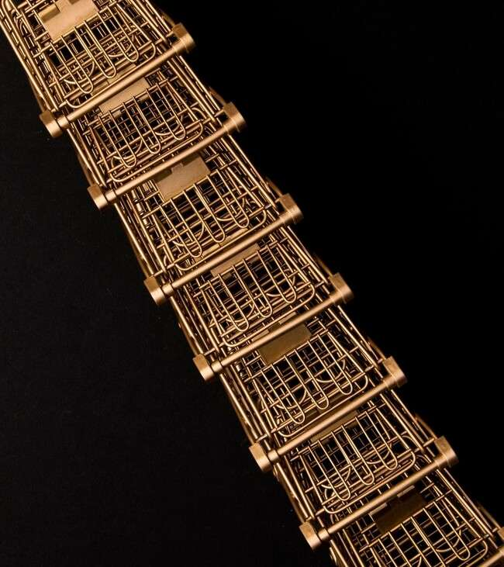




What is Mathematical
Induction?
is a method used to prove statements about
. It consists of two main steps:
the and the . Understanding these steps is crucial as they form the backbone of this elegant
mathematical tool.

Slide 4




Base Case Explained
The establishes the truth of a statement for the , usually . This step acts as the foundation upon which the rest of the proof is built, ensuring that the induction process can
effectively.

Slide 5


Inductive Step Demystiﬁed
The involves assuming the statement holds for some arbitrary and then proving it for
. This leap is what allows us to conclude that the statement is true for all greater than or equal to the base case.

Slide 6







Applications of Induction
Mathematical induction is not just a theoretical concept; it has
in areas such as
,
, and
. Understanding these
applications can enhance your problem-solving skills and deepen your appreciation for mathematics.

Slide 7



Common Pitfalls
While using mathematical induction, it's easy to fall into common such as skipping the base case or incorrectly assuming the inductive hypothesis. Awareness of these pitfalls can help you avoid and strengthen your proofs.

Slide 8




Mastering Induction Techniques
To truly master
, practice is key. Engage with diverse problems, explore different strategies, and challenge yourself to think creatively. This will not only improve your skills but also make the learning process
.

Slide 9

Conclusion: The Induction Journey
In conclusion, the journey through
reveals its elegance and power. By mastering this technique, you unlock new avenues in mathematics and develop a deeper understanding of how to construct .
Embrace the brilliance of induction!

Slide 10
Thanks!
Do you have any questions? youremail@email.com
+91 620 421 838
www.yourwebsite.com @yourusername

