Slide 1






Math Topics
By.Teacher Sam

Slide 2

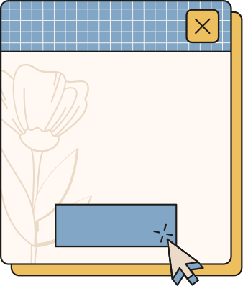
Exponentiation
  Exponential Numbers with Integer Exponents
2. Multiplication and Division of Exponential numbers with Integer Exponents
3. Scientific Notation
4. Real-Life Applications

Slide 3
Real Numbers
  Writing Fractions as Recurring Decimals
2. Square Roots and Cube roots.
3. Real Numbers
4. Real-Life Applications

Slide 4
Polynomials
  Algebraic Expressions
2. Adding and Subtracting Polynomials
3. Multiplying Polynomials
4. Dividing Polynomials

Slide 5
Geometric Transformation
  Transformation
2. Translation
3. Rotation
4. Reflection

Slide 6
Congruence
  Geometric Figures
2. Triangles
3. Real Life Applications

