Slide 1

Read the headings and say what they have in common.
Dreaming Of A Trip At 100
A Grandma Sets A Record
98-Year-Old Teacher Inspires Community
A Skydiving Present For His 100th Birthday
Notes:
Do this task before revealing the lesson topic to the students.
Possible answer: elderly people doing sports/extreme sports/something interesting.
Reveal the title and ask your students if they agree with it and why or why not.

Slide 2
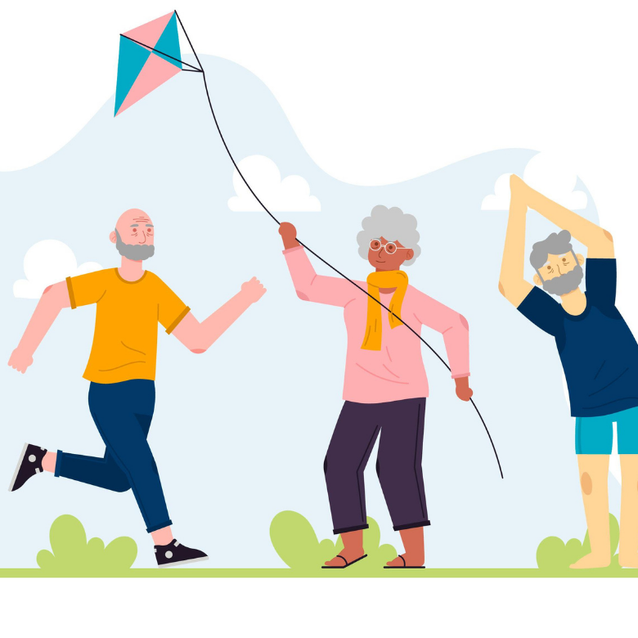
You’re never too old for great things
Notes:
To get an editable version of this presentation:
1. Click File > Make a copy > Entire presentation
OR
2. Click File > Download > Microsoft Powerpoint

Slide 3

Let’s get started
with a warm-up
ESL Brains

Slide 4
Think of three pieces of information that you expect to read in each article with the headings below.
Dreaming Of A Trip At 100
A Grandma Sets A Record
98-Year-Old Teacher Inspires Community
A Skydiving Present For His 100th Birthday

Slide 5

It’s reading time!
ESL Brains

Slide 6
part 1/3
Read the texts, check your ideas and match the headings with the texts. There is one heading you do not need to use.
Dreaming Of A Trip At 100
98-Year-Old Teacher Inspires Community
A Grandma Sets A Record
A Skydiving Present For His 100th Birthday
Johanna Quaas was born in 1925 in Germany and started doing gymnastics at an early age. She took part in her first competition in 1934. In 2012, Johanna got into the Guinness Book of Records as the oldest gymnast in the world. Johanna, who is now a grandmother and mother of three, has been married to Gerhard Quaas, a gymnast coach, for more than 50 years.

Slide 7
part 2/3
Read the texts, check your ideas and match the headings with the texts. There is one heading you do not need to use.
Dreaming Of A Trip At 100
98-Year-Old Teacher Inspires Community
A Grandma Sets A Record
A Skydiving Present For His 100th Birthday
Weifeng Yuan, from Richmond, Canada has helped thousands of people in his community to become healthier. He came to Canada from China in 1981 and in 1992 he founded the Richmond Wellness Centre, where he teaches tai chi to 100–200 people every day. Weifeng learned tai chi when he worked in Hong Kong. He likes tai chi so much that he has recently written a song about it!

Slide 8
part 3/3
Read the texts, check your ideas and match the headings with the texts. There is one heading you do not need to use.
Dreaming Of A Trip At 100
98-Year-Old Teacher Inspires Community
A Grandma Sets A Record
A Skydiving Present For His 100th Birthday
Gloria Tramontine Struck is 90 but she still rides her Harley Davidson motorcycle and wants to go on a cross-country trip when she is 100. When she was born, her father had a motorcycle shop. ‘I’ve been with motorcycles every day of my life,’ she says. She learned to ride when she was 16 and since then she has owned 14 motorcycles. Over the years, she has taken part in many races and motorcycling events in the USA and Europe.

Slide 9
part 1/3
Let’s check the answers.
Dreaming Of A Trip At 100
98-Year-Old Teacher Inspires Community
A Grandma Sets A Record
A Skydiving Present For His 100th Birthday
A Grandma Sets A Record
Johanna Quaas was born in 1925 in Germany and started doing gymnastics at an early age. She took part in her first competition in 1934. In 2012, Johanna got into the Guinness Book of Records as the oldest gymnast in the world. Johanna, who is now a grandmother and mother of three, has been married to Gerhard Quaas, a gymnast coach, for more than 50 years.

Slide 10
part 2/3
Let’s check the answers.
Dreaming Of A Trip At 100
98-Year-Old Teacher Inspires Community
A Skydiving Present For His 100th Birthday
98-Year-Old Teacher Inspires Community
Weifeng Yuan, from Richmond, Canada has helped thousands of people in his community to become healthier. He came to Canada from China in 1981 and in 1992 he founded the Richmond Wellness Centre, where he teaches tai chi to 100–200 people every day. Weifeng learned tai chi when he worked in Hong Kong. He likes tai chi so much that he has recently written a song about it!

Slide 11
part 3/3
Let’s check the answers.
Dreaming Of A Trip At 100
A Skydiving Present For His 100th Birthday
Dreaming Of A Trip At 100
Gloria Tramontine Struck is 90 but she still rides her Harley Davidson motorcycle and wants to go on a cross-country trip when she is 100. When she was born, her father had a motorcycle shop. ‘I’ve been with motorcycles every day of my life,’ she says. She learned to ride when she was 16 and since then she has owned 14 motorcycles. Over the years, she has taken part in many races and motorcycling events in the USA and Europe.

Slide 12
part 1/3
Read the texts again and decide whether the statements are true (T) or false (F).
Johanna Quaas was born in 1925 in Germany and started doing gymnastics at an early age. She took part in her first competition in 1934. In 2012, Johanna got into the Guinness Book of Records as the oldest gymnast in the world. Johanna, who is now a grandmother and mother of three, has been married to Gerhard Quaas, a gymnast coach, for more than 50 years.
Johanna took part in her first competition when she was at college.
Johanna got married when she was 50 years old.

Slide 13
part 1/3
Let’s check the answers.
Johanna Quaas was born in 1925 in Germany and started doing gymnastics at an early age. She took part in her first competition in 1934. In 2012, Johanna got into the Guinness Book of Records as the oldest gymnast in the world. Johanna, who is now a grandmother and mother of three, has been married to Gerhard Quaas, a gymnast coach, for more than 50 years.
Johanna took part in her first competition when she was at college.
Johanna got married when she was 50 years old.
False, Johanna took part in her first competition in 1934, which means she was 9.
False, Johanna has been married for more than 50 years.

Slide 14
part 2/3
Read the texts again and decide whether the statements are true (T) or false (F).
Weifeng Yuan, from Richmond, Canada has helped thousands of people in his community to become healthier. He came to Canada from China in 1981 and in 1992 he founded the Richmond Wellness Centre, where he teaches tai chi to 100–200 people every day. Weifeng learned tai chi when he worked in Hong Kong. He likes tai chi so much that he has recently written a song about it!
Weifeng has lived in Canada since 1981.
Weifeng taught tai chi in Hong Kong.

Slide 15
part 2/3
Let’s check the answers.
Weifeng Yuan, from Richmond, Canada has helped thousands of people in his community to become healthier. He came to Canada from China in 1981 and in 1992 he founded the Richmond Wellness Centre, where he teaches tai chi to 100–200 people every day. Weifeng learned tai chi when he worked in Hong Kong. He likes tai chi so much that he has recently written a song about it!
Weifeng has lived in Canada since 1981.
Weifeng taught tai chi in Hong Kong.
True, Weifeng came to Canada in 1981.
False, Weifeng learned tai chi in Hong Kong.

Slide 16
part 3/3
Read the texts again and decide whether the statements are true (T) or false (F).
Gloria Tramontine Struck is 90 but she still rides her Harley Davidson motorcycle and wants to go on a cross-country trip when she is 100. When she was born, her father had a motorcycle shop. ‘I’ve been with motorcycles every day of my life,’ she says. She learned to ride when she was 16 and since then she has owned 14 motorcycles. Over the years, she has taken part in many races and motorcycling events in the USA and Europe.
Gloria has 14 motorcycles.
Gloria started riding a motorcycle when she was a teenager.

Slide 17
part 3/3
Let’s check the answers.
Gloria Tramontine Struck is 90 but she still rides her Harley Davidson motorcycle and wants to go on a cross-country trip when she is 100. When she was born, her father had a motorcycle shop. ‘I’ve been with motorcycles every day of my life,’ she says. She learned to ride when she was 16 and since then she has owned 14 motorcycles. Over the years, she has taken part in many races and motorcycling events in the USA and Europe.
Gloria has 14 motorcycles.
Gloria started riding a motorcycle when she was a teenager.
False, Gloria has owned 14 motorcycles.
True, Gloria learned to ride when she was 16.

Slide 18

It’s grammar time!

Slide 19
Study the rules about Present Perfect and Past Simple and match the sentences to the rules.
RULE
We use Past Simple to talk about experiences if we mention a specific time in the past.
We use Present Perfect to talk about experiences when we don’t mention a specific time.
We use Past Simple to talk about something that finished in the past.
We use Present Perfect to talk about a period of time that continues until now.
Weifeng learned tai chi when he worked in Hong Kong.
He likes tai chi so much that he has recently written a song about it!
‘I’ve been with motorcycles every day of my life,’ she says.
She took part in her first competition in 1934.

Slide 20
Let’s check the answers.
RULE
We use Past Simple to talk about experiences if we mention a specific time in the past.
We use Present Perfect to talk about experiences when we don’t mention a specific time.
We use Past Simple to talk about something that finished in the past.
We use Present Perfect to talk about a period of time that continues until now.
Weifeng learned tai chi when he worked in Hong Kong.
He likes tai chi so much that he has recently written a song about it!
‘I’ve been with motorcycles every day of my life,’ she says.
She took part in her first competition in 1934.
Notes:
Elicit possible adverbs and time expressions for Past Simple (e.g. yesterday, a week ago, ‘when’ clauses, etc.) and Present Perfect (e.g. just, already, yet, recently).

Slide 21

Let’s talk!
ESL Brains

Slide 22

Discuss the questions.
Which story impressed you the most? Why?
Do you know other stories like these?
How old is the oldest member of your family? Are they active?
Do you know anyone who is active at an older age? What do they do?

Slide 23

In a moment, you’ll watch a video about:
a man named Tilmann Waldthaler, who is 78 years old

Slide 24
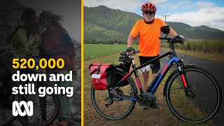
Put a tick (✓) next to the topics that are discussed in the video.
cycling
Tilmann’s health
the weather in New Zealand
Tilmann’s wife
car racing
Tilmann’s job
Tilmann’s plans

Slide 25
Let’s check the answers.
cycling
Tilmann’s health
the weather in New Zealand
Tilmann’s wife
car racing
Tilmann’s job
Tilmann’s plans

Slide 26
Watch the first part of the video again (to 00:47) and write sentences to explain the following numbers.
1977
520,000
five

Slide 27
Let’s check the answers.
1977
520,000
five
He started cycling in 1977.
Altogether he has cycled 520,000 kilometres.
He spent five years on his first big trip from New Zealand to Norway.
Notes:
TIMESTAMPS:
00:06
00:15
00:40

Slide 28
Choose the correct verb form.
His first big trip from New Zealand to Norway changed/has changed him a lot.
Since he started his cycling trips, Tilmann met/has met a few celebrities.
They were/have been together since they met.

Slide 29
Watch the rest of the video again (00:48-01:52) and check.
His first big trip from New Zealand to Norway changed/has changed him a lot.
Since he started his cycling trips, Tilmann met/has met a few celebrities.
They were/have been together since they met.

Slide 30
Let’s check the answers.
His first big trip from New Zealand to Norway changed/has changed him a lot.
Since he started his cycling trips, Tilmann met/has met a few celebrities.
They were/have been together since they met.
Notes:
TIMESTAMPS:
00:53
00:58
01:32

Slide 31
Let’s discuss!
ESL Brains

Slide 32
Discuss the questions.
Would you like to do something like that when you grow old? Why/Why not?
Do you think there are a lot of people like the ones you have read about and seen in this lesson?
What should we do to make sure we are in such good shape when we’re older?
Do you think such stories can inspire young people to be more mindful of their lifestyle? If so, how?
Did any of these stories inspire you to change something about your lifestyle? Why/Why not?

Slide 33
Let’s imagine!
ESL Brains

Slide 34
Imagine yourself in your 80s. Think about your life and what you might do and like at that age. Think about the following areas and make notes if you need to.
sport
family
work
travel
home
relationships
hobbies

Slide 35
In pairs, tell each other about your lives in your 80s using the notes you prepared
and Past Simple and Present Perfect.
Then, ask each other two questions
about what you have said.

Slide 36
THANKS!
ESL Brains

