Slide 1
Introduction into economics

Slide 2
Objectives
Define the term 'Economics'
Understand the basic economic question and how economic agents attempt to answer three basic questions
Illustrate how the concept of opportunity cost can be explained through the use of production possibilities curves/frontiers

Slide 3
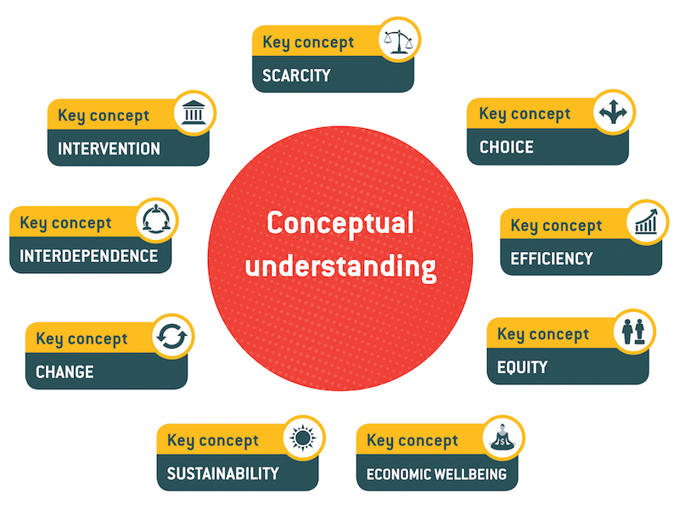
Key concepts
Have a look at the key concepts for economics. Give some thought as to how you interpret them and what they mean to you. (10 min)
Watch the video and share with the class if your initial thoughts about the concepts were correct. (This is an exercises, do not worry about making mistakes)

Slide 4
What do economists do? (EQ)
In pairs, discuss what you think it is that economists do. (5 min and share with class)
Watch the video and conclude in what way the speaker’s views align with yours.
Why are the issues he brings up economic issues?
Now in pairs read the given article.
Brainstorm on why global warming in an economic issue.

Slide 5
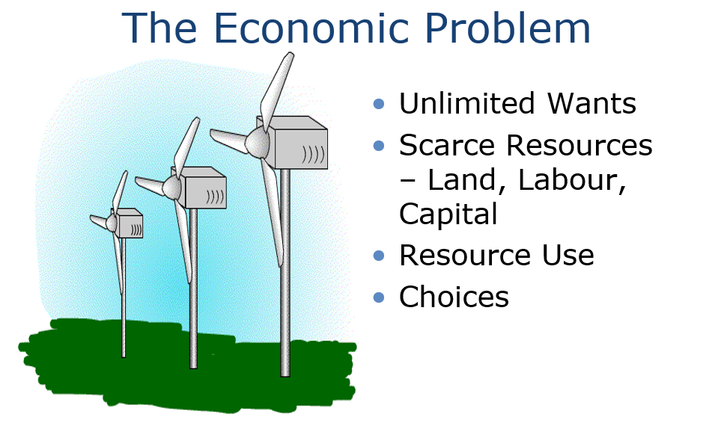
Notes:
Discussion can take place here about the key elements of the economic problem – the unlimited wants of humans against the scarce resources that exist to meet those wants. The notion of supply and demand can be introduced here and students can be involved by making a list of all the things they would like to buy if they had unlimited amounts of money! If then asked to trim that list down to meet a budget the more outrageous items disappear. This then introduces the notion of having to make choices – this issue can be discussed further using examples drawn from students own experiences about the choices they have had to make – possibly involving the choice of subjects they have had to make at college or school in relation to the time available etc! How we use our scarce resources can also be linked into this discussion. The wind turbines highlight an issue raised in the In the News section (http://www.bized.ac.uk/cgi-bin/chron/chron.pl?year=2003&locale=uk&quart=0 - 14th July) about the intention to build wind farms in areas of the UK and the controversies that it creates – useful to link theory and practice at an early stage.

Slide 6
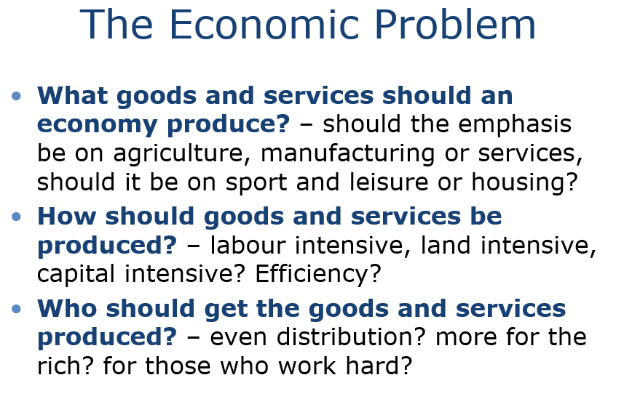
Notes:
This is the traditional three key questions any economic system has to answer. Many students would have difficulty defining what an ‘economy’ actually is! It is useful at this stage to clear this up – a system for the production and exchange of goods and services to satisfy the wants and needs of the population. This is open ended enough to be able to incorporate all manner of economic systems from a barter system that still exists in remote parts of the world to sophisticated economic systems such as the UK and US! The questions and the examples raised can be used for discussion – get the students to express their views at this stage and be as controversial as possible to stimulate discussion and involvement!

Slide 7
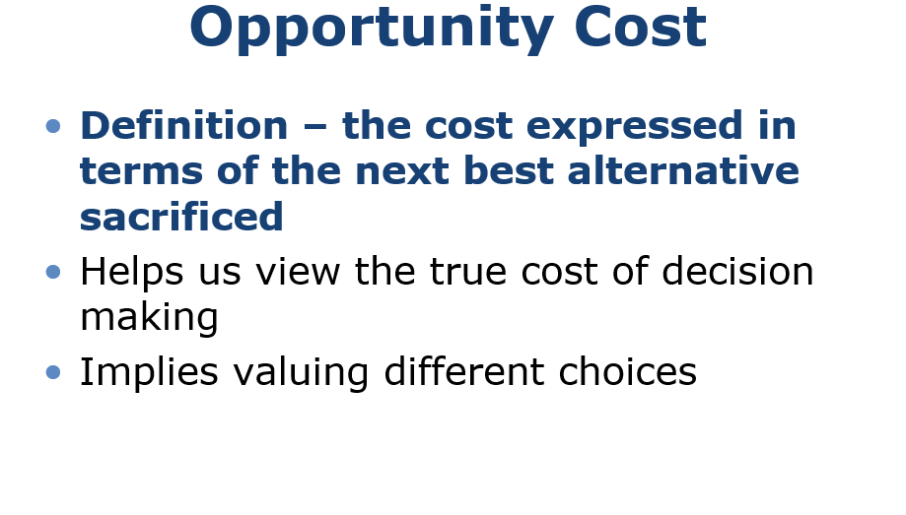
From your own recent experience, give a brief example of opportunity cost
Notes:
is central to students thinking like an economist. The crucial thing to knock out of students is their thinking that everything costs ‘money’. Because we have to make choices there are issues surrounding value judgements about what is important and what is not – it should not be difficult to stimulate discussion about what issues of government spending are important and what are not!

Slide 8
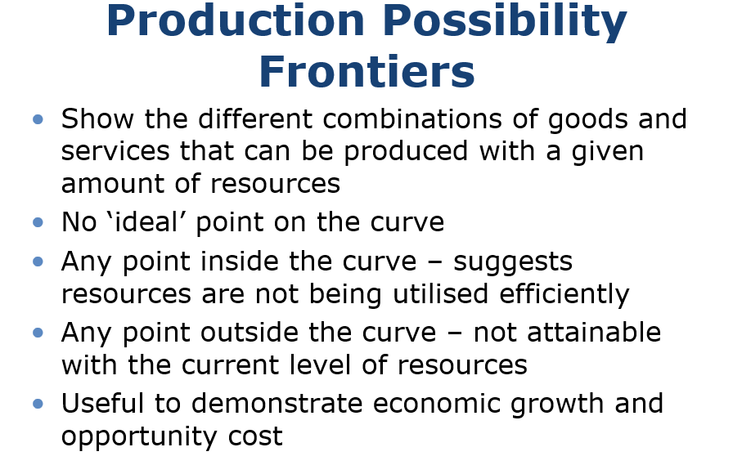
Notes:
This slide introduces the key features about PPFs. The activity that accompanies this presentation seeks to apply PPFs in a slightly different way – focussing on using health resources. Going through the theory at this stage and then following it up with the activity will be useful in developing early understanding of the issues.

Slide 9
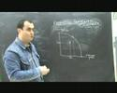

Slide 10
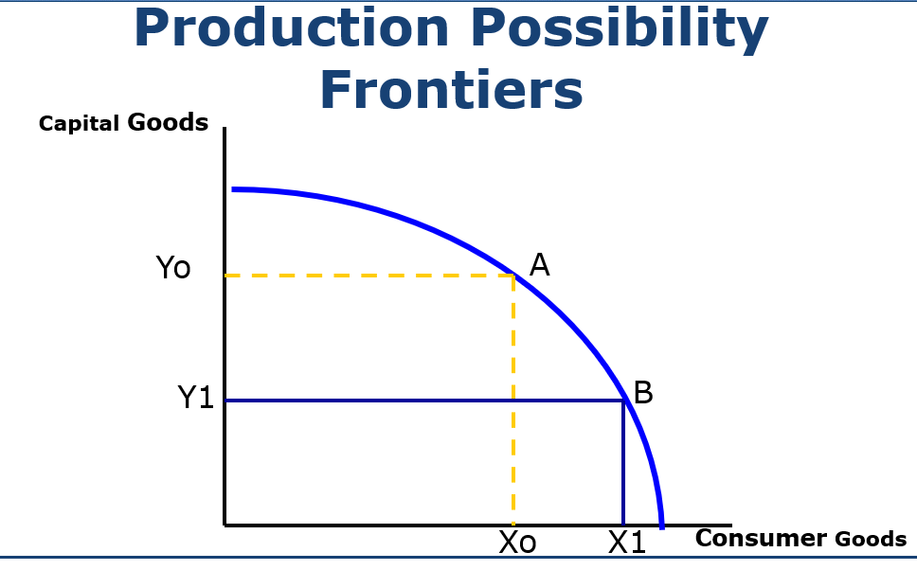
If you want to move from point A to B, what do you need to sacrifice?
Notes:
These slides introduce the diagrams and then have animation to show how points on the PPF relate to different resource use and allocation. Moving from point A to point B involves sacrificing some capital goods to gain more consumer goods and thus demonstrates the opportunity cost involved.

Slide 11
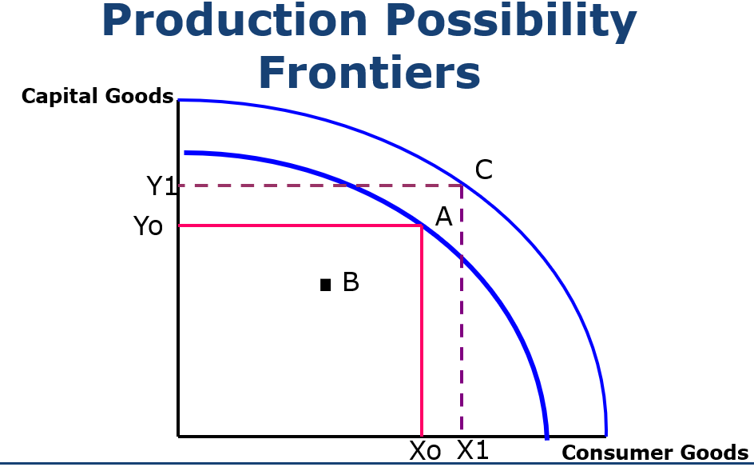
Notes:
The next slide allows the lecturer to demonstrate what happens when resources are not used efficiently and production takes place within the PPF. It then allows the expansion of the PPF and an be used to illustrate the issue of economic growth and where opportunity cost does not exist if the economy moves from point A to point C(in a simple context of course – there is always some form of sacrifice of using resources!)

Slide 12
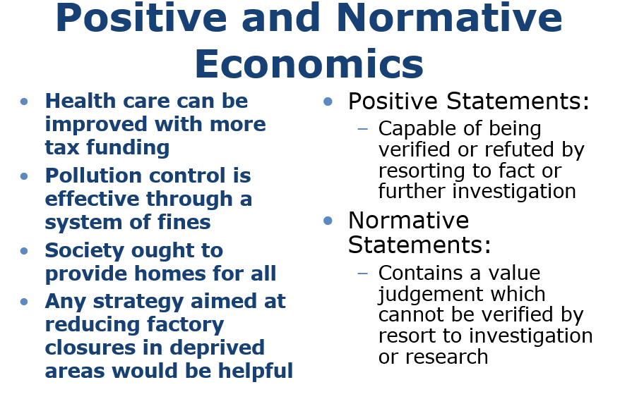
Notes:
The final slide introduces positive and normative statements. Definitions are given on the right hand side and then successive statements appear on the left – each of these can be used as a basis of discussion as to whether they are positive or normative statements and why!

Slide 13
Hall
Read pages : 2-28

