Slide 1

Warm-Up
Hiking
Sun-Drenched
Deck Chair
Amateurish
Voyage

Slide 2
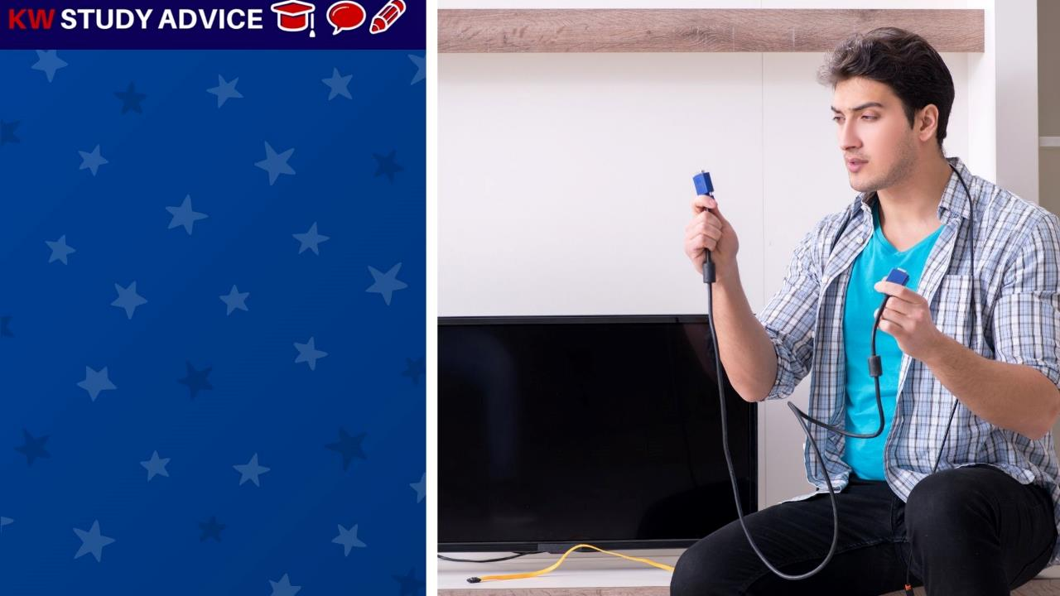
Amateurish
Someone who doesn’t have the correct skills required to do a job properly. They often struggle and make serious mistakes.
The boy was amateurish when it came to setting up new TVs. He was not sure which cables he should be fitting into his new TV.

Slide 3
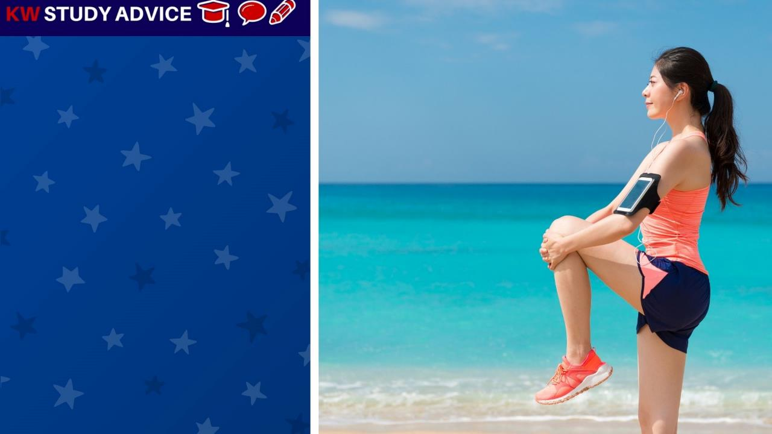
Warm-Up
These are the gentle exercises we do before we start our main exercise. It reduces the risk of getting an injury.
The girl made sure she always did her warm up before her long run. This time she did her warm up on the beach before her long run.

Slide 4

Sun-Drenched
A particular place which receives a lot of sunlight. Many summer flowers, like sunflowers, need sun-drenched conditions.
The farmer decided to plant his sunflowers in the sun-drenched field. Here, the sunflowers would get the sunlight needed.

Slide 5
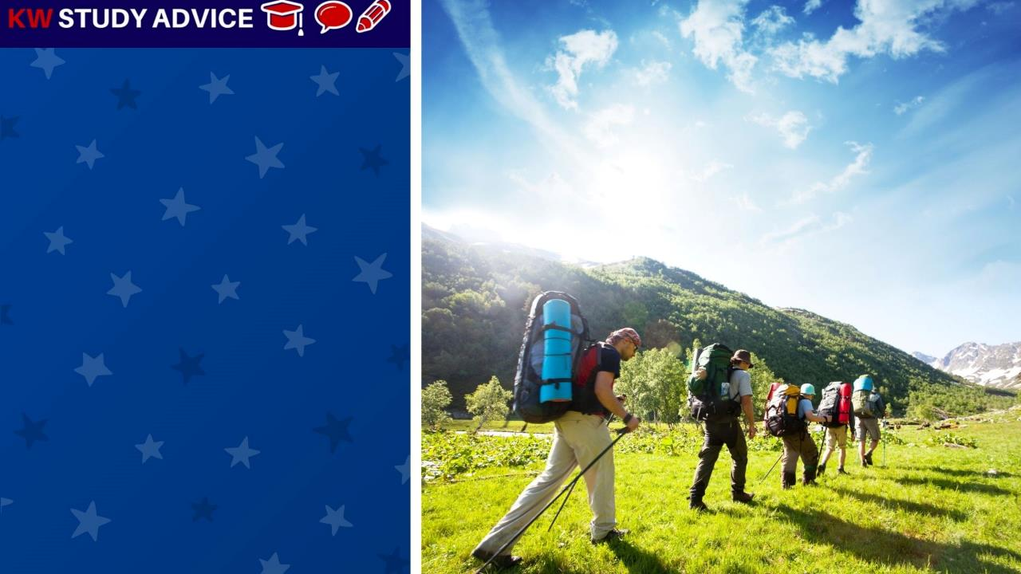
Hiking
This is when we go on long walks which usually last for most of the day. Hiking mainly takes place in countryside areas.
The group of hikers often went hiking when the weather was warm and sunny. They walk 15km in total from village to village

Slide 6
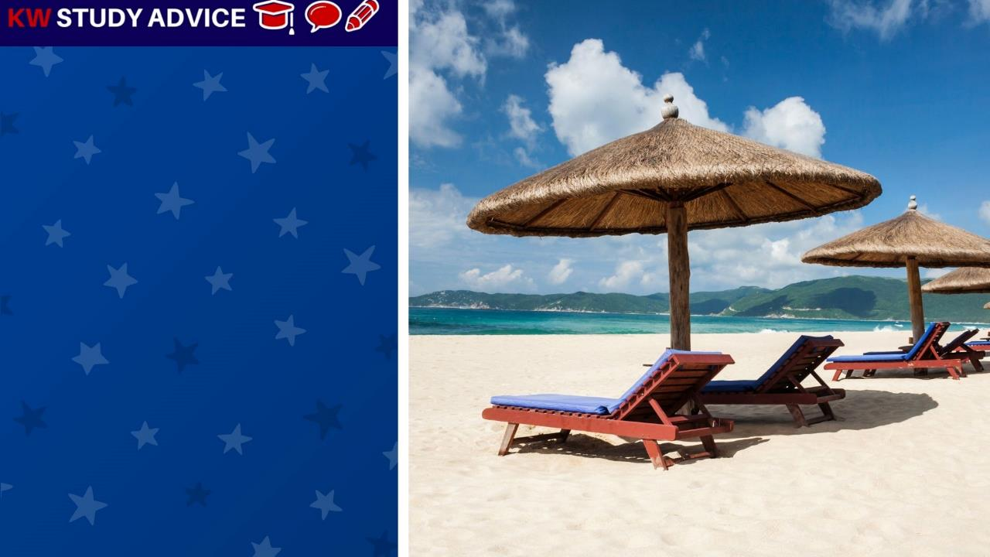
Deck Chair
This is a foldable wooden chair with cushions. These deck chairs are often found at places such as beaches or pools.
The deck chairs were set out on the beach in the morning ready for the tourists to use. Tourists like to sit & relax in front of the sea.

Slide 7
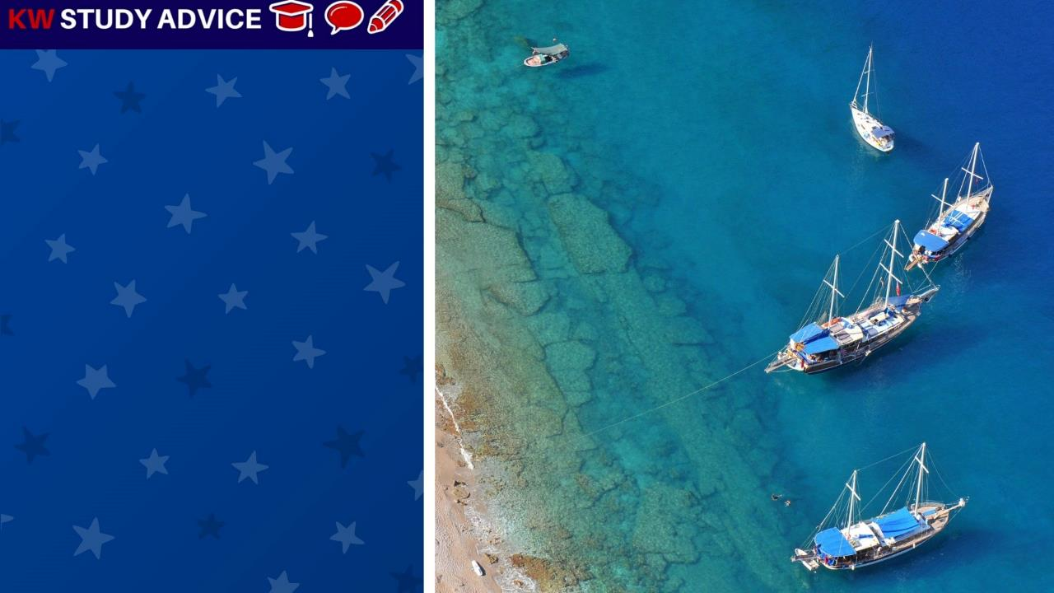
Voyage
This is a journey made either by boat through the sea, or by spaceship through space. Voyages are usually long journeys.
There were a number of boats used at the beach to take tourists on day voyages around the coast. These were popular.

Slide 8


