Slide 1

Summit
Duplicate
Lads
Witty
Laud
Gossip

Slide 2

Summit
This is the very top of a mountain or a hill. The summit provides the very best of views from the top of the hill or mountain
The girl took a trip to the nearby mountain. She really wanted to get to the summit and enjoy the brilliant view from the very top.

Slide 3
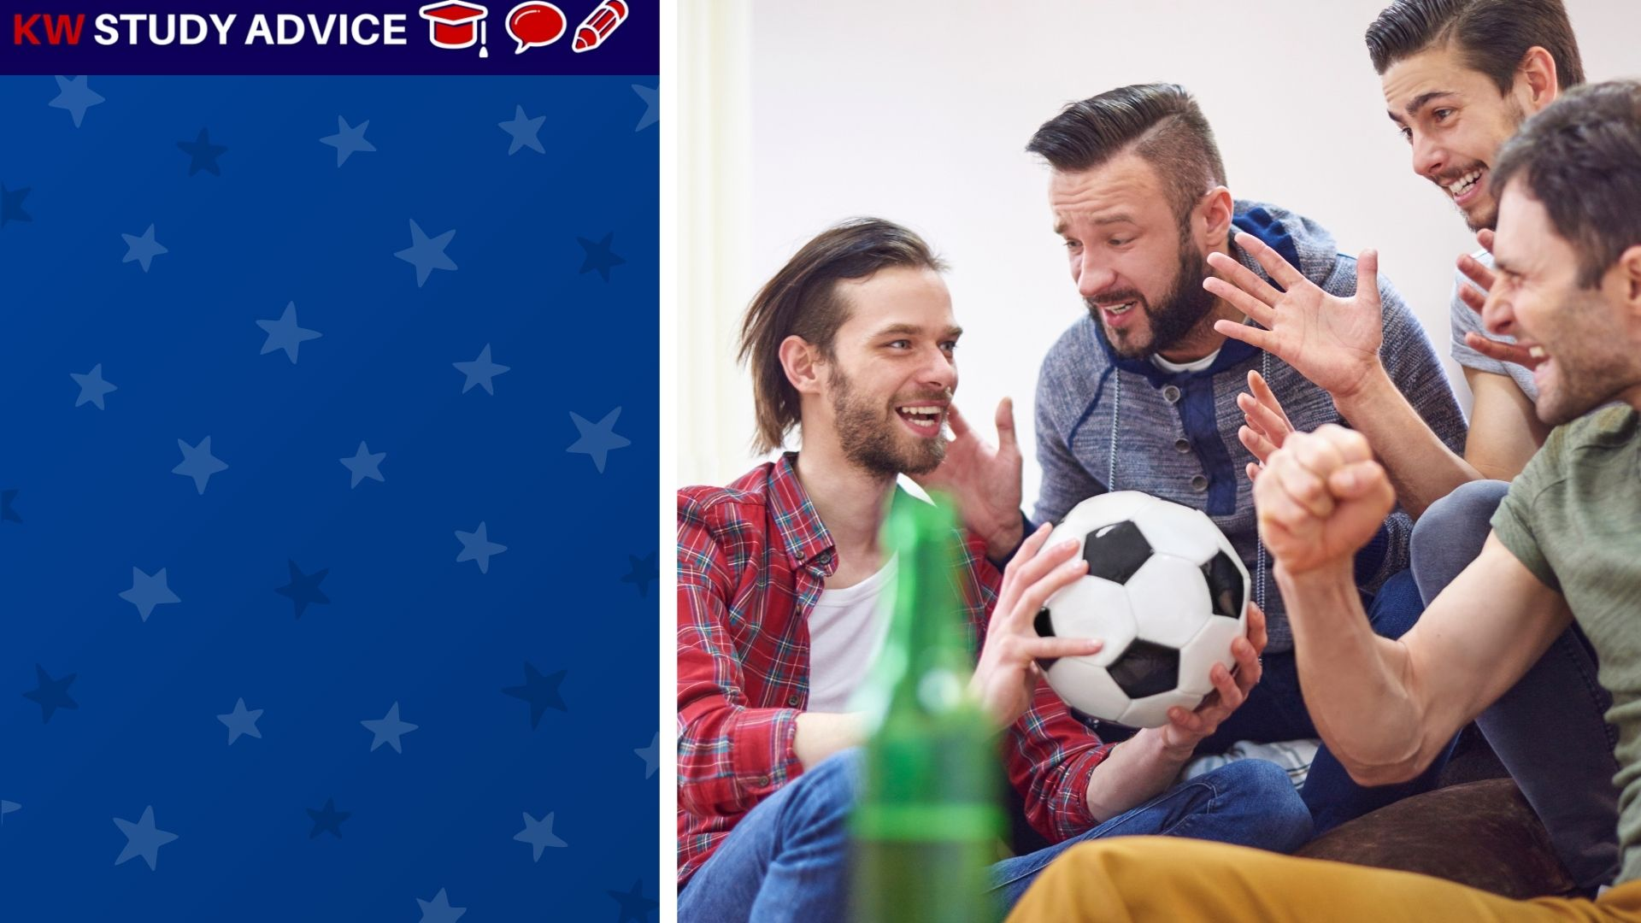
Lads
This is the informal name given to young men or boys. It is used to refer to them in social settings amongst family or friends.
The lads went to the park to play a game of football. They would go every Thursday to chat and give themselves a good workout.

Slide 4
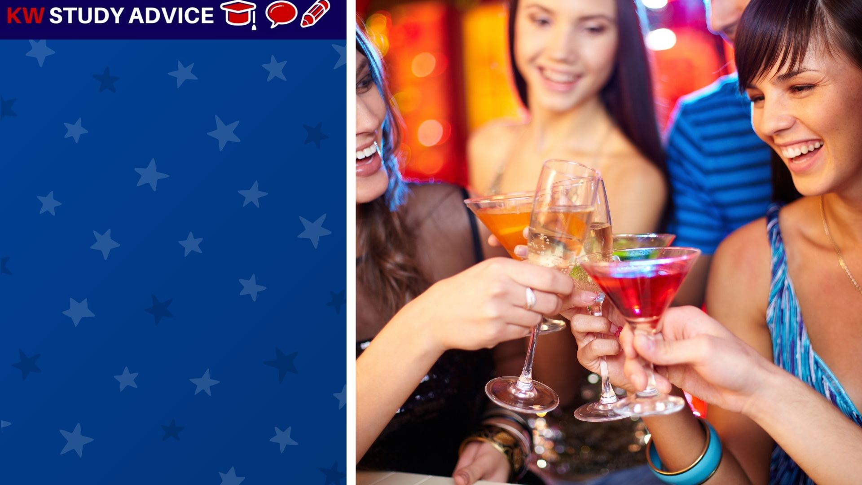
Laud
This is the formal term given to praise someone in a professional setting. This may be in a work or educational setting.
The group were lauded by their lecturer for producing a brilliant presentation. They decided to celebrate with a few drinks.

Slide 5
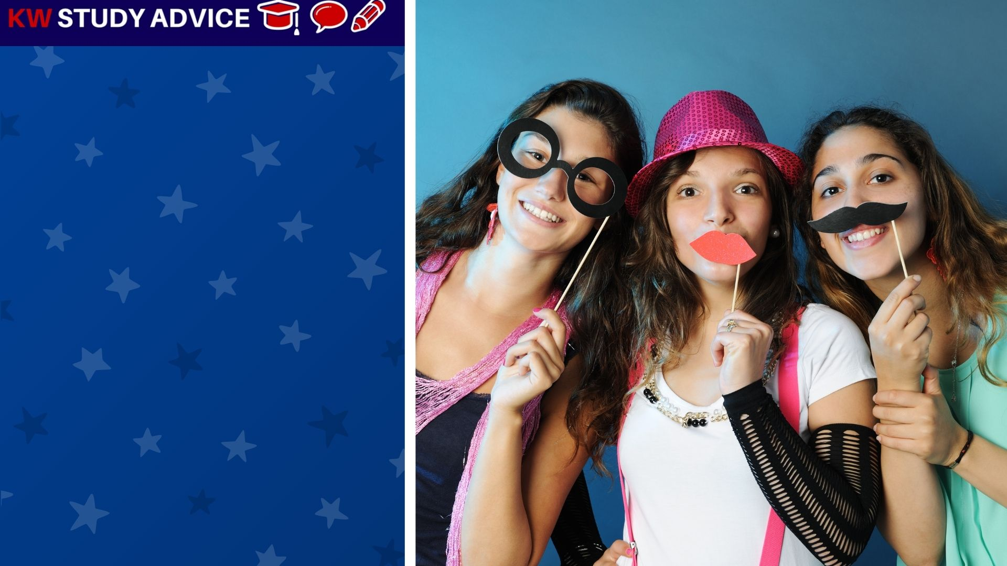
Witty
Someone who has the ability to make people laugh by using clever and well timed jokes. They are funny people.
The girls were always being witty. They decided to dress up in funny clothing for their party. They made everyone laugh.

Slide 6
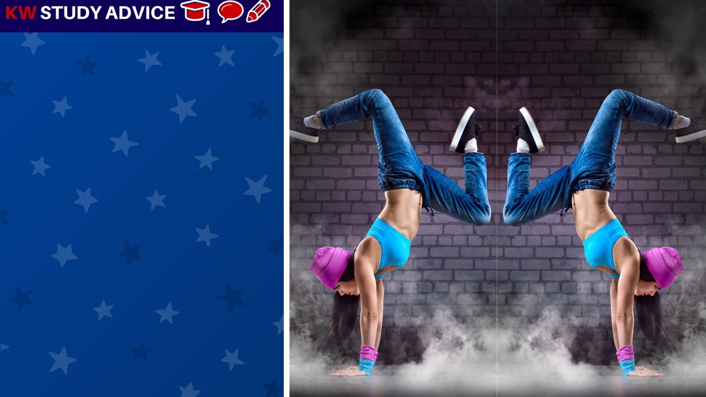
Duplicate
This is when an exact copy of something is made. They look exactly the same. There are usually two of these similar things.
The content creator took a photo of the dancer. He then decided to duplicate the image of the dancer to make another image.

Slide 7
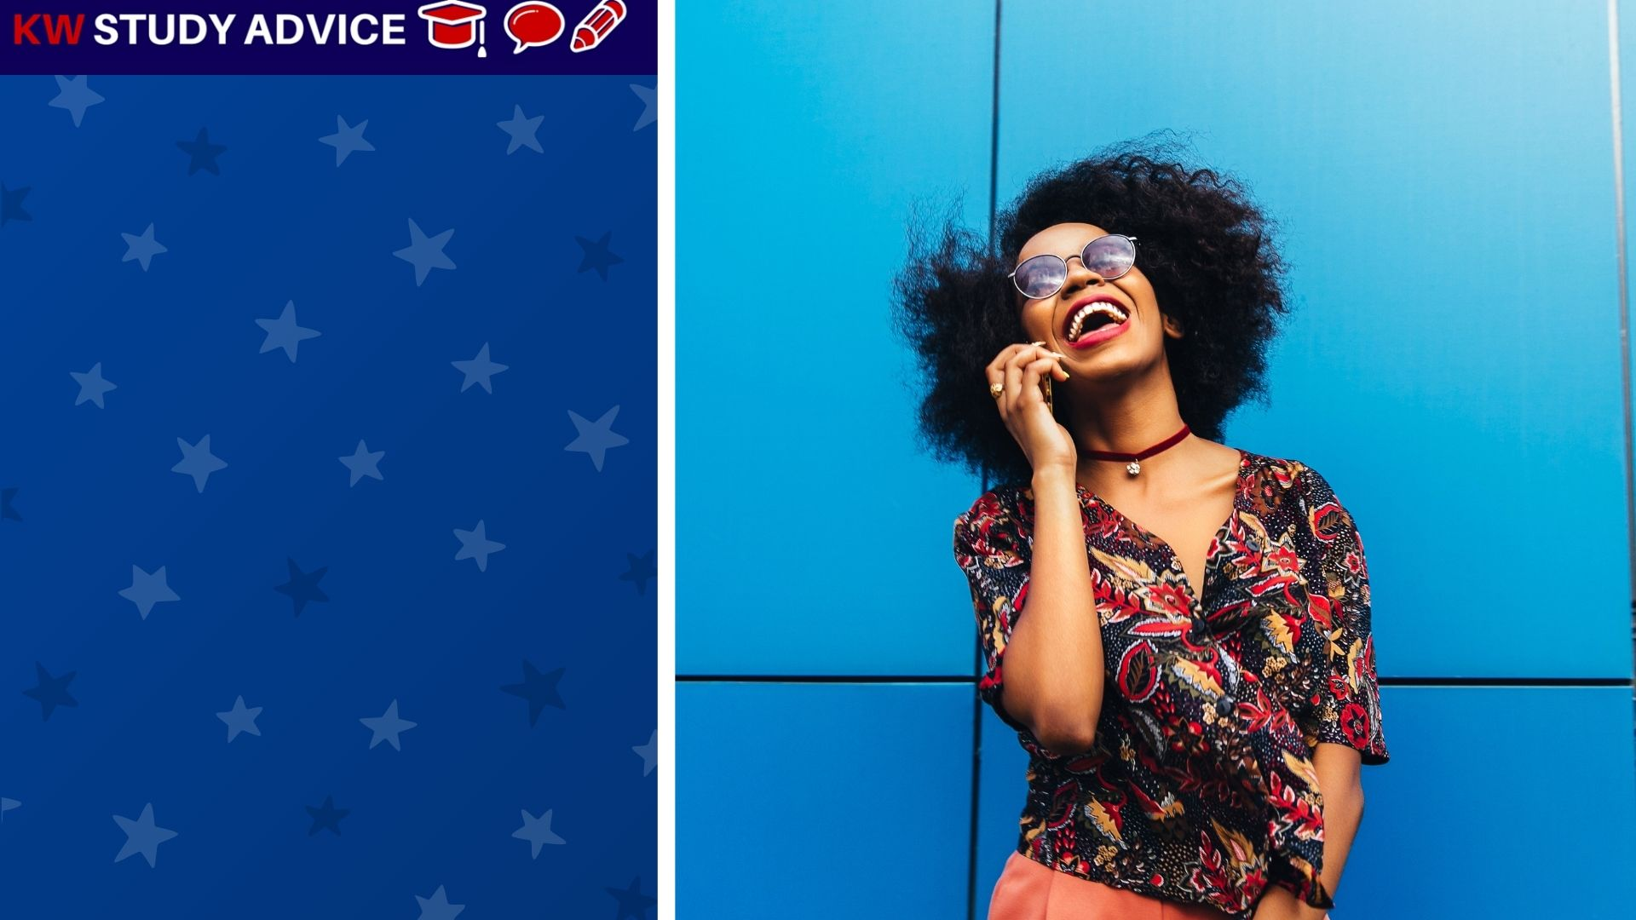
Gossip
Informal conversation about topics that may be either true or untrue. We should never believe gossip as it may not be true.
The woman was gossiping with her friend on what grade they were likely to get in their assignment. They hoped for around 80%.

Slide 8


