Slide 1

Intro to
Statistics
OCT
2024
LESSON 1

Slide 2
Intro
What do you think Statistics is all about?

Slide 3
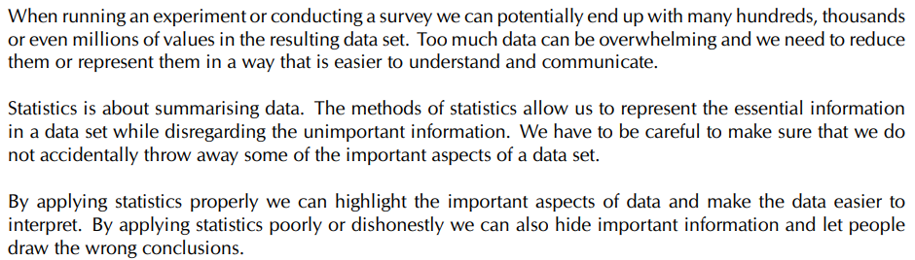

SUMMARISING DATA!

Slide 4
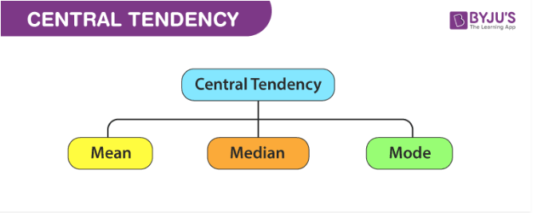
Measures of Central Tendency
Note that we are working with ungrouped data for now.
Measures of Central Tendency are summary statistics that represent the center point or typical value in a dataset.

Slide 5
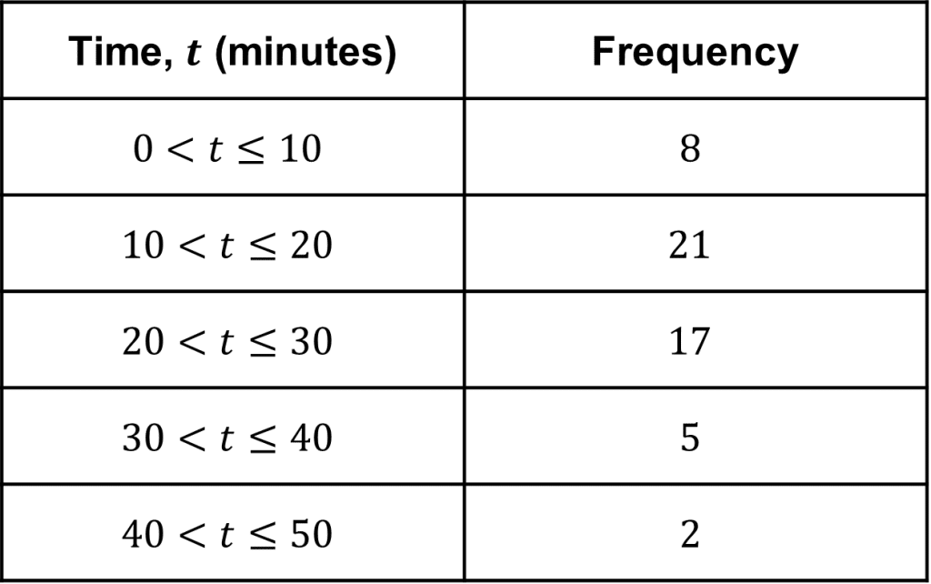
Ungrouped vs Grouped Data
Grouped data is data that has been bundled together in categories. Frequency tables can be used to show this type of data
Ungrouped data is the data you first gather from an experiment or study. The data is not sorted into categories, classified, or grouped. An ungrouped set of data is basically a list of numbers.

Slide 6
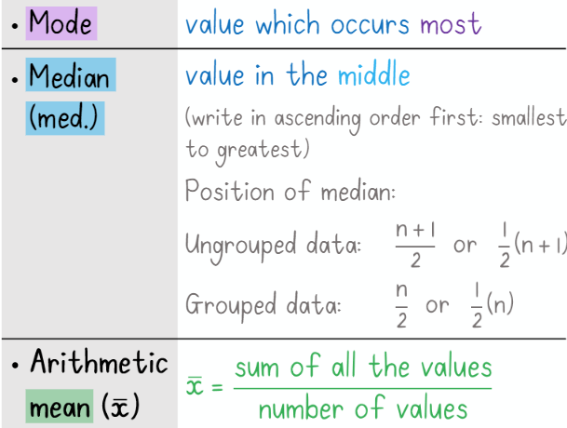

















Mean,Median, Mode
For example:
7, 12, 11, 6, 6, 5, 4, 3, 5
Mean: x̄ = 59/9 = 6.56
Median: 3, 4, 5, 5, 6, 6, 7, 11, 12
OR
(n+1)/2 = (9+1)/2 = 5
Mode: 5 & 6

Slide 7

Mean,Median,Mode in Grouped Data
Frequency: the number of times something happens or appears
1
3
Category | How many? / Frequency
15
23
2
11
32

Slide 8

Continued…
Category | How many? / Frequency
0 ≤ x < 10 | 3
10 ≤ x < 20 | 2
20 ≤ x < 30 | 1
30 ≤ x < 40 | 1
Modal interval/class: the class/interval with the highest frequency (meaning it has the highest number of data values)
Median interval/class: the class/interval where the median should occur
Mean: average (but calculated differently in grouped data)
Because the data is grouped and we wouldn’t know what the individual numbers are, we have to calculate mean differently.
Find the middle of each category/interval/class
Multiply each middle by the corresponding frequency
Add all the results of 2. and divide by the number of values

Slide 9
Measures of Dispersion
Measures of Dispersion show us how the values are distributed/spread around the centre.
For example, if we look at the 2 diagrams above. Note: each dot represents one value from the dataset.
The 2 data sets have the same mean, which is 0(zero), but have different spreads around the mean.

Slide 10
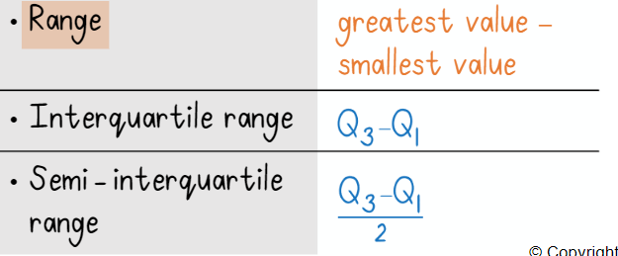
Continued…
To be discussed in upcoming slides
Percentiles

Slide 11
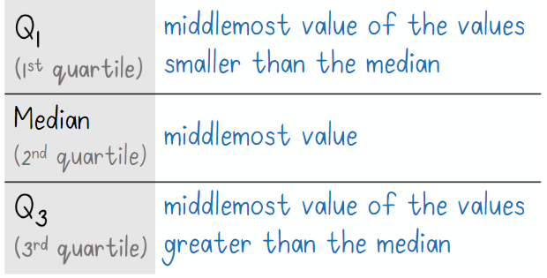
Quartiles
Quartiles divide the data set into 4 equal parts. (used to study both ungrouped and grouped data)
There are 3:

Slide 12


How to find Quartiles?
Order the values from smallest to biggest.
Find the median. The median is Q2.
Take the values before the median. Find their middle. That is Q1.
Take the values after the median. Find their middle. That is Q3.

Slide 13
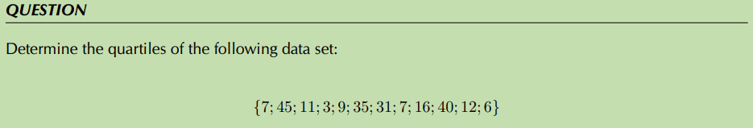
Examples
Also determine the Interquartile Range and Semi-interquartile range of the data set

Slide 14
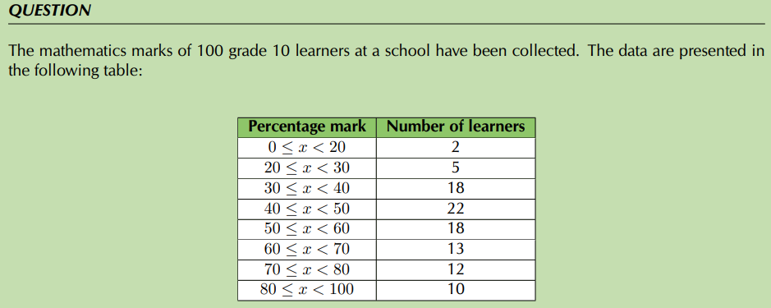
Quartiles in Grouped Data
1. In which intervals are the quartiles of the data set?

Slide 15
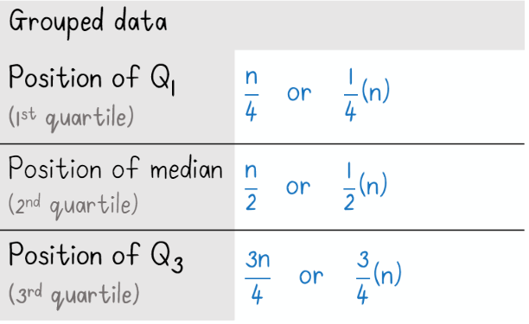
Quartiles in Grouped Data

Slide 16
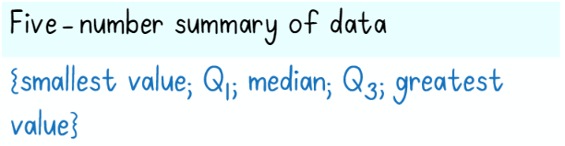


Five Number Summary & Box-and-Whisker
In other words: minimum, lower quartile, median, upper quartile, maximum

Slide 17
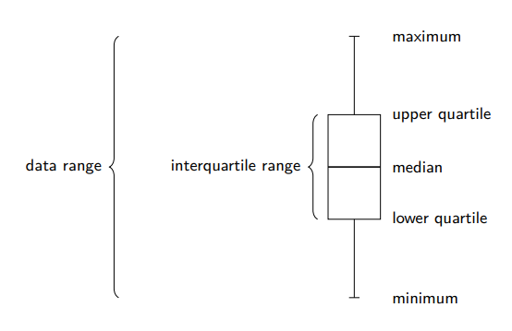
Box-and-Whisker explained
NOTE!!
The box-and-whisker diagram usually lays flat instead of upwards. This is just for explanation purposes. (See next slide for accurate representation)

Slide 18
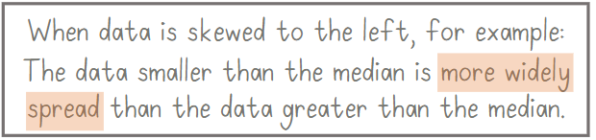
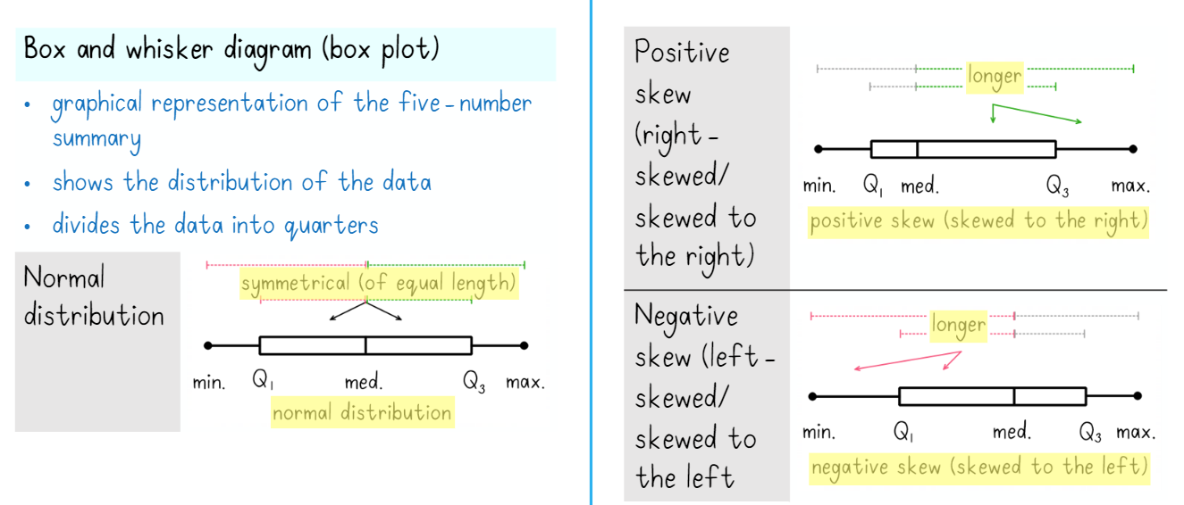
Box-and-Whisker explained

Slide 19
Summary of Important Terms
Term | Definition
Mean | Average
Median | Value in the middle
Mode | Value that occurs the most
Ungrouped data | Data that is not sorted into categories or groups. Basically, a list of values.
Grouped data | Data that is bundled together into categories.
Modal interval/class/group | The group with the highest frequency
Median interval/class/group | The group where the median occurs
Range | = Maximum – Minimum
Interquartile range | = Q3 – Q1
Semi-interquartile range | = (Interquartile range) / 2
Maximum | Greatest value in the data set
Five-number summary | Summary containing minimum, Q1, Q2, Q3, maximum
Outlier | A value that differs a lot from other values in the data set, usually much greater or much less than other values and sticks out.

Slide 20

Exercises
Worksheet 2
Grade 10 Edwardsmaths Test

Slide 21
Credits
https://statisticsbyjim.com/basics/measures-central-tendency-mean-median-mode/
https://byjus.com/maths/central-tendency/
https://mmerevise.co.uk/gcse-maths-revision/grouped-frequency-tables/
https://www.maths4africa.co.za/
https://www.siyavula.com/read/za/mathematics/grade-10

