Slide 1
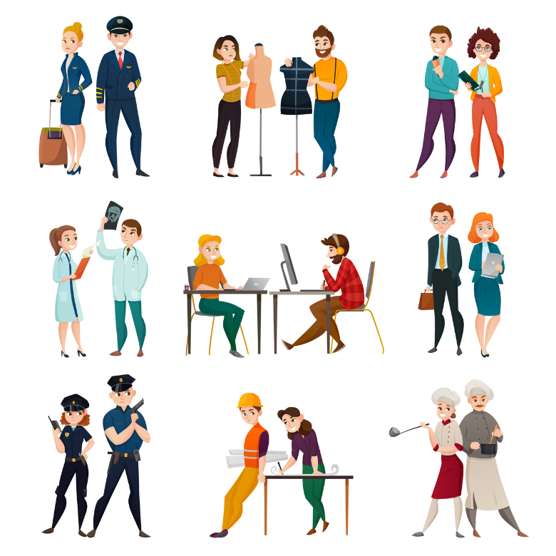
Talking about professions
Notes:
To get an editable version of this presentation:
1. Click File > Make a copy > Entire presentation
OR
2. Click File > Download > Microsoft Powerpoint

Slide 2

Let’s get started
with a warm-up
ESL Brains

Slide 3

Talk about two of the topics below.
the job you have at the moment
a job you had in the past
a job you wanted to have when you were younger
a job you would like to have

Slide 4

Let’s talk!
ESL Brains

Slide 5
part 1/2
Discuss the questions.
Which of the jobs below would you call a dream job? Why?
  secret agent
  personal shopper
  chocolatier
  food critic
  island caretaker
  YouTuber

Slide 6
part 2/2
Discuss the questions.
Look at the list of unusual jobs. What do you think the responsibilities in each job are? Would you choose them as a career?
  panda babysitter
  movie animal trainer
  professional sleeper
How do people usually choose the job they want to do?
  car tester
  professional wedding guest
  ethical hacker

Slide 7

In a moment, you’ll watch two videos about:
unusual jobs

Slide 8
Look at the words and say what the jobs might be.
VIDEO 1
walk
meet new people
conversation
VIDEO 2
dumpster
brand new
save

Slide 9
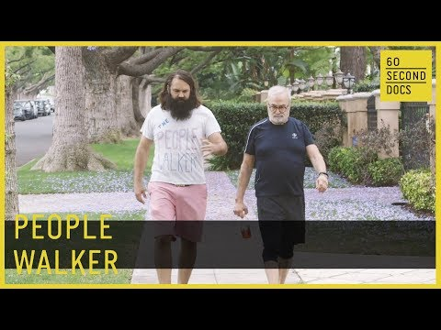
Watch the first video and check your ideas.
ESL Brains

Slide 10

Watch the second video and check your ideas.
ESL Brains

Slide 11
Discuss the questions.
Which job surprised you more: people walker or dumpster diver? Why?
What skills do you need to do these jobs?
Would you like to try these jobs? Why/Why not?

Slide 12

Let’s think!
ESL Brains

Slide 13

Think of three jobs for each category. Explain your choices.
stressful jobs
jobs which are useful to society
jobs for people who are patient
jobs for people who are confident
jobs for people who are creative

Slide 14
Let’s talk!
ESL Brains

Slide 15
part 1/2
Discuss the questions.
Why do people change careers/go into a new profession?
What advice would you give to young people who don’t know what they want to do?
What kind of education, training or skills do you need to do your job?
What things are important for you in a job (e.g. friendly colleagues, good salary, interesting tasks)?

Slide 16
part 2/2
Discuss the questions.
Is it better to be a boss or an employee? Why?
Why do so many people want to do jobs that might make them famous, e.g. YouTuber, actor or influencer?
Can you think of any professions that are paid too little or too much?

Slide 17
THANKS!
ESL Brains

