Slide 1
Chapter 4.2: Using Electricity (Page 138)
TRANSDUCERS
传感器

Slide 2
Chapter 4.2: Using Electricity (Page 138)
SIGNAL-PROCESSING
信号处理

Slide 3
Chapter 4.2: Using Electricity (Page 138)
Potentiometer
电位器

Slide 4
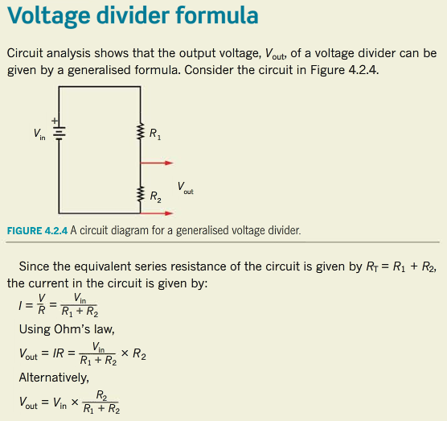
Chapter 4.2: Using Electricity (Page 138)
Voltage Divider
分压器

Slide 5
Chapter 4.2: Using Electricity (Page 141)
Thermistor
热敏电阻

Slide 6
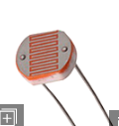
Chapter 4.2: Using Electricity (Page 143)
Light-dependent resistor
光敏电阻

Slide 7
Chapter 4.2: Using Electricity (Page 145)
Diodes
二极管

Slide 8
Chapter 4.2: Using Electricity (Page 145)
semiconductor
半导体

Slide 9
Chapter 4.2: Using Electricity (Page 146)
light-emitting diode (LED)
发光二极管

Slide 10
Chapter 4.2: Using Electricity (Page 148)
Summary
Most complex electrical circuits can be understood as a combination of input and output transducers separated by signal-processing circuitry.

Slide 11
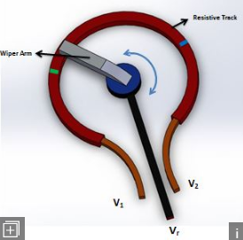
Chapter 4.2: Using Electricity (Page 148)
Summary
The basic design of potentiometers is always the same, consisting of a three-terminal resistor with a sliding or rotating contact called the wiper.

Slide 12
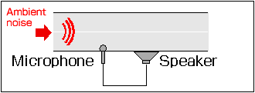
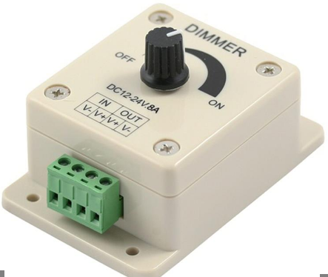
Chapter 4.2: Using Electricity (Page 148)
Summary
The potentiometer can also be used to divide voltage.
Potentiometers are widely used as light dimmer switches and for volume control on sound systems.

Slide 13
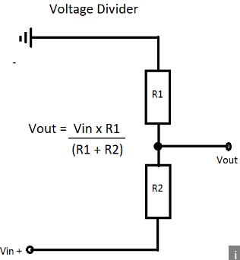
Chapter 4.2: Using Electricity (Page 148)
Summary
A voltage divider circuit is simply a series circuit with two or more components.
The circuit is called a voltage divider because the voltage supplied to the circuit is shared (or divided) between the components in the circuit.

Slide 14
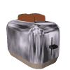
Chapter 4.2: Using Electricity (Page 148)
Summary
The resistance of the thermistor depends on its temperature.
Thermistor are used in a wide variety of temperature-control applications such as in refrigerators, toasters, coffee makers, electrical circuits or engines.

Slide 15
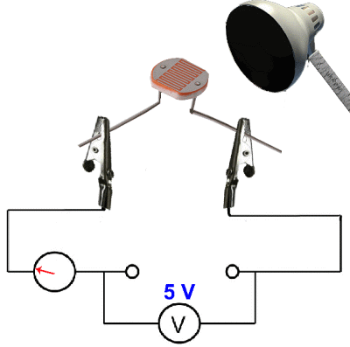
Chapter 4.2: Using Electricity (Page 148)
Summary
A light-dependent resistor is a transducer whose resistance depends on the amount of light falling on it.
Usually an LDR is designed to have a very high resistance in the dark and a very low resistance in the light.

Slide 16
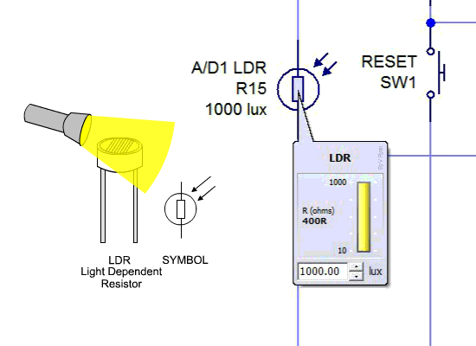
Chapter 4.2: Using Electricity (Page 148)
Summary
LDRs have a range of applications.
They can be found in camera light meters, street lights and night lights.
They can also be used to detect when a person’s body blocks a beam of light shinning across a doorway, triggering a buzzer or doorbell chime.

Slide 17
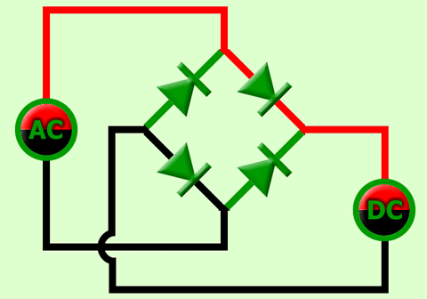
Chapter 4.2: Using Electricity (Page 148)
Summary
A diode is a semiconductor device that will only allow electrical current to flow in one direction through it.
They are used in circuits which convert alternating current into direct current.

Slide 18
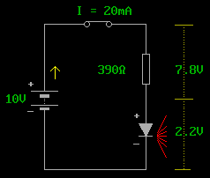
Chapter 4.2: Using Electricity (Page 148)
Summary
A light-emitting diode or LED is a type of diode that emits light as current passes through it.

Slide 19
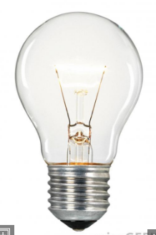
Chapter 4.2: Using Electricity (Page 148)
Summary
LEDs are increasingly used as highly energy-efficient replacements for traditional incandescent light globes.

Slide 20
The End

Slide 21
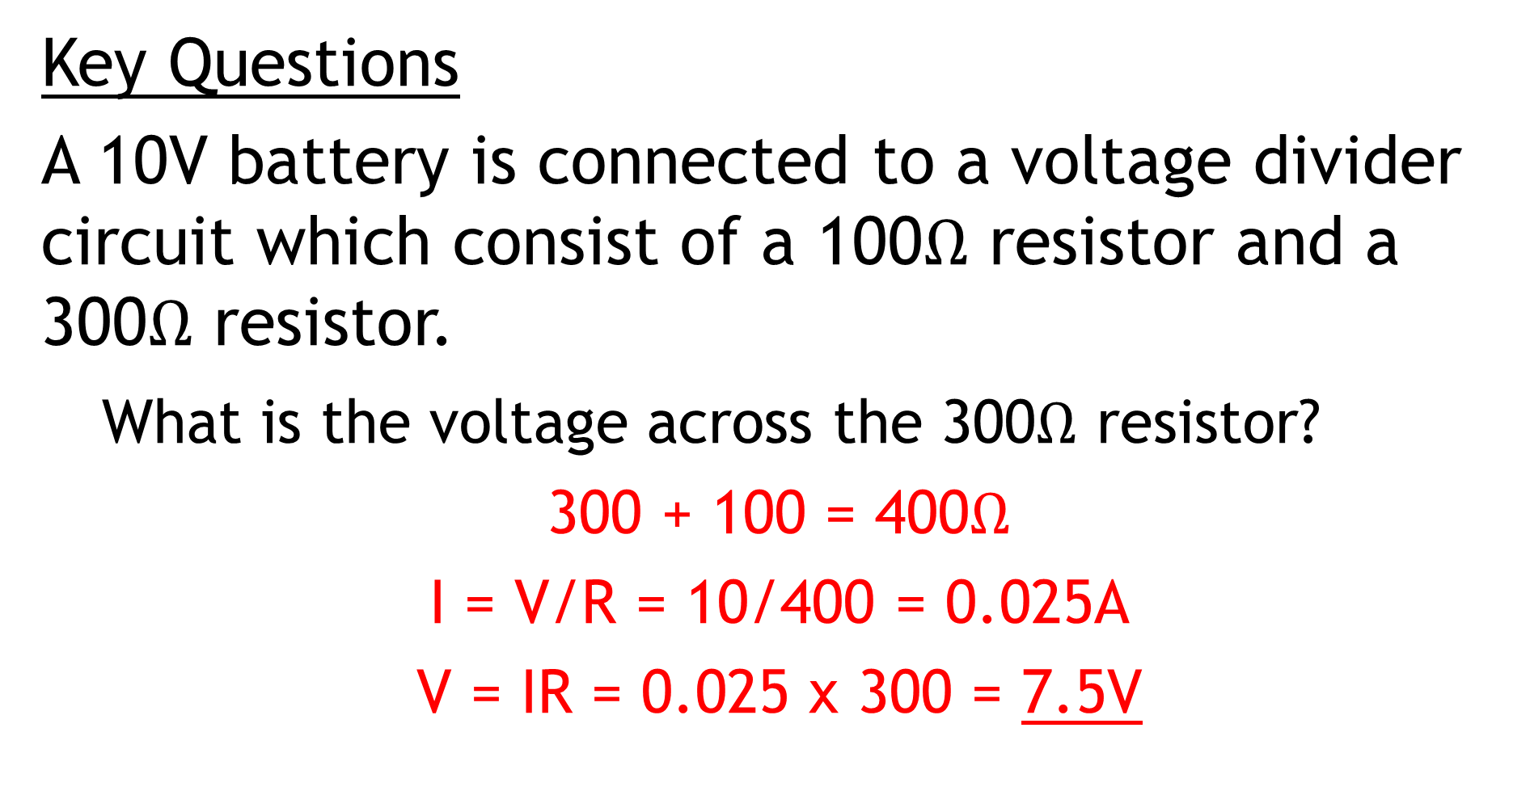
Chapter 4.2: Using Electricity (Page 148)
Key Questions
A 10V battery is connected to a voltage divider circuit which consist of a 100$Ω$ resistor and a 300$Ω$ resistor.
What is the voltage across the 300$Ω$ resistor?
300 + 100 = 400$Ω$
I = V/R = 10/400 = 0.025A
V = IR = 0.025 x 300 = 7.5V

Slide 22
Chapter 4.2: Using Electricity (Page 148)
Key Questions
Question 1 to Question 10

Slide 23
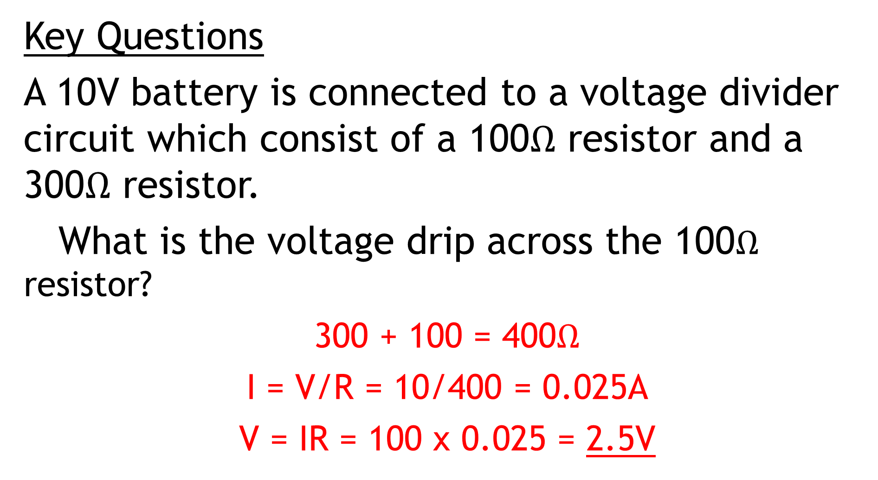
Chapter 4.: Using Electricity (Page 148)
Key Questions
A 10V battery is connected to a voltage divider circuit which consist of a 100$Ω$ resistor and a 300$Ω$ resistor.
What is the voltage drip across the 100$Ω$ resistor?
300 + 100 = 400$Ω$
I = V/R = 10/400 = 0.025A
V = IR = 100 x 0.025 = 2.5V

Slide 24
Chapter 4.: Using Electricity (Page 148)
Key Questions
A 24V battery is connected to a voltage divider circuit consisting of a 1kΩ resistor and a 2kΩ resistor. What is the voltage across the 2kΩ resistor?
1 + 2 = 3Ω
I = V/R
I = 24/3 = 8A
V = IR = 8 x 2 = 16V

Slide 25
Chapter 4.: Using Electricity (Page 148)
Key Questions
Copy the table below and classify the following components under the appropriate heading:
Diode, LED, LDR, light globe, microphone, potentiometer, speaker, thermistor.
I = V/R
I = 24/3 = 8A
V = IR = 8 x 2 = 16V

Slide 26
Chapter 4.: Using Electricity (Page 148)
Key Questions
Which of the following components only allow current to flow in one direction? (More than one correct answer is possible.)
Diode
LED
Potentiometer
Thermistor
V = IR = 8 x 2 = 16V

Slide 27
Chapter 4.: Using Electricity (Page 148)
Key Questions
As the temperature of a PTC thermistor increases, what happens to its resistance?
Decreases
Increases
Remain constant
Approaches infinity
V = IR = 8 x 2 = 16V

Slide 28
Chapter 4.: Using Electricity (Page 148)
Key Questions
Which of the following could be used as an input transducer in a circuit to control the temperature inside a refrigerator?
LED
Thermistor
LDR
Diode
V = IR = 8 x 2 = 16V

Slide 29
Chapter 4.: Using Electricity (Page 148)
Key Questions
As the amount of light falling on an LDR increases, what happen to the resistance of the LDR?
Decreases
Increases
Remains constant
Approaches infinity
= IR = 8 x 2 = 16V

Slide 30
Chapter 4.: Using Electricity (Page 149)
Key Questions
The LED in the circuit below has a switch on voltage (V_{s}) of 2.0V and an operating current of 20mA. Determine the value of R₁ for the LED to be operating correctly.
= IR = 8 x 2 = 16V

Slide 31
Chapter 4.: Using Electricity (Page 149)
Key Questions
All LEDs in the circuits (i) and (ii) below are identical. Each LED has a switch-on voltage (V_{s}) of 2V and draws a current of 20mA for optimal light production. (If the current is much smaller, the LED light output is too dim. If the current is much larger, the LED overheats and burns out.)
For each circuit determine the R_{L} that gives optimum operation for all of the LEDs.
Which combination of LEDs (circuit (i) or (ii)) emits the most light with these particular values of R_{L}?
Assuming circuits (i) and (ii) have exactly the same ideal battery power supply, determine which circuit will emit light (i.e. with the LEDs operating at their optimum level) for the longest time. Explain your answer.

Slide 32
Chapter 4.: Using Electricity (Page 149)
Key Questions
The following graph shows the resistance-temperature characteristics of a thermistor. A circuit uses this thermistor as part of a temperature sensor which can activate an LED whenever the temperature rises above a certain level.
What is the resistance of the thermistor of 20ºC?
The potential difference across the LED at 20ºC is 2.5V and the current through it is 11mA. What is the value of R?
The LED is activated by a minimum potential difference of 2.0V across it which gives a current through it of 4.8mA. What is the minimum temperature that will activate the LED?

Slide 33
The END

