Slide 1
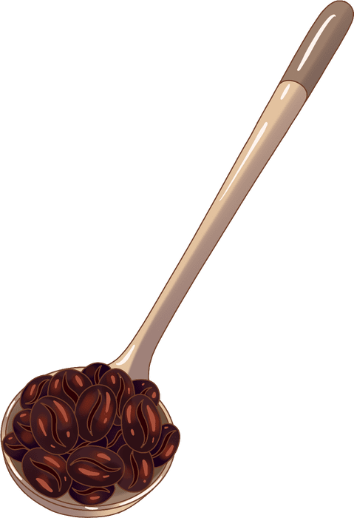
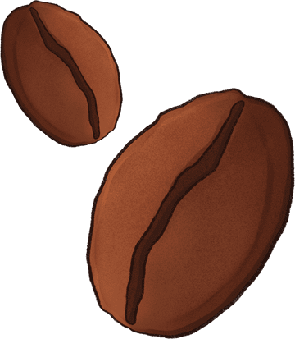


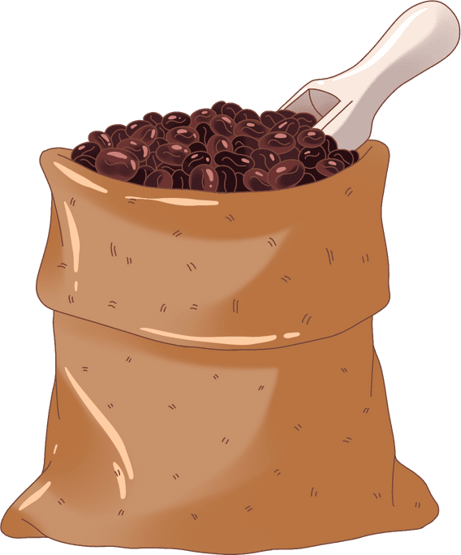

A CAPPUCHINO, PLEASE!
Enfluent Learners

Slide 2
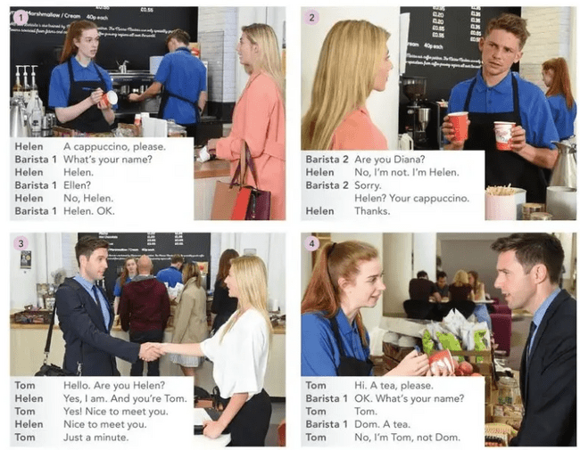

Listen and speak

Slide 3
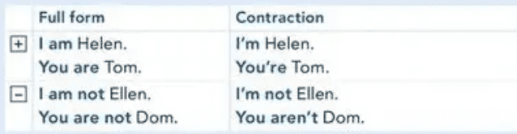

Tip for speaking:
Use contractions

Slide 4
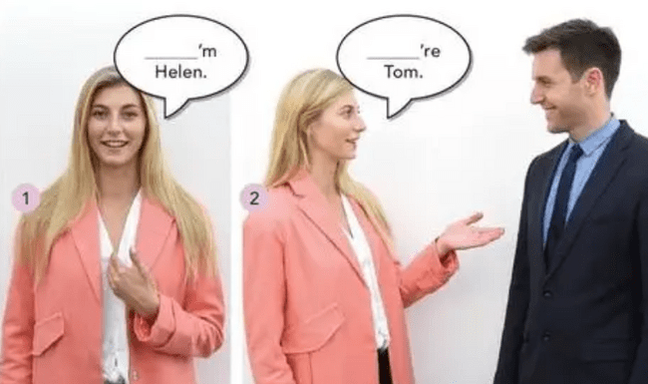

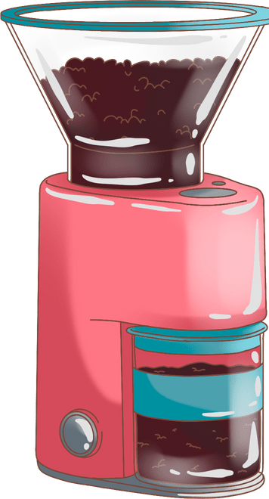
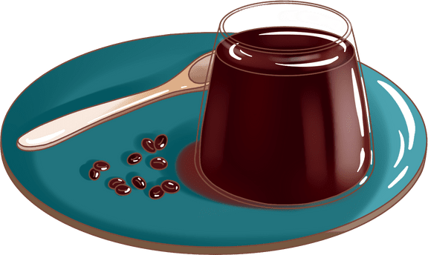

Slide 5
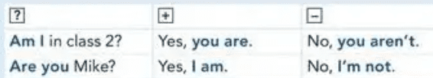
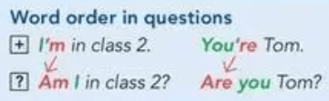

Asking questions

Slide 6
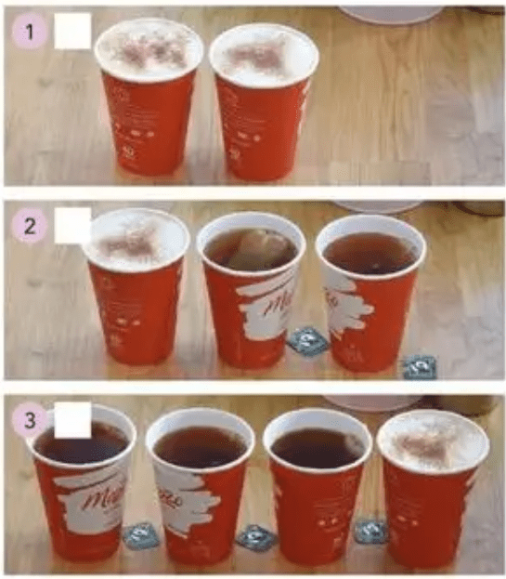
Listening
  Listen and tick the correct order from the listening
  Can you also tell whose order is what?

Slide 7

Practice
Speaking

Slide 8
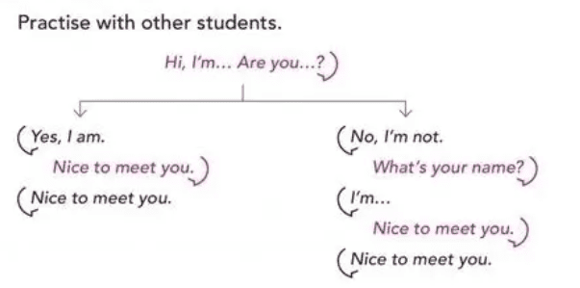

Slide 9

Checking pronunciation
Please pronounce all these words so we can correct if there are any issues
Monday
Tuesday
Wednesday
Thursday
Friday
Saturday
Sunday

Slide 10

Saying goodbye :)

Slide 11
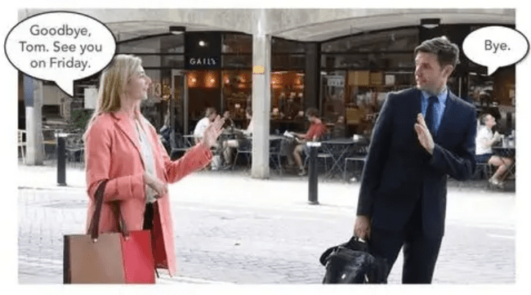
Read the dialogues

Slide 12
Group work

Slide 13
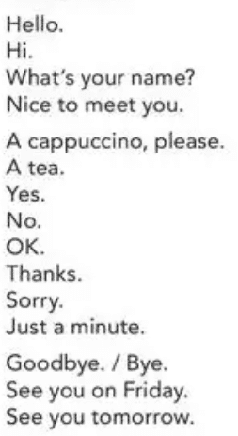
Work together and prepare a conversation with each other using some of the following vocabulary. Feel free to add more words and phrases of your choice

Slide 14
THANK YOU

