Slide 1
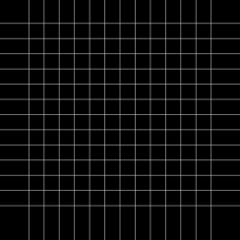
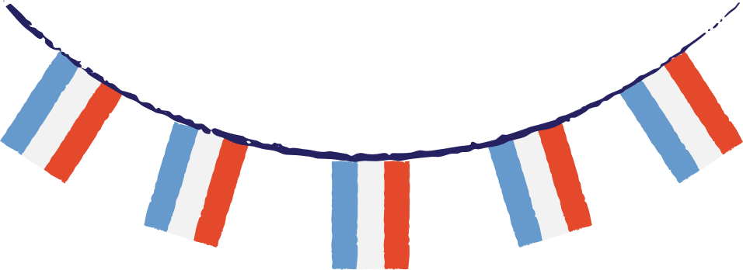

Professeur Rémi‘s
French Quiz
Let’s practise our French! See what you can remember about colours, animals and numbers.

Slide 2


What is the French word for “five”?
cinq
quinze
huit

Slide 3


What is the French word for “five”?
cinq
quinze
huit

Slide 4
1 2 3
Which is correct?
un, douze, treize
un, deux, trois
onze, deux, trois
onze, douze, trois

Slide 5
1 2 3
Which is correct?
un, douze, treize
un, deux, trois
onze, deux, trois
onze, douze, trois

Slide 6
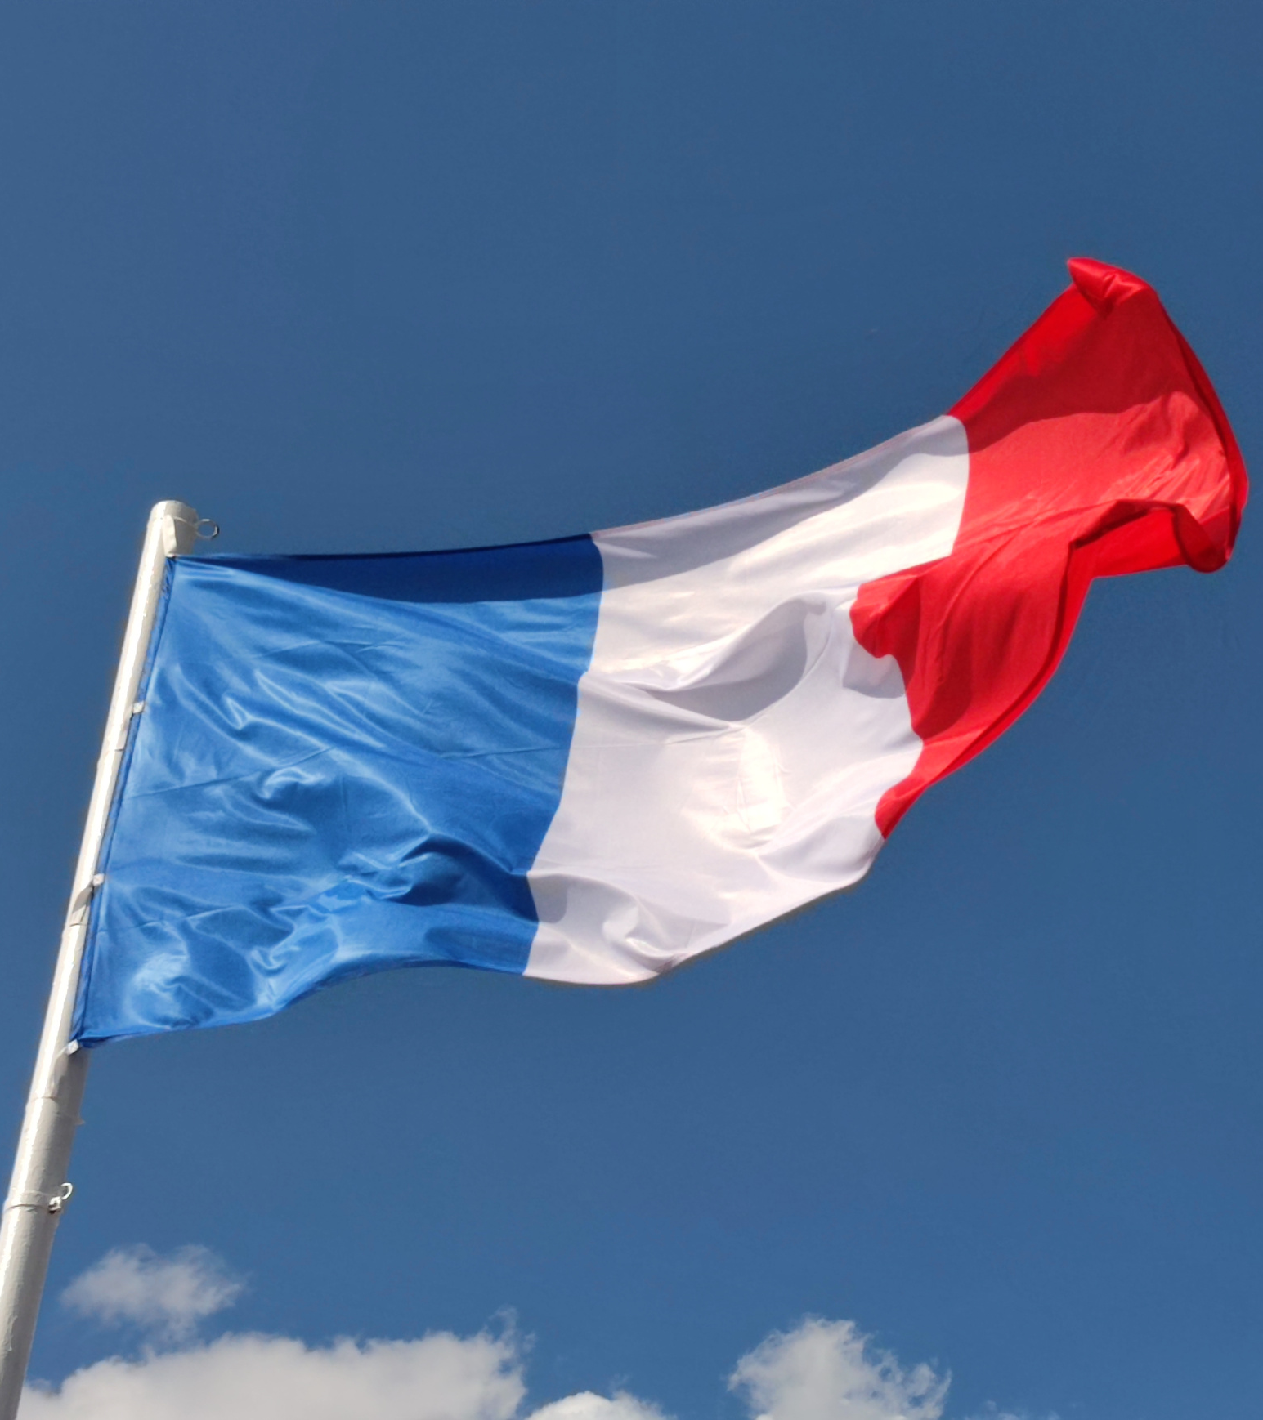
Which colours are on the French flag?
bleu, brun, rouge
bleu, blanc, rouge
bleu, blanc, rose

Slide 7
What does “jaune” mean in English?
green
orange
yellow

Slide 8
What does “jaune” mean in English?
green
orange
yellow

