Slide 1

Plural form of regular nouns (nouns ending in -y and -f/-fe)

Slide 2
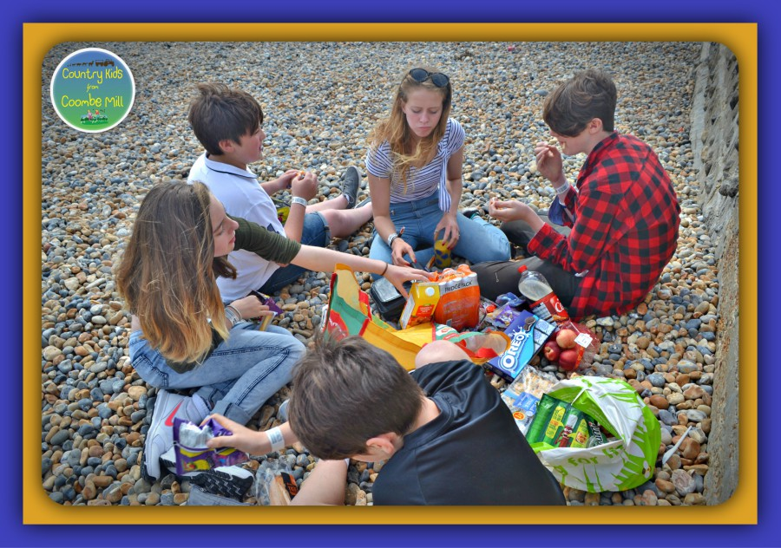
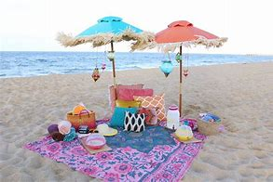

Slide 3
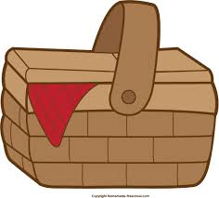

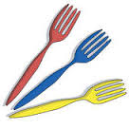
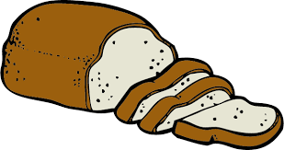
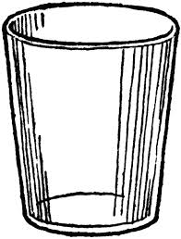
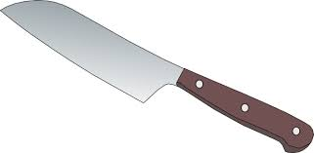
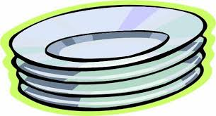
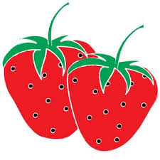

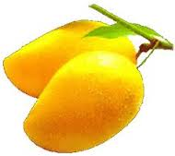
What are the things that we usually prepare
for a picnic?
loaves of bread
spoons
forks
knives
glasses
plates
strawberries
mangoes
table napkins

Slide 4
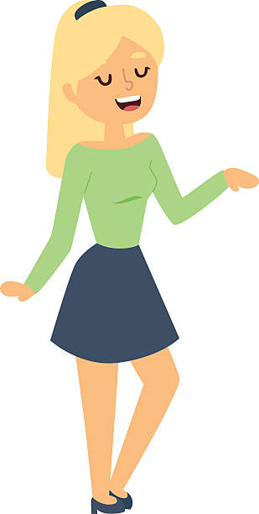

spoons forks loaves of bread
plates mangoes strawberries
glasses knives table napkins
What kind of words
are these?
They are Nouns.
A noun is a name of person,
place or thing.

Slide 5
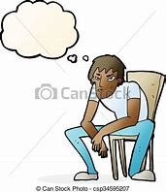
spoons forks loaves of bread
plates mangoes strawberries
glasses knives table napkins
Do they refer to more than one noun?
What tells us that these nouns are more than one?
What do we add to the noun when forming its plural form?

Slide 6

Study this chart.
A |  | B
Singular Noun | Plural Noun | Singular Noun | Plural Noun
spoon | spoons | knife | knives
plate | plates | glass | glasses
fork | forks | strawberry | strawberries
How is the plural of nouns
Formed in Group A ?

Slide 7

How is the plural of nouns formed in Group B?
What do we do with letters f/fe before adding –es?
B
Singular Noun | Plural Noun
knife | knives
glass | glasses
strawberry | strawberries
What happened to the letter y at the end of the word?
What other rules can you give when forming the plural of regular nouns?

Slide 8
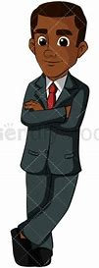
Remember
Some nouns ending in –f or –fe form their plural by changing f/fe to v before adding –es
Example: leaf – leaves elf - elves hoof – hooves
Except: handkerchief – handkerchiefs roof – roofs
Some nouns that end in –y form their plural by changing y to i before adding –es.
Example: candy – candies berry-berries
However, when a vowel letter is before –y, just add s.
Example: boy – boys tray – trays key – keys

Slide 9

Find Out and Learn
Underline the correct form of the plural nouns in the following sentences.
Mother bought some (blackberrys, blackberries) at the market.
She baked some (loafs, loaves) of blackberry bread.
We divided the bread into (halfs, halves).
Eric, my brother, won’t eat them because someone told him that blackberry bread is for (fairys, fairies) only.

Slide 10

Do and Learn
Write a sentence using the plural form of the following nouns:
key 5. trolley
wolf 6. handkerchief
calf 7. half
strawberry 8. roof

Slide 11
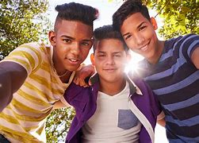
Look around your home and its surrounding. List as many nouns as you can see and write their plural forms.

