Slide 1

Device
Ramble
Positivity
Courier
Resources
Excess

Slide 2
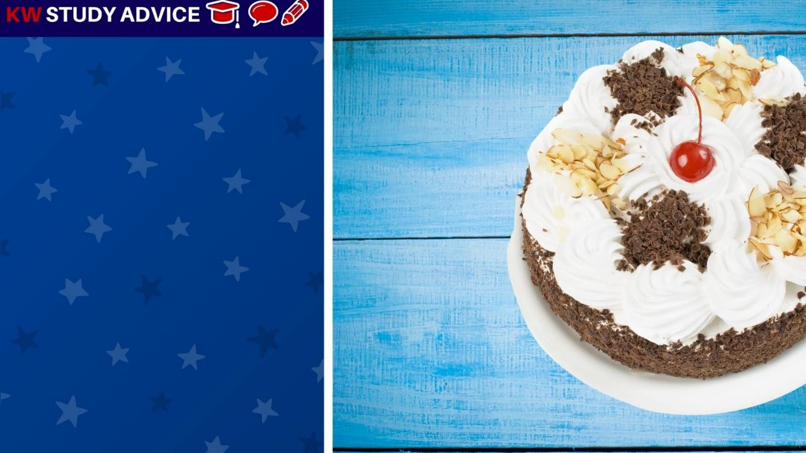
Excess
An amount of something which is more than what is required. Things in excess are often given to others to reduce waste.
The man received a huge birthday cake from his wife. It was far too much for both of them. They gave the excess cake to friends.

Slide 3

Ramble
A relaxed walk which is most commonly done in the countryside. People often travel to the countryside for long rambles
The man went rambling on his own as he really wanted to see the spectacular views on the warm summer’s day. He loved it.

Slide 4
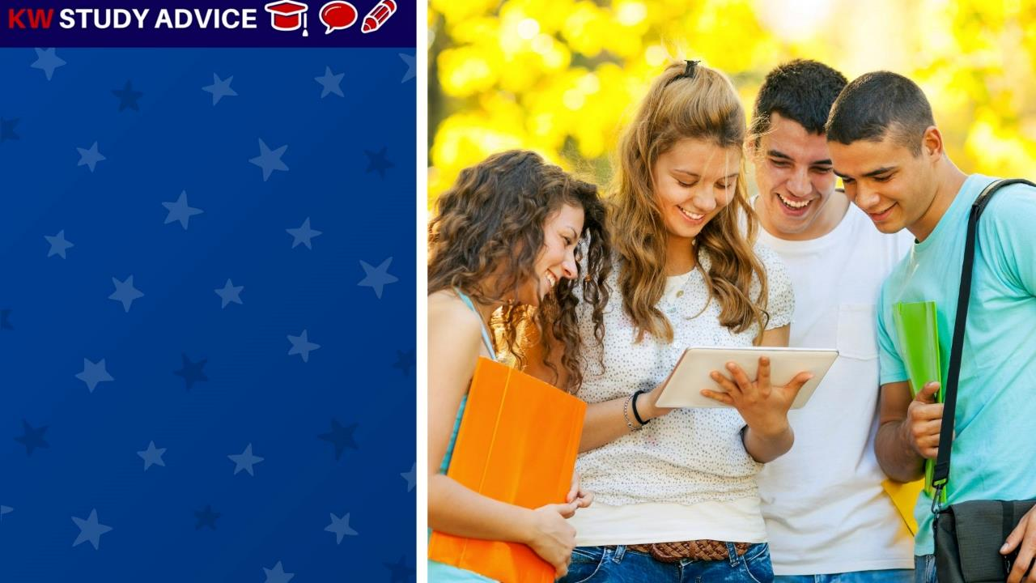
Device
A thing which is used for a specific purpose. This is usually and electronic device. It could be a smart phone or tablet
The friends used their friend’s tablet device to check their new academic year’s timetable. It gave the information quickly.

Slide 5

Resources
These are items that are needed to complete a specific task or piece of work. Often tasks can not be done without them
The students decided to show their tutor what they had created during their group project with all of their resources.

Slide 6
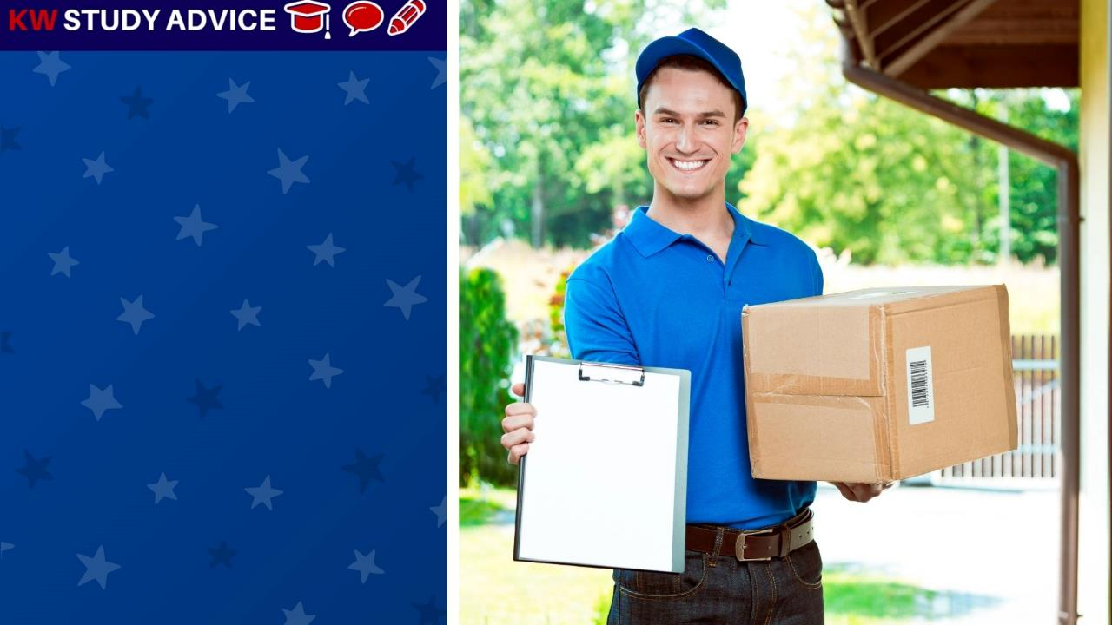
Courier
This is a person or a company which delivers letters and parcels to homes and businesses. They deliver to most places
The courier delivered the man’s new shoes on the day he requested them. This made the man very happy with the courier service

Slide 7

Positivity
A type of attitude someone has which is both positive and optimistic. These people often smile and have a ‘can do attitude’.
The woman said that positivity was very important as a tv presenter. She was able to use this to catch viewers’ attention.

Slide 8


