Slide 1
SCIENCE QUIZ
Suitable for grades 9-10

Slide 2
Round 1

Slide 3

Question 1 (60 s)
Grab something around you that is suitable for storing an acidic solution.
Explain your choice of object.
Notes:
Anything except a metal or paper, eg. plastic or glass containers because they do not react with dilute acids. A copper container is a possible answer because copper does not react with dilute acids.

Slide 4
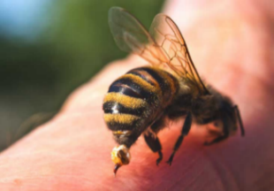
Question 2 (60 s)
Grab something you could use to relieve bee stings.
Explain your choice of object.
Notes:
Anything that is a weak alkaline to neutralise the acidic bee stings, eg. toothpaste, baking soda, soap.

Slide 5
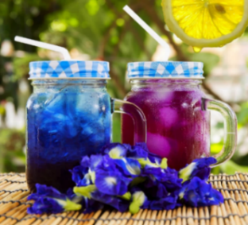
Question 3 (60 s)
Butterfly pea flower tea is an herbal tea made from dried butterfly pea flowers steeped in water. Its color goes from blue to purple when lemon juice is added.
Explain how this happens.
Notes:
The blue pea tea contains an indicator which turns purple in acidic pH

Slide 6
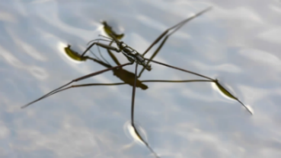
Question 4 (60 s)
Water striders are slender water bugs that is a predator on other insects. It lives on the surface of quiet waters. Their feet are covered in fine, dense hairs.
Explain how water striders stay afloat on water.
Notes:
Water has surface tension strong enough to withstand their body weight.

Slide 7
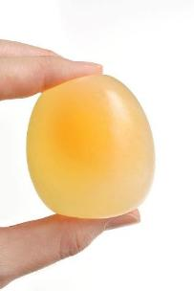
Question 5 (60 s)
Explain what happens to the egg when it is kept in vinegar for 24 hours.
Notes:
Calcium carbonate reacts with the acid so the shell becomes soft.

Slide 8
Question 6 (60 s)
Can a fire have a shadow?
Notes:
Yes, so long as the light from a lamp is brighter than the fire.

Slide 9
Question 7 (60 s)
Does light always travel in a straight line?
Notes:
No. Light bends when it travels from one medium to another.

Slide 10
Question 8 (60 s)
Find something that has a higher density than rocks.
Notes:
Any metal.

Slide 11
Question 9 (60 s)
Can gold be created from other elements?
Notes:
Yes. In nuclear reactions, proton number changes and new elements are produced.

Slide 12
Question 10 (60 s)
Can sound generate heat?
Notes:
Yes, a sound wave makes air molecules move faster and increase air temperature slightly.

Slide 13
Question 11 (60 s)
Human Body Riddle
I can be long, or I can be short.
I can be grown, and I can be bought.
I can be painted, or left bare.
I can be round, or I can be square.
What am I?
Notes:
Answer: Fingernails

Slide 14
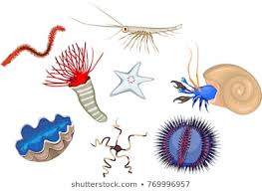
Question 12 (60 s)
Which of these is a multicellular animal without circulatory system, and hence no heart?
A. Amoeba
B. Paramecium
C. Butterfly
D. Jellyfish
Notes:
Answer: Jellyfish

Slide 15
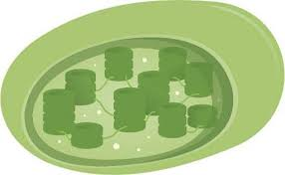
Question 13 (60 s)
Chloroplasts are organelles found in plant cells and eukaryotic algae that conduct photosynthesis.
In which of these are you most likely to find chloroplasts?
Stone cells
Tracheids
Companion cells
Guard cells
Notes:
Answer: D. Guard cells

Slide 16
Question 14 (60 s)
Human Body Riddle
I read the same forward and backwards.
I know you'll get the answer, I know you'll see.
It's a word that is important to you and me.
What word am I?
Notes:
Answer: Eye

Slide 17
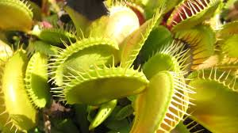
Question 15 (60 s)
Autotrophs are organisms that can produce their own food, using materials from inorganic sources.
What is the name of the pigment-containing organelles in autotrophs that collect light energy?
Notes:
Answer: chloroplasts

Slide 18
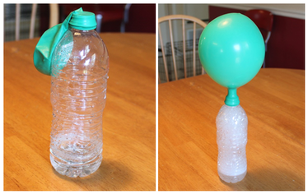
Question 16 (60 s)
What two substances could you react in the bottle to fill up the balloon?
Notes:
Any moderately reactive metals and any acid, or any carbonates and acids.

Slide 19

Question 17 (60 s)
Catalysts speed up a chemical reaction by lowering the amount of energy you need to react.
Find a metal around you that can be used to catalyse a chemical reaction.
Notes:
Any transition metals, eg. iron, copper, nickel

Slide 20
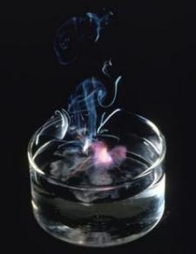
Question 18 (60 s)
Alkali metals react with water to produce heat, hydrogen gas, and the corresponding metal hydroxide.
Grab something around you that contains the ion of such metal and explain your choice of object.
Notes:
Anything with lithium, sodium, potassium, cesium or rubidium ions, such as Li battery in the cell phone, table salt, baking soda, MSG-containing food etc.

Slide 21
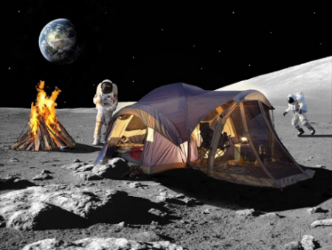
Question 19 (40 s)
Convince me using a scientific reasoning that this picture on the Moon is fake.
Notes:
There is no oxygen on the Moon so it is impossible to build fire.

Slide 22
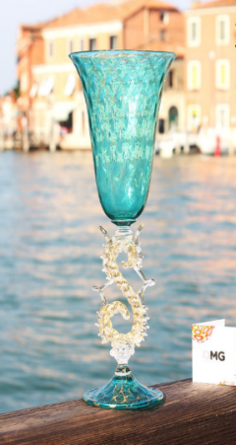
Question 20 (60 s)
Murano glass is coloured glass crafted by glassmakers in Murano, Venetia. The glass basic composition is colourless. The colours are obtained by adding small amounts of transition metal compounds to the glass powder. Which metal ion could be added to create this colour?
Notes:
Copper(II) or iron(II)

Slide 23
Question 21 (60 s)
Could electronic devices get charged without being plugged into an electricity source?
Notes:
Yes, they can be charged from other sources of energy.

Slide 24
Question 22 (60 s)
What is the maximum sum of the following 3 forces: 2 N, 3 N and 4 N?
Notes:
9 N, when they are in the same direction.

Slide 25
Question 23 (60 s)
What is the minimum sum of the following 3 forces:
2 N, 3 N and 4 N?
Notes:
0 N, when these 3 forces form an enclosed triangle, connected head to tail.

Slide 26
Question 24 (60 s)
What energy is always produced in any physical processes?
Notes:
Heat/thermal energy

Slide 27
Question 25 (60 s)
What is the speed of sound in a vacuum in m/s?
Notes:
0 m/s

Slide 28
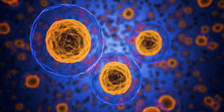
Question 26 (60 s)
The most prominent roles of mitochondria are to produce the energy currency of the cell through respiration.
Which of the following is found within mitochondria?
endoplasmic reticulum
Golgi apparatus
patella
cristae
Notes:
Answer: D. cristae

Slide 29
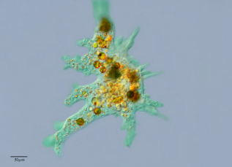
Question 27 (60 s)
Amoebas engulf their food by sticking out finger-like projections called pseudopodia. What is this process called?
Notes:
Answer: phagocytosis

Slide 30

Question 28 (60 s)
Inside the cell, molecules are constantly being broken down to allow the constituent parts to be repurposed in new molecules. Which organelle, containing a potent mix of enzymes, is responsible for much of this degradation?
Notes:
Answer: Lysosome

Slide 31
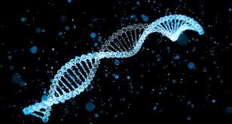
Question 29 (60 s)
DNA is the hereditary material in humans and almost all other organisms. Nearly every cell in a person’s body has the same DNA.
In DNA, adenine pairs with thymine. But in RNA, what replaces thymine?
Notes:
Answer: uracil

Slide 32
Question 30 (60 s)
Mammals and birds have double circulatory systems, with four-chambered hearts that keep the pulmonary and systemic subsystems separated. What is the name for each of the chambers through which blood enters the heart?
Notes:
Answer: Atrium

Slide 33
END OF ROUND 1

