Slide 1
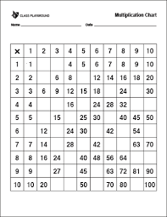
Can you fill in the missing
values for this times table grid?

Slide 2
2 3
4 10
21 27
Did you get them all?
Can you see any patterns?
8 12 20 36 40
10 20 35
6 18 36 48 60
21 35 49 56
32 72 80
18 36 54
30 40 60 90

Slide 3
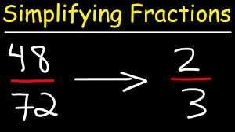
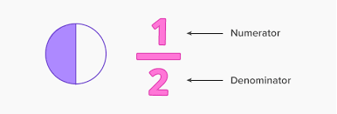
Simplifying fractions
Simplifying fractions is just the opposite of finding equivalent fractions!

Slide 4
To simplify fractions you
divide the numerator (the top number) and
the denominator (the bottom number) by the
same value (the factor) until there are no
more whole numbers you can divide by.

Slide 5
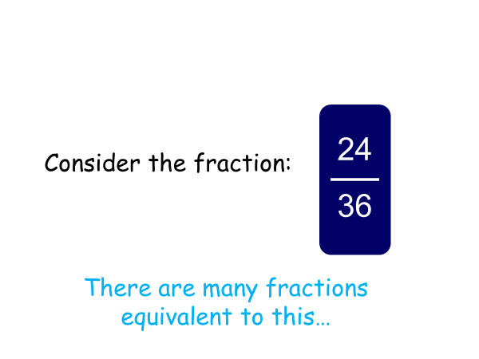

Slide 6
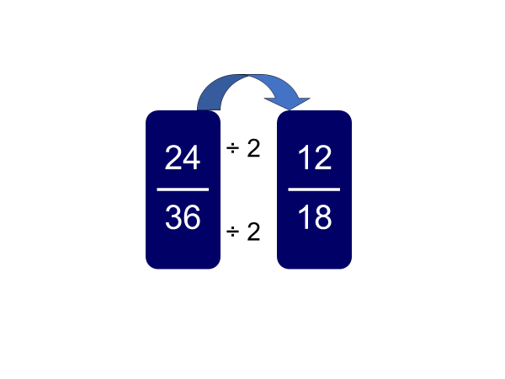
Instead of multiplying we have to divide instead.
This can be by any common factor.

Slide 7
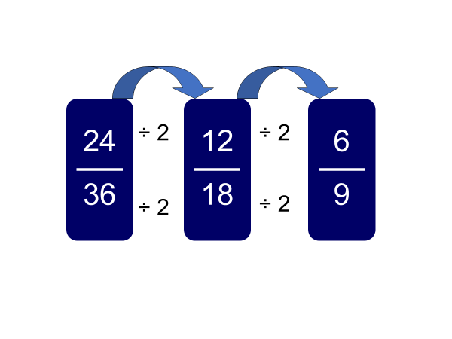

Slide 8
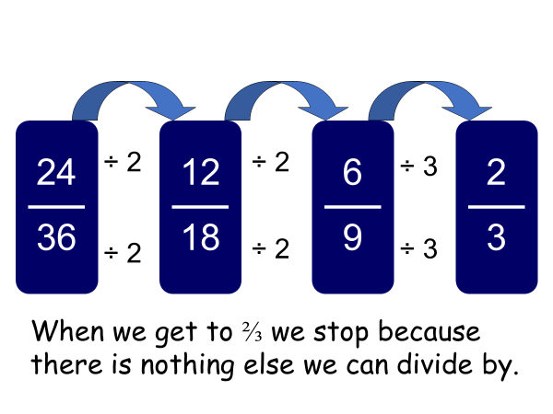

Slide 9
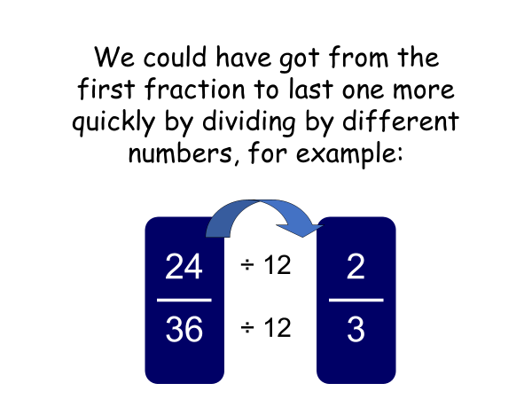

Slide 10
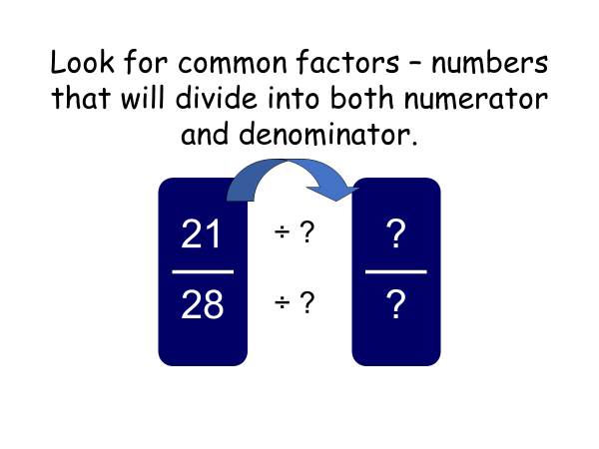

Slide 11
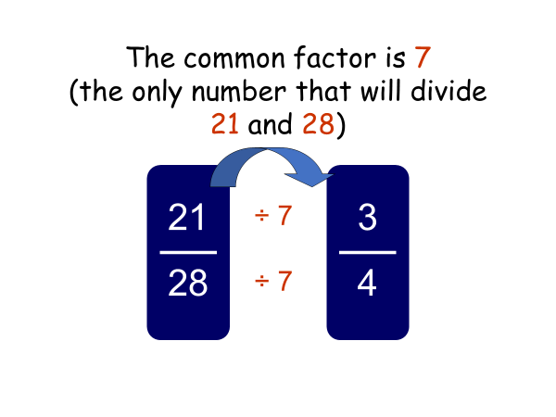

Slide 12
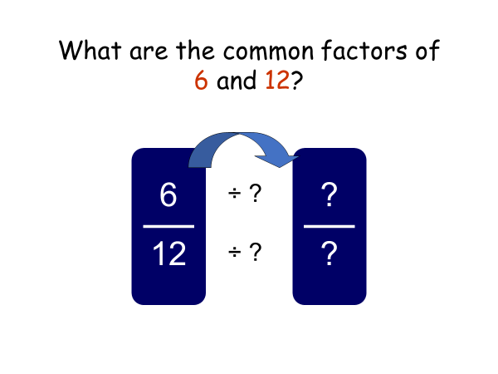

Slide 13
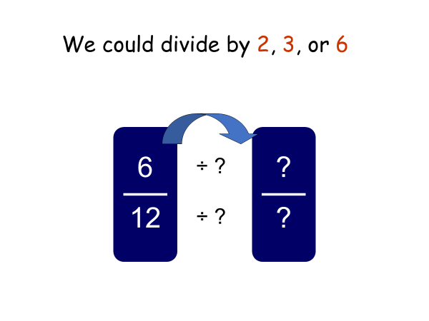

Slide 14
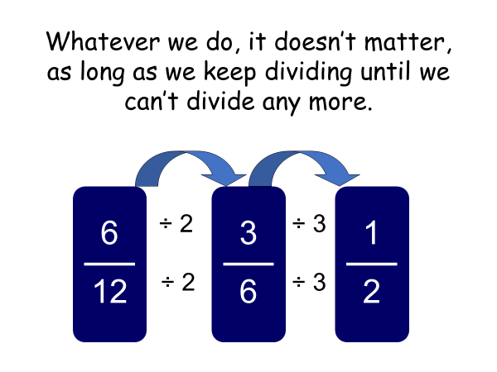

Slide 15
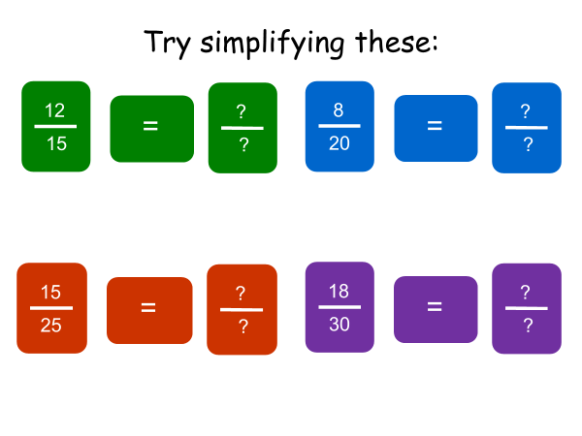

Slide 16
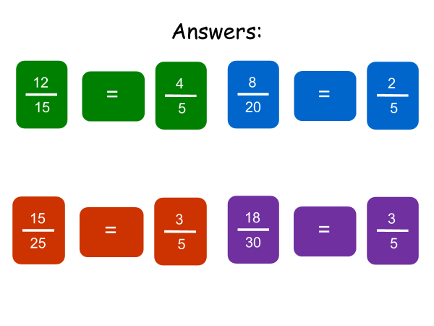

Slide 17
