Slide 1
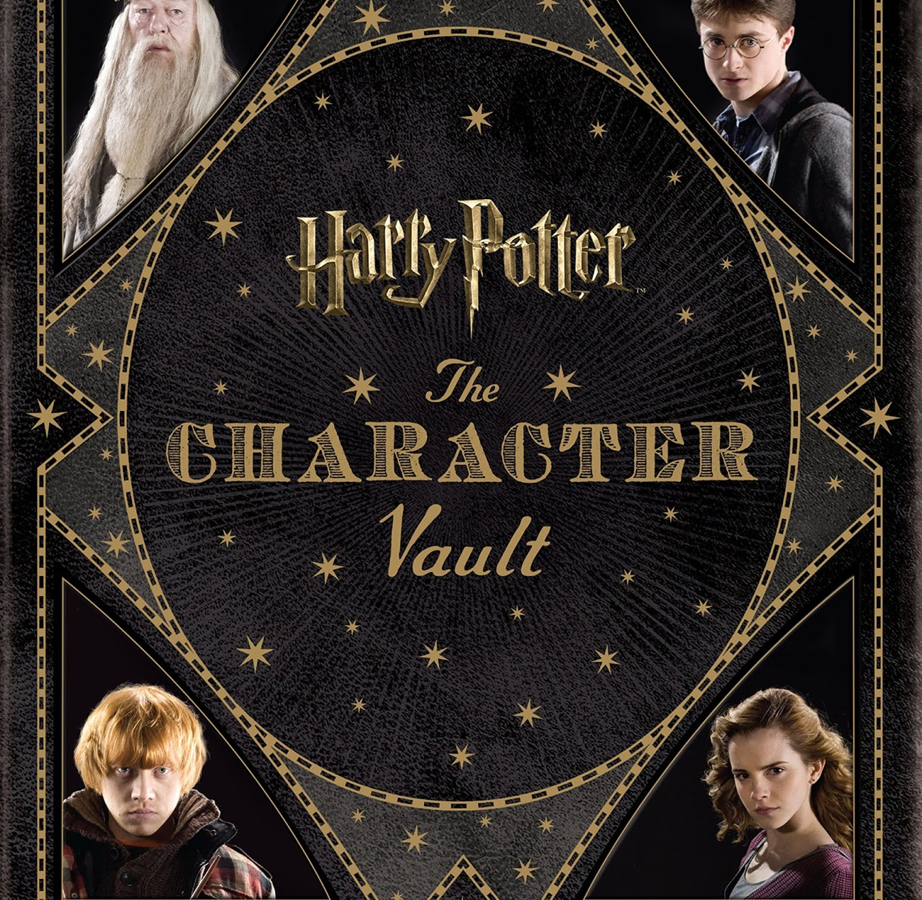
Character Development
In
Harry Potter
(Demo Lesson)

Slide 2
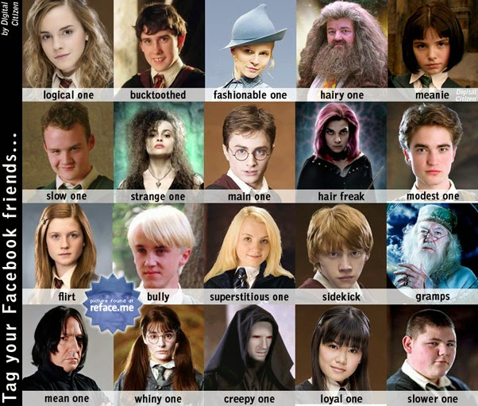
Main Characters in Harry Potter
There are many characters in Harry Potter, both human and magical.
How many do you know?
Could you name twelve of the main characters?

Slide 3

Guess the character quiz
o l- - m - - t
H - - m – o - -
u – b- - d - - e
- r – y
o –
H - g – i - -

Slide 4
Guess the character quiz - Answers
Voldemort
Hermione
Dumbledore
Harry
Ron
Hagrid

Slide 5
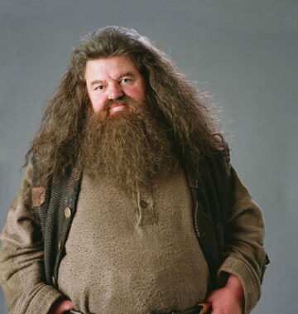

The character of Hagrid

Slide 6
How does the writer develop character?
A low rumbling sound had broken the silence around them. It grew steadily louder as they looked up and down the street for some sign of a 11 headlight; it swelled to a roar as they both looked up at the sky – and a huge motorcycle fell out of the air and landed on the road in front of them.
If the motorcycle was huge, it was nothing to the man sitting astride it. He was almost twice as tall as a normal man and at least five times as wide. He looked simply too big to be allowed, and so wild – long tangles of bushy black hair and beard hid most of his face, he had hands the size of trash can lids, and his feet in their leather boots were like baby dolphins. In his vast, muscular arms he was holding a bundle of blankets.
"Hagrid," said Dumbledore, sounding relieved. "At last. And where did you get that motorcycle?

Slide 7

How does the writer develop character in this extract?
Through foreshadowing
Through physical description
Through dialogue

Slide 8

What is foreshadowing?
Foreshadowing is a literary device in which a writer gives an advance hint of what is to come later in the story. Foreshadowing often appears at the beginning of a story, or a chapter, and it helps the reader develop expectations about the upcoming events.
A writer may implement foreshadowing in many different ways. Some of these ways include: character dialogues, plot events, and changes in setting. Even the title of a work or a chapter can act as a clue that suggests what is going to happen. Foreshadowing in fiction creates an atmosphere of suspense in a story, so that the readers are interested and want to know more.

Slide 9
How does the writer develop character?
A low rumbling sound had broken the silence around them. It grew steadily louder as they looked up and down the street for some sign of a 11 headlight; it swelled to a roar as they both looked up at the sky – and a huge motorcycle fell out of the air and landed on the road in front of them.
If the motorcycle was huge, it was nothing to the man sitting astride it. He was almost twice as tall as a normal man and at least five times as wide. He looked simply too big to be allowed, and so wild – long tangles of bushy black hair and beard hid most of his face, he had hands the size of trash can lids, and his feet in their leather boots were like baby dolphins. In his vast, muscular arms he was holding a bundle of blankets.
"Hagrid," said Dumbledore, sounding relieved. "At last. And where did you get that motorcycle?

Slide 10

Remember…
Writers can develop characters through:
*foreshadowing
*physical description
*dialogue

