Slide 1
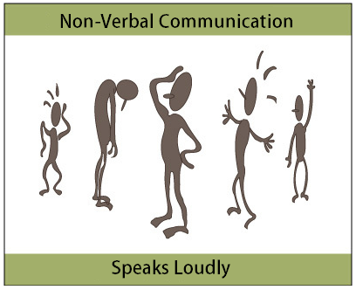
What is Non-Verbal Communication?
The processes of conveying a type of information in the form of non-linguistic representations.
Research shows it takes 4 minutes to make a first impression.
Non-verbal cues are important when communicating feelings and attitudes.
When your verbal and non-verbal communication are different, people will believe the non-verbal.

Slide 2

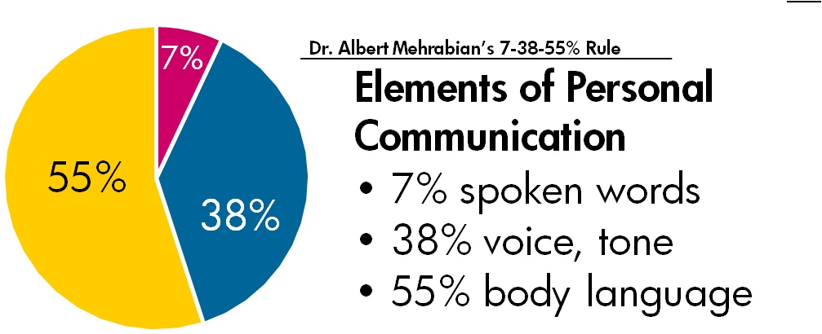
We communicate not only through words but also through means other than words.
A research (Mehrabian’s research) show the impact of speaker’s message on receiver’s as follows;
    Words spoken (7%)
    Tone of voice (38%)
    Facial Expression/Body language (55%)
Its shows receiver derived 93% of meaning through non-verbal communication.

Slide 3

Why is it important?
❖ One of the key aspects of communication.
❖ Especially important in a high-context culture and signiﬁcant in intercultural situations.
❖ It is used to repeat, to accent and to complement the verbal message.
❖ It regulate interactions and replace verbal message.

Slide 4
NVC helps people to:
Reinforce or modify what is said in words.
Convey information about their emotional state.
Define or reinforce the relationship between people.
Provide feedback to the other person.
Regulate the flow of communication
Notes:
1. For example, people may nod their heads vigorously when saying "Yes" to emphasize that they agree with the other person, but a shrug of the shoulders and a sad expression when saying "I'm fine thanks,” may imply that things are not really fine at all.
5. For example by signaling to others that they have finished speaking or wish to say something.

Slide 5

Types of Non- Verbal Communication
Kinesics
Body movements
Physiological Changes
Haptics
Internal reactions
Touch
NVC
Proxemics
Vocalics
Space
Para-language

Slide 6
Tips for reading NVC
Once you’ve developed your abilities to manage stress and recognize emotions, you’ll naturally become better at reading the nonverbal signals sent by others.
Pay attention to inconsistencies.
  Nonverbal communication should reinforce what is being said. Is the person is saying one thing, and their body language something else? For example, are they telling you “yes” while shaking their head no?
Look at nonverbal communication signals as a group.
  Don’t read too much into a single gesture or nonverbal cue. Consider all of the nonverbal signals you are receiving, from eye contact to tone of voice and body language.
Trust your instincts.
  Don’t dismiss your gut feelings. If you get the sense that someone isn’t being honest or that something isn’t adding up, you may be picking up on a mismatch between verbal and nonverbal cues.

Slide 7
Signs you send to others:
Be neat in your personal appearance
  Dress properly. Don’t overdress.
Face the listener
  Discern and decode the expressions of the listeners.
Focus on the speaker
  Maintain eye contact.
Position yourself properly
  Stand and sit upright to look involved.

Slide 8
Signs you send to others:
Consider past experience
  We can predict their behavior on basis of past experience.
Clarify from time to time
  Talk to audience and clarify whether we are being proper understood or not.
Use positive gestures
  Should be friendly, caring and non-threatening.
Keep reasonable distance
  Be mindful of their personal space.

Slide 9
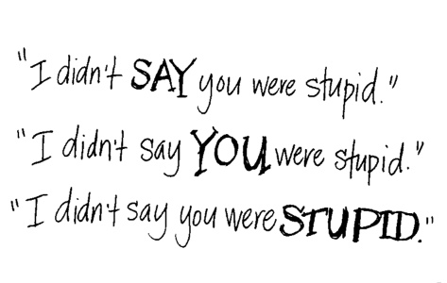
It’s not what you say, it’s how you say it.
What you say is a vital part of any communication. But what you don’t say can be even more important.
Nonverbal communication can’t be faked.
You can’t control all of the signals you’re constantly sending off about what you’re really thinking and feeling. And the harder you try, the more unnatural your signals are likely to come across.
Notes:
When we speak, other people “read” our voices in addition to listening to our words. Things they pay attention to include your timing and pace, how loud you speak, your tone and inflection, and sounds that convey understanding, such as “ahh” and “uh-huh.” Think about how someone's tone of voice, for example, can indicate sarcasm, anger, affection, or confidence.
You may be familiar with advice on how to sit a certain way, steeple your fingers, or shake hands just so in order to appear confident or assert dominance. But the truth is that such tricks aren’t likely to work (unless you truly feel confident and in charge).

Slide 10

Final thoughts!
Nonverbal communication plays an important role in how we convey meaning and information to others, as well as how we interpret the actions of those around us.
Nonverbal behaviors and actions is to consider it in groups. What a person says along with his/her expressions, appearance, and tone of voice might tell you a great deal about what that person is really trying to say.
Even when you're silent, you're still communicating nonverbally.

