Slide 1
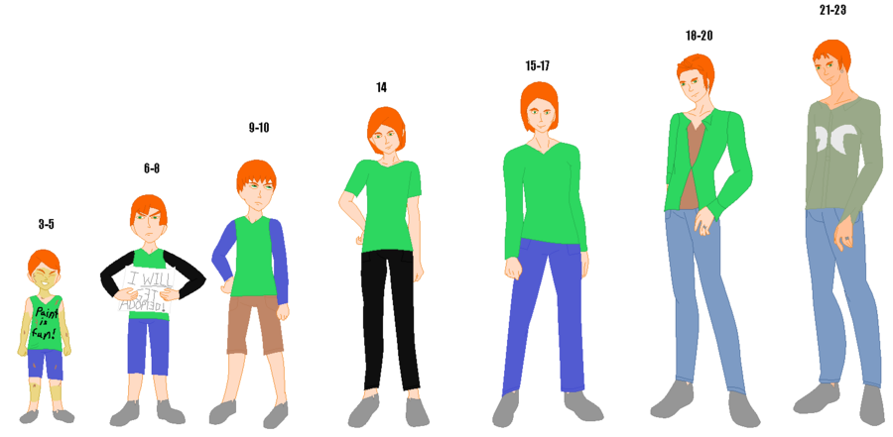
Age (n)

Slide 2

Small (Adj.)

Slide 3

Town (n)

Slide 4
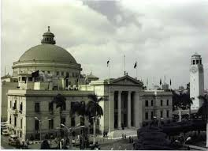
University (n)

Slide 5

Leave (v)

Slide 6
Age
Small
Town
University
Leave

Slide 7
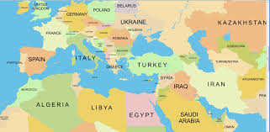
Country (n)

Slide 8

Manager (n)

Slide 9
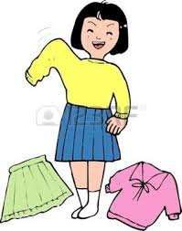
Change (n-v)

Slide 10

Life (n)

Slide 11
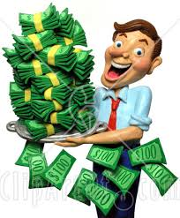
Millionaire (n)

Slide 12
Country
Manager
Change
Life
Millionaire

Slide 13

Mom (n)

Slide 14
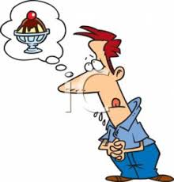
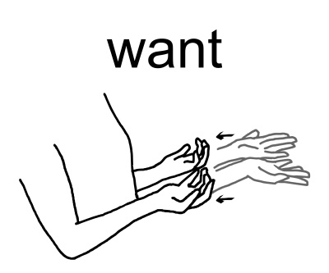
Want (v)

Slide 15


Easy (Adj.)

Slide 16


Understand (v)

Slide 17
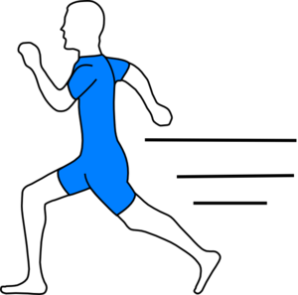
Quickly (Adv.)

Slide 18
Mom
Want
Easy
Understand
Quickly

Slide 19

Thank (v)

Slide 20

God (n)

Slide 21

Language (n)

Slide 22
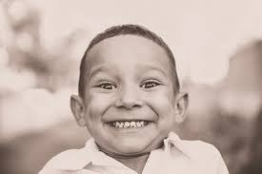
Happy (Adj.)

Slide 23

Man (n)

Slide 24
Thank
God
Language
Happy
Man

Slide 25
Age
Small
Town
University
Leave
Country
Manager
Change
Life
Millionaire
Mom
Want
Easy
Understand
Quickly
Thank
God
Language
Happy
Man

