Slide 1
How to Write a Literature Analysis using an example from ‘Hard Times’ by Charles Dickens.
Analyzing Literary and Structural Devices
Answer First Language English Question (GCSE/IGCSE)

Slide 2
What Are Literary Devices?
Literary devices are techniques that authors use to enhance their writing, convey meaning, or evoke emotions.
Examples:
- Metaphor: Comparing two unlike things without using 'like' or 'as.'
- Simile: Comparing two things using 'like' or 'as.'
- Personification: Giving human qualities to inanimate objects.
- Imagery: Descriptive language that appeals to the senses.

Slide 3
What Are Structural Devices?
Structural devices relate to how a text is organized or structured to create a particular effect.
Examples:
- Syntax: The arrangement of words and phrases to create well-formed sentences.
- Repetition: Repeating words or phrases for emphasis.
- Chronological order: Presenting events in the order they occur.
- Juxtaposition: Placing contrasting elements side by side to highlight differences.

Slide 4
Example of Literary Devices in Action
'It was a town of red brick, or of brick that would have been red if the smoke and ashes had allowed it... the piston of the steam-engine worked monotonously up and down like the head of an elephant in a state of melancholy madness.'
Analysis:
- Metaphor: 'The piston of the steam-engine worked... like the head of an elephant' – This metaphor gives the steam-engine a sense of weight and monotony.
- Personification: 'Interminable serpents of smoke' – Smoke is described as a snake, poisoning the town.

Slide 5
Example of Structural Devices in Action
Text: 'It contained several large streets all very like one another, and many small streets still more like one another...'
Analysis:
- Repetition: Repeating 'like one another' emphasizes the uniformity and monotony of the town, reflecting the boredom and lack of liveliness in the town.
- Long Sentences: The use of long, flowing sentences reflects the unending and monotonous life of the town’s inhabitants.

Slide 6
Effects of Devices on Reader’s Impression
- Mood of Gloom and Oppression: The dark imagery and repetition create a sense of hopelessness and bleakness.
- Mechanical Life: The repetitive sentence structure mirrors the repetitive lives of the townspeople, highlighting the lack of individuality and freedom.

Slide 7
How to Write a PEEL Paragraph
PEEL Structure:
- Point: Make a clear point.
- Evidence: Support your point with evidence.
- Explanation: Explain how the evidence supports your point.
- Link: Connect your point to the question or overall argument.

Slide 8
Example PEEL Paragraph Question
Question: How does the author use structural and literary devices to express the mood of the town in Hard Times?

Slide 9
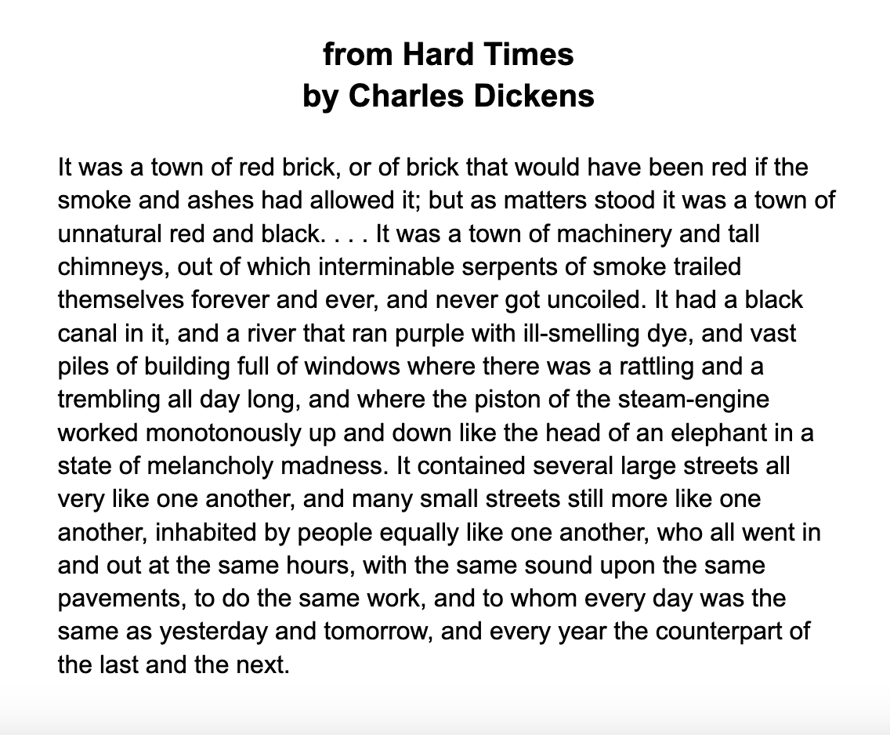

Slide 10
Example PEEL Paragraph Answer
In Hard Times, Dickens uses both literary and structural devices to emphasize the bleak and lifeless atmosphere of the town.
The author employs personification and metaphor to describe the town, such as the 'interminable serpents of smoke' that suggest a threatening and overwhelming presence, and the 'piston of the steam-engine' compared to 'the head of an elephant in a state of melancholy madness.’
These images evoke a sense of power and misery in the town. Structurally, Dickens uses repetition in the description of the streets and inhabitants being 'very like one another,' which reflects the monotonous and mechanical lives of the people, making every day indistinguishable from the next.
By combining these devices, Dickens creates a vivid, oppressive mood that mirrors the dehumanizing effects of industrialization.

Slide 11
Summary of Key Points
- Literary Devices: Metaphor, Personification, Imagery etc.
- Structural Devices: Repetition, Long Sentences etc.
- PEEL Paragraph: Helps organize analysis in a clear, structured way.

