Slide 1


Welcome to the World of Algebra!
Get ready for an exciting adventure into the world of algebra! Algebra is like a secret code that helps us solve problems and understand patterns in math. It's all about using letters and symbols to represent numbers and finding their hidden relationships. In this journey, we'll learn how to use these symbols, solve equations, and discover amazing things about numbers. Are you ready to unlock the secrets of algebra?
by Onyedikachi Ikenna Onwurah

Slide 2
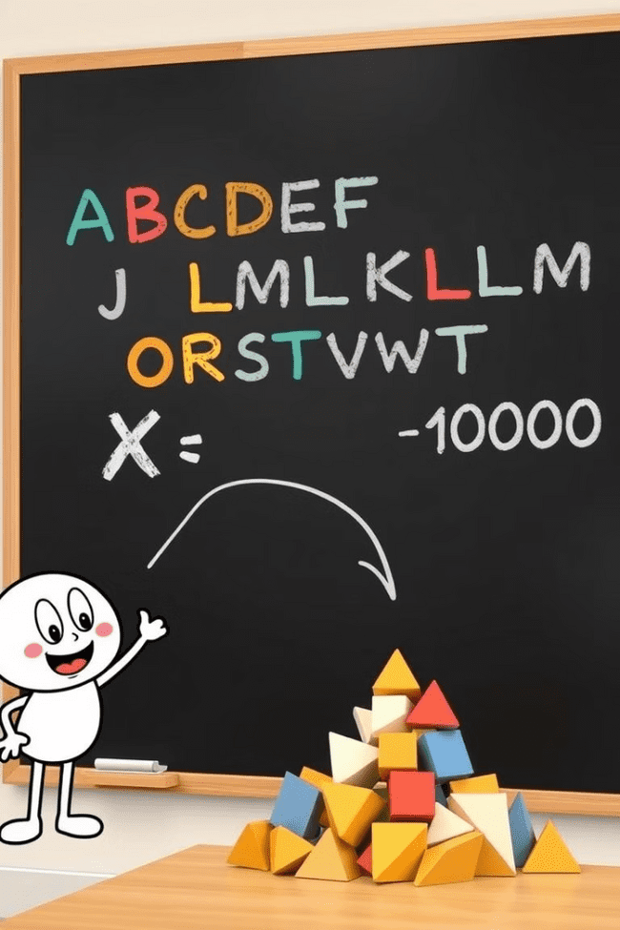
Understanding Variables
In algebra, we use letters like "x" or "y" to represent unknown numbers. These letters are called variables. They are like empty boxes waiting to be filled with a number. Think of it like a treasure hunt! You have clues (equations) that tell you where to find the treasure (the value of the variable).
Example
Think about it!
Let's say "x" represents the number of apples you have. If you have 3 apples, then "x = 3".
Can you think of some other examples of things that could be represented by variables?

Slide 3
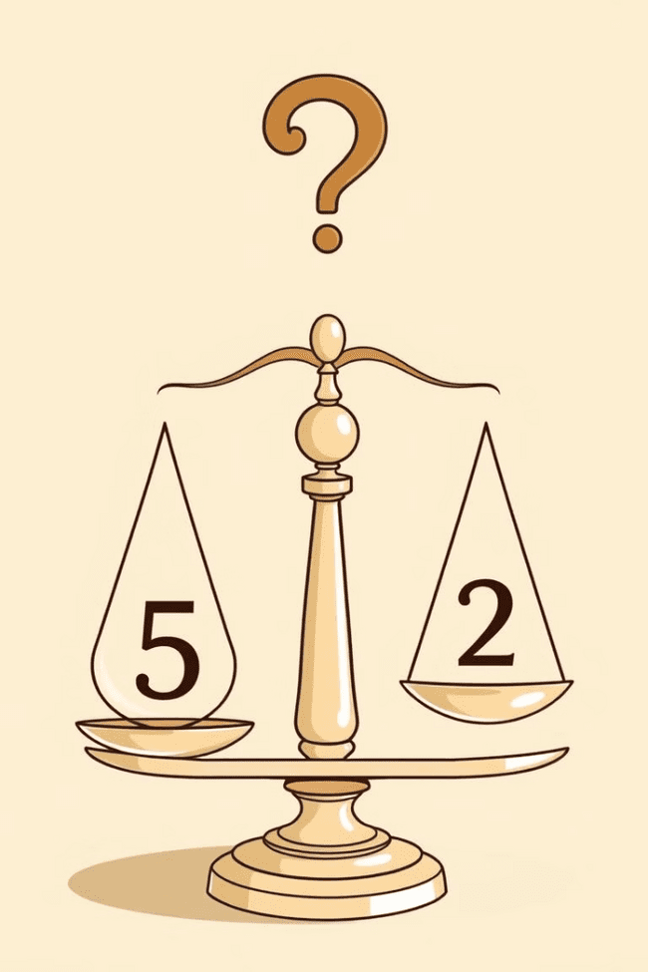


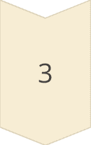
Solving Simple Equations
An equation is like a statement that says two things are equal. For example, "x + 2 = 5" is an equation. To solve an equation, we need to find the value of the variable that makes the equation true. It's like figuring out the missing piece of a puzzle!
Step 1
Start by isolating the variable on one side of the equation. In this case, we want to get "x" by itself.
Step 2
Subtract "2" from both sides of the equation. This keeps the equation balanced. (x + 2) - 2 = 5 - 2
Step 3
This simplifies to x = 3. We have found the value of "x" that makes the equation true!

Slide 4
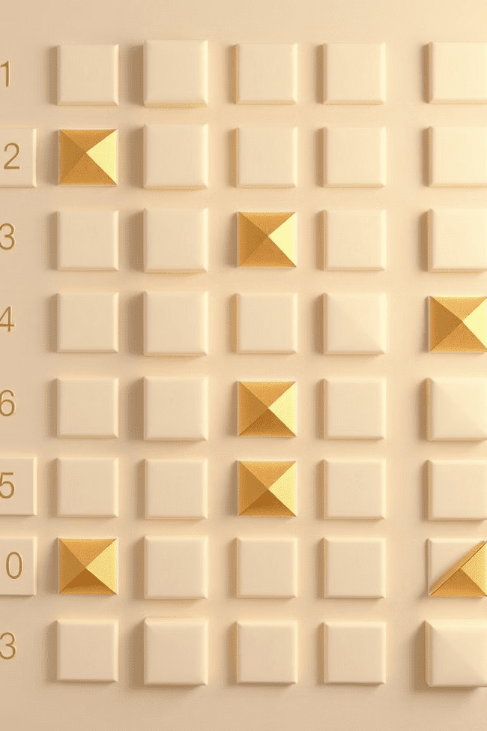
Exploring Algebraic Patterns
Algebra helps us discover hidden patterns in math! Patterns can be found in shapes, numbers, and even in everyday life. Imagine a growing pattern of dots. The first row has 1 dot, the second row has 2 dots, and so on. We can write this pattern as an equation: "y = x", where "x" is the number of the row and "y" is the number of dots in that row.
Row Number (x)
Number of Dots (y)
1
1
2
2
3
3

Slide 5
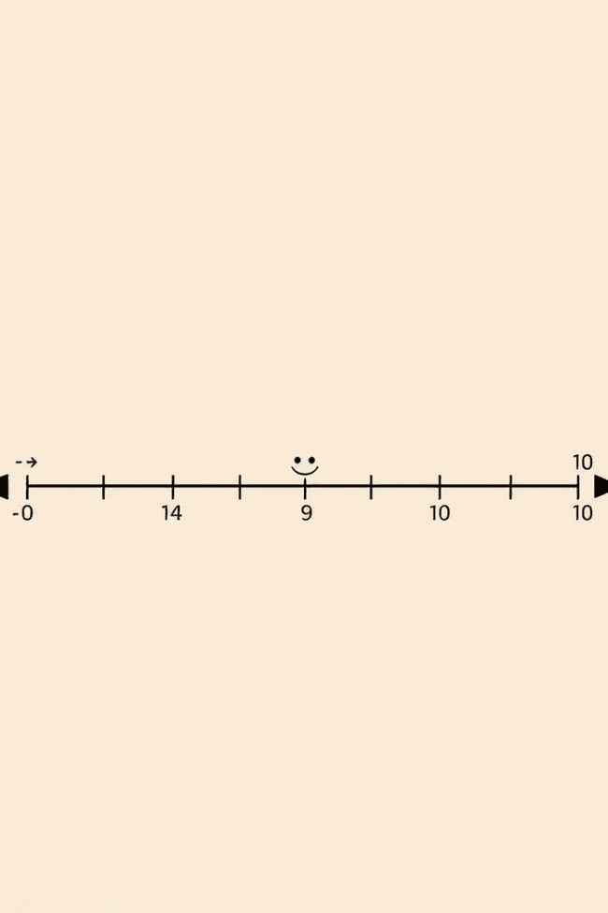
Positive and Negative Numbers
You know about positive numbers, like 1, 2, 3, and so on. But there are also negative numbers, like -1, -2, -3, and so on. Negative numbers are like the opposite of positive numbers. Imagine a thermometer. The numbers above zero are positive, and the numbers below zero are negative.
1
Addition
2
Subtraction
Adding a positive number moves you to the right on the number line, and adding a negative number moves you to the left.
Subtracting a positive number moves you to the left on the number line, and subtracting a negative number moves you to the right.

Slide 6
Combining Like Terms
Imagine you have apples and oranges. You can only add apples to apples and oranges to oranges. It's the same with variables! We can only combine terms that have the same variable and the same exponent. For example, 2x + 3x = 5x, because both terms have the variable "x". But 2x + 3y cannot be combined because they have different variables.
Combining Like Terms
Not Combining Like Terms
3x + 5x = 8x
2x + 3y cannot be combined
4y - 2y = 2y
5a + 2b^2 cannot be combined

Slide 7
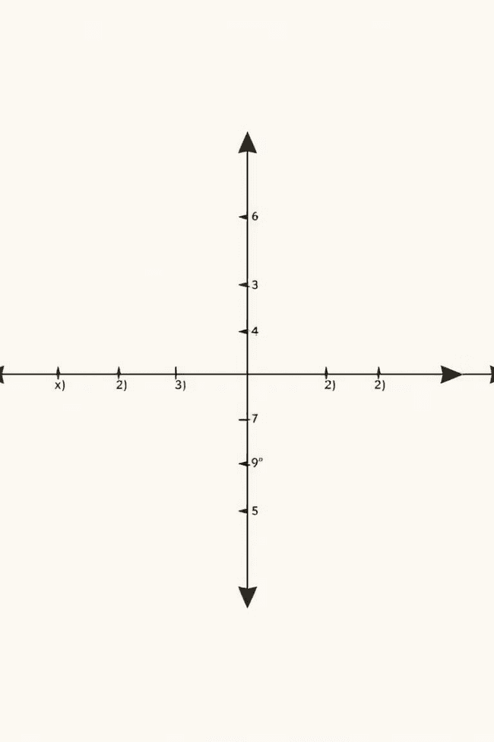
Graphing Linear Equations
A linear equation is an equation that creates a straight line when graphed. To graph a linear equation, we need to find two points on the line. Then, we connect those points with a straight line. The equation tells us how the "x" and "y" values are related.
1
Step 1
Choose two values for "x" and substitute them into the equation to find the corresponding "y" values.
2
Step 2
Plot the two points on a coordinate plane.
3
Step 3
Draw a straight line through the two points.

Slide 8
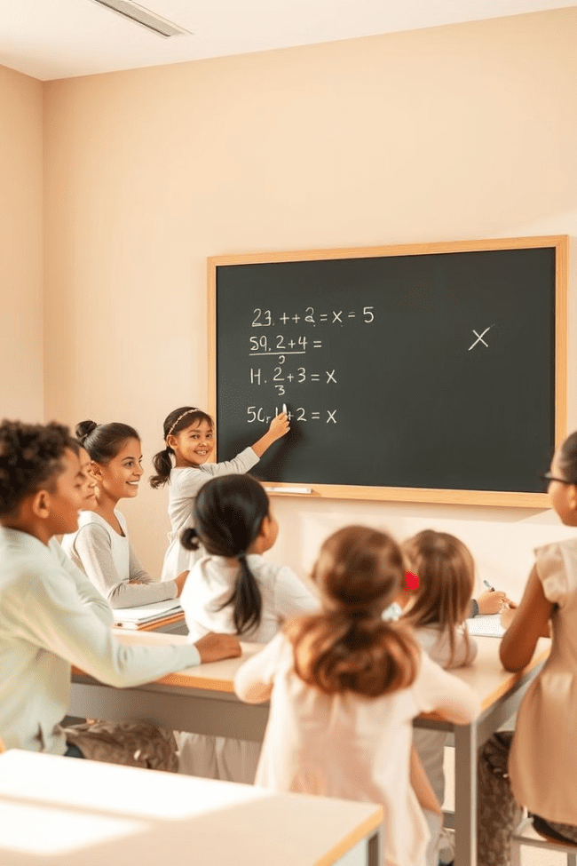



Word Problems and Applications
Algebra can be used to solve real-life problems! Word problems are like puzzles that describe a situation using words. We need to translate the words into an equation to solve the problem. For example, "John has 5 apples, and his friend gives him 3 more apples. How many apples does John have now?"
Step 1
Identify the unknown. Let's say "x" represents the total number of apples John has.
Step 2
Write the equation. x = 5 + 3
Step 3
Solve for "x". x = 8. John has 8 apples.

Slide 9

Wrap-up and Review
Congratulations! You've learned so much about algebra. You've discovered the power of variables, solved equations, explored patterns, and even used algebra to solve word problems. Algebra is a valuable tool that helps us understand the world around us. Keep practicing, and you'll become a master of algebra in no time!
Am available to take your wards to any level of knowledge in mathematics.

