Slide 1

Probability

Slide 2

LESSON THEME
REVIEW OF PROBABILITY
STUDY UNIT 2.1
Random Variables & Probability Distributions
Learning Objectives:
On completion of this study unit it will be expected of you to:
Understand what a random variable is and distinguish between discrete and continuous random variables.
Interpret and construct probability distributions for a single random variable.
Calculate and interpret event probabilities and cumulative probability distributions.

Slide 3
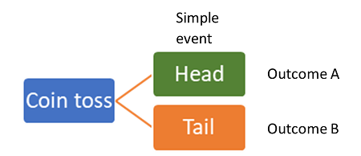
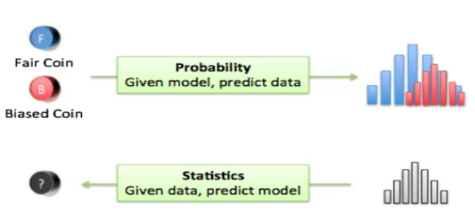
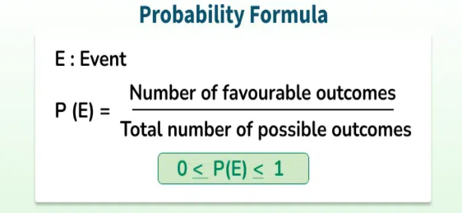
Probability & Statistics
Definitions:
Outcomes is are the mutually exclusive possible results that can occur from a random process or experiment.
Probability is a measure of the likelihood or chance that a particular event will occur. It quantifies uncertainty and is expressed as a number between 0 and 1.
0: The event is impossible.
1: The event is certain.
Therefore the probability of an outcome is the proportion of the time that the outcome
occurs in the long run.
Statistics is the art and science of collecting, analysing, presenting and interpreting data.

Slide 4
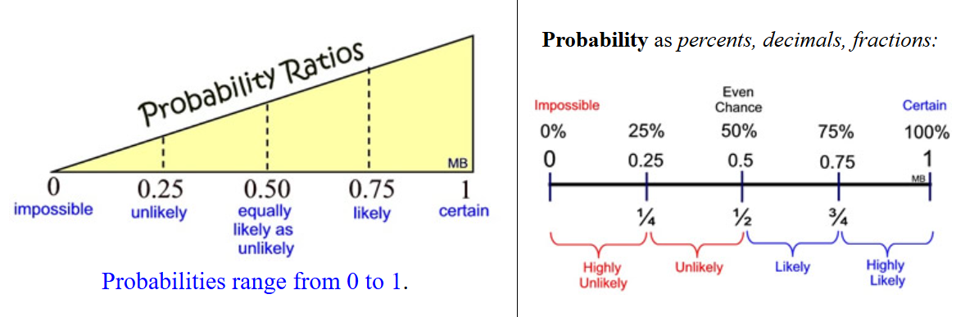
Probability and Statistics

Slide 5
Sample Space & Random Variables
Definitions:
The sample space is the set of all possible outcomes of a random process.
Example: When rolling a six-sided die, the sample space is {1, 2, 3, 4, 5, 6} which represents each side of the die.
An event is a subset of the sample space, meaning it includes one or more possible outcomes.
Example: The event “rolling an even number” is the set {2, 4, 6}.
Similarly, the event “my wireless connection will fail no more than once” includes the outcomes “no failures” and “one failure.”
A random variable is a numerical summary of a random outcome (i.e. represents the possible outcomes of a random process):
Discrete Random Variable: Takes on specific, countable values (e.g., number of heads in a coin toss, like 0, 1, 2,…).
Continuous Random Variable: Takes on any value within a range on a continuum of possible values (e.g., height, temperature).

Slide 6
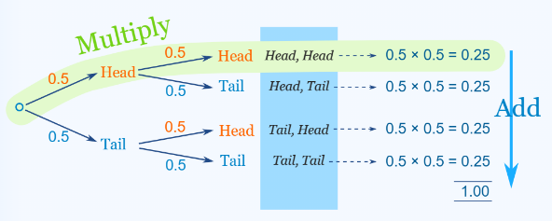
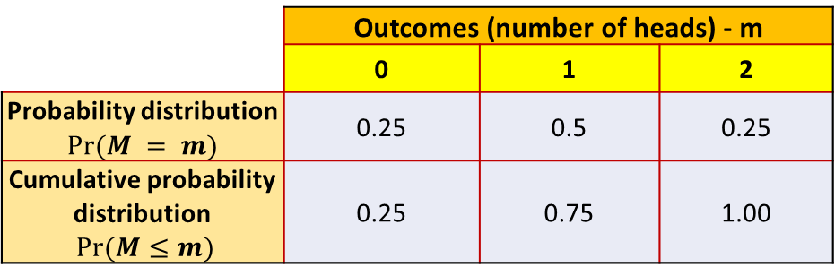
Probability Distribution of a Discrete Random Variable
Definitions:
Probability distribution describes how probabilities are assigned to the outcomes of a random variable, providing a complete picture of all possible outcomes and their likelihoods.
CASE: If you were to toss a fair twice, what would the probability of getting a head and a tail? Let M, be number of times the outcome of the toss is heads.
The probability distribution of a discrete random variable shows all the possible values the variable can take and the probability associated with each value. The sum of all these probabilities is equal to 1.
The probability of an event can be found using the probability distribution and calculated by adding the probabilities of all outcomes that make up the event.
Example:
Event: “Zero or two heads”
Calculation: Pr(M = 0 or M = 2) = Pr(M = 0) + Pr(M = 2)
= 0.25 + 0.25 = 0.50 (50%)
 | Outcomes (number of heads) - m
 | 0 | 1 | 2
Probability distribution $Pr⁡(M = m)$ | 0.25 | 0.5 | 0.25
Cumulative probability distribution $Pr⁡(M≤m)$ | 0.25 | 0.75 | 1.00
The cumulative probability distribution (or cumulative distribution function c.d.f.) gives the probability that a random variable is less than or equal to a certain value.
Example: Probability of at most one head:
Pr(M ≤ 1) = Pr(M = 0) + Pr(M = 1) = 0.25 + 0.5 = 0.75 (75%)

Slide 7
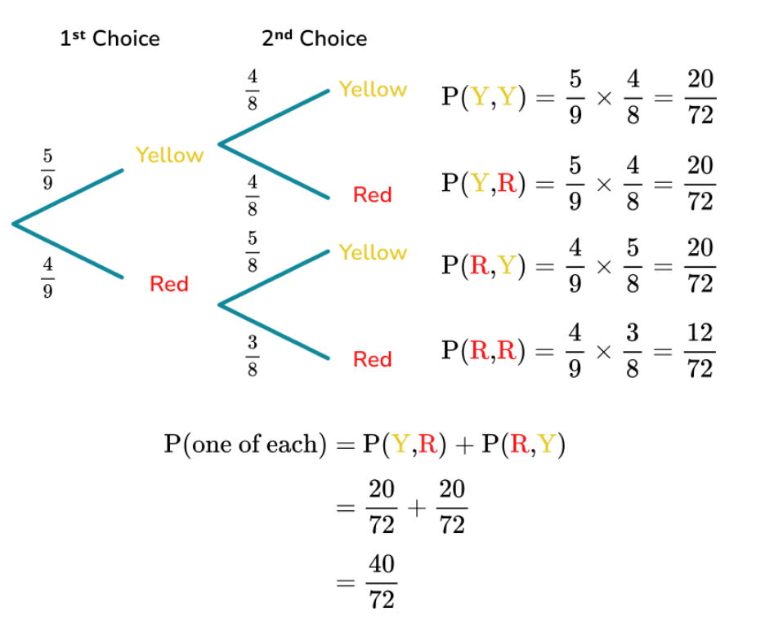
Probability Distribution of a Discrete Random Variable – Example
CASE: Charles has a bag of 9 sweets which are a mixture of red and yellow. He picks two sweets from the bag.
Given the case study above:
How likely is Charles to pick two red sweets without replacement?
Notes:
Variables: Student ID, Student Name, University, Leisure Time (Hours)

Slide 8
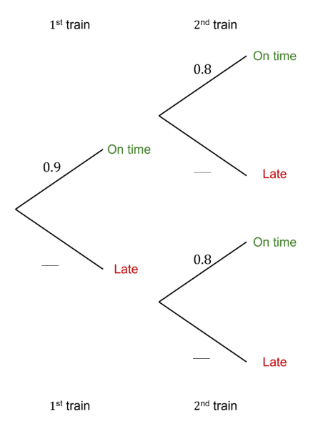
Probability Distribution of a Discrete Random Variable – Example
CASE: Two trains leave Amsterdam Central Station for Groningen. There is a 90% chance that the first train arrives on-time and a 80% chance that the second is also arrives on-time.
Given the case study above:
Fill in the missing probabilities in the diagram.
Provide the sample space of events.
Provide the probability distribution of for both train journeys.
What is the likelihood of both trains arriving late?
Notes:
Pr(1st train late (L)) = 0.1, Pr(2nd train late (L)) = 0.2
Sample space = { (OT, OT), (OT,L), (L, OT), (L, L) }
P(OT, OT) = 0.9*0.8 = 0.72, P(OT, L) = 0.9*0.2 = 0.18, P(L, OT) = 0.1*0.8 = 0.08, P(L, L) = 0.2*0.1 = 0.02
P(L, L) = 0.2*0.1 = 0.02 therefore there is a 2% chance that both trains will be late.

Slide 9
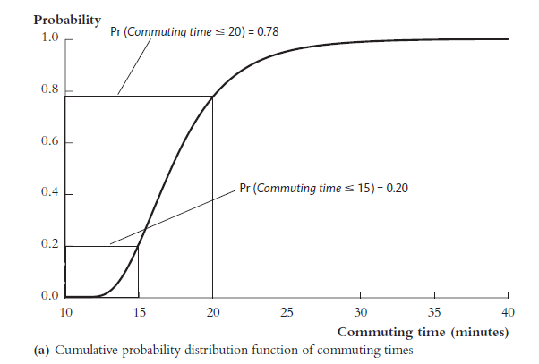
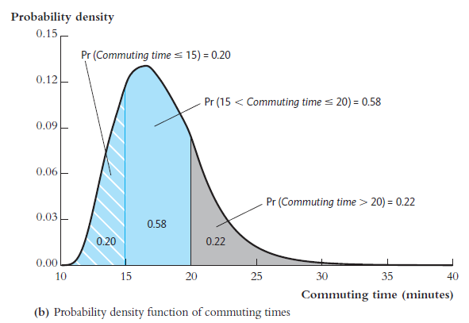
Probability Distribution of a Continuous Random Variable
Definitions:
A probability density function (p.d.f.) is used for continuous variables to describe how probability is distributed over possible values. The area under the curve between two points represents the probability that the variable falls within that range.
Example: Probability that commute takes between 15 and 20 minutes = 58% (area under the curve between 15 and 20).
The cumulative probability distribution (C.D.F.) of a continuous random variable gives the probability that the variable is less than or equal to a specific value.
Example:
Probability that commute takes less than 15 minutes = 20% (i.e., Pr(Commute time ≤15) = 0.2)
Probability that commute takes less than 20 minutes = 78% (i.e., Pr(Commute time ≤20) = 0.78)
CASE: A student’s commuting time is a continuous random variable since it can take on any value depending on factors like traffic or weather.

Slide 10

Probability Distribution of a Continuous Random Variable - Example
CASE: A student’s commuting time is a continuous random variable since it can take on any value depending on factors like traffic or weather.
Based on the case study above and the graphs given below:
What is the likelihood that the commute will take more than 15 minutes?
What is the likelihood that the commute will take at most 20 minutes?
Notes:
Note: understand that at least means greater than equal to (≥), at most means less than equal to (≤), more than means greater than (>) and less than (<).
P(Commute time > 15 minutes) = 1 - P(Commute time ≤ 15 minutes) = 1 – 0.2 = 0.58 + 0.22 = 0.8
P(Commute time ≤ 20 minutes) = 1 - P(Commute time > 20 minutes) = 1 – 0.22 = 0.58 + 0.2 = 0.78

Slide 11
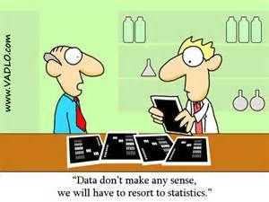
LESSON THEME
REVIEW OF PROBABILITY
STUDY UNIT 2.2
Expected Values, Mean and Variance
Learning Objectives:
On completion of this study unit it will be expected of you to:
Understand the concepts of mathematical expectation (expected value), mean, and variance of a single random variable.
Calculate and interpret the expected value and variance in practical contexts.
Recognize the importance of extending these concepts to situations involving more than one variable.

Slide 12


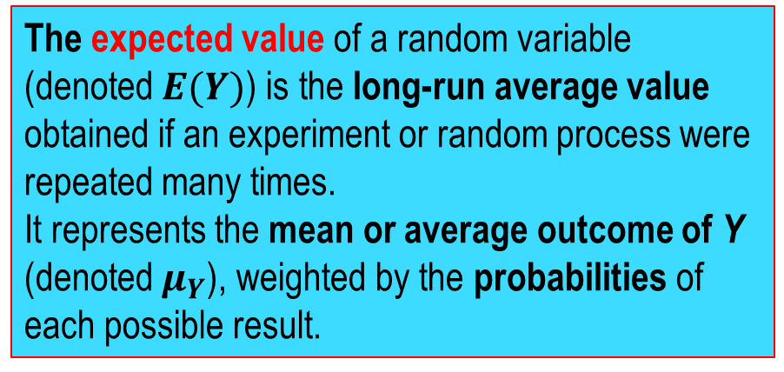
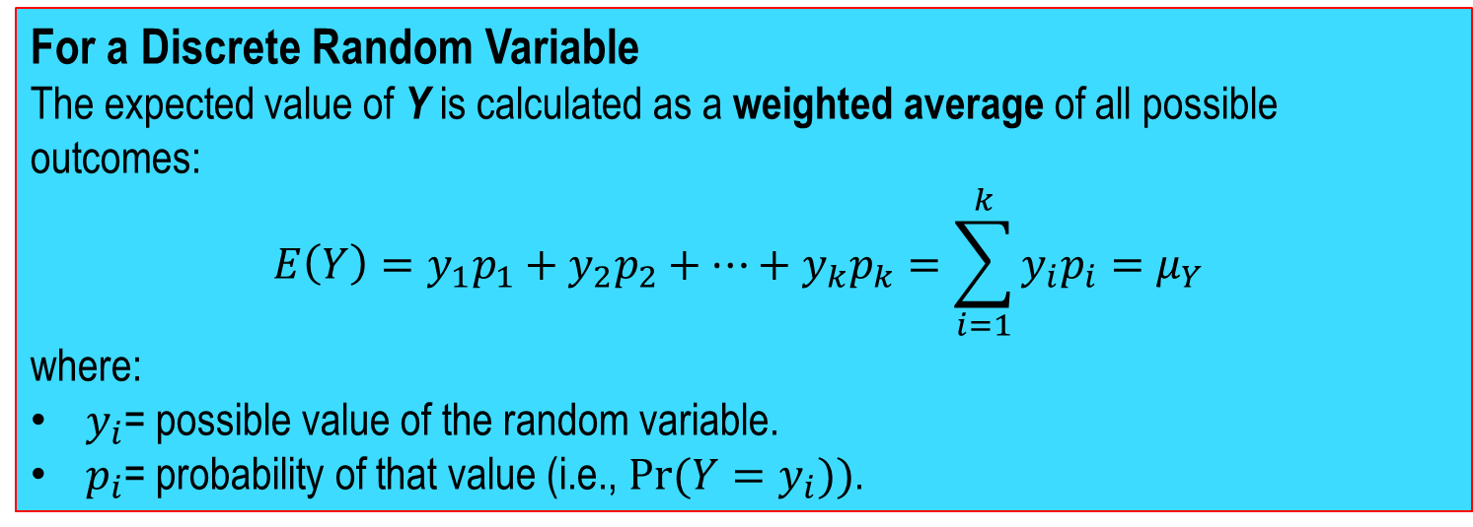
Expected Value of a Random Variable
Definitions:
The expected value of a random variable (denoted $E(Y)$) is the long-run average value obtained if an experiment or random process were repeated many times.
It represents the mean or average outcome of Y (denoted $μ_{Y}$), weighted by the probabilities of each possible result.
For a Discrete Random Variable
The expected value of Y is calculated as a weighted average of all possible outcomes:
$$E\left(Y\right)=y_{1}p_{1}+y_{2}p_{2}+⋯+y_{k}p_{k}=\sum_{i=1}^{k}{y_{i}p_{i}}=μ_{Y}$$
where:
$y_{i}$= possible value of the random variable.
$p_{i}$= probability of that value (i.e., $Pr⁡(Y=y_{i}))$.

Slide 13
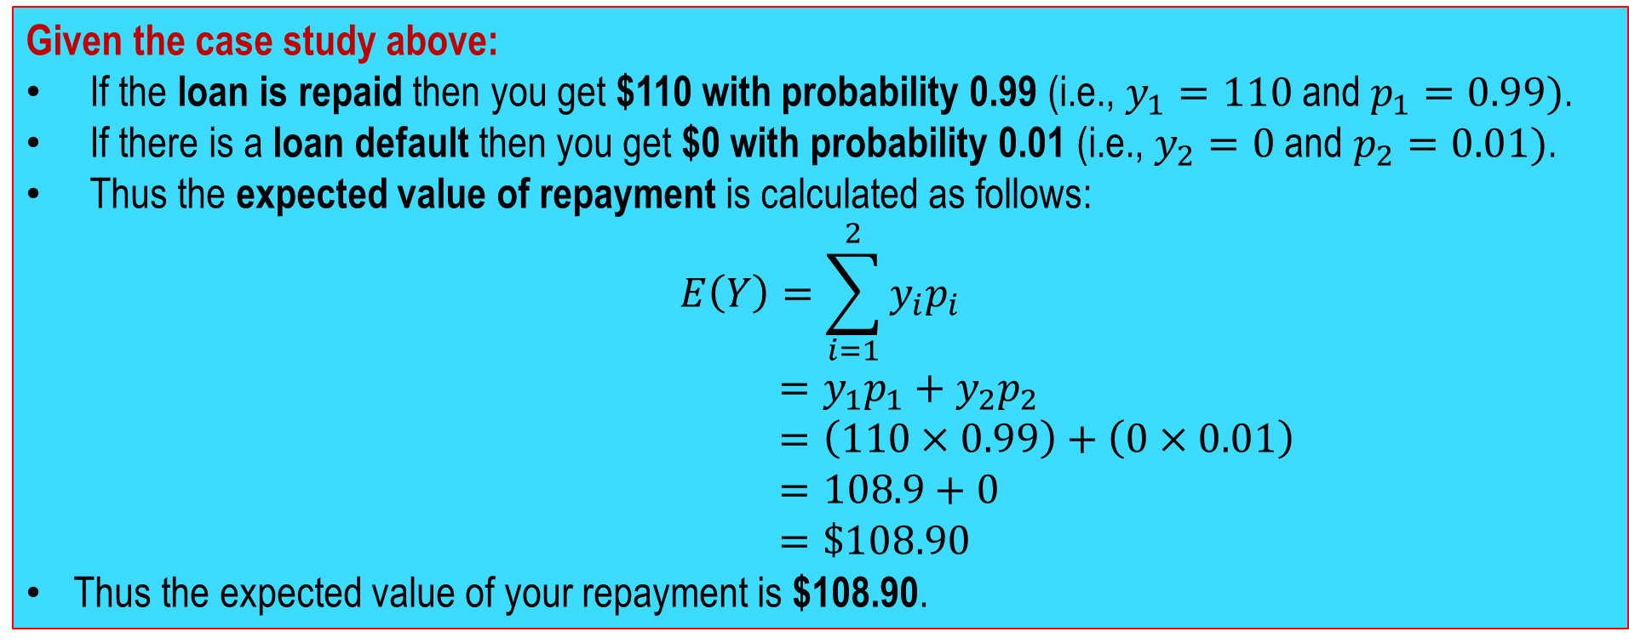
Expected Value of a Random Variable – Example
CASE: You loan a friend $100 at 10% interest. If the loan is repaid, you get $110 (the principal of $100 plus interest of $10), but there is a risk of 1% that your friend will default and you will get nothing at all. What is the expected value of your repayment?
Given the case study above:
If the loan is repaid then you get $110 with probability 0.99 (i.e., $y_{1}=110$ and $p_{1}=0.99)$.
If there is a loan default then you get $0 with probability 0.01 (i.e., $y_{2}=0$ and $p_{2}=0.01)$.
Thus the expected value of repayment is calculated as follows:
$$E\left(Y\right)=\sum_{i=1}^{2}{y_{i}p_{i}}$$
$=y_{1}p_{1}+y_{2}p_{2}$
$=\left(110×0.99\right)+\left(0×0.01\right)$
$=108.9+0$
$=\$108.90$
Thus the expected value of your repayment is $108.90.

Slide 14
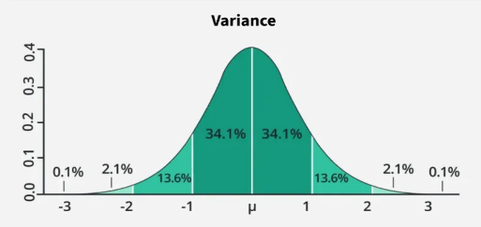
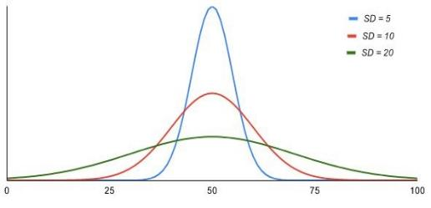
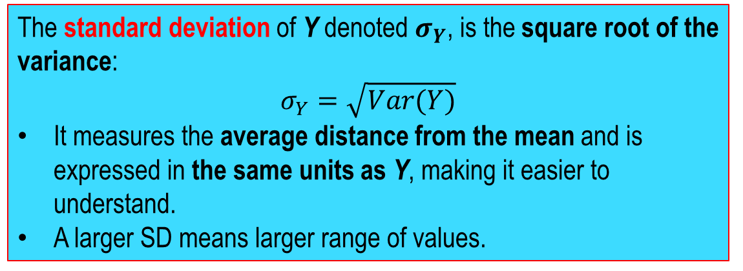
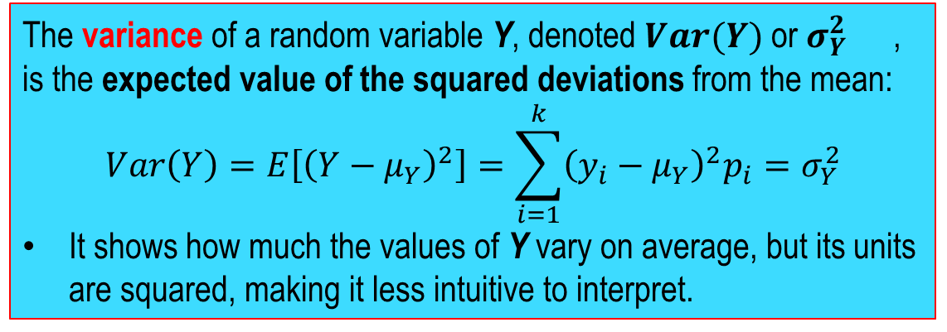
Standard Deviation and Variance
Definitions:
The variance of a random variable Y, denoted $Var(Y)$or $σ_{Y}^{2}$ ​, is the expected value of the squared deviations from the mean:
$$Var\left(Y\right)=E\left[{\left(Y−μ_{Y}\right)}^{2}\right]=\sum_{i=1}^{k}{{\left(y_{i}−μ_{Y}\right)}^{2}p_{i}}=σ_{Y}^{2}$$
It shows how much the values of Y vary on average, but its units are squared, making it less intuitive to interpret.
The standard deviation of Y denoted $σ_{Y}$​, is the square root of the variance:
$$σ_{Y}=\sqrt{Var(Y)}$$
It measures the average distance from the mean and is expressed in the same units as Y, making it easier to understand.
A larger SD means larger range of values.
Note: The variance and standard deviation measure the spread or dispersion of a probability distribution — how far the values of a random variable typically are from the mean.

Slide 15
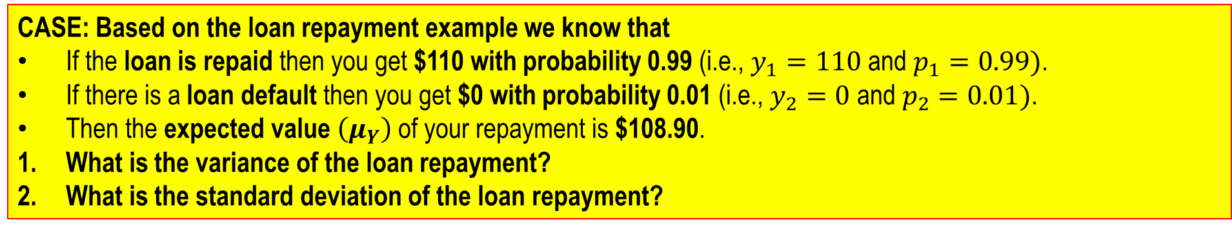
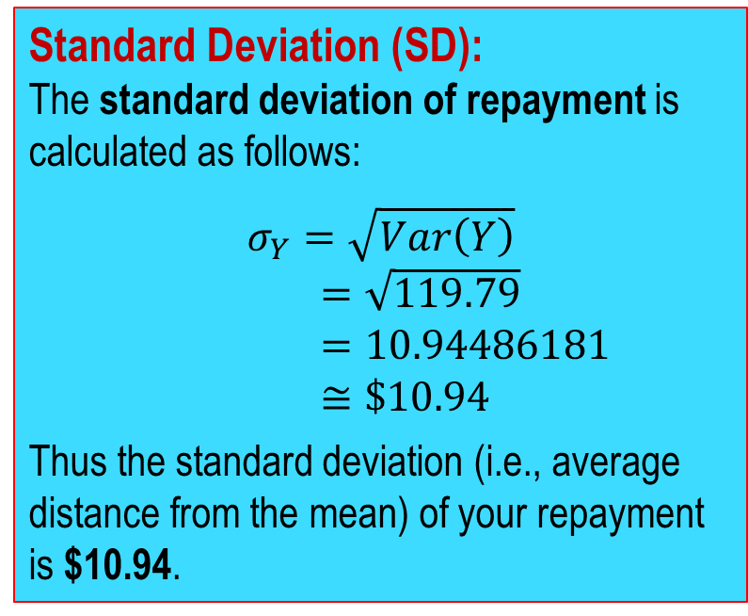
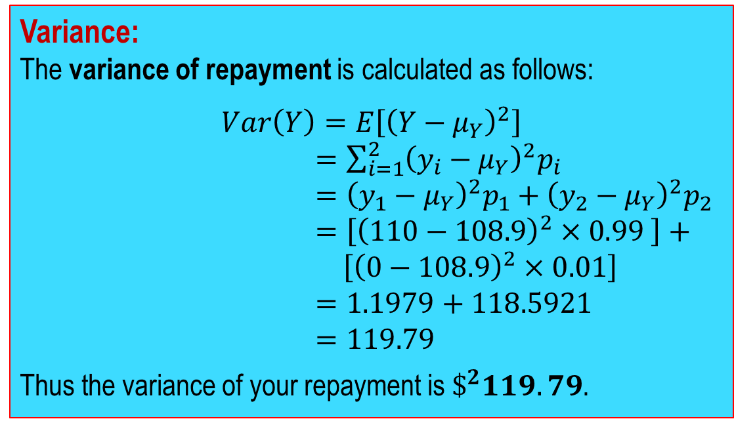
Standard Deviation and Variance – Example
CASE: Based on the loan repayment example we know that
If the loan is repaid then you get $110 with probability 0.99 (i.e., $y_{1}=110$ and $p_{1}=0.99)$.
If there is a loan default then you get $0 with probability 0.01 (i.e., $y_{2}=0$ and $p_{2}=0.01)$.
Then the expected value $\left(μ_{Y}\right)$ of your repayment is $108.90.
What is the variance of the loan repayment?
What is the standard deviation of the loan repayment?
Variance:
The variance of repayment is calculated as follows:
$$Var\left(Y\right)=E\left[{\left(Y−μ_{Y}\right)}^{2}\right]$$
$=\sum_{i=1}^{2}{{\left(y_{i}−μ_{Y}\right)}^{2}p_{i}}$
$={\left(y_{1}−μ_{Y}\right)}^{2}p_{1}+{\left(y_{2}−μ_{Y}\right)}^{2}p_{2}$
$=\left[{\left(110−108.9\right)}^{2}×0.99 \right]+$
$\left[{\left(0−108.9\right)}^{2}×0.01\right]$
$=1.1979+118.5921$
$=119.79$
Thus the variance of your repayment is $\$^{2}119.79$.
Standard Deviation (SD):
The standard deviation of repayment is calculated as follows:
$$σ_{Y}=\sqrt{Var\left(Y\right)}$$
$=\sqrt{119.79}$
$=10.94486181$
$≅\$10.94$
Thus the standard deviation (i.e., average distance from the mean) of your repayment is $10.94.

Slide 16
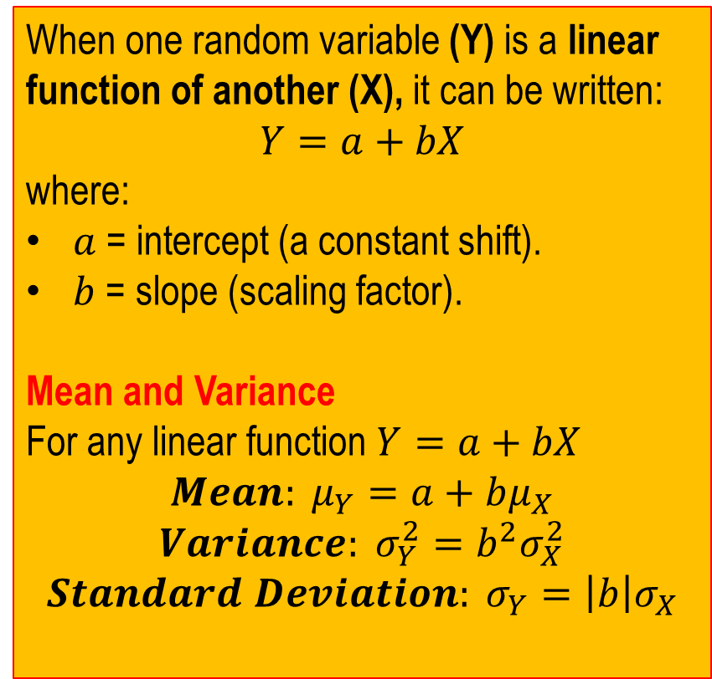
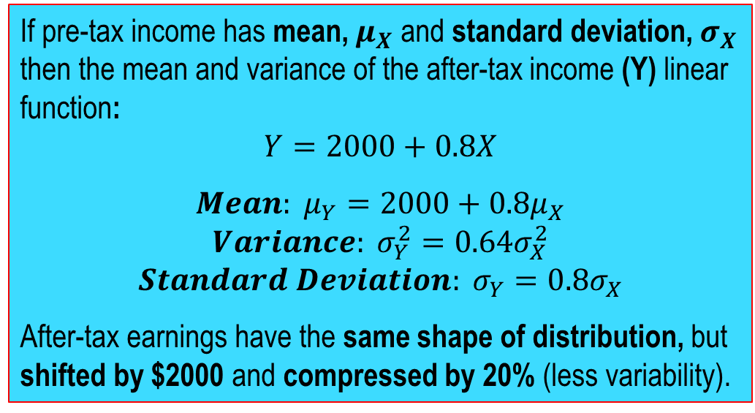
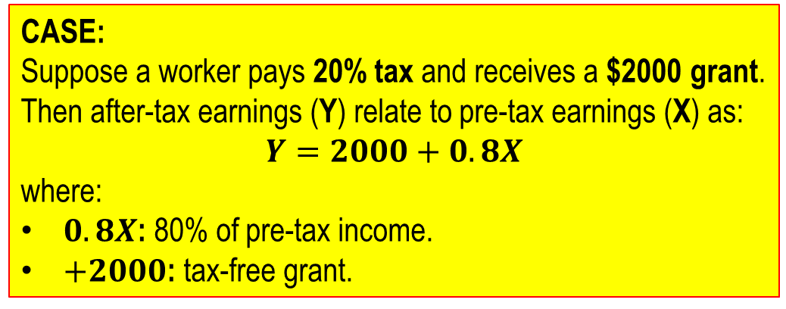
Mean and Variance of a Linear Function of a Random Variable
CASE:
Suppose a worker pays 20% tax and receives a $2000 grant.
Then after-tax earnings (Y) relate to pre-tax earnings (X) as:
$$Y=2000+0.8X$$
where:
$0.8X$: 80% of pre-tax income.
$+2000$: tax-free grant.
When one random variable (Y) is a linear function of another (X), it can be written:
$$Y=a+bX$$
where:
$a$ = intercept (a constant shift).
$b$ = slope (scaling factor).
Mean and Variance
For any linear function $Y=a+bX$
$$Mean: μ_{Y}=a+bμ_{X}$$
$$Variance: σ_{Y}^{2}=b^{2}σ_{X}^{2}$$
$$Standard Deviation: σ_{Y}=\left|b\right|σ_{X}$$
If pre-tax income has mean, $μ_{X}$ and standard deviation, $σ_{X}$ then the mean and variance of the after-tax income (Y) linear function:
$$Y=2000+0.8X$$
$$Mean: μ_{Y}=2000+0.8μ_{X}$$
$$Variance: σ_{Y}^{2}=0.64σ_{X}^{2}$$
$$Standard Deviation: σ_{Y}=0.8σ_{X}$$
After-tax earnings have the same shape of distribution, but shifted by $2000 and compressed by 20% (less variability).
Notes:
In the example:
$$Y=2000+0.8X$$
the 0.8 affects both the mean and the spread (standard deviation) of the distribution of Y.
The “shifted by $2000” part refers to the +2000, which moves the entire distribution to the right — but doesn’t change its shape or spread.
The “compressed by 20%” refers to the 0.8, which scales down the variability.

