Slide 1
LANGUAGE VARIETIES
AND
LANGUAGE REGISTERS
James Henry Abrina

Slide 2
WHAT IS LANGUAGE VARIETY?
  Any distinctive form of language or linguistic expression
  Also called “lect” or simply “varieties”
  Commonly used term to refer to the overlapping subcategories of languages (e.g. dialects, jargons, idiolects, registers, etc.)
  Mainly associated with sociolinguistics as its forms and its development are trigged by social factors
  May change from region to region, from one social class to another, or from individual to individual

Slide 3
WHAT IS LANGUAGE VARIETY?
Factors that contribute to language variation:
  social situation
  occupation
  age
  geography
  education
  gender
social status/class
ethnicity
culture

Slide 4
VARIETIES OF ENGLISH
  Many languages in the world have their own varieties.
  For instance, the English language has many varieties all over the world. Usually, they are affected by geography or location, such as:
      American English (North America)
      British English (Europe)
      Australian English (Oceania)
      Philippine English (Asia)
      Nigerian English (Africa)

Slide 5
VARIETIES OF ENGLISH
AMERICAN ENGLISH | BRITISH ENGLISH | AUSTRALIAN ENGLISH | PHILIPPINE ENGLISH | NIGERIAN ENGLISH
Pharmacy | Apothecary or Pharmacy | Chemist (may refer to the pharmacy or the pharmacist) | Drugstore | Pharmacy
Thank you! | Cheers! | Cheers, mate! | Thanks! | You too much!
How are you doing? | How are you? | G’day? | How are you? | How you dey?
Traffic jam | Traffic jam | Traffic jam | Traffic | Go slow
Toilet or Bathroom | Loo | Loo | Comfort room or CR | Toilet
Freeway | Motorway | Freeway | Highway | Highway

Slide 6
VARIETIES OF ENGLISH
  The Philippine English was derived from American English while the Nigerian English and Australian English were derived from British English.
  Nevertheless, you will notice that the Philippine English does not necessarily share the same terminologies with American English, and the Nigerian English and the Australian English may also be slightly different from the British English, where they originated from.

Slide 7
VARIETIES OF ENGLISH
  There are times when the varieties of the English language are not due to geography, but due to culture and ethnicity.
  For instance, the American English can have many varieties in the USA. They all belong to the same country, but varies mainly due to culture.
  Some of the varieties of the American English language are: Standard American English (SAE), African American English (AAE) or Ebonics, Chicano English, Hawaiian Pidgin, American Indian English, etc.

Slide 8
VARIETIES OF ENGLISH
  The varieties of American English may vary in terms of grammar, like how SAE uses proper grammar while AAE typically uses general singular verb.
  It doesn’t matter (SAE) vs. It don’t matter (AAE)
  The difference may also be in accent and pronunciation, although this is due to a combination of ethnical and geographical factors.
  Country singers sound differently from hip-hop artists

Slide 9
VARIETIES OF ENGLISH
STANDARD AMERICAN ENGLISH (SAE) | AFRICAN AMERICAN ENGLISH (AAE)
I am not going with you. | I ain’t goin’ with you.
I don’t know what my friend is usually doing. | Ah ‘oh know what homey be doin’.
I asked John if he could bring it over to Tom’s house. | I asked John could he bring it ovah to Tom’s crib.
I do not want ketchup. | I don’t want no ketchup.
I tell him to be quiet because he doesn’t know what he is talking about. | I tell ‘em to be quiet coz’ he don’t know what he talkin’ about.
He has been married. | He been married.
Can’t anybody beat them? | Can’t nobody beat ‘em?
I did not believe you that day, man. | I ain’t believe you that day, man.
Are you mad at me? | You mad at me?
He didn’t do anything. | He didn’t do nothing.

Slide 10
VARIETIES OF ENGLISH
  Standard American English (SAE) is sometimes called “White English” while Ebonics or African American English (AAE) is sometimes called “Black English.”
  Moreover, SAE is considered “formal” and “educated” while AAE is considered as “informal” and “low class.”
  Nevertheless, these comparisons are seen as discriminatory, although the reasons for these descriptions are quite obvious (i.e. African Americans used to lack education in the early 20th century).

Slide 11
VARIETIES OF ENGLISH
ASPECT | AMERICAN ENGLISH | BRITISH ENGLISH
Punctuation | I like eating strawberry, kiwi, and banana. | I like eating strawberry, kiwi and banana.
Date | September 26, 2020 | 26 September 2020
Spelling | center, color, organize, program | centre, colour, organise, programme
Words | elevator, pants, diaper | lift, trousers, nappy
Expression/Local Idiom | ruffled feathers (agiated) | knickers in a twist (agitated)
Grammar | Do you have that book? | Have you got that book?
Pronunciation (irrelevant in writing) | Vase is pronounced as “VEYZ” | Vase is pronounced as “VAHZ”

Slide 12
VARIETIES OF ENGLISH
  In the Philippines, there are also terminologies that are only used in the Philippine English and not in the other English varieties.
comfort room (toilet) | traffic (heavy traffic/traffic jam)
salvage (means “brutally murdered in the Philippines, but means “to save” in the US) | for a while (just a second/just a moment)
dirty kitchen (kitchen/second kitchen) | I’ll go ahead (I’ll be going now)
hostess (it means “prostitute” in the Philippines, but means “female host” in the US) | tomboy (it means “lesbian” in the Philippines, but means “a girl who enjoys manly activities” in the US)

Slide 13
VARIETIES OF ENGLISH
  Other English terminologies that probably only Filipinos understand are:
  nose bleed (means “having a hard time speaking the English language)
  ref (usually called “fridge” in other countries)
  napkin (means “sanitary pad” in the Philippines)
  high blood (means “angry” or “stressed out” in the Philippines)
  aircon (simply called “A/C” in other countries)
  tricycle and jeep/jeepney

Slide 14
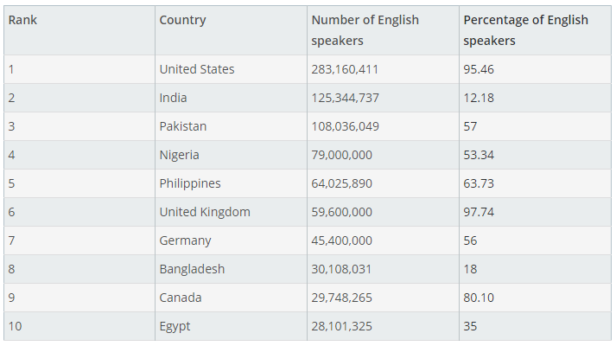
VARIETIES OF ENGLISH
As of 2019, the Philippines no longer belongs to the “3 largest English-speaking countries” in the world. This also shows how fast the English varieties have developed in recent years.

Slide 15
WHAT QUALIFIES TO BE A LANGUAGE VARIETY?
  There is no specific set of rules when determining a language variety. Many linguists believe that any language can be called a language variety if it has attained a certain level of application, has attained recognition from a group of people, or has achieved a certain level of standardization.
  Nevertheless, most linguists believe that standard language (also called standard variety, standard dialect or standard), which is also a type of language variety, should follow a specific set of rules.
  The Standard American English (SAE) is one of these standard languages.

Slide 16
WHAT IS A STANDARD LANGUAGE?
  Has undergone substantial codification of grammar and usage
  Employed by a population for public communication
  Has been officially declared or legally recognized as a standard language
  Codification: the process of selecting, developing, and laying down a model of standard language usage
  creation of prescriptive grammatical rules
  authoritative recognition (e.g. Merriam-Webster)

Slide 17
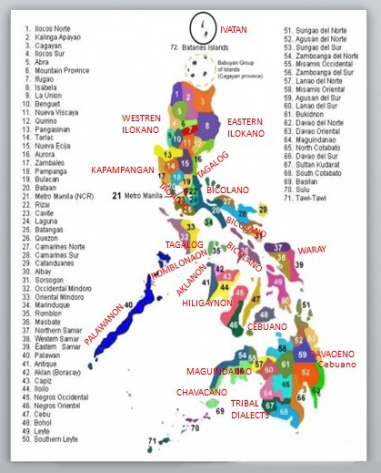
TYPES OF LECTS
  1. REGIONAL DIALECT OR DIALECT
  Regional or social variety
  of language distinguished
  by pronunciation, grammar
  or vocabulary
  Variety spoken in a
  particular region
  Geographical barriers
  Example:
  Tagalog, Ilocano

Slide 18
LANGUAGE VS DIALECT
  SIMILARITIES
LANGUAGE | DIALECT
Standardized | Standardized
Recognized by authorities | Recognized by authorities
Socially, politically and culturally relevant and important | Socially, politically and culturally relevant and important
Serves as cultural identity | Serves as cultural identity

Slide 19
LANGUAGE VS DIALECT
  DIFFERENCES
LANGUAGE | DIALECT
More popular/prestigious | Less popular/prestigious
More speakers | Less speakers
Officially declared by a country | Officially recognized by a country
Prominent in both spoken and written forms | More prominent in spoken form
Broader | May have evolved from the language

Slide 20
LANGUAGE VS DIALECT
  When does a dialect become a language?
  When officially declared for political reasons
  Example: Italian (1861)
  When officially declared for cultural reasons
  Example: Hindi and Urdu (of India and Pakistan, respectively)
  When legally recognized after spreading
  Example: French, Italian and Spanish from Latin

Slide 21
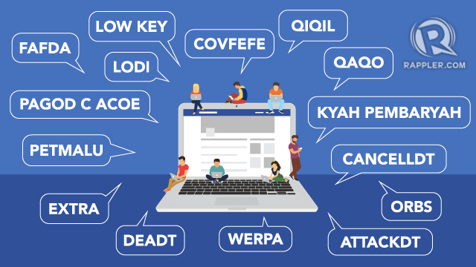

TYPES OF LECTS
  2. SOCIOLECT
  Also known as social dialect
  Used by socio-economic class, a profession, an age group, or any other social group
  Affected by social barriers
  Any variety that develops due to social factors

Slide 22
EXAMPLES OF SOCIOLECT
  Jargons:
  the specialized language of a professional or occupational group
  meaningless to outsiders
  technical language
  usually formal
  Coño:
  Tagalog with English
  accent and words

Slide 23
EXAMPLE OF SOCIOLECT
  Examples of jargons:
  Medicine: acute, chronic, hematuria, epistaxis
  Law: due diligence, homicide, arbitration
  Journalism: play, beat, vfx, sfx, sign off
  Law enforcement: 10-4, 10-15, code eight

Slide 24

TYPES OF LECTS
  3. ETHNOLECT
  Spoken by a specific ethnic group
  Example:
  Ebonics by African Americans
  Tausug (spoken in Sulu and Sabah)

Slide 25

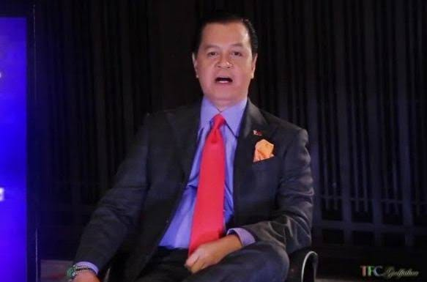


TYPES OF LECTS
  4. IDIOLECT
  the language spoken by each individual
  refers to an individual’s different styles, registers, and languages
  a person’s unique way of communicating

Slide 26
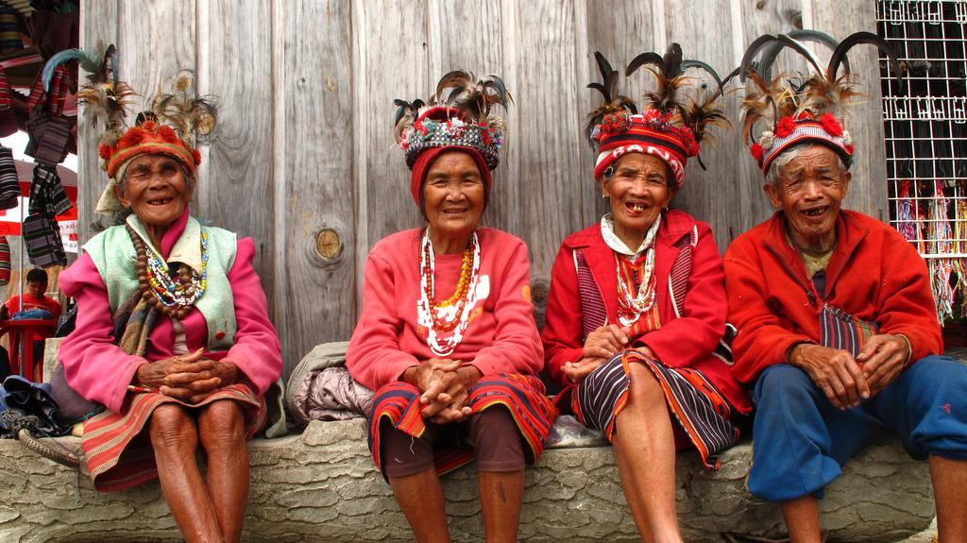
OTHER LANGUAGE VARIETIES
  MINORITY DIALECT
  the variety used by an ethnic group as a marker of identity

Slide 27
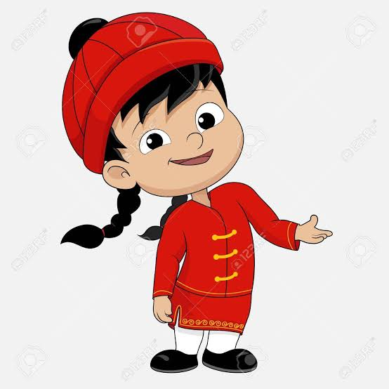
OTHER LANGUAGE VARIETIES
  PIDGIN
  nobody’s native language
  may arise when speakers of different languages with no common language try to have an impromptu conversation
  used for social situations but not adopted to a personal or cultural level
“Ikaw bili akin, ako bigay discount.”

Slide 28
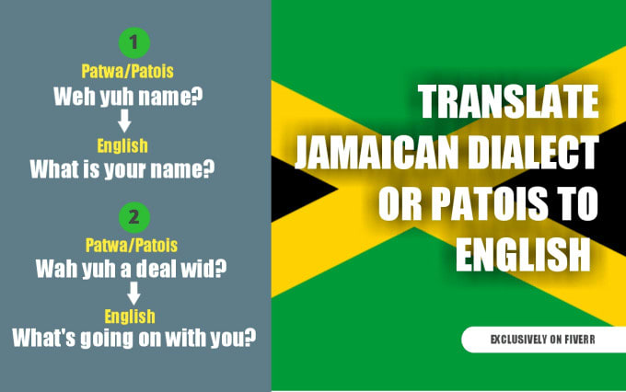
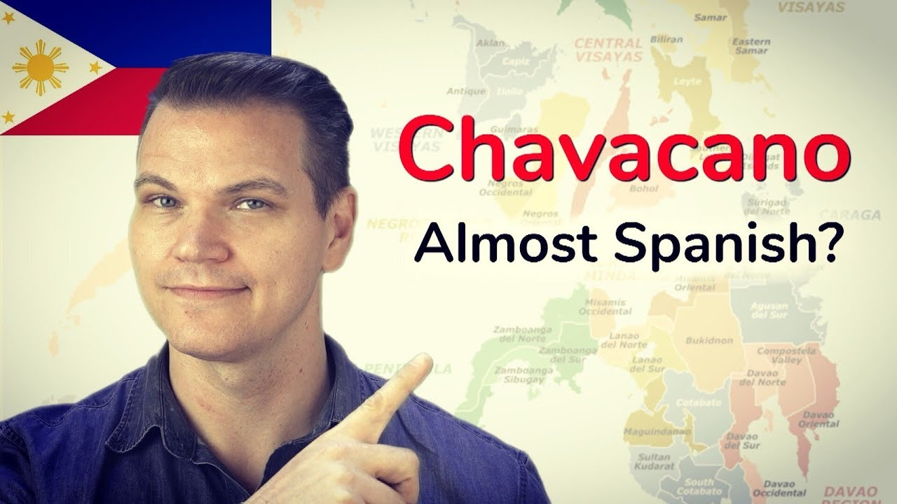
OTHER LANGUAGE VARIETIES
  CREOLE
  a distinct language which has taken most of its vocabulary from another language (called the lexifier)
  essentially pidgin that has been used as native tongue (a pidgin that has been nativized)

Slide 29
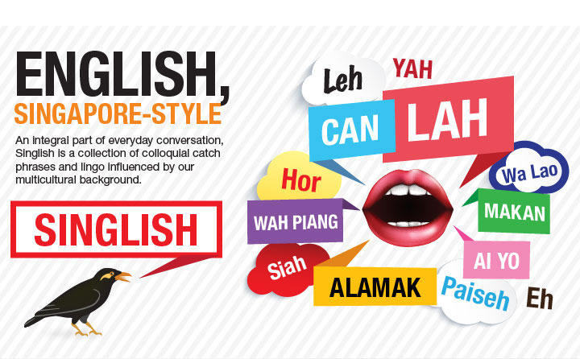
OTHER LANGUAGE VARIETIES
  INDIGENIZED VARIETY
  spoken mainly as a second language in ex-colonies with multilingual populations
  the language adopted by a colony from the official language of its colonizer

Slide 30
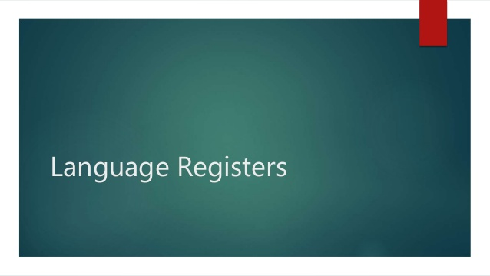

Slide 31
LANGUAGE REGISTERS
  What is language register?
  describes the various styles of language available for writing and speaking
  refers to the level of formality when speaking or writing
  the appropriate register is chosen based on:
      audience (the relationship between the speaker)
      topic (the goal of communication)
      situation

Slide 32
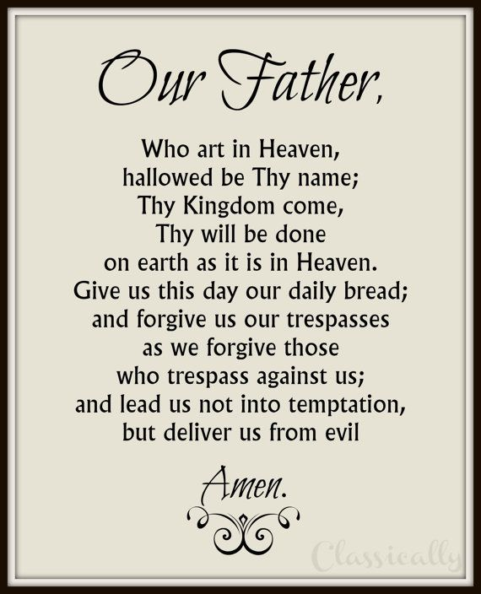
TYPES OF LANGUAGE REGISTERS
  STATIC REGISTER
  also known as static register
  rarely or never changes

Slide 33
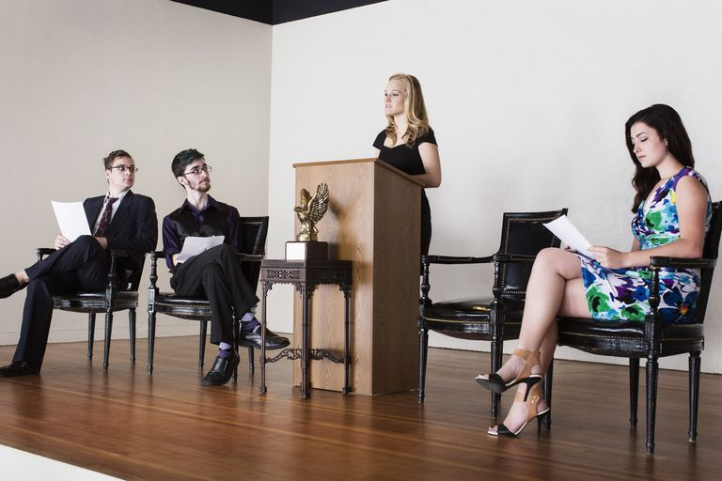
TYPES OF LANGUAGE REGISTERS
  2. FORMAL REGISTER
  usually a one-way communication
  follows commonly accepted format
  usually impersonal
  standardized

Slide 34

TYPES OF LANGUAGE REGISTERS
  3. CONSULTATIVE REGISTER
  two-way communication
  used when consulting an expert
  used in a professional discourse

Slide 35
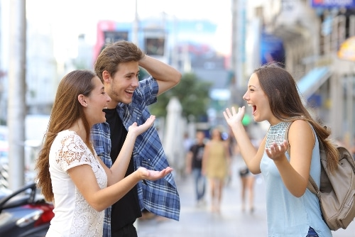
TYPES OF LANGUAGE REGISTERS
  4. CASUAL REGISTER
  conversational tone
  used with a certain degree of familiarity
  used by peers and friends

Slide 36

TYPES OF LANGUAGE REGISTERS
  5. INTIMATE REGISTER
  used by lovers or people with very close relationships
  private communication

Slide 37
GENERAL TYPES OF LANGUAGE REGISTERS
  Sometimes, language registers are classified according to their level of formality:
  1. Formal Language Register
  2. Informal Language Register
  3. Neutral Language Register
  Neutral language register is non-emotional (objective) and sticks to facts. This is typically used in technical writing

Slide 38
- END -

