Slide 1
IB Math AI HL
TI-Nspire CX II

Slide 2
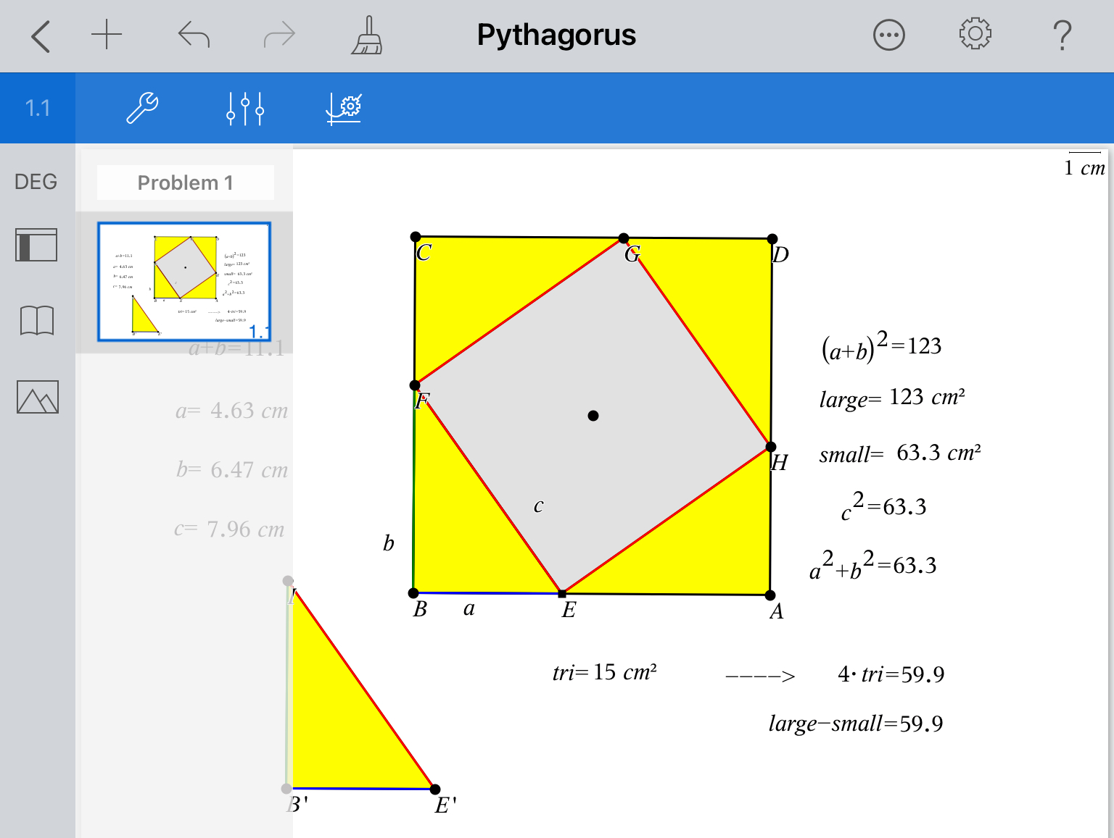

Slide 3
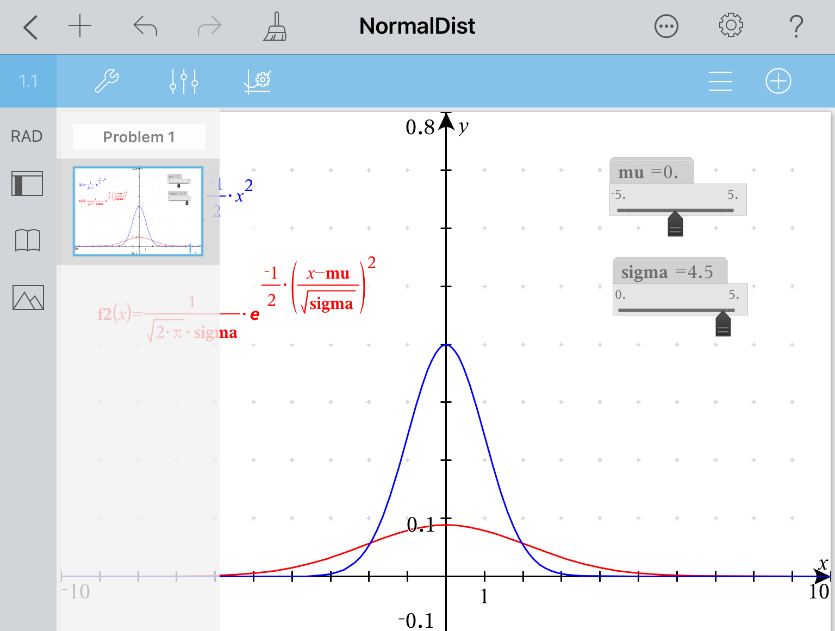

Slide 4
