Slide 1

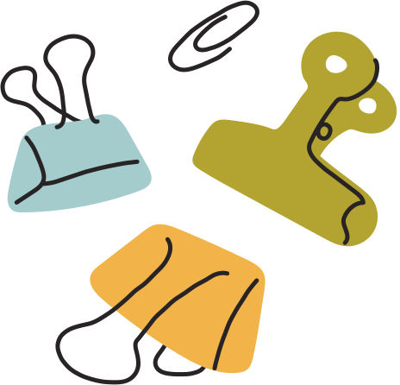

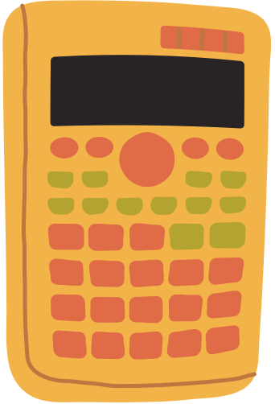




ROUNDING
IB Math AI SL
Topic 1: Number and Algebra
by @TUTORIO.MATH

Slide 2



0, 1, 2, 3, 4 round down
5, 6, 7, 8, 9 round up
Rounding (d.p. and s.f.)
*Significant figures: start from first (most left) non-zero digit!

Slide 3
Estimate using a one figure approximation:
a. 384 x 28
b. 6.92 x 0.792
c. 37954 : 211
Practice 1

Slide 4
A circle has a diameter 7.37 cm. Find the area of the circle, rounding your answer to:
a. 3 significant figures
b. 4 decimal places
Practice 2

